Slide 1
关于SAT、Max-SAT及相关NP性质
何知涵
2017/4/20

Slide 2
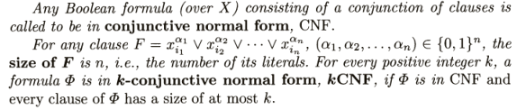
CNF,kCNF

Slide 3
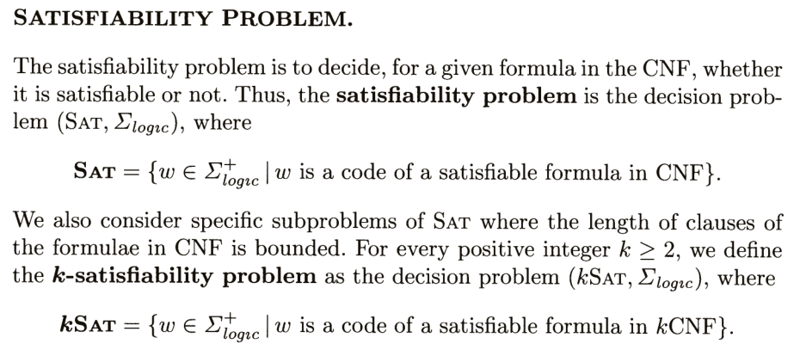
SAT

Slide 4
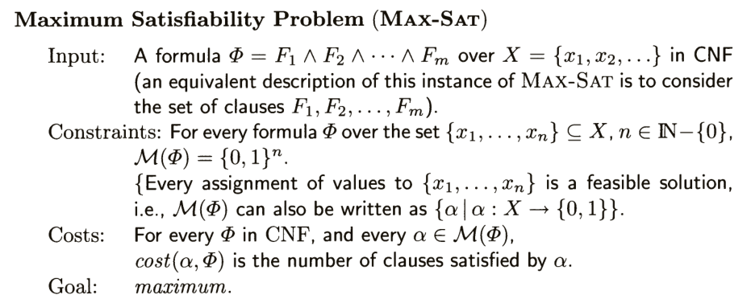
MAX-SAT

Slide 5
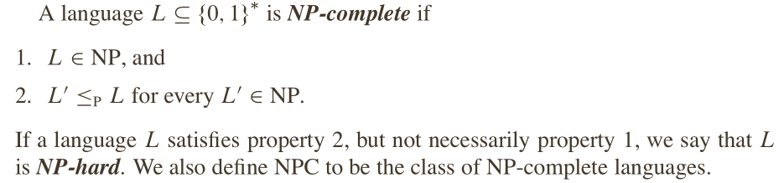
NP,NP-hard,NP-complete

Slide 6
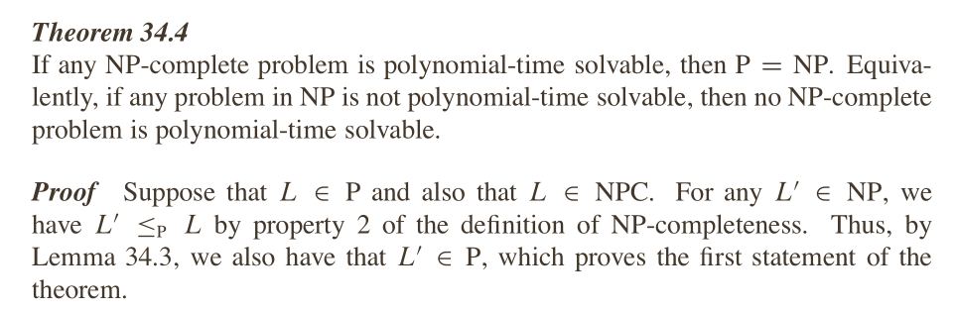
P=NP?

Slide 7
The first proved NPC problem
CRICUIT-SAT

Slide 8
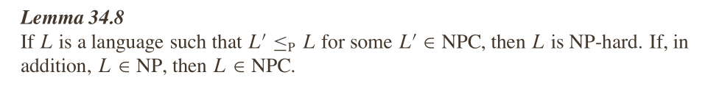
SAT—NPC
CIRCUIT-SAT -> SAT

Slide 9
Even harder
The MAX-SAT problem is NP-hard, since its solution easily leads to the solution of the Boolean satisfiability problem, which is NP-complete.
It is also difficult to find an approximate solution of the problem, that satisfies a number of clauses within a guaranteed approximation ratio of the optimal solution. More precisely, the problem is APX-complete.

Slide 10
APX,APX-complete
the class APX (an abbreviation of "approximable") is the set of NP optimization problems that allow polynomial-time approximation algorithms with approximation ratio bounded by a constant (or constant-factor approximation algorithms for short).
A problem is said to be APX-hard if there is a PTAS reduction from every problem in APX to that problem, and to be APX-complete if the problem is APX-hard and also in APX.

Slide 11
Thank you~

