Slide 1
4-5 数论基础

Slide 2
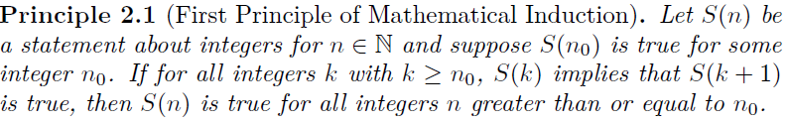
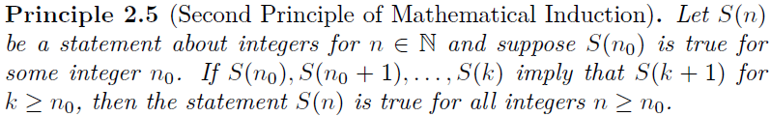
Problem TJ2-13 Prove that the two principles of mathematical induction are equivalent.
A
$$\left[S\left(n_{0}\right),∀k≥n_{0}\left(S\left(k\right)→S\left(k+1\right)\right)\right]→∀n≥n_{0}\left(S\left(n\right)\right)$$
B
$$\left[S\left(n_{0}\right),∀k≥n_{0}\left(S\left(n_{0}\right)…S\left(k\right)→S\left(k+1\right)\right)\right]→∀n≥n_{0}\left(S\left(n\right)\right)$$
等价？
A<=>B

Slide 3


Problem TJ2-13 A=>B
A:$\left[S\left(n_{0}\right),∀k≥n_{0}\left(S\left(k\right)→S\left(k+1\right)\right)\right]→∀n≥n_{0}\left(S\left(n\right)\right)$
B:$\left[S\left(n_{0}\right),∀k≥n_{0}\left(S\left(n_{0}\right)…S\left(k\right)→S\left(k+1\right)\right)\right]→∀n≥n_{0}\left(S\left(n\right)\right)$
能被A（WMI）所证明的S(n)，一定也能被B（SMI）所证明
显然，因为
$∀k≥n_{0}\left(S\left(k\right)→S\left(k+1\right)\right)⇒∀k≥n_{0}\left(S\left(n_{0}\right)…S\left(k\right)→S\left(k+1\right)\right)$
$$理由：A→C⇒A∧B→C$$

Slide 4
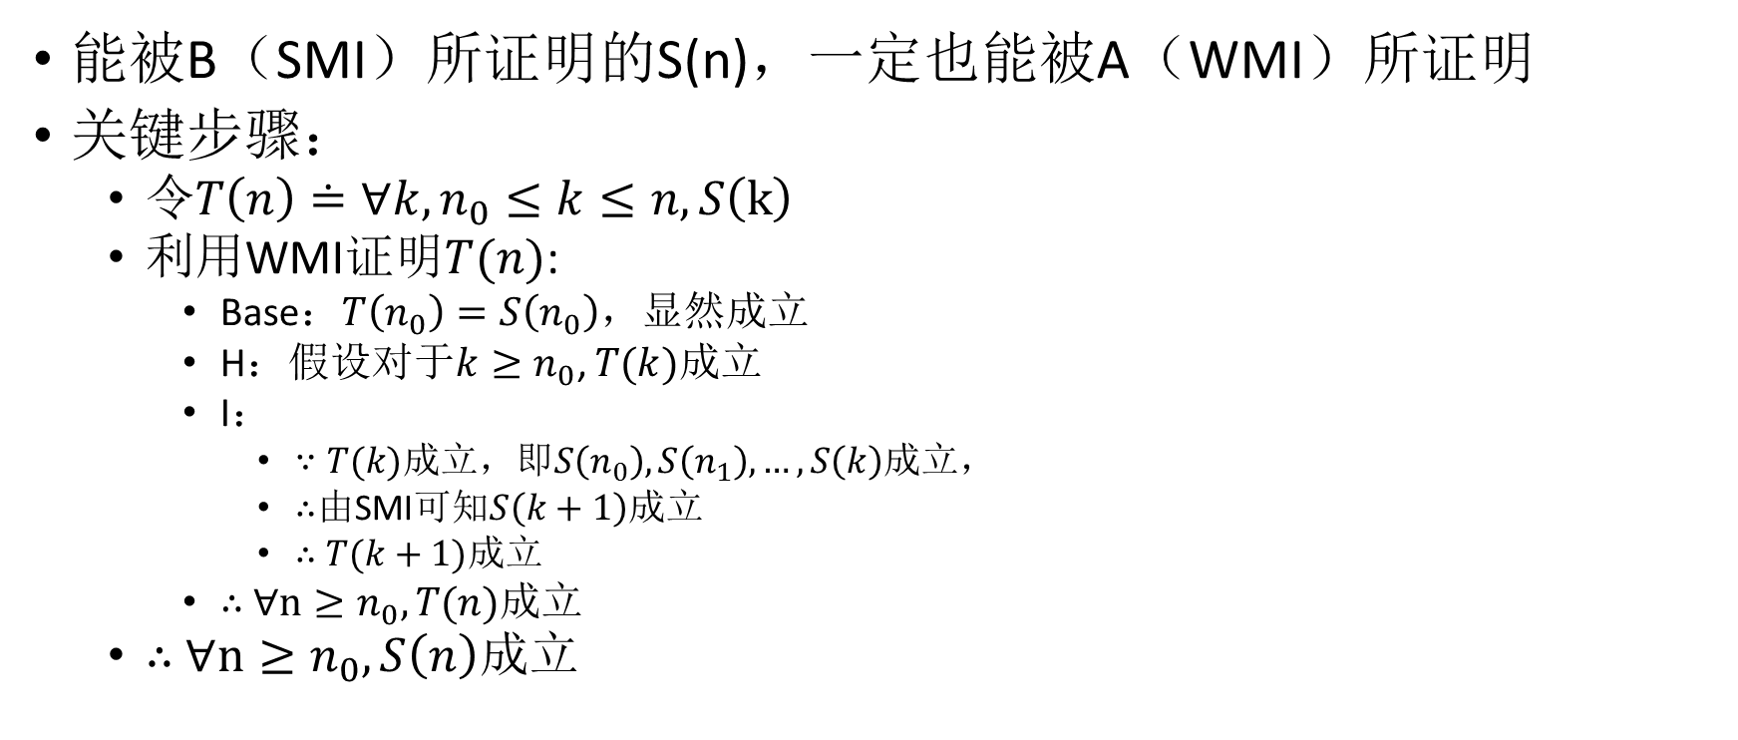
Problem TJ2-13 A<=B
A:$\left[S\left(n_{0}\right),∀k≥n_{0}\left(S\left(k\right)→S\left(k+1\right)\right)\right]→∀n≥n_{0}\left(S\left(n\right)\right)$
B:$\left[S\left(n_{0}\right),∀k≥n_{0}\left(S\left(n_{0}\right)…S\left(k\right)→S\left(k+1\right)\right)\right]→∀n≥n_{0}\left(S\left(n\right)\right)$
能被B（SMI）所证明的S(n)，一定也能被A（WMI）所证明
关键步骤：
令$T\left(n\right)≐∀k,n_{0}≤k≤n, S\left(k\right)$
利用WMI证明$T(n)$:
Base：$T\left(n_{0}\right)=S\left(n_{0}\right)$，显然成立
H：假设对于$k≥n_{0}$, $T(k)成立$
I：
$∵T(k)$成立，即$S\left(n_{0}\right),S\left(n_{1}\right),…,S\left(k\right)$成立，
$∴$由SMI可知$S\left(k+1\right)$成立
$∴$ $T(k+1)$成立
$∴$ $∀n≥n_{0}, T(n)成立$
$∴$ $∀n≥n_{0}, S\left(n\right)成立$

Slide 5
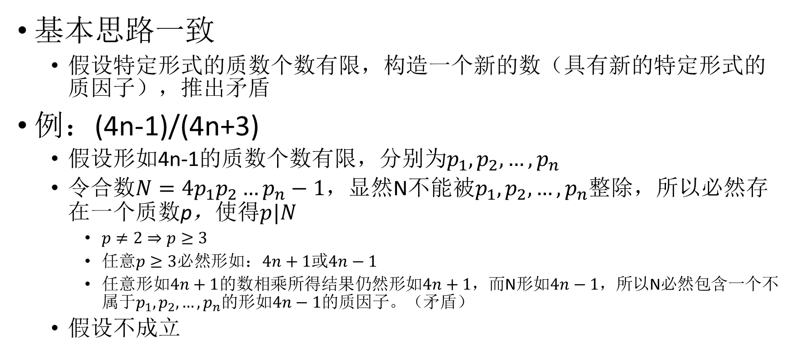
Problem TJ 2-29: Prove that there are an infinite number of primes of the form 6n+5. TJ 2-30: Prove that there are an infinite number of primes of the form 4n-1.
基本思路一致
假设特定形式的质数个数有限，构造一个新的数（具有新的特定形式的质因子），推出矛盾
例：(4n-1)/(4n+3)
假设形如4n-1的质数个数有限，分别为$p_{1},p_{2},…,p_{n}$
令合数$N={4p}_{1}p_{2}…p_{n}−1$，显然N不能被$p_{1},p_{2},…,p_{n}$整除，所以必然存在一个质数p，使得$p|N$
$p≠2⇒p≥3$
任意$p≥3必然$形如：$4n+1$或$4n−1$
任意形如$4n+1$的数相乘所得结果仍然形如$4n+1，$而N形如$4n−1，$所以N必然包含一个不属于$p_{1},p_{2},…,p_{n}$的形如$4n−1$的质因子。（矛盾）
假设不成立

Slide 6
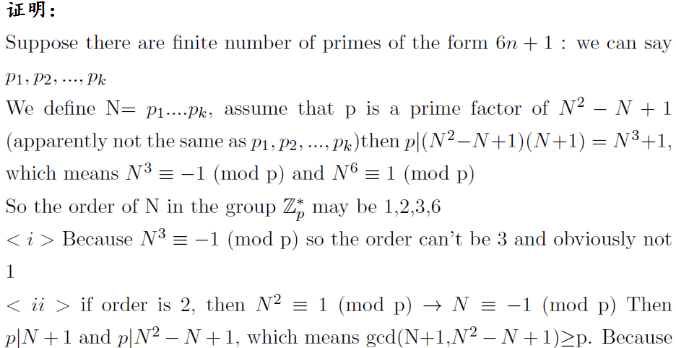
Problem TJ 2-29: Prove that there are an infinite number of primes of the form 6n+1.

Slide 7
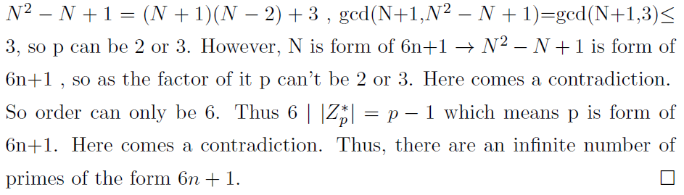
Problem TJ 2-29: Prove that there are an infinite number of primes of the form 6n+1.

Slide 8

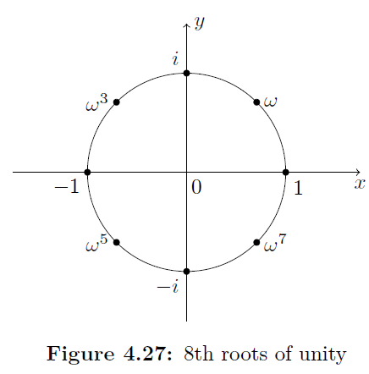
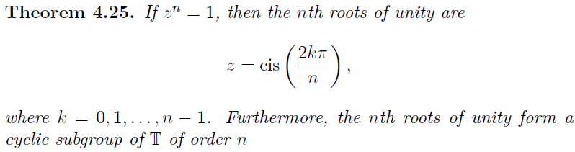
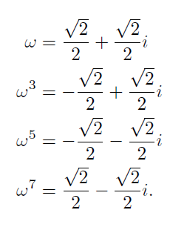
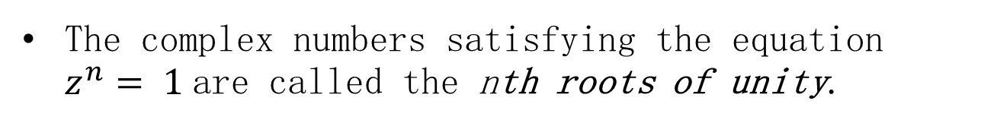

The Circle Group
The complex numbers satisfying the equation $z^{n}= 1$are called the nth roots of unity.
A generator for the group of the nth roots of unity is called a primitive nth root of unity.
$$\gcd\left(k,n\right)=1$$

Slide 9
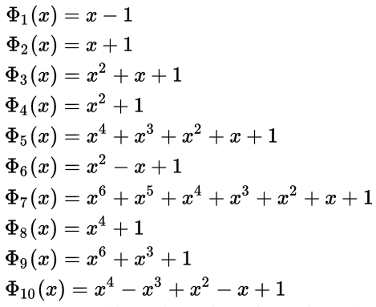
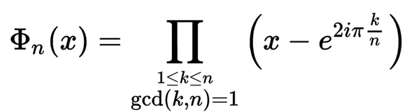


Cyclotomic polynomial(分圆多项式)
primitive nth root of unity
n=4
$$x^{4}−1=\left(x−1\right)\left(x−i\right)\left(x+1\right) (x+i)$$
https://en.wikipedia.org/wiki/Cyclotomic_polynomial

Slide 10
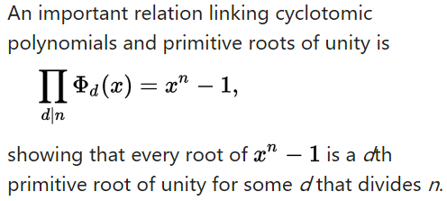
Cyclotomic polynomial(分圆多项式)
https://en.wikipedia.org/wiki/Cyclotomic_polynomial

Slide 11
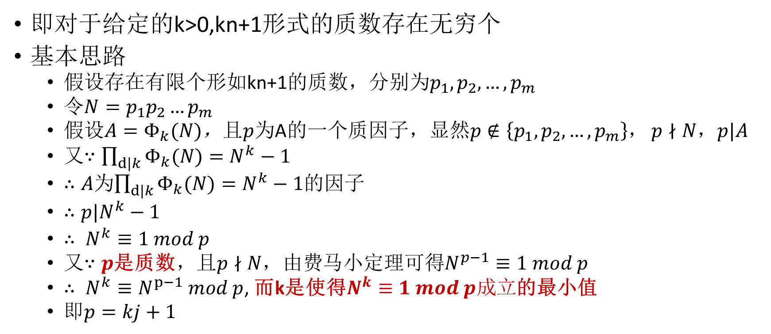
Let k be a positive integer. There are infinitely many primes congruent to 1 mod k
即对于给定的k>0,kn+1形式的质数存在无穷个
基本思路
假设存在有限个形如kn+1的质数，分别为$p_{1},p_{2},…,p_{m}$
令$N=p_{1}p_{2}…p_{m}$
假设$A=Φ_{k}(N)$，且$p$为A的一个质因子，显然$p∉\left\{p_{1},p_{2},…,p_{m}\right\}$， $p∤N$，$p|A$
又$∵\prod_{d|k}{Φ_{k}(N)}=N^{k}−1$
$∴A$为$\prod_{d|k}{Φ_{k}(N)}=N^{k}−1$的因子
$∴p|N^{k}−1$
$∴ N^{k}≡1 mod p$
又$∵p$是质数，且$p∤N，$由费马小定理可得$N^{p−1}≡1 mod p$
$∴ {N^{k}≡N}^{p−1} mod p$, 而k是使得$N^{k}≡1 mod p成立$的最小值
即$p=kj+1$
矛盾

Slide 12
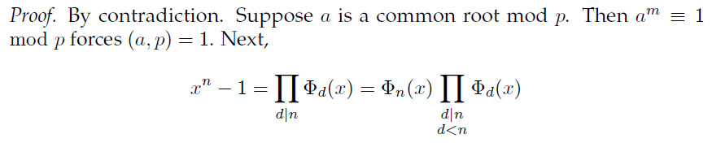
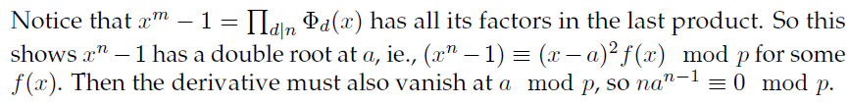
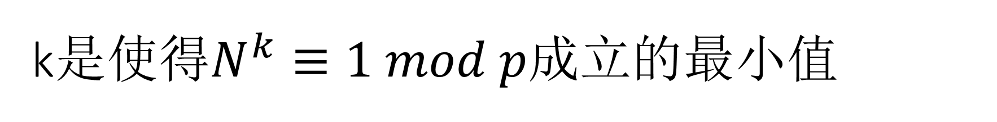
k是使得$N^{k}≡1 mod p成立$的最小值
为什么不会是：$\left(x^{n}−1\right)≡{\left(x−a\right)}^{j}f\left(x\right) mod p, j≥3$

Slide 13
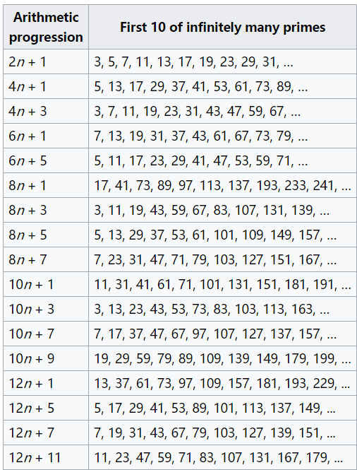
Dirichlet‘s (prime number) theorem
For any two positive coprime integers a and d, there are infinitely many primes of the form a + nd, where n is a non-negative integer.
In other words, there are infinitely many primes that are congruent to a modulo d.
The theorem extends Euclid's theorem that there are infinitely many prime numbers.
https://en.wikipedia.org/wiki/Dirichlet%27s_theorem_on_arithmetic_progressions#CITEREFNeukirch1999

Slide 14
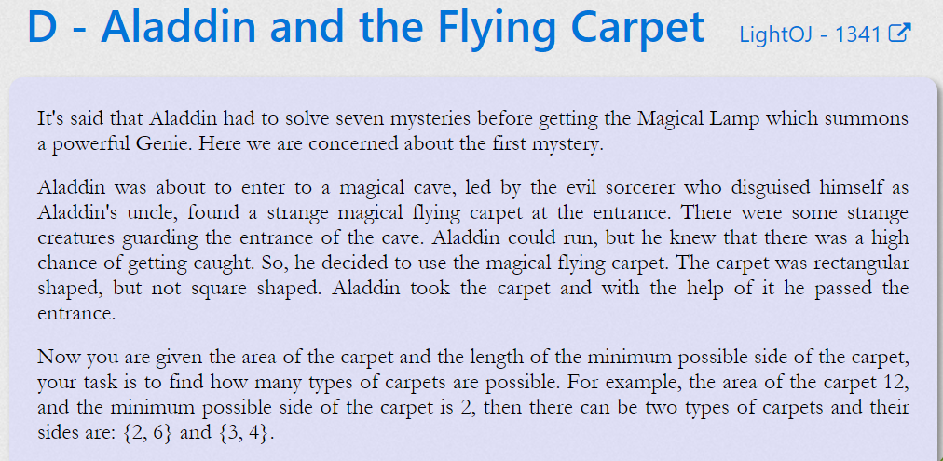
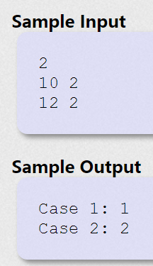
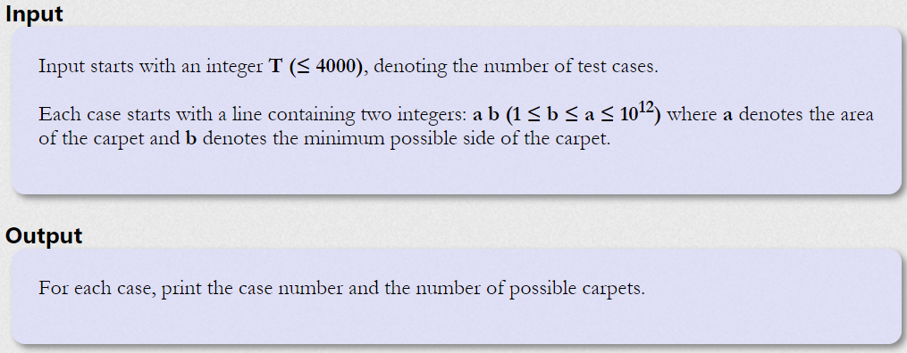

你能想到最naïve的方法？
暴力？
从$b\sim \left\lceil \sqrt{a}\right\rceil -1逐个$尝试是否是a的因子

Slide 15
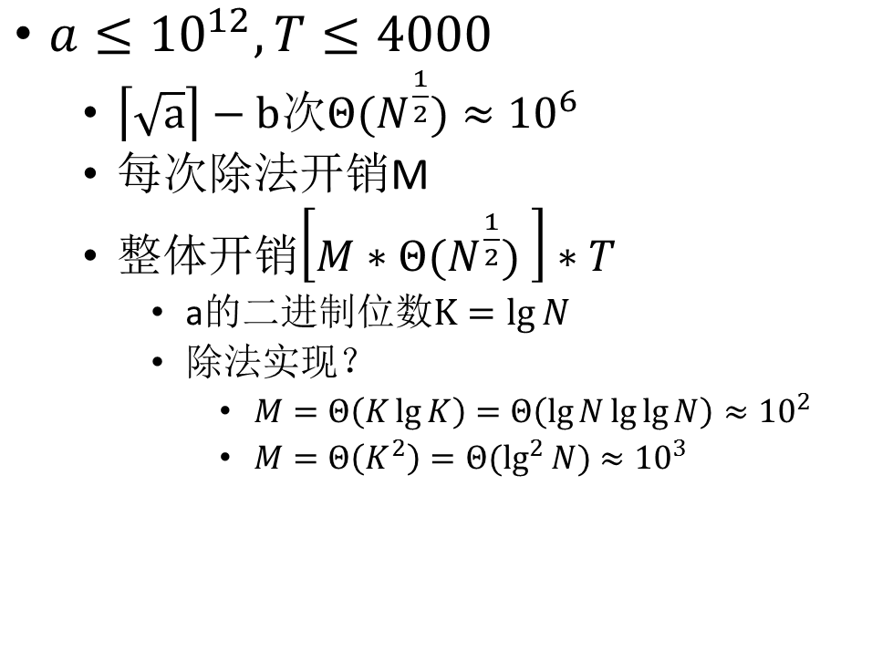
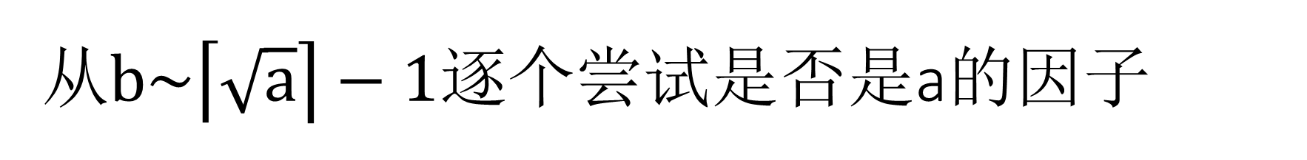
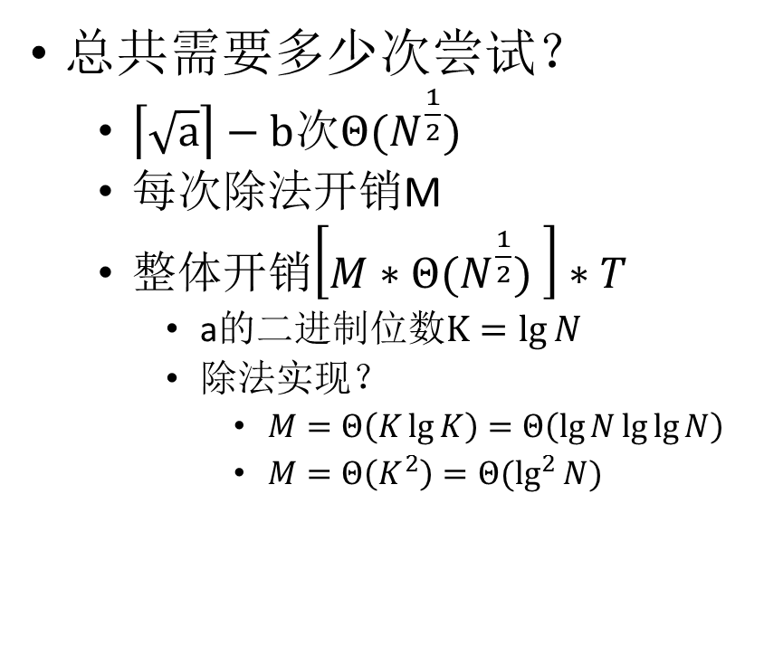
从$b\sim \left\lceil \sqrt{a}\right\rceil −1逐个$尝试是否是a的因子
总共需要多少次尝试？
$\left\lceil \sqrt{a}\right\rceil −b$次$Θ(N^{\frac{1}{2}})$
每次除法开销M
整体开销$\left[M∗Θ(N^{\frac{1}{2}}) \right]∗T$
a的二进制位数$K=\lg{N}$
除法实现？
$M=Θ\left(K\lg{K}\right)=$ $Θ\left(\lg{N}\lg{\lg{N}}\right)$
$M=Θ\left(K^{2}\right)=Θ(\lg^{2}{N})$
$a≤{10}^{12},T≤4000$
$\left\lceil \sqrt{a}\right\rceil −b$次$Θ(N^{\frac{1}{2}})≈{10}^{6}$
每次除法开销M
整体开销$\left[M∗Θ(N^{\frac{1}{2}}) \right]∗T$
a的二进制位数$K=\lg{N}$
除法实现？
$M=Θ\left(K\lg{K}\right)=$ $Θ\left(\lg{N}\lg{\lg{N}}\right)≈{10}^{2}$
$M=Θ\left(K^{2}\right)=Θ(\lg^{2}{N})$ $≈{10}^{3}$

Slide 16
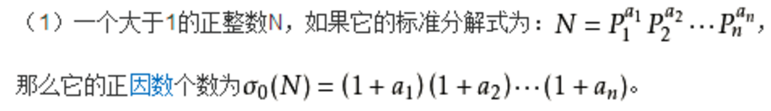
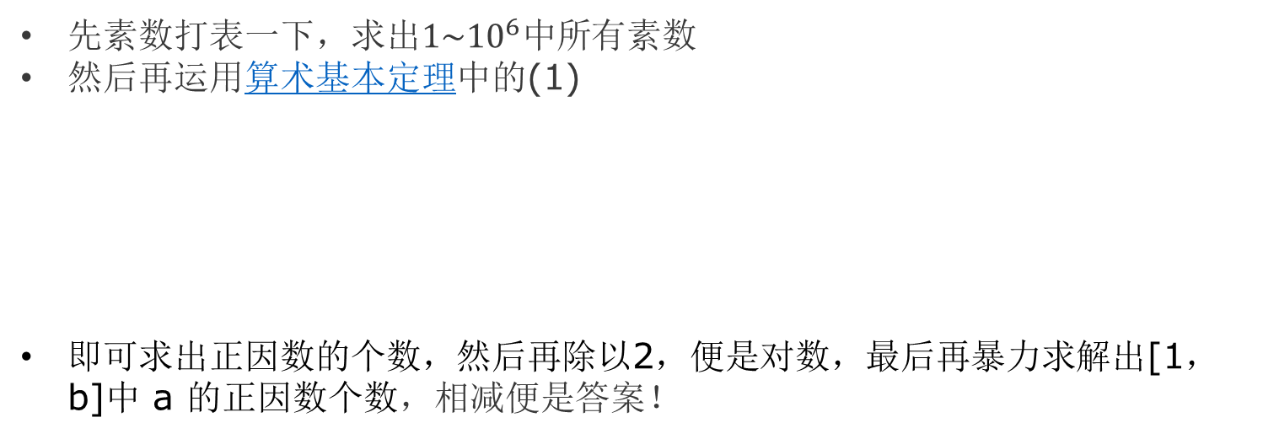
巧用算数基本定理
先素数打表一下，求出$1\sim {10}^{6}中$所有素数
然后再运用算术基本定理中的(1)
即可求出正因数的个数，然后再除以2，便是对数，最后再暴力求解出[1，b]中 a 的正因数个数，相减便是答案！

Slide 17
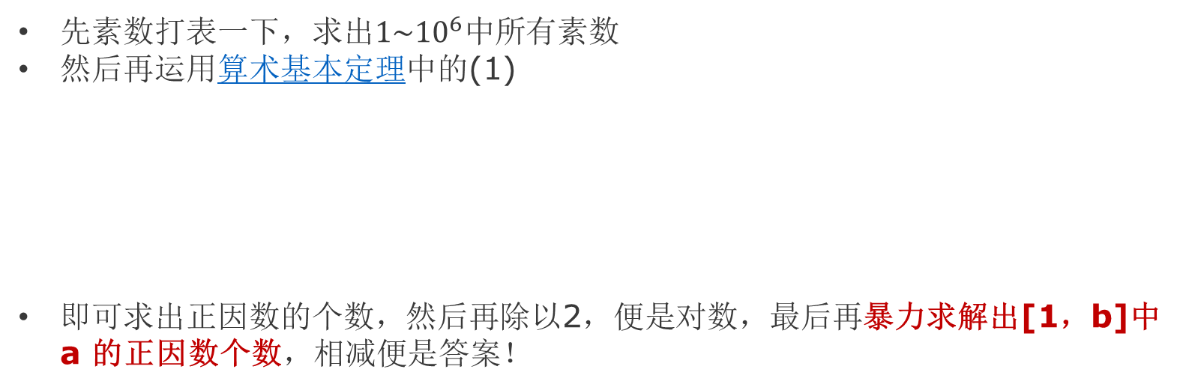
巧用算数基本定理
先素数打表一下，求出$1\sim {10}^{6}中$所有素数
然后再运用算术基本定理中的(1)
即可求出正因数的个数，然后再除以2，便是对数，最后再暴力求解出[1，b]中 a 的正因数个数，相减便是答案！
最坏情况下开销多少？

