Slide 1
Josephus Puzzle
171860624 毕秋宇

Slide 2
Background & Variants
01

Slide 3
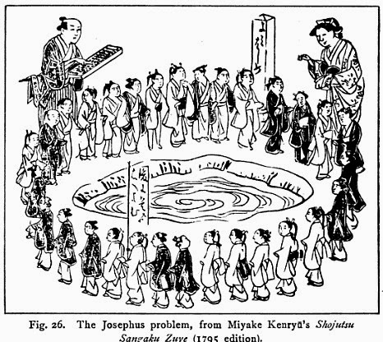
Background & Variants
The problem is named after Flavius Josephus, a Jewish historian living in the 1st century. According to Josephus' account of the siege of Yodfat, he and his 40 soldiers were trapped in a cave by Roman soldiers.
A Medieval version of the Josephus problem involves 15 Turks and 15 Christians on board a ship in a storm which will sink unless half the passengers are thrown overboard. All 30 stand in a circle and every ninth person is to be tossed into the sea. Where should the Christians stand to ensure that only the Turks are tossed?

Slide 4
Observe & Simulate
02

Slide 5

Observe & Simulate

Slide 6
Observe & Simulate
Soldier 1
Soldier 2
Soldier 4
Soldier 3

Slide 7
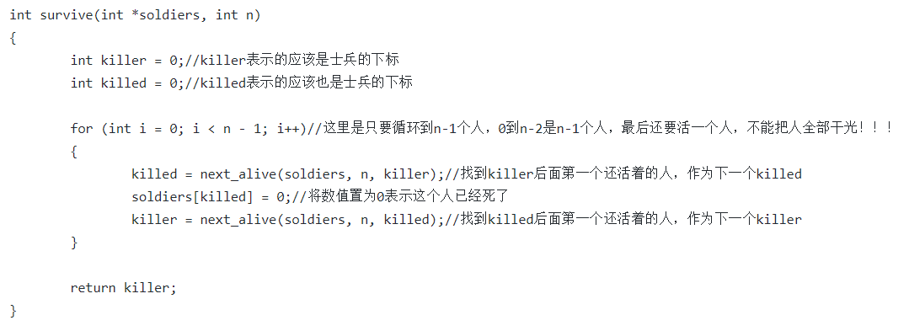
Observe & Simulate
However it is too young, sometimes even naïve!

Slide 8
Mathematical solution
03

Slide 9
Mathematical solution
K is the step
N is the number of soldiers
And then denote f(N,K)+1
The first place s is not important at all !
=> (f(N,K)+s)%N+1

Slide 10
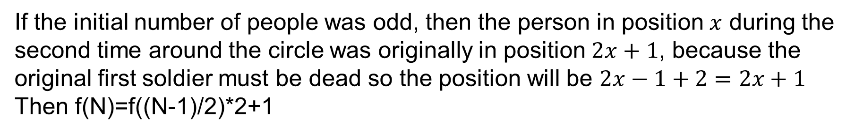
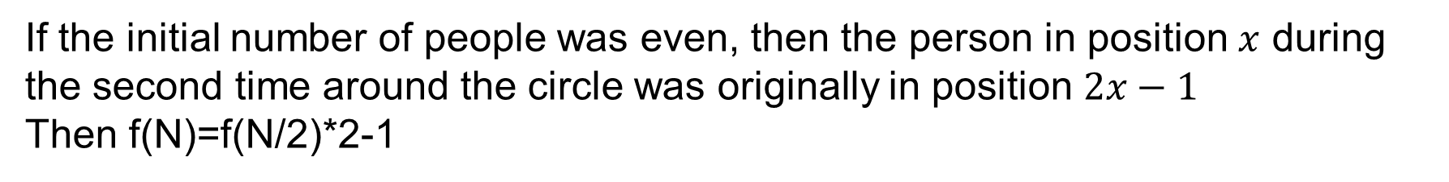
Mathematical solution
When k is 2
f(N) means the original position of the survivor
If the initial number of people was even, then the person in position $x$ during the second time around the circle was originally in position $2x−1$
Then f(N)=f(N/2)*2-1
If the initial number of people was odd, then the person in position $x$ during the second time around the circle was originally in position $2x+1$, because the original first soldier must be dead so the position will be $2x−1+2=2x+1$
Then f(N)=f((N-1)/2)*2+1

Slide 11
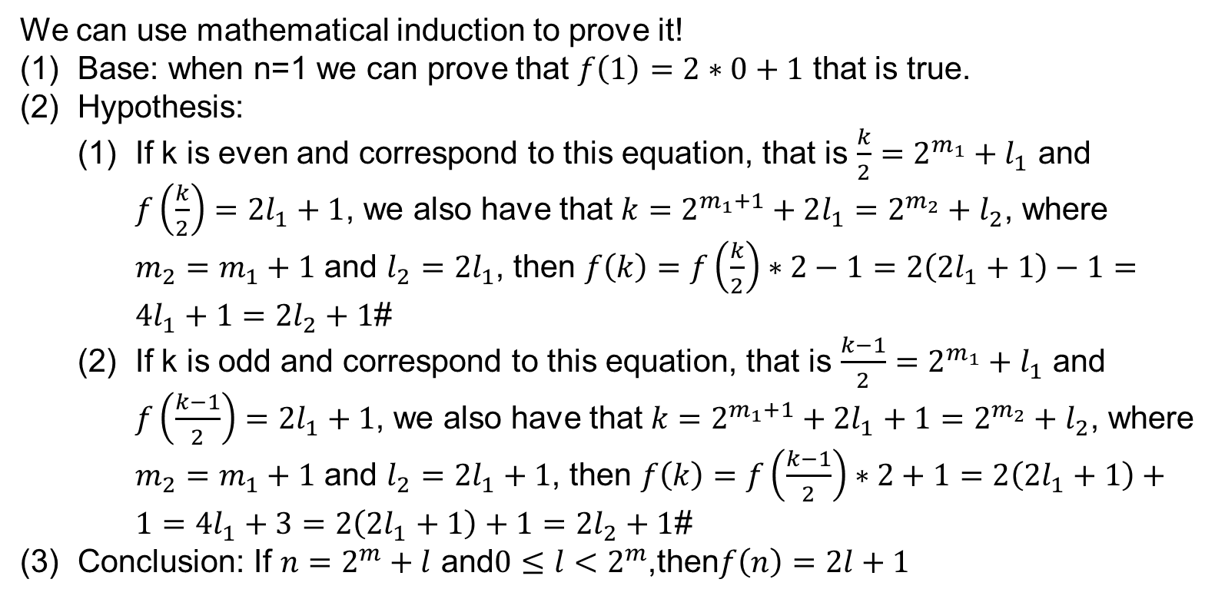
Mathematical solution
So we get the most important formula of this problem:
If $n=2^{m}+l$ and$0≤l<2^{m}$,then$f\left(n\right)=2l+1$
We can use mathematical induction to prove it!
Base: when n=1 we can prove that $f\left(1\right)=2∗0+1$ that is true.
Hypothesis:
If k is even and correspond to this equation, that is $\frac{k}{2}=2^{m_{1}}+l_{1}$ and $f\left(\frac{k}{2}\right)=2l_{1}+1$, we also have that $k=2^{m_{1}+1}+2l_{1}=2^{m_{2}}+l_{2}$, where $m_{2}=m_{1}+1$ and $l_{2}=2l_{1}$, then $f\left(k\right)=f\left(\frac{k}{2}\right)∗2−1=2\left(2l_{1}+1\right)−1=4l_{1}+1=2l_{2}+1$#
If k is odd and correspond to this equation, that is $\frac{k−1}{2}=2^{m_{1}}+l_{1}$ and $f\left(\frac{k−1}{2}\right)=2l_{1}+1$, we also have that $k=2^{m_{1}+1}+2l_{1}+1=2^{m_{2}}+l_{2}$, where $m_{2}=m_{1}+1$ and $l_{2}=2l_{1}+1$, then $f\left(k\right)=f\left(\frac{k−1}{2}\right)∗2+1=2\left(2l_{1}+1\right)+1=4l_{1}+3=2\left(2l_{1}+1\right)+1=2l_{2}+1$#
Conclusion: If $n=2^{m}+l$ and$0≤l<2^{m}$,then$f\left(n\right)=2l+1$

Slide 12
More common?
04

Slide 13
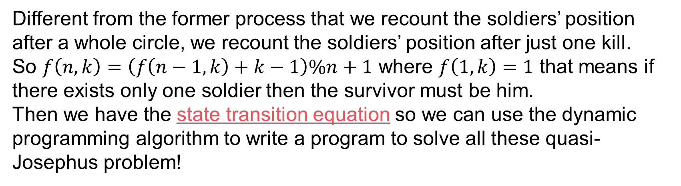
More common?
What if $k≠2$ ?
Different from the former process that we recount the soldiers’ position after a whole circle, we recount the soldiers’ position after just one kill.
So $f\left(n,k\right)=\left(f\left(n−1,k\right)+k−1\right)\%n+1$ where $f\left(1,k\right)=1$ that means if there exists only one soldier then the survivor must be him.
Then we have the state transition equation so we can use the dynamic programming algorithm to write a program to solve all these quasi-Josephus problem!
Is there any easier and straightforward formula that directly tell us the position of the survivor?
Sorry, I didn’t find it -_-!

Slide 14

More common?
Young people can’t always think of making a flash-news!

Slide 15
Thanks.

