Slide 1
Integer LP: Algorithms
Zhao-H. Yin
Mar 4, 2019

Slide 2
Concepts
Integer LP is LP with integer constraints on variables.
A LP-Relax of Integer LP is to remove such constraints.
Necessity to introduce ILP ?
Fractional Knapsack => LP
0-1 Knapsack => ILP

Slide 3
Observation
1. A feasible solution of ILP is always
a feasible solution of its’ LP Relax.
2. The solution of ILP is very close to the border of LP Relax’s feasible region.

Slide 4
Observation
A intuitive method is to solve it’s LP-Relax, and examine the internal integer points around the solution.
How to examine (list all the candidates) ?
In other words, move the decision super plane carefully to filter one integer point ?

Slide 5
Algorithms
Many effective algorithms were proposed to solve ILP.
The most classical among them are
Branch and bound Algorithm (Accurate algorithm)
Cut Plane Algorithm (Accurate algorithm)
LP Relax-Rounding Algorithm (Approximation Algorithm)

Slide 6
Branch and bound
Divide and conquer

Slide 7
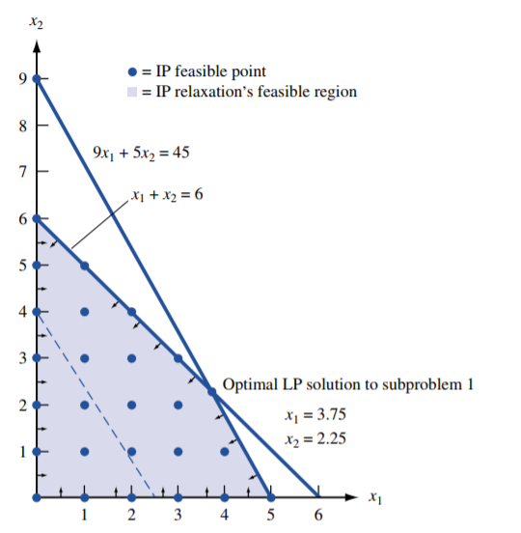
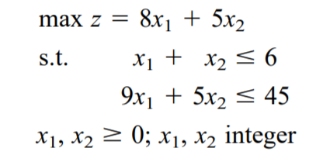
Branch and bound
Consider the following problem.
Divide the region with a new constraint defined by one non-integer variable.

Slide 8
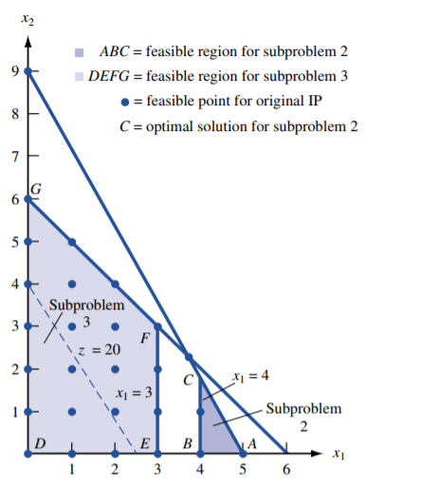
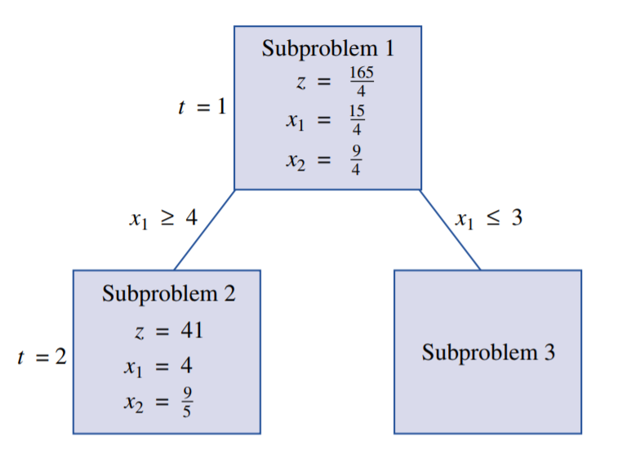
Branch and bound
Now we solve two subproblem again, gather best solution from each subproblem.

Slide 9
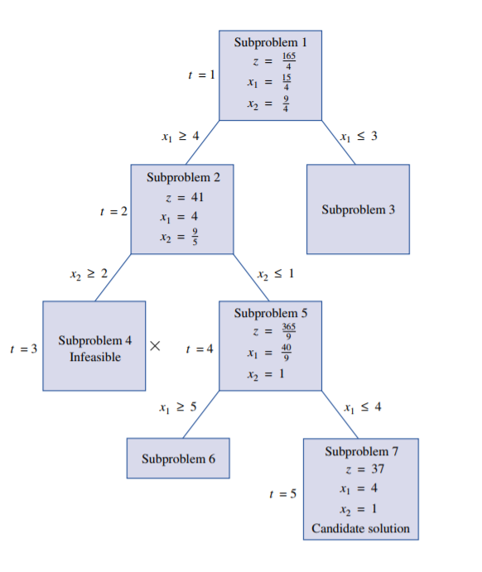
Branch and bound
The problem is split into branches.
A node terminated to grow if :
Infeasible (Too narrow) Or
One candidate is found.

Slide 10
Branch and bound
Very time consuming…
Solve some subsets for many times, which obviously don’t contain a optimal solution.
One improvement: Cut plane algorithm

Slide 11
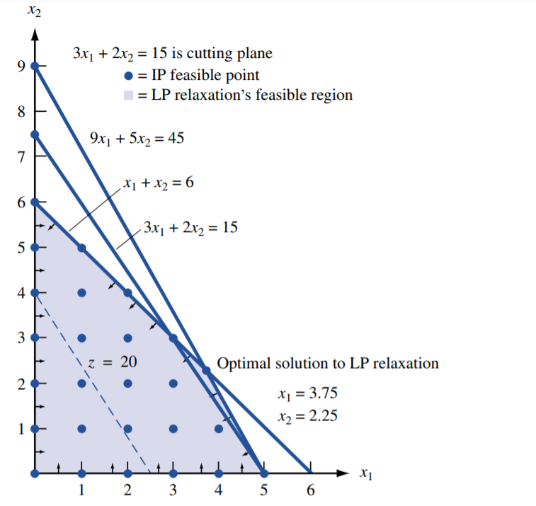
Cut plane algorithm
Add one constraint delicately remove the redundant region.

Slide 12
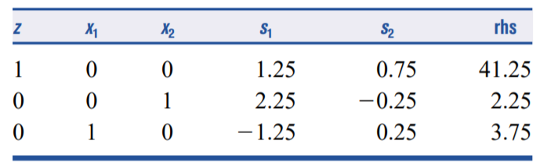

Cut plane algorithm
Arbitrarily select one constraint with fractional basic variable.
Rewrite it by applying floor function [] to each coefficients.

Slide 13

Cut plane algorithm
Rewrite it by applying floor function to each coefficients.
Now we find a new constraint, which is also called a cut.
?
If the revised LP yields a integer solution, it’s the optimal IP solution.
Otherwise, repeat the process above until a solution is found.

Slide 14
Cut plane algorithm
Cut properties
Any feasible IP always satisfy the cut inequality.
The original LP optimal doesn’t satisfy the cut inequality.
For IP, The left hand of the equation must be a integer. Since the variables are non-negative,
the right side

Slide 15
Cut plane algorithm
Cut property 1
Step 1. For IP, The left hand of the equation must be a integer.
Step 2 Since the variables are non-negative, the right side must less than 1, yielding the value of the equation must be non-positive integer.
i.e.

Slide 16
Cut plane algorithm
Cut property 2
Since basic variables are set to 0, the cut
fails on the optimal point.
Thus the region shrinks when the cut is done.

Slide 17
LP Relax-Rounding algorithm
Solve the relax problem, and round the fractional solution to integer using some rounding strategies (such as randomized rounding)
Many 0.85+ approx. ratio algorithms are proposed recent years.

Slide 18
A Snap : More topics on LP related Optimization

Slide 19
Revised Simplex Algorithm
Simplex tableau stores many information that can be generate by a matrix, this method reduces the memory occupied by simplex algorithm.

Slide 20
Interior Point Algorithm
Gradient method is a generic method in Convex Optimization.
Interior point algorithm start from a inner point in the feasible region and seeks path to the optimal by using Newton method (gradient method).

Slide 21
Reference
Numerical Analysis
S. J. Wright, J. Nocedal
Operations Research: Applications and Algorithms
Wayne L. Winston.

