Slide 1
Open Topic 1-9(1) : 概念辨析
2017 年 12 月 11 日
何润雨 & 孙思钰
Notes:
中文翻译仅供参考
主要给大家补充一些比较基础的知识
如部分内容有误还请大佬们及时指出

Slide 2
Partial Order
Strict Partial Order
Total Order
Partial Equivalence Relation

Slide 3
Partial Order 偏序
Reflective 自反的
Antisymmetric 反对称的
Transitive 可传递的
Notes:
定义：设R为非空集合A上的关系，如果R是自反的、反对称的和可传递的，则称R为A上的偏序关系。
其中（自反性）x~x；
（反对称性）如果x~y,且y~x,则x=y；
（传递性）如果x~y,且y~z ,则x~z。

Slide 4
Partial Order 偏序
Wikipedia :
A (non-strict) partial order is a binary relation ≤ over a set P satisfying particular axioms which are discussed below.
When a ≤ b, we say that a is related to b.
The most familiar partial orders are the relations “less than or equal to” and “more than or equal to” on Z and R. So when speaking in general of a partial order R on a set A, we shall always use symbols or for R.

Slide 5
Partial Order 偏序
Poset 偏序集
The set A together with the partial order R (on A) is called a partially ordered set, or simply a poset, and we will denote this poset by (A, R).
Notes:
一个集合A与A上的偏序关系R一起叫作偏序集，记作<A,R>或<A, ≦>。

Slide 6
Partial Order 偏序
Example 01
A : a collection of subsets of a set S.
The relation ⊆ is a partial order on A.
(A, ⊆) is a poset.
Notes:
A 是集合S所有子集所构成的集合。包含关系是A上的一个偏序关系。

Slide 7
Partial Order 偏序
Example 02
Z⁺ (the set of all positive integers)
“less than or equal to” is a partial order on Z⁺.
“more than or equal to” is a partial order on Z⁺.
Notes:
小于等于和大于等于是正整数集上的偏序。

Slide 8
Partial Order 偏序
Example 03
Divisibility ( a R b if and only if a | b ) is a partial order on Z⁺.
Notes:
整除关系是整数集上的偏序。

Slide 9
Partial Order 偏序
Example 04
Let R be a partial order on a set A.
Let R⁻¹ be the inverse relation of R.
R⁻¹ is also a partial order.
Dual 对偶
The poset (A, R⁻¹) is the dual poset of (A, R).
R⁻¹ is the dual of the partial order R.
Notes:
若一个关系R是集合A上的偏序， 则R的逆也是A上的一个偏序。
对偶

Slide 10
Partial Order 偏序
Theorem :
The diagraph of the partial order has no cycle of length greater than 1.
Notes:
偏序的diagraph上没有长度超过1的cycle。

Slide 11
Strict Partial Order 严格偏序
Irreflective 反自反的
Asymmetric 强反对称的
Transitive 可传递的
Notes:
与偏序最大的不同在于反自反 且 强反对称
x<x不成立
x < y → y < x 不成立

Slide 12
Strict Partial Order 严格偏序
Example
The relation “less than” is a strict partial order on Z⁺.
The relation “more than” is a strict partial order on Z⁺.
Notes:
“x is less than x”不成立
x is less than y, y is less than z → x is less than z
x is less than y → y is not less than x

Slide 13
Every partial order ≤ induces a strict order :
a < b : (a ≤ b) ∧ (a ≠ b).
Every strict order < induces a partial order :
a ≤ b : (a < b) ∨ (a = b).
Notes:
严格偏序与偏序的互推

Slide 14
Comparability
If (A, ≤ ) is a poset, the elements a and b are said to be comparable if
a ≤ b or b ≤ a
Notes:
可比性
（a, b）或（b, a）满足A上的这个偏序关系

Slide 15
Total Order 全序
Reflective 自反的
Antisymmetric 反对称的
Transitive 可传递的
Comparable 可比的
Notes:
要求其中任意2个元素都是可比的

Slide 16
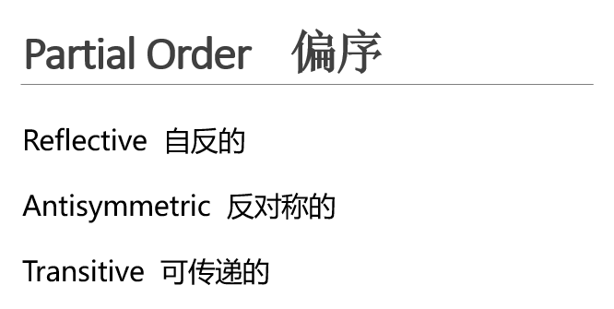
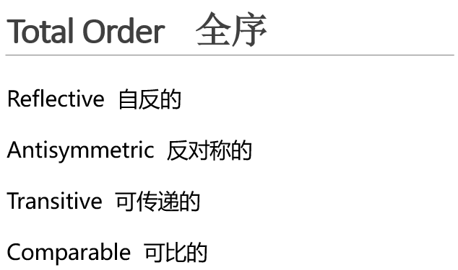
Notes:
全序是一种特殊的偏序

Slide 17
Total Order 全序
Example 01
Z⁺ : the set of all positive integers
“less than or equal to” is a total order on Z⁺
“more than or equal to” is a total order on Z⁺
Notes:
大于等于，小于等于
也都是正整数上的全序

Slide 18
Total Order 全序
Example 02
Lexicographic (Dictionary order)
(a, b) < (a’, b’) if a < a’ or if a = a’ and b ≤ b’.
Notes:
字典序

Slide 19
Extrema
Greatest element and least element:
An element g in P is a greatest element if for every element a in P, a ≤ g.
An element m in P is a least element if for every element a in P, a ≥ m.
A poset can only have one greatest or least element.
Notes:
解释几个概念
不一定有（不可比）

Slide 20
Extrema
Maximal elements and minimal elements:
An element g in P is a maximal element if there is no element a in P such that a > g.
An element m in P is a minimal element if there is no element a in P such that a < m.
Notes:
Maximal和minimal不一定唯一

Slide 21
Extrema
Upper and lower bounds :
For a subset A of P,
An element x in P is an upper bound of A if a ≤ x for each element a in A.
An element x in P is a lower bound of A if a ≥ x, for each element a in A.
Notes:
X不一定是A中的元素
但是必须是P中的元素

Slide 22
Extrema
Example：
Consider the positive integers, ordered by divisibility.
1 is a least element.
No greatest element. No maximal element.
Notes:
举例分析
1 可以整除其他任何元素
没有greatest，没有maximal(any g divides for instance 2g)

Slide 23
Extrema
Example：
Consider the positive integers and 0, ordered by divisibility.
1 is a least element.
0 is a greatest element.
Notes:
举例分析
0是任何数的倍数（如果认为0|0的话）

Slide 24
Extrema
Example：
Consider the positive integers but 1 excluded, ordered by divisibility.
No least element.
Any prime number is a minimal element.
Notes:
举例分析
没有least（不可比）
任何素数都是minimal

Slide 25
Extrema
Example：
Consider the positive integers but 1 excluded, ordered by divisibility.
60 is an upper bound of the subset {2, 3, 5, 10}, which does not have a lower bound.
Notes:
举例分析
1不在偏序集中

Slide 26
Partial Equivalence Relation
Symmetric 对称的
Transitive 可传递的
If R is also reflexive, then R is an equivalence relation.
Notes:
部分等价
区别于等价：不一定自反

Slide 27
Partial Equivalence Relation
Example
f is defined on some elements of A but not all.
x ≈ y if and only if f is defined at x, f is defined at y, and f ( x ) = f ( y ).
≈ is a partial equivalence but not a equivalence.
Notes:
X上可能没有定义，所以不是reflective。

Slide 28
参考文献
1-9关系及其基本性质.pptx
Discrete Mathematical Structures ( Sixth Edition)
https://en.wikipedia.org/wiki/Partially_ordered_set
https://en.wikipedia.org/wiki/Lexicographical_order
https://en.wikipedia.org/wiki/Partial_equivalence_relation
http://mathworld.wolfram.com/

