Slide 1
Information

Slide 2
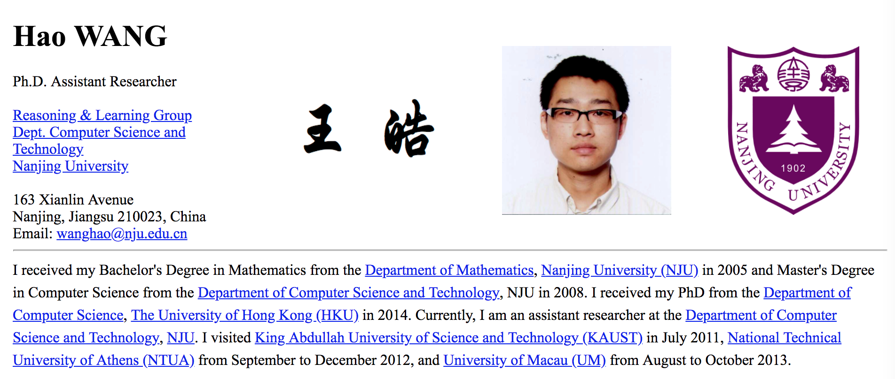
About me
wanghao@nju.edu.cn
wanghao.hku@gmail.com

Slide 3
The textbook
C++ Primer (5th edition)
One of the best C++ textbooks for beginners
Very reader-friendly
Chinese version is available but NOT recommended

Slide 4
Other resources
cplusplus.com
Tutorial, reference, forum, …

Slide 5
Lectures outline
Lecture 1 Getting Started
Lecture 2 Variables, Basic Types, and Strings
Lecture 3 Vectors and Arrays
Lecture 4 Expressions and Statements
Lecture 5 Functions
Lecture 6 Classes
Lecture 7 The I/O Library
Lecture 8 STL Containers

Slide 6
Objectives
The students are expected to be able to use C++ as a tool to study algorithms.

Slide 7
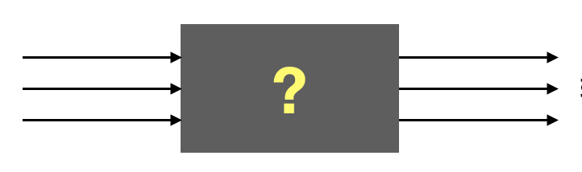
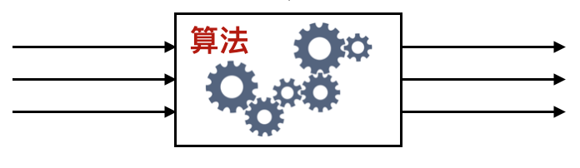
Problem, algorithm & program
Problem
Input
Output
Problem solving /
Algorithm design
Algorithm
Input
Output
Programming /
Algorithm implementation
Program

