Slide 1
Expressions & Statements
Lecture 4

Slide 2
Expressions
An expression is composed of one or more operands and yields a result when it is evaluated.
The simplest form of an expression is a single literal or variable.
More complicated expressions are formed from an operator and one or more operands.
cout << 2
a * b
“Hello” + “World”

Slide 3
Operators
Unary operators
Binary operators
int a = 3;
int *p = &a;
int b = *p;
double x = 2.3 * 5.0;
cout << x;
// multiplication
// insertion
// address-of
// dereference

Slide 4
Operators
vector<int> v;
// do something to v
string s;
if (v.size( ) > 10) {
s = “long”;
}
else {
s = “short”;
}
The conditional operator (ternary)
vector<int> v;
string s = (v.size( ) > 10) ? “long” : “short”;
Syntax
(condition) ? (if_true) : (if_false);

Slide 5
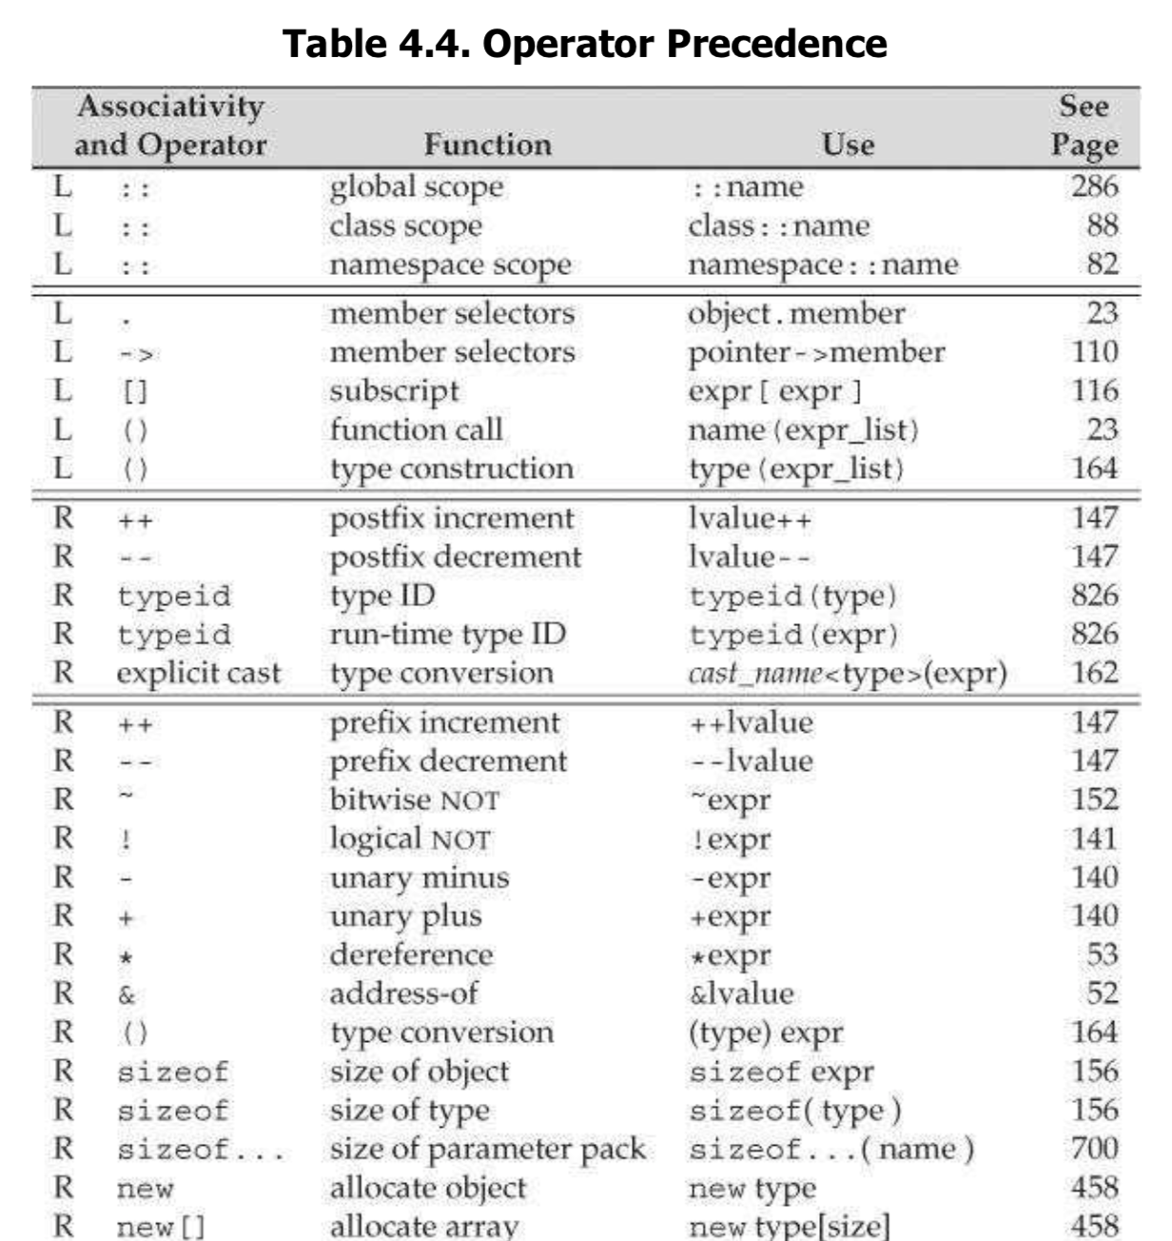
Precedence & associativity
优先级
结合性
3 + 4 * 5
20 – 15 – 3
int a[5] = {1, 2, 4, 8, 16};
int b = *(a + 3);
int c = *a + 3;
// b = 8
// c = 4

Slide 6
Precedence & associativity
cout << a == b << endl;
error: reference to overloaded function could not be resolved; did you mean to call it?
3.4 + 2 / 5 * 0.6
ok. the result is 3.4.
if (a & b != b) // do something
else // do something else
warning: self-comparison always evaluates to false

Slide 7
Precedence & associativity
vector<int> v{1, 2, 4, 8, 16};
vector<int>::const_iterator it = v.begin( );
while (it != v.end( )) {
cout << *it << endl;
++it;
}
利用优先级写出更简洁的code
while (it != v.end( )) cout << *it++ << endl;

Slide 8
Increment & decrement
注意区分表达式的执行结果/效果和表达式的值。
An expression is composed of one or more operands and yields a result when it is evaluated.
int a = 3, b = 3;
cout << ++a << endl;
cout << a << endl;
cout << b++ << endl;
cout << b << endl;
++a
变量a自增1，表达式的值为自增后的值
4
4
3
4
a++
变量a自增1，表达式的值为自增前的值

Slide 9
Order of evaluation
Precedence specifies how the operands are grouped.
It says nothing about the order in which the operands are evaluated.
In most cases, the order is largely unspecified.
int a = Expr1 + Expr2 * Expr3;
It is an error for an expression to refer to and change the same object.
int a = ++i + i++ * i;
// warning: multiple unsequenced modifications to 'i'

Slide 10
Order of evaluation
引用传递，函数改变传入参数的值
值传递，函数不改变传入参数的值
int f(int &x) { return ++x; }
int g(int &x) { return x *= 2; }
int main( ) {
int a = 3;
cout << a + f(a) * g(a) << endl;
return 0;
}
int f(int x) { return x + 1; }
int g(int x) { return x * 2; }
int main( ) {
int a = 3;
cout << a + f(a) * g(a) << endl;
return 0;
}
不确定的evaluation顺序，且编译器无法发现。
OK。Evaluation顺序不影响结果。

Slide 11
Short-circuit evaluation
The logical AND and OR operators always evaluate their left operand before the right. Moreover, the right operand is evaluated if and only if the left operand does not determine the result.
int a = 5, b = 3, c = 7;
if ( a++ == 3 || b++ == 3 || c++ == 3)
cout << a << “, “ << b << “, “ << c << endl;
6, 4, 7

Slide 12
Assignment
The value of an assignment expression is the value of the right-side operand.
int a = 5;
if ( a = 3 ) cout << “Equal.“;
Equal.
warning: using the result of an assignment as a condition

Slide 13
Assignment
int i = get_value( );
while ( i != 42 ) {
// do something
i = get_value( );
}
while ( ( i = get_value( ) ) != 42 ) {
// do something
}

Slide 14
Statements
Null statement.
;
Expression statements.
a + 1;
cout << a;
++a;
The expression is evaluated but the result is discarded.

Slide 15
Using the null statement
vector<int>::const_iterator it = v.begin( );
for ( ; it != v.end( ); ++it) // do something with *it
循环变量的初始化已经在循环头外完成。
if (1 <= a && a <= 5) { // do something }
else if (b > 5) { // do something else }
else ; // do nothing
补全if-else语句，表示什么也不做。

Slide 16
Scope
for (int i = 0; i != 5; ++i) { // do something }
cout << i;
error: use of undeclared identifier 'i'
0
1
2
3
4
-1
int i = -1;
for (int i = 0; i != 5; ++i) cout << i << endl;
cout << i;

Slide 17
Scope
// global variable i
int i = 1;
int main( ) {
int i = -1;
{
int i = 0;
cout << i << endl;
cout << ::i << endl;
}
cout << i;
return 0;
}
// local variable i₁
// local variable i₂
i₂生命期结束
0
1
-1
i₁生命期结束

Slide 18
If-else statement
在多重if-else嵌套时要注意if和else的正确配对
int a = 3, b = 4;
if (a == 2) { cout << “a == 2\n”; }
else
if (a == 3) cout << “a == 3\n”;
if (b == 3) cout << “b == 3\n”;
else cout << “???\n”;
建议if-else语句始终使用括号
C++无视空格缩进，但应使用正确的缩进增强代码的可读性
a == 3
???

Slide 19
Switch statement
switch (Expr) {
case Case1:
// handle case 1
break;
case Case 2:
// handle case 2
break;
// handle other cases, if any
default:
// do default execution
}
Expr必须是整型或者能够被转换成整型
Case1、Case2必须是常数
break语句一般都要有

Slide 20
Switch statement
string s = “hello”;
switch (s) {
case “hello”:
cout << “hi\n”;
break;
case “goodbye”:
cout << “bye\n”;
break;
default:
cout << “…\n”;
}
error: statement requires expression of integer type

Slide 21
Switch statement
int a = 0, b = 1;
switch (a) {
case 0:
cout << a + b << endl;
break;
case b:
cout << a * b << endl;
break;
default:
cout << a - b << endl;
}
error: case value is not a constant expression

Slide 22
Switch statement
int a = 0, b = 1;
switch (a) {
case 0:
cout << a + b << endl;
case 1:
cout << a * b << endl;
default:
cout << a - b << endl;
}
Case语句提供一个标记，指示程序开始执行的位置。
1
0
-1

Slide 23
Break, continue & goto
A break statement terminates the nearest enclosing while, do-while, for, or switch statement.
for (int i = 0; i != 2; ++i) {
for (int j = 0; j != 2; ++j) {
for (int k = 0; k != 3; ++k){
if (k == 1) break;
cout << “(” << i << “, “ << j << “, “ << k << “)\n”;
}
}
}
(0, 0, 0)
(0, 1, 0)
(1, 0, 0)
(1, 1, 0)

Slide 24
Break, continue & goto
A continue statement terminates the current iteration of the nearest enclosing loop and immediately begins the next iteration.
for (int i = 0; i != 2; ++i) {
for (int j = 0; j != 2; ++j) {
for (int k = 0; k != 3; ++k){
if (k == 1) continue;
cout << “(” << i << “, “ << j << “, “ << k << “)\n”;
}
}
}
(0, 0, 0)
(0, 0, 2)
(0, 1, 0)
(0, 1, 2)
(1, 0, 0)
(1, 0, 2)
(1, 1, 0)
(1, 1, 2)

Slide 25
Break, continue & goto
A goto statement provides an unconditional jump from to another statement in the same function.
for (int i = 0; i != 2; ++i) {
for (int j = 0; j != 2; ++j) {
for (int k = 0; k != 3; ++k){
if (k == 1) goto break_me_here;
cout << “(” << i << “, “ << j << “, “ << k << “)\n”;
}
}
}
break_me_here: // do something
(0, 0, 0)

Slide 26
Break, continue & goto
尽可能避免使用goto语句。
从多重循环的深处跳出几乎是goto语句唯一的合理用法。

Slide 27
Next lecture
C++ Primer, Chapter 6

