Slide 1
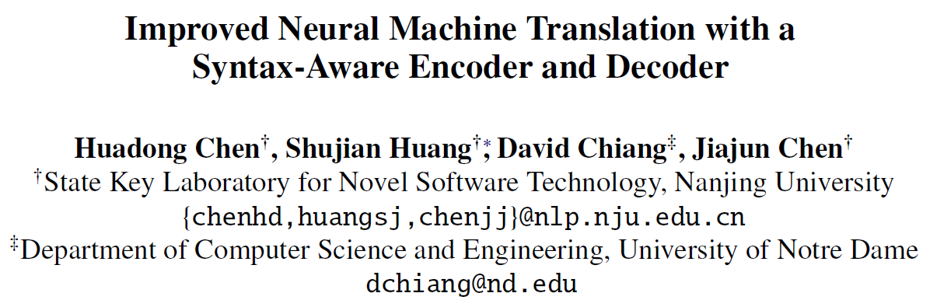
Report by:
陆纪圆

Slide 2
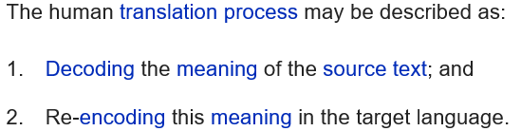
MT(machine translation)
gap
“understand”
Notes:
Example-based, Hybrid

Slide 3
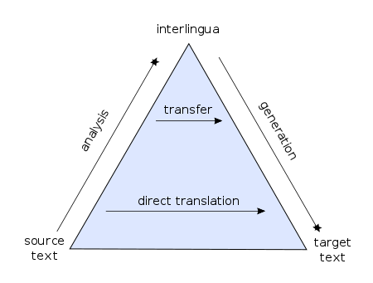
RBMT(rule-based machine translation)
Notes:
Generally, rule-based methods parse a text, usually creating an intermediary, symbolic representation, from which the text in the target language is generated.
The rule-based machine translation paradigm includes transfer-based machine translation, interlingual machine translation and dictionary-based machine translation paradigms.
Unlike interlingual MT, transfer-based machine translation depends partially on the language pair involved in the translation.

Slide 4


SMT(statistical machine translation)
By Bayes Theorem:
The best translation:
Notes:
e: string in the target language
f: string in the source language
The probability distribution p(e|f) is modeled by:
Translation model p(f|e): The probability that the source string f is the translation of the target string e
Language model p(e): the probability of seeing the target string e in the target language

Slide 5
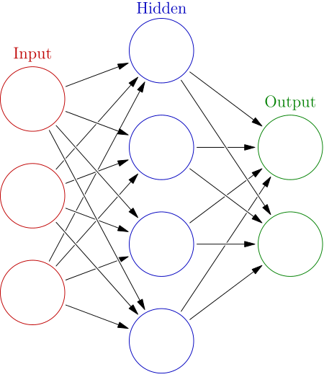
ANN(artificial neural networks)

Slide 6
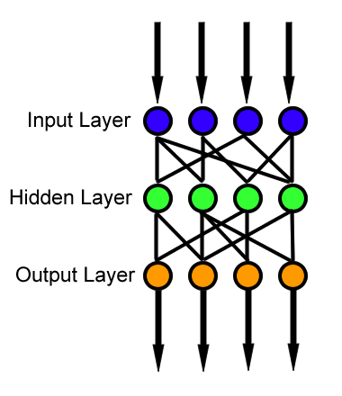
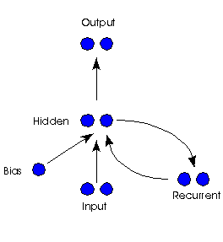
RNN(Recurrent neural networks)
FNN(Feedforward neural networks)
Notes:
Recurrent回归的 This creates an internal state of the network which allows it to exhibit dynamic temporal behavior.
Feedforward前馈 的

Slide 7
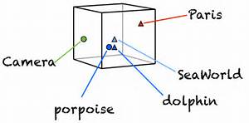
Word embedding

Slide 8
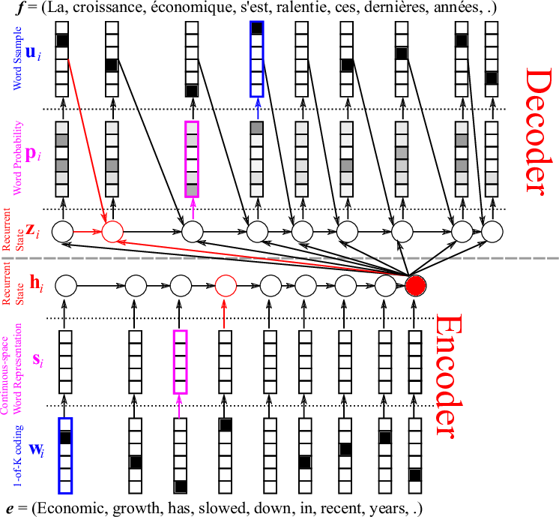
NMT(neural machine translation)
Notes:
A bidirectional recurrent neural network (RNN), known as an encoder, is used by the neural network to encode a source sentence for a second RNN, known as a decoder, that is used to predict words in the target language.^{[8]}
A sequence of fixed-dimensional vectors

Slide 9
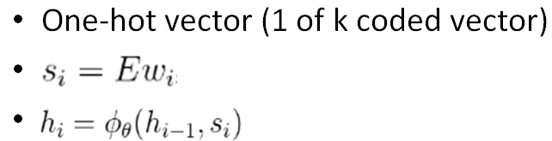
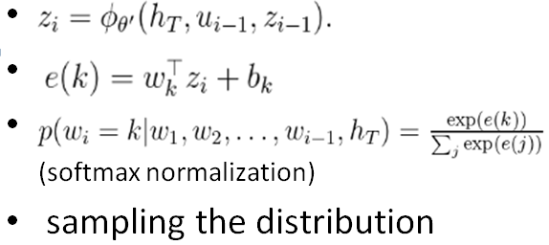
Encoder
Decoder
Notes:
E has as many columns as there are words in the source vocabulary and as many rows as you want
h0 is all zero

Slide 10
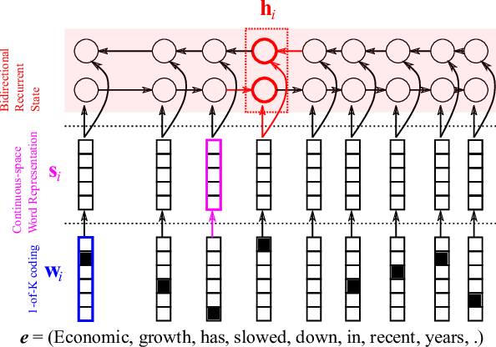
BiRNN(Bidirectional RNN)
Notes:
Bidirectional RNN
Future context

Slide 11
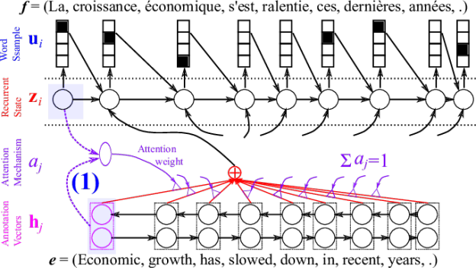


Soft attention
Notes:
Softmax normalization
Expected vector ci instead of ht for every i

Slide 12
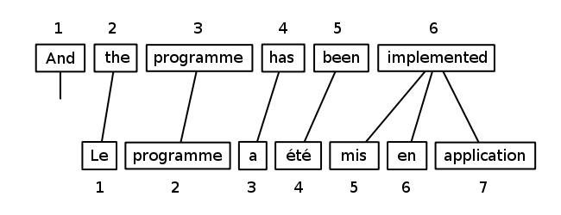
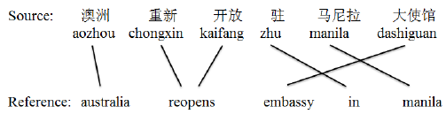
Word alignment
Notes:
Bitext word alignment or simply word alignment is the natural language processing task of identifying translation relationships among the words (or more rarely multiword units) in a bitext, resulting in a bipartite graph between the two sides of the bitext, with an arc between two words if and only if they are translations of one another.

Slide 13
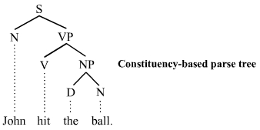
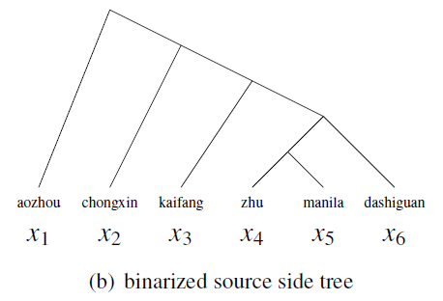
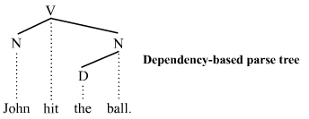
Parse tree

Slide 14
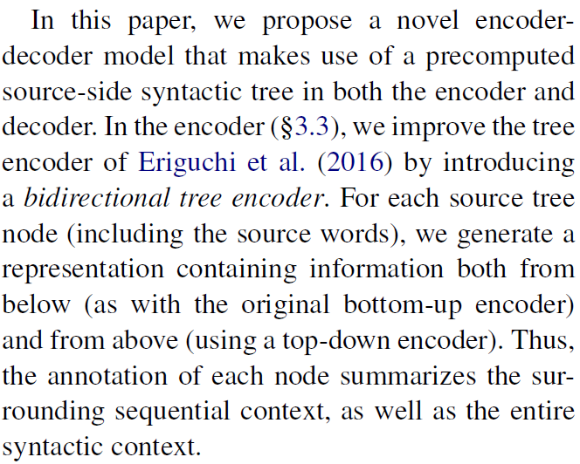
Bidirectional tree encoder
Notes:
Novel: top-down encoder

Slide 15
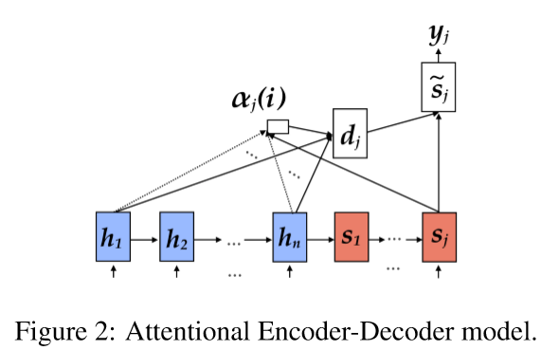
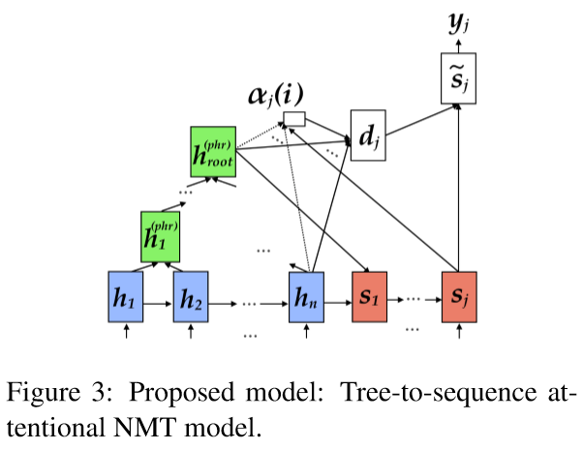
Bottom-up tree encoder
Notes:
Phrase vector -> sentence vector
Dj == Cj，the expected vector
Sj is the jth target hidden unit(previous?)

Slide 16
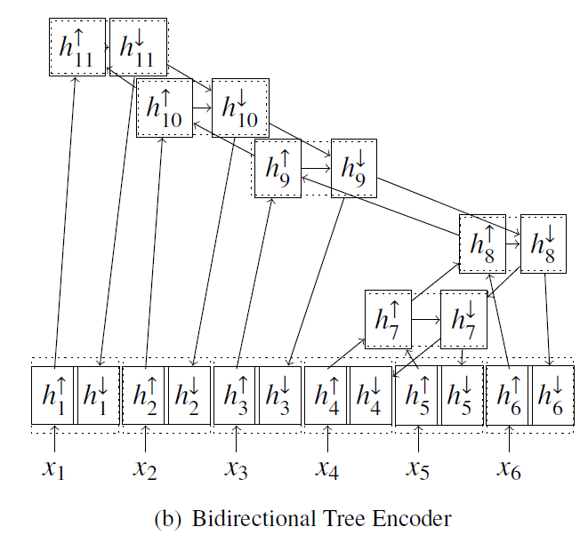
Top-down tree encoder
Notes:
Draw separate pictures
h11 up -> h11 down

Slide 17
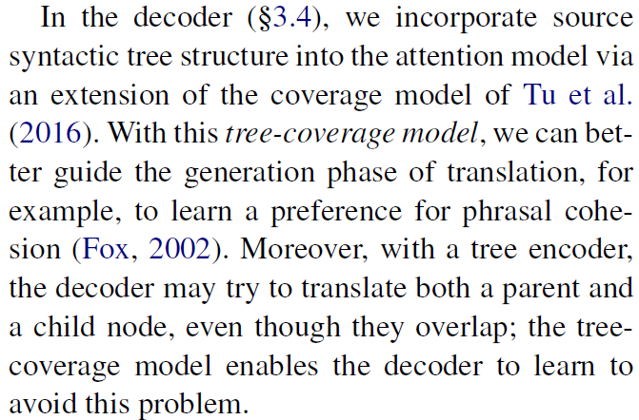
Incorporate source syntactic tree

Slide 18
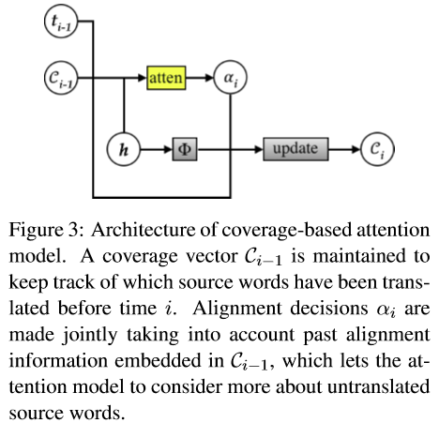
Coverage model

Slide 19
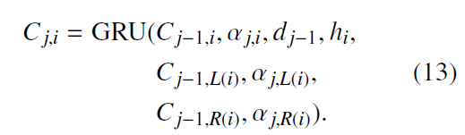
Tree coverage model
Notes:
What about top-down coverage?

Slide 20
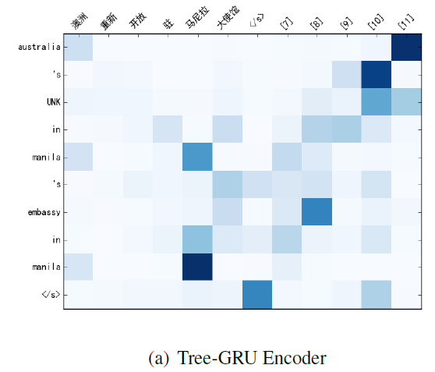
Notes:
UNK: out-of-vocabulary words

Slide 21
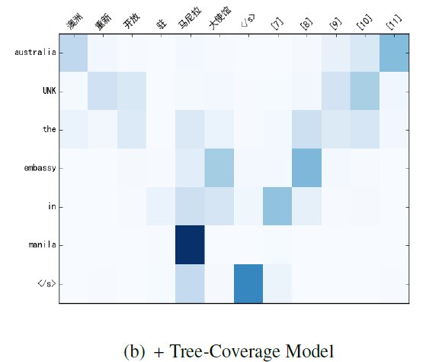

Slide 22
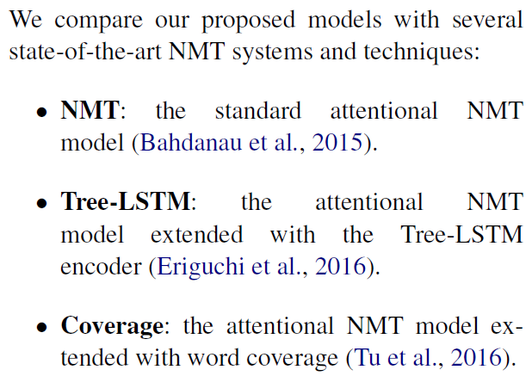
Model comparison
Notes:
LSTM: long short-term memory

Slide 23
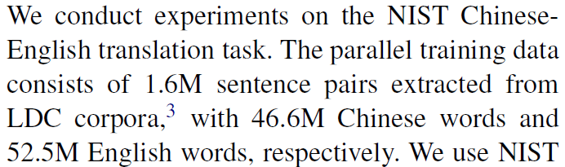
Data run
Notes:
National Institute of Standards and Technology
美国国家标准技术研究院
Linguistic Data Consortium
语言学数据库

Slide 24
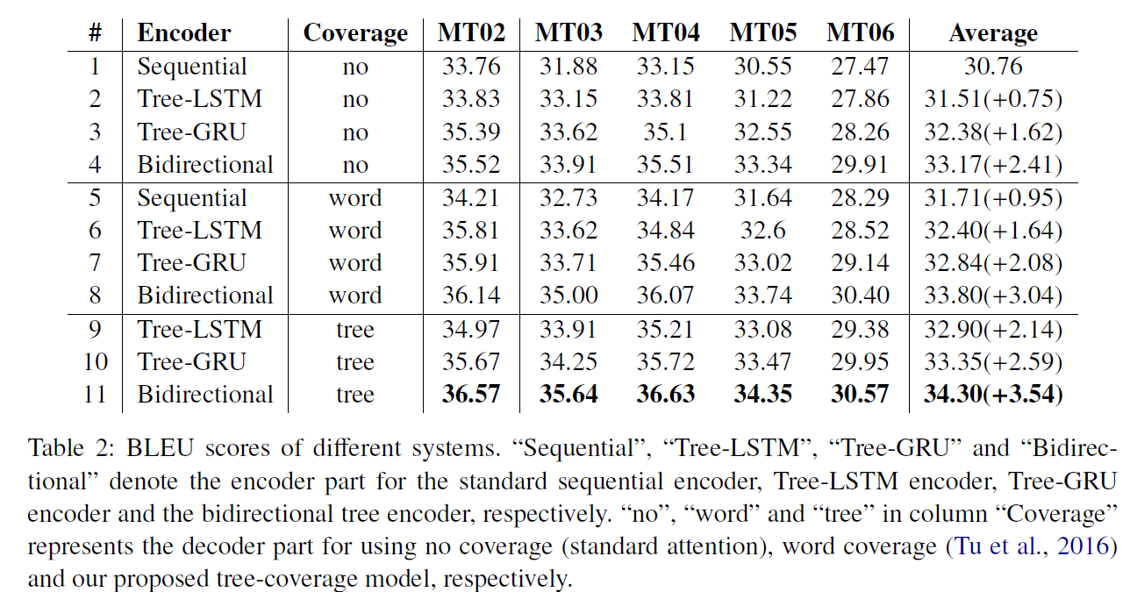
BLEU scores (bilingual evaluation understudy)
Notes:
LSTM: long short-term memory
GRU: gated recurrent unit

Slide 25
Thanks!
Q&A

