Slide 1

Deep Cross-Modal Hashing
Qing-Yuan Jiang Wu-Jun Li
Presented by Zi-Fan Shi

Slide 2
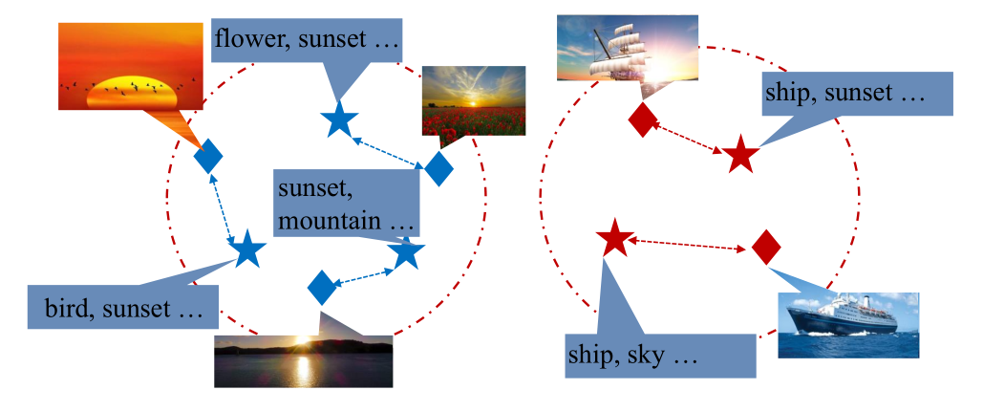
Multi-Modal Data
In reality, data can have multi-modalities
– Images, Textual tags…

Slide 3
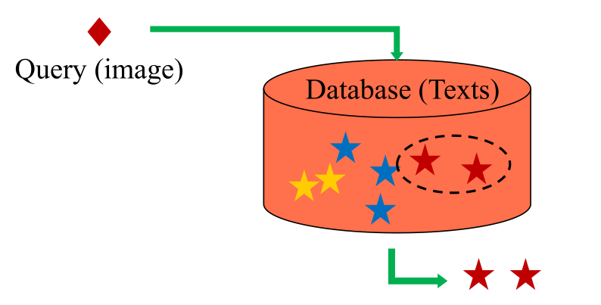
Cross-Modal Similarity Search
Cross-Modal Similarity Search
– Query: from one modality
– Database: from another modality

Slide 4
Cross-Modal Hashing
Learn compact representations that preserve cross-modal similarity
Existing methods (hand-crafted based methods):
– Cross view hashing (CVH)
– Semantic correlation maximization (SCM)
– Collective matrix factorization hashing (CMFH)
– Semantics-preserving hashing (SePH)

Slide 5






Cross-Modal Hashing
X
Image
$$x_{i}$$
-1 -1 -1 1
Y
$$y_{1}$$
Husky
British Shorthair
-1 -1 -1 1
1 1 -1 -1
$$y_{2}$$
Text
…
…
…
$$y_{n−1}$$
Pomeranian
American Shorthair
-1 -1 1 -1
1 1 1 -1
$$y_{n}$$

Slide 6

Cross-Modal Hashing
Distance
- Hamming Distance
- Euclidean Distance
……
Ranking
$b_{i}^{(x)}→b_{j1}^{(y)}, ……, b_{jn}^{(y)}$
Two Functions
$h^{\left(x\right)}\left(x_{i}\right)→{\{+1,−1\} }^{c}$
$h^{\left(y\right)}\left(y_{i}\right)→{\{+1,−1\} }^{c}$

Slide 7
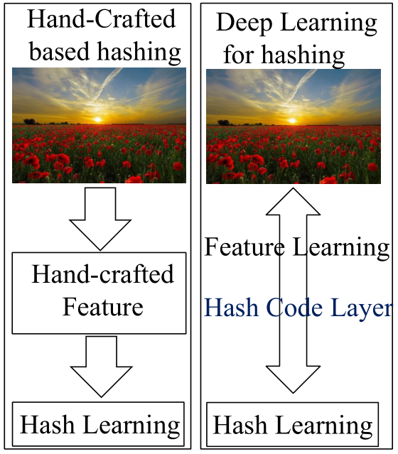
Deep Learning for Hashing
Deep hashing
– An end-to-end way
Existing methods
– Deep hashing network(DHN)
– Deep pairwise-supervised hashing (DPSH)
We propose deep cross-modal hashing

Slide 8
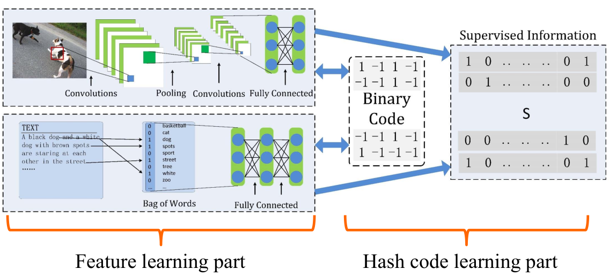
Deep Cross-Modal Hashing

Slide 9
Feature learning part
Two neural networks for image and text modality
Image modality
– First seven layers: VGG-F structure
– Eight layer: Hash code layer
Text modality
– First layer: Full connected layer
– Second layer: Hash code layer

Slide 10
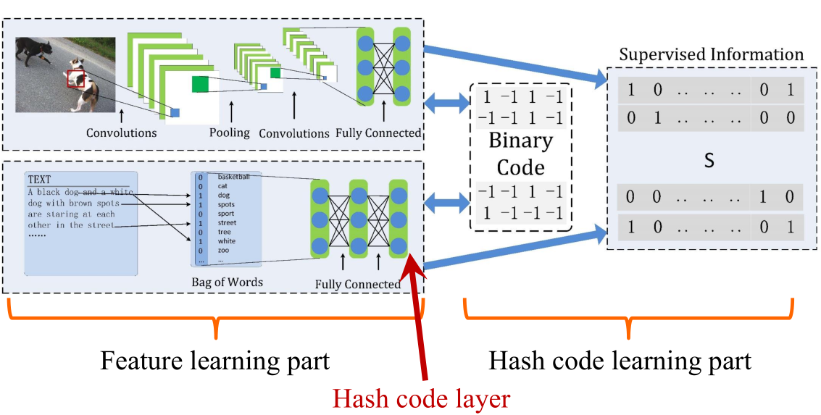
Deep Cross-Modal Hashing

Slide 11
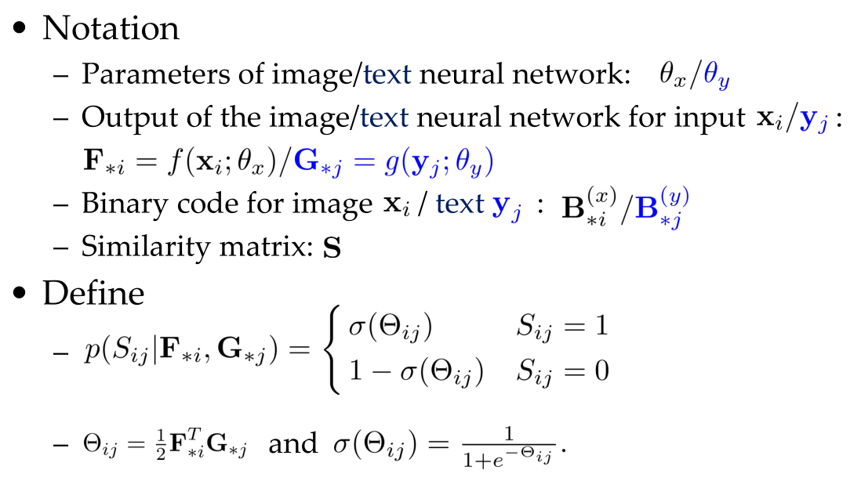
Hash code learning part

Slide 12
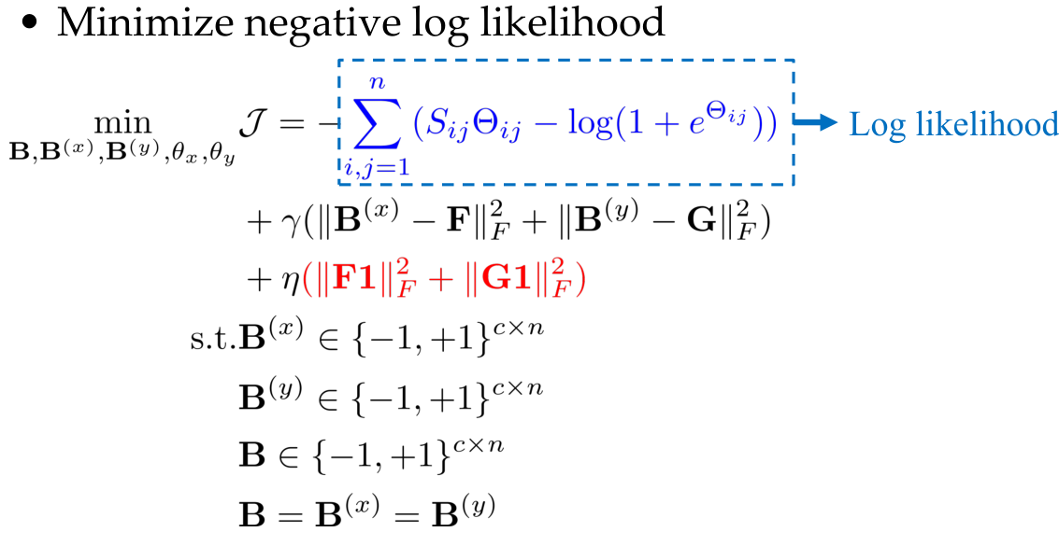
Hash code learning part

Slide 13
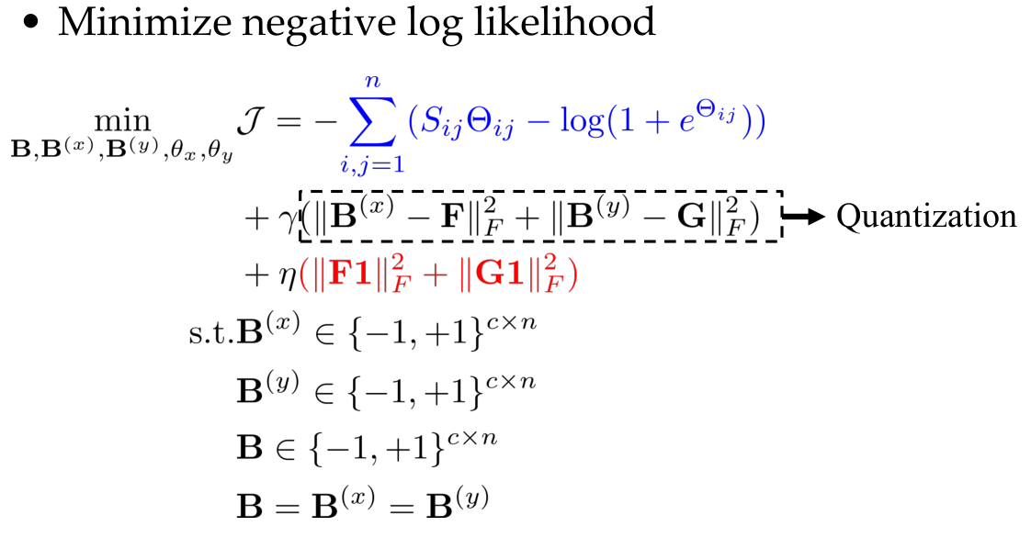
Hash code learning part

Slide 14
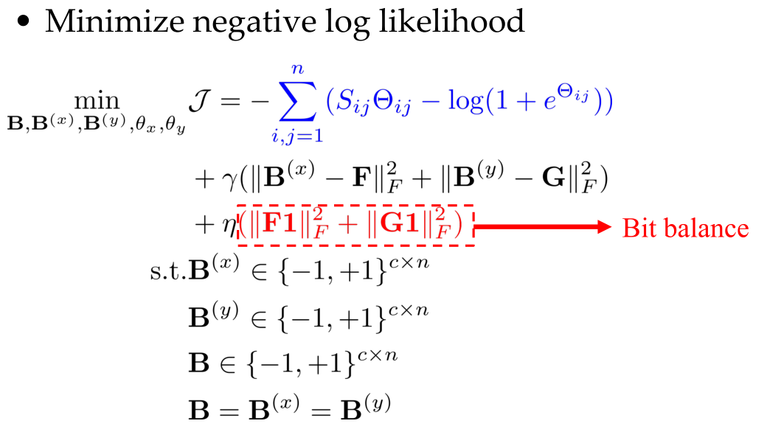
Hash code learning part

Slide 15
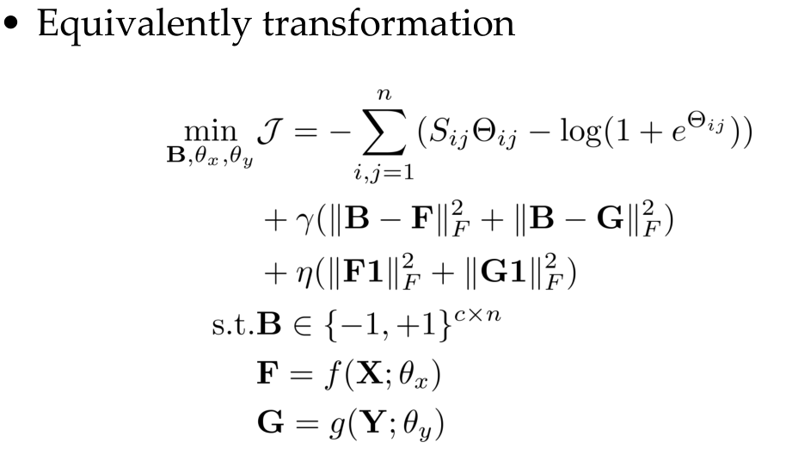
Hash code learning part

Slide 16
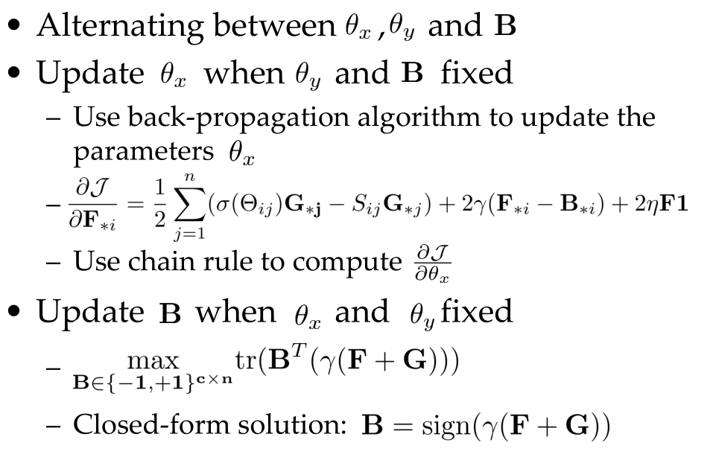
Learning

Slide 17
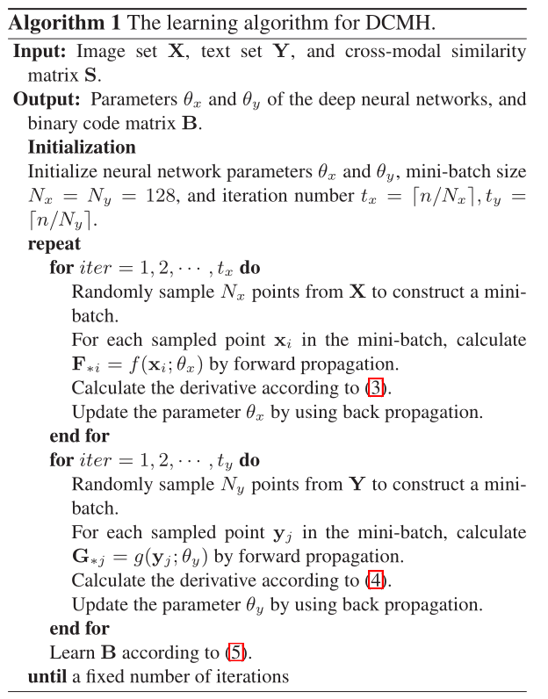
Algorithm

Slide 18

Generate hash codes
$b_{p}^{(x)}=h^{\left(x\right)}\left(x_{p}\right)=sign(f(x_{p};θ_{x}))$
$b_{q}^{(y)}=h^{\left(y\right)}\left(x_{q}\right)=sign(f(x_{q};θ_{y}))$

Slide 19
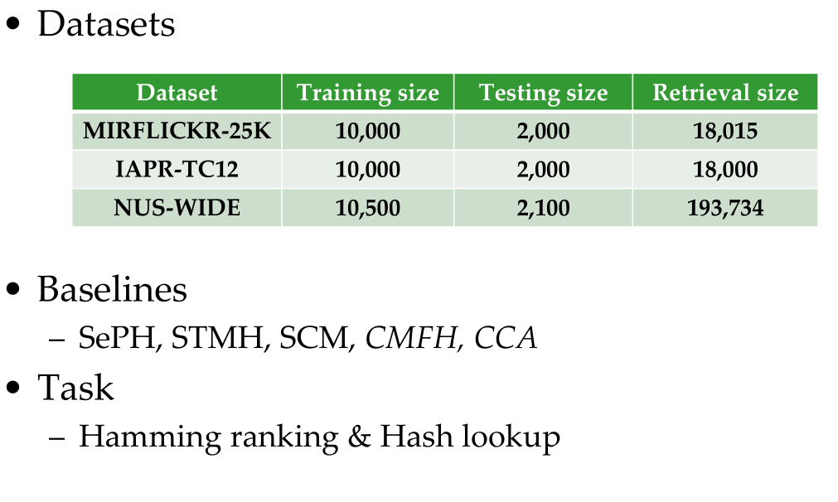
Datasets and evaluation protocols

Slide 20
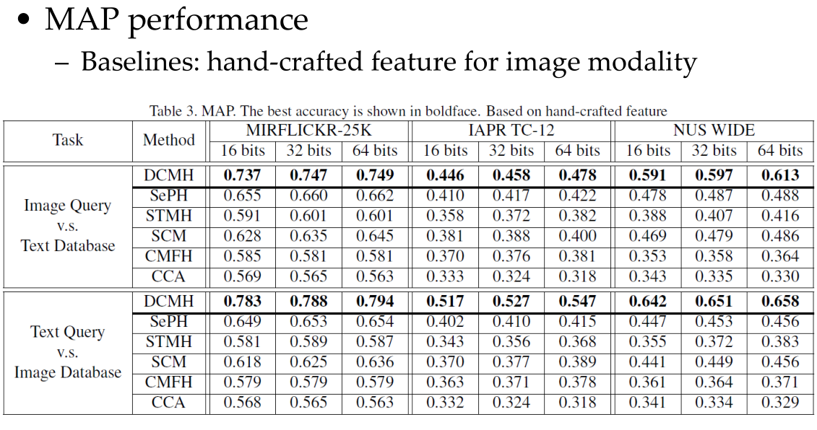
Hamming ranking

Slide 21
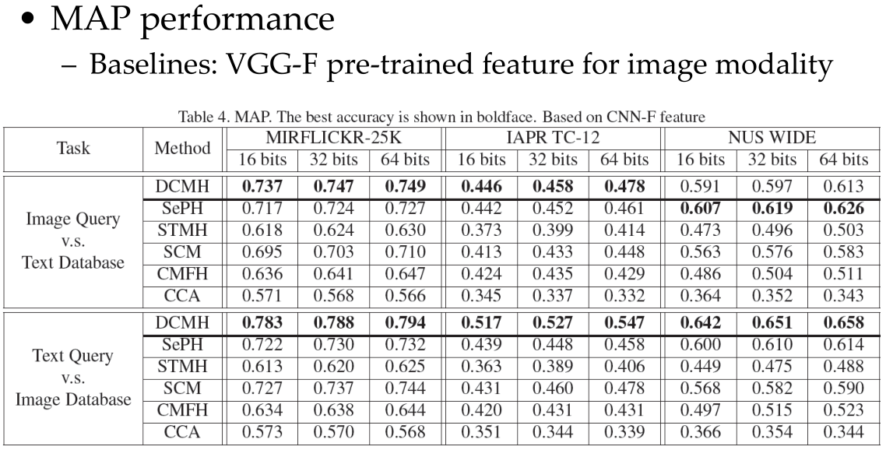
Hamming ranking

Slide 22
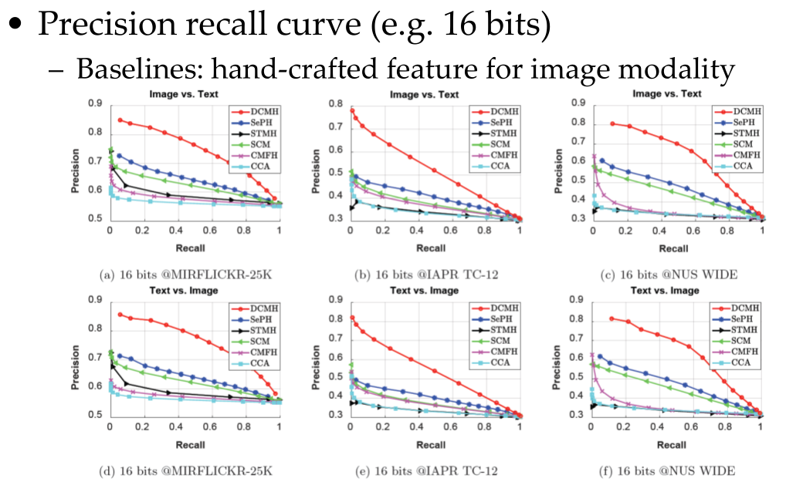
Hash lookup

Slide 23
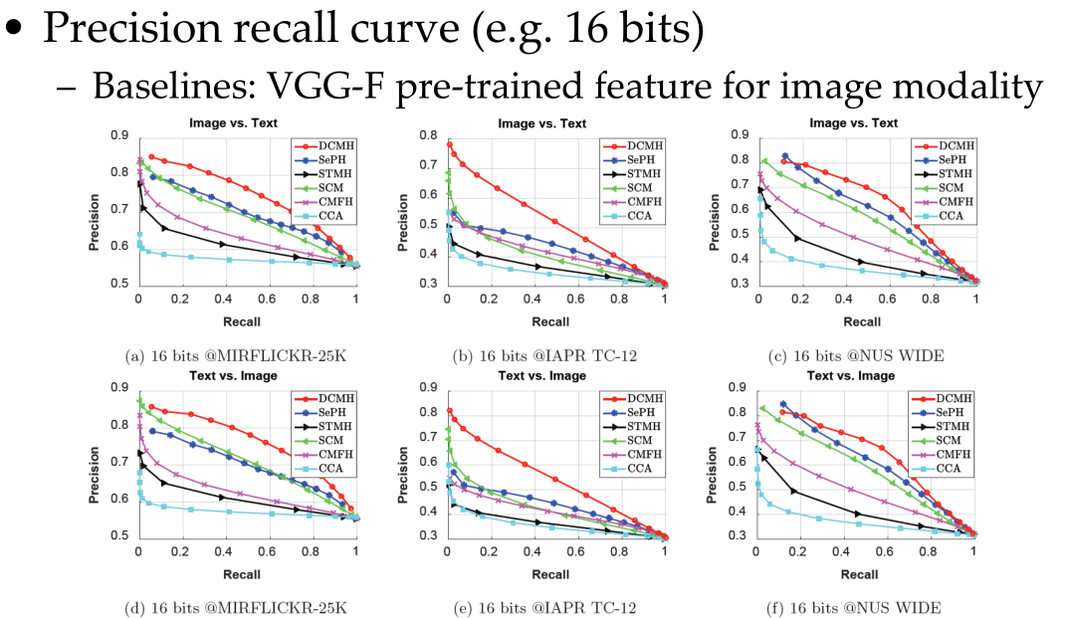
Hash lookup

Slide 24
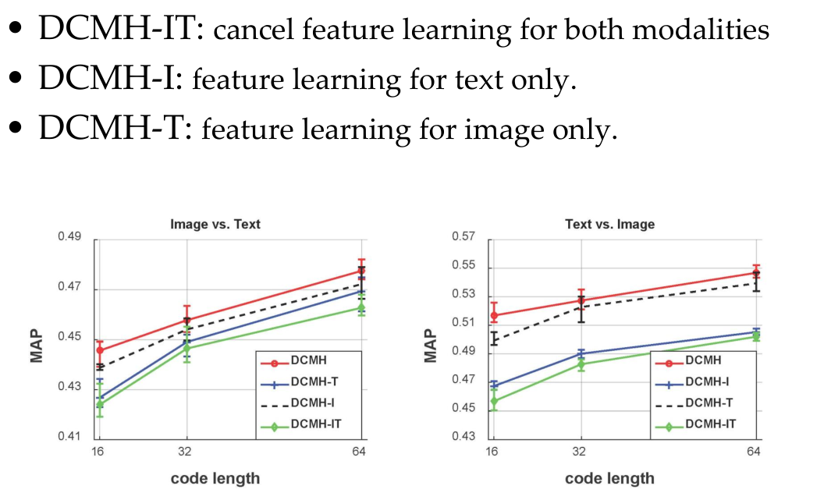
Effectiveness of feature learning

Slide 25
THANK YOU ~.~

