Slide 1
Open topic
Akra-Bazzi method
4/2/2018

Slide 2
AB方法的拓展性
使用条件
CONTENTS
一些示例
证明思路

Slide 3
1
Intoduction to AB method

Slide 4

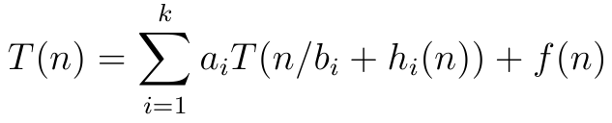
Akra-Bazzi method
Master method:
Akra–Bazzi method 为如下形式的递归式提供了求解方法：

Slide 5
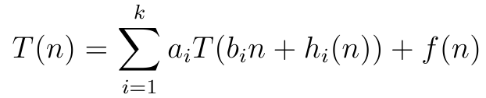
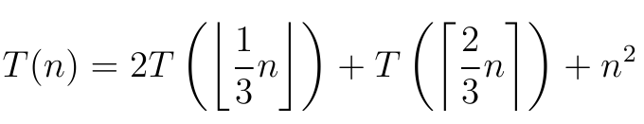
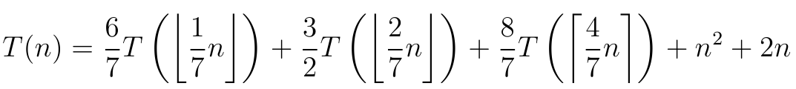
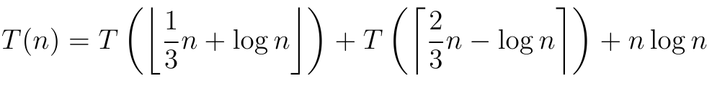
Generalization of Master Theorem
Examples:

Slide 6
2
Conditions
for usage

Slide 7
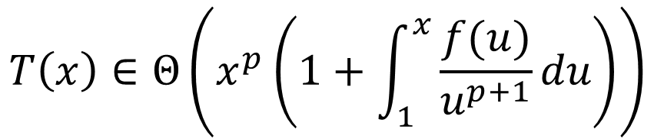
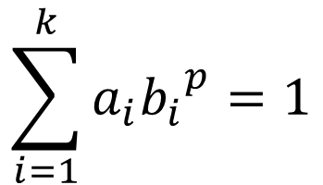
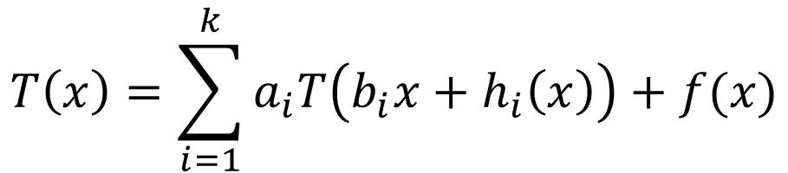
Asymptotic behavior of T(x)
$$T\left(x\right)=\sum_{i=1}^{k}{a_{i}T\left(b_{i}x+h_{i}\left(x\right)\right)+f(x)}$$
$$T\left(x\right)∈Θ\left(x^{p}\left(1+\int_{1}^{x}{\frac{f(u)}{u^{p+1}}}du\right)\right)$$
$$\sum_{i=1}^{k}{{a_{i}b_{i}}^{p}=1}$$
Where p is the solution of

Slide 8
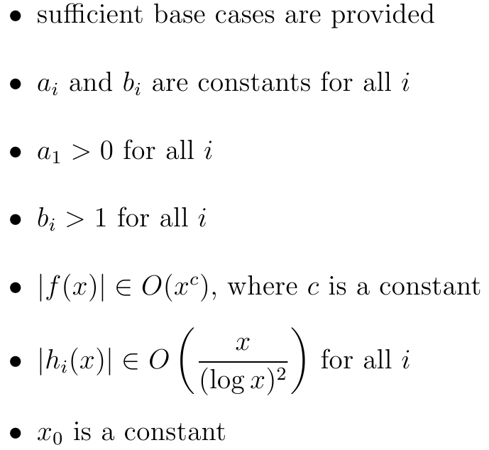
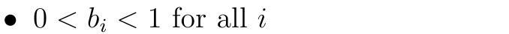
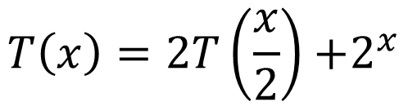
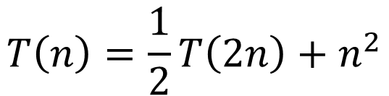

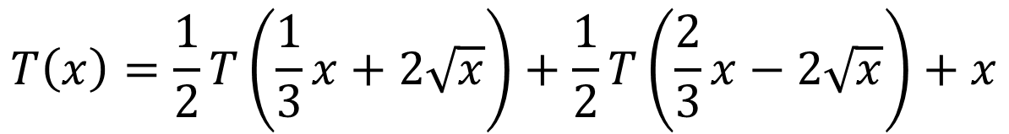
Conditions for usage
$$T\left(1\right)=Θ(1)$$
$$T\left(n\right)=\frac{1}{2}T\left(2n\right)+n^{2}$$
$$T\left(x\right)=2T\left(\frac{x}{2}\right){+2}^{x}$$
$$T\left(x\right)=\frac{1}{2}T\left(\frac{1}{3}x+2\sqrt{x}\right)+\frac{1}{2}T\left(\frac{2}{3}x−2\sqrt{x}\right)+x$$

Slide 9
3
Some
examples

Slide 10
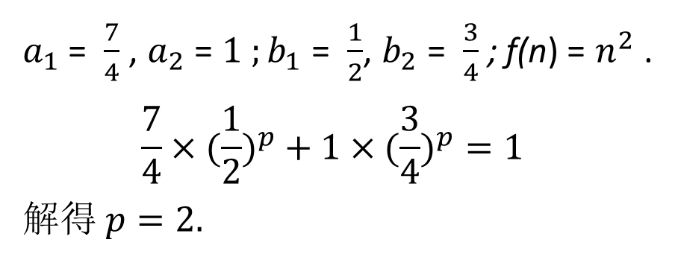
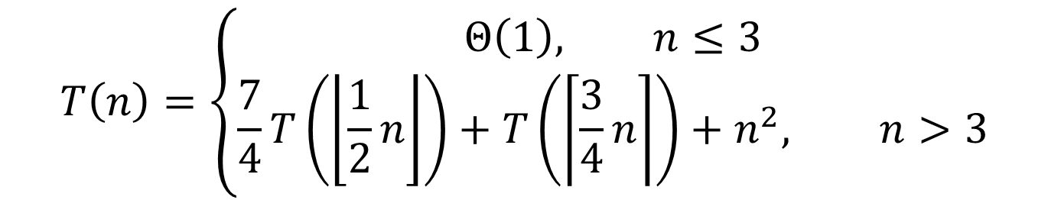
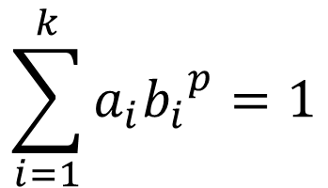
Example 1
$$T\left(n\right)=\left\{\begin{aligned}Θ\left(1\right), n≤3 \\ &\frac{7}{4}T\left(\left\lfloor \frac{1}{2}n\right\rfloor \right)+T\left(\left\lceil \frac{3}{4}n\right\rceil \right)+n^{2}, n>3\end{aligned}\right.$$
$$\sum_{i=1}^{k}{{a_{i}b_{i}}^{p}=1}$$
Step 1
求解p.
$a_{1}$ = $\frac{7}{4}$ , $a_{2}$ = $1 ;b_{1}$ = $\frac{1}{2}$, $b_{2}$ = $\frac{3}{4}$ ; f(n) = $n^{2}$ .
$$\frac{7}{4}×({\frac{1}{2})}^{p}+1×({\frac{3}{4})}^{p}=1$$
解得$p=2.$

Slide 11
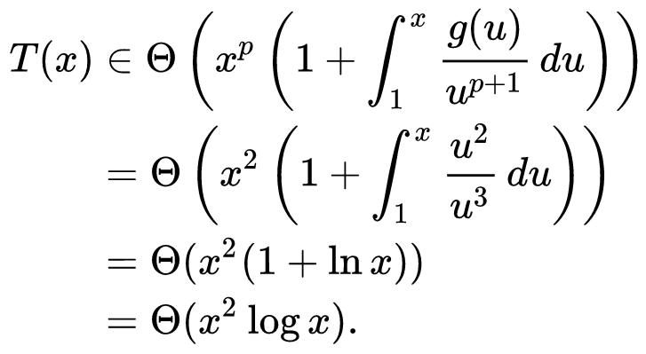

Example 1
$$T\left(n\right)=\left\{\begin{aligned}Θ\left(1\right), n≤3 \\ &\frac{7}{4}T\left(\left\lfloor \frac{1}{2}n\right\rfloor \right)+T\left(\left\lceil \frac{3}{4}n\right\rceil \right)+n^{2}, n>3\end{aligned}\right.$$
Step 2
求解$Θ$
f

Slide 12
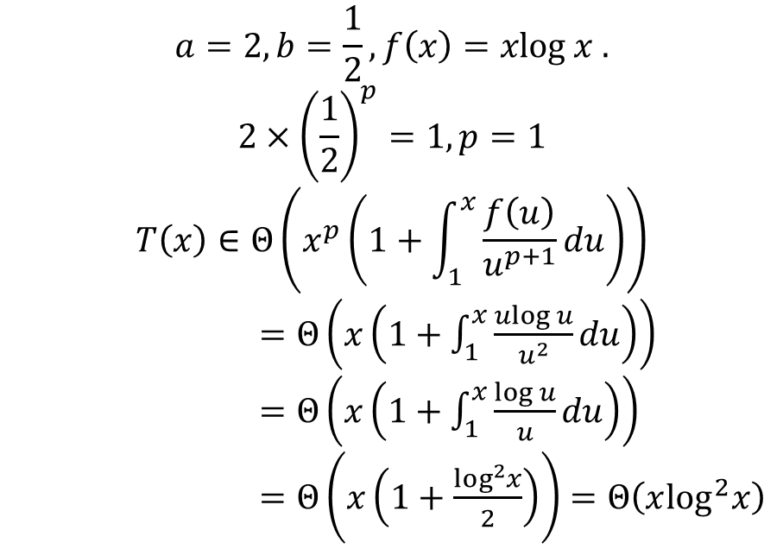
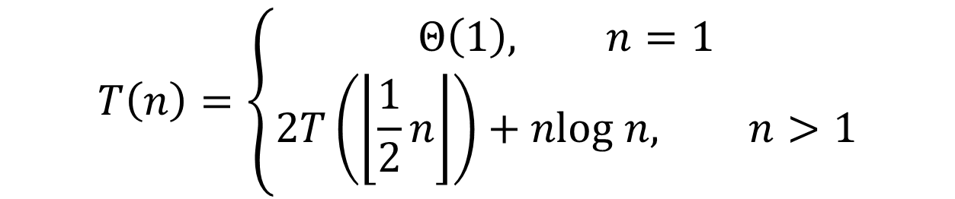
Example 2
$$T\left(n\right)=\left\{\begin{aligned}Θ\left(1\right), n=1 \\ &2T\left(\left\lfloor \frac{1}{2}n\right\rfloor \right)+nlog n, n>1\end{aligned}\right.$$
$$a=2, b=\frac{1}{2}, f\left(x\right)=xlog x .$$
$$2×{\left(\frac{1}{2}\right)}^{p}=1, p=1$$
$$T\left(x\right)∈Θ\left(x^{p}\left(1+\int_{1}^{x}{\frac{f\left(u\right)}{u^{p+1}}}du\right)\right)$$
$=Θ\left(x\left(1+\int_{1}^{x}{\frac{ulog u}{u^{2}}}du\right)\right)$
$=Θ\left(x\left(1+\int_{1}^{x}{\frac{log u}{u}}du\right)\right)$
$=Θ\left(x\left(1+\frac{\log^{2}x}{2}\right)\right)=Θ\left(x\log^{2}x\right)$
AB-method fills the gap in Master Theorem
Solution.

Slide 13
4
Proof

Slide 14

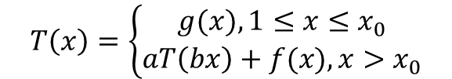
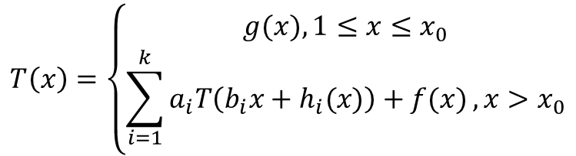
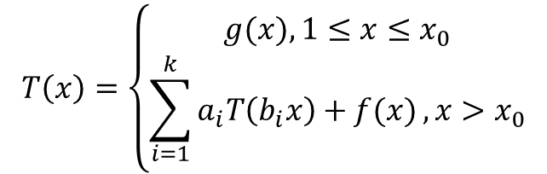
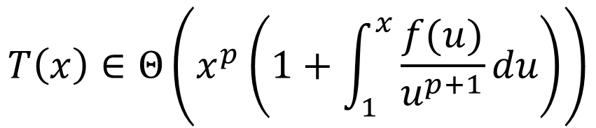
THREE-STEP STRATEGE
$$T\left(x\right)∈Θ\left(x^{p}\left(1+\int_{1}^{x}{\frac{f(u)}{u^{p+1}}}du\right)\right)$$
Step 1
Step 2
Step 3
$$T\left(x\right)=\left\{\begin{aligned}g(x), 1≤x≤x_{0} \\ \sum_{i=1}^{k}{a_{i}T\left(b_{i}x\right)+f(x)}, x>x_{0}\end{aligned}\right.$$
$$T\left(x\right)=\left\{\begin{aligned}g(x), 1≤x≤x_{0} \\ \sum_{i=1}^{k}{a_{i}T\left(b_{i}x+h_{i}(x)\right)+f(x)}, x>x_{0}\end{aligned}\right.$$
$$T\left(x\right)=\left\{\begin{aligned}g(x), 1≤x≤x_{0} \\ aT\left(bx\right)+f(x), x>x_{0}\end{aligned}\right.$$

Slide 15
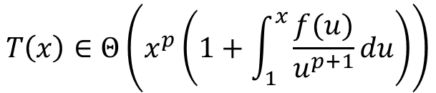
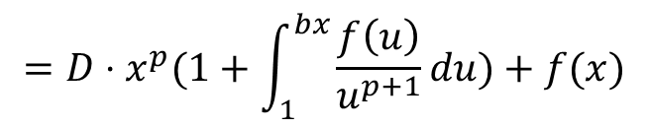
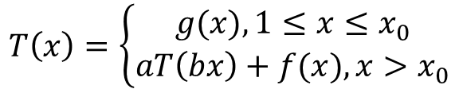
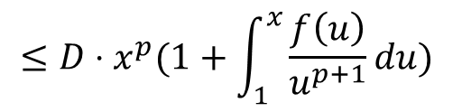
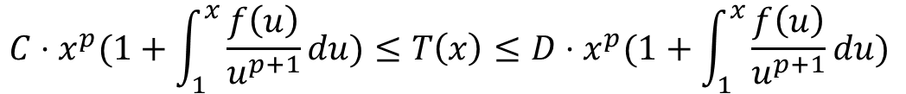
Step 1
$$T\left(x\right)=\left\{\begin{aligned}g(x), 1≤x≤x_{0} \\ aT\left(bx\right)+f(x), x>x_{0}\end{aligned}\right.$$
$$T\left(x\right)∈Θ\left(x^{p}\left(1+\int_{1}^{x}{\frac{f(u)}{u^{p+1}}}du\right)\right)$$
$${C⋅x}^{p}(1+\int_{1}^{x}{\frac{f\left(u\right)}{u^{p+1}}du)≤T\left(x\right)≤{D⋅x}^{p}(1+\int_{1}^{x}{\frac{f\left(u\right)}{u^{p+1}}du) }}$$
$$T\left(x\right)=aT\left(bx\right)+f\left(x\right)≤a⋅D⋅({\left(bx\right)}^{p}(1+\int_{1}^{bx}{\frac{f\left(u\right)}{u^{p+1}}du))+f\left(x\right)}$$
$$={D⋅x}^{p}(1+\int_{1}^{bx}{\frac{f\left(u\right)}{u^{p+1}}du)+f(x)}$$
$$≤D⋅x^{p}(1+\int_{1}^{x}{\frac{f\left(u\right)}{u^{p+1}}du) }$$

Slide 16
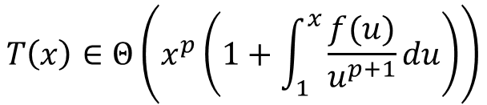
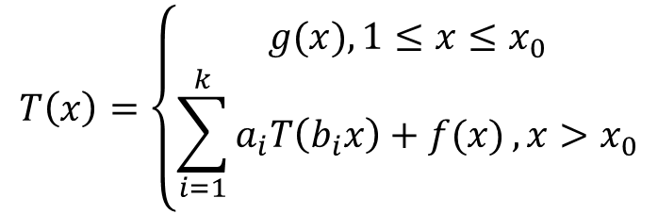
$$T\left(x\right)=\left\{\begin{aligned}g(x), 1≤x≤x_{0} \\ \sum_{i=1}^{k}{a_{i}T\left(b_{i}x\right)+f(x)}, x>x_{0}\end{aligned}\right.$$
$$T\left(x\right)∈Θ\left(x^{p}\left(1+\int_{1}^{x}{\frac{f(u)}{u^{p+1}}}du\right)\right)$$
Step 2
Lemma: $T\left(x\right)=a^{k}T\left(b^{k}x\right)+\sum_{0≤i<k}{a^{i}f(b^{i}x)}=a^{k}g\left(b^{k}x\right)+\sum_{0≤i<k}{a^{i}f(b^{i}x)}$

Slide 17
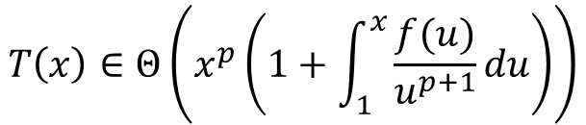
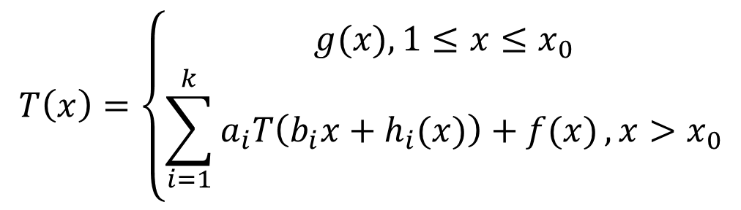
$$T\left(x\right)=\left\{\begin{aligned}g(x), 1≤x≤x_{0} \\ \sum_{i=1}^{k}{a_{i}T\left(b_{i}x+h_{i}(x)\right)+f(x)}, x>x_{0}\end{aligned}\right.$$
Step 3
$$T\left(x\right)∈Θ\left(x^{p}\left(1+\int_{1}^{x}{\frac{f(u)}{u^{p+1}}}du\right)\right)$$

Slide 18
THANK YOU
刘寒 171240502
PPT模板下载：www.1ppt.com/moban/ 行业PPT模板：www.1ppt.com/hangye/
节日PPT模板：www.1ppt.com/jieri/ PPT素材下载：www.1ppt.com/sucai/
PPT背景图片：www.1ppt.com/beijing/ PPT图表下载：www.1ppt.com/tubiao/
优秀PPT下载：www.1ppt.com/xiazai/ PPT教程： www.1ppt.com/powerpoint/
Word教程： www.1ppt.com/word/ Excel教程：www.1ppt.com/excel/
资料下载：www.1ppt.com/ziliao/ PPT课件下载：www.1ppt.com/kejian/
范文下载：www.1ppt.com/fanwen/ 试卷下载：www.1ppt.com/shiti/
教案下载：www.1ppt.com/jiaoan/
字体下载：www.1ppt.com/ziti/

