Slide 1
DeepMIML Network
Ji Feng and Zhi-Hua Zhou
LAMDA Group
Nanjing University, China

Slide 2
About this work
Proposed an end-to-end deep model for multi-instance multi-label learning
Learn instance representations from raw data
Allows instance-label discovery in a MIML view
Ji Feng and Zhi-hua Zhou
DeepMIML Network
http://lamda.nju.edu.cn

Slide 3
Outline
Introduction
DeepMIML Network
Experiments
Conclusion
Ji Feng and Zhi-hua Zhou
DeepMIML Network
http://lamda.nju.edu.cn

Slide 4
Outline
Introduction
DeepMIML Network
Experiments
Conclusion
Ji Feng and Zhi-hua Zhou
DeepMIML Network
http://lamda.nju.edu.cn

Slide 5
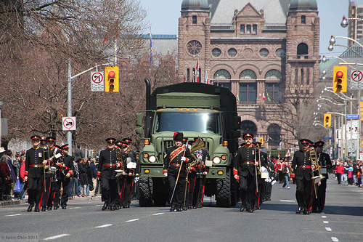
Multiple instances with multiple labels
Input Pattern:
MS-COCO dataset [Lin, T.-Y. et al. ECCV 2014]
Output Label: Truck, Traffic Light, Person, Handbag
Ji Feng and Zhi-hua Zhou
DeepMIML Network
http://lamda.nju.edu.cn

Slide 6


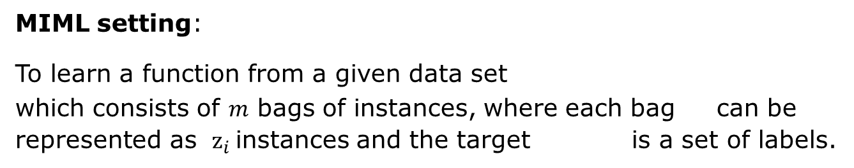
Multiple instances with multiple labels
Input Pattern:
MS-COCO dataset [Lin, T.-Y. et al. ECCV 2014]
Output Label: Truck, Traffic Light, Person, Handbag
MIML setting:
To learn a function from a given data set
which consists of $m$ bags of instances, where each bag can be represented as ${\text{z}}_{i}$instances and the target is a set of labels.
Ji Feng and Zhi-hua Zhou
DeepMIML Network
http://lamda.nju.edu.cn

Slide 7
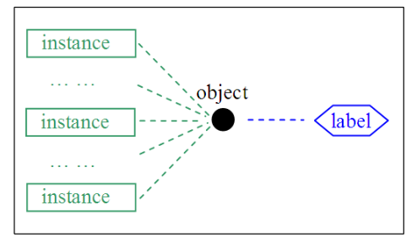
Why MIML
A more general framework
Multi-instance single Label
Ji Feng and Zhi-hua Zhou
DeepMIML Network
http://lamda.nju.edu.cn

Slide 8
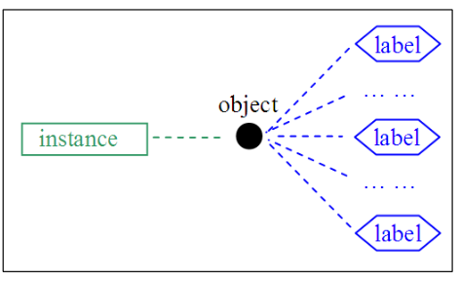
Why MIML
A more general framework
Multi-instance single Label
Single-instance multi-label
Ji Feng and Zhi-hua Zhou
DeepMIML Network
http://lamda.nju.edu.cn

Slide 9
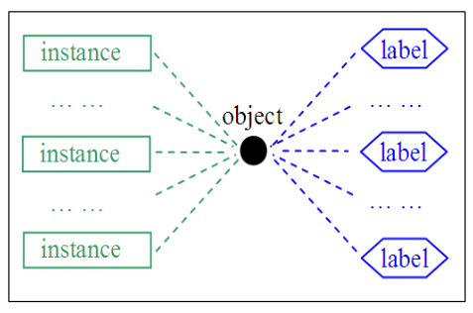
Why MIML
A more general framework
Multi-instance single Label
Single-instance multi-label
Multi-instance multi-label
Ji Feng and Zhi-hua Zhou
DeepMIML Network
http://lamda.nju.edu.cn

Slide 10
Why MIML
A more general framework
Traditional supervised learning/Multi-instance learning/ Multi-label learning can all be viewed as special case
More realistic to model real world scenarios
Many-to-many mapping is better
Ji Feng and Zhi-hua Zhou
DeepMIML Network
http://lamda.nju.edu.cn

Slide 11
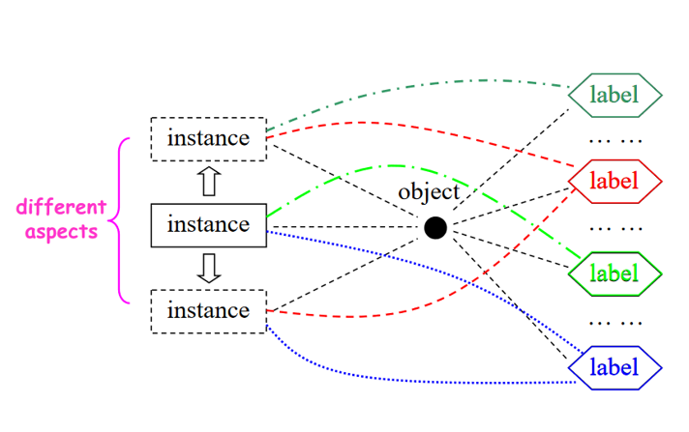
Instance label relation discovery
A built-in functionality in MIML setting
Tries to explore the interactions between key instance and the correspondent label
Can be used in identifying the key input pattern which triggers the output label
Ji Feng and Zhi-hua Zhou
DeepMIML Network
http://lamda.nju.edu.cn

Slide 12
Previous Approaches
Rank-loss support instance machines for MIML[Briggs et al, 2013]
KISAR: What instance trigger what labels [Li et al, 2012]
Discriminative probabilistic MIML model [Pham et al, 2012]
Successful applications include
image classification
text categorization
video annotation
gene function prediction
ecosystem protection
and more…
[Xu et al, 2011; Zhou et al. 2012; Surdeanu et al. 2012;Briggs, Fern, and Reich 2013; Wu, Huang, and Zhou 2014]
Ji Feng and Zhi-hua Zhou
DeepMIML Network
http://lamda.nju.edu.cn

Slide 13
Motivation
Quality of representation matters
A unified MIML framework with the ability to automatically learn instance representations from raw data
Ji Feng and Zhi-hua Zhou
DeepMIML Network
http://lamda.nju.edu.cn

Slide 14
Outline
Introduction
DeepMIML Network
Experiments
Conclusion
Ji Feng and Zhi-hua Zhou
DeepMIML Network
http://lamda.nju.edu.cn

Slide 15
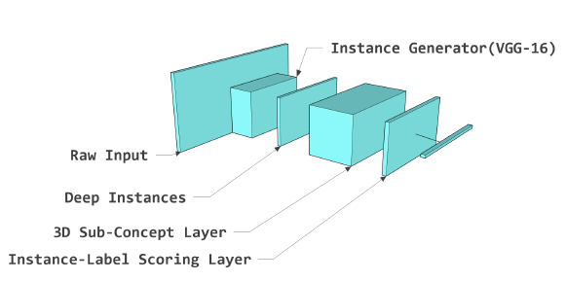
DeepMIML Network
Ji Feng and Zhi-hua Zhou
DeepMIML Network
http://lamda.nju.edu.cn

Slide 16
Deep Learning as Instance Generator
Given a pre-trained model, there are 2 common strategies to extract representations from raw data:
Extract the fully connected layer activations
Extract the convolutional layer activations
Ji Feng and Zhi-hua Zhou
DeepMIML Network
http://lamda.nju.edu.cn

Slide 17
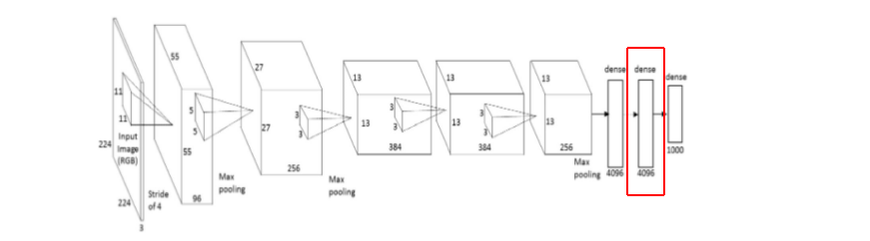
Deep Learning as Instance Generator
Strategy 1
Extract the last fully connected layer activations
Can’t explore instance-label relationships, not suitable for MIML ☹
Ji Feng and Zhi-hua Zhou
DeepMIML Network
http://lamda.nju.edu.cn

Slide 18
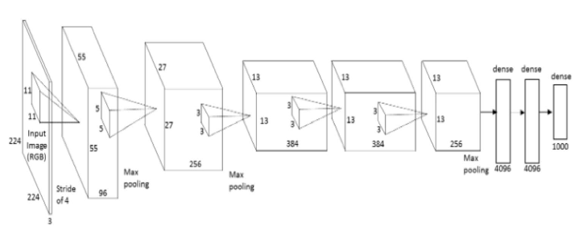
Deep Learning as Instance Generator
Strategy 2
Extract the convolutional layer activations
Can be used as instance representations ☺
Ji Feng and Zhi-hua Zhou
DeepMIML Network
http://lamda.nju.edu.cn

Slide 19
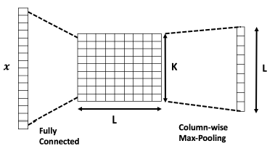
2D Sub-concept layer
Each node models the matching score between an input instance and one sub-concept of one label.
It is different with:
2D convolutional layer.
1D fully connected layer.
Ji Feng and Zhi-hua Zhou
DeepMIML Network
http://lamda.nju.edu.cn

Slide 20
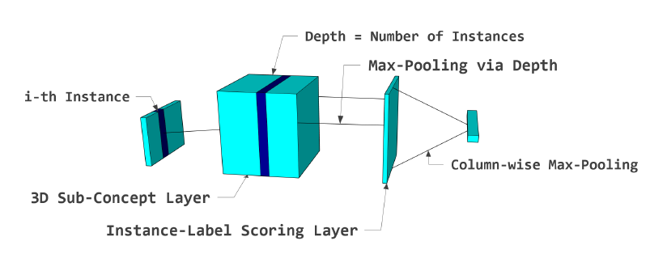
Sub-Concept layer for multiple instances
Each instance is connected with its corresponding sub-concept layer only. The resulting 3D tensor has depth equals the number of input instances.
Ji Feng and Zhi-hua Zhou
DeepMIML Network
http://lamda.nju.edu.cn

Slide 21
Sub-Concept layer for multiple instances
Each instance is connected with its corresponding sub-concept layer only. The resulting 3D tensor has depth equals the number of input instances.
Ji Feng and Zhi-hua Zhou
DeepMIML Network
http://lamda.nju.edu.cn

Slide 22
Sub-Concept layer for multiple instances
Each instance is connected with its corresponding sub-concept layer only. The resulting 3D tensor has depth equals the number of input instances.
Ji Feng and Zhi-hua Zhou
DeepMIML Network
http://lamda.nju.edu.cn

Slide 23
DeepMIML Network
A more sophisticated instance generator may be used for specific tasks.
Sub-Concept layer can be plug into most deep structures.
Degenerate to multi-label or multi-instance learning easily
Ji Feng and Zhi-hua Zhou
DeepMIML Network
http://lamda.nju.edu.cn

Slide 24
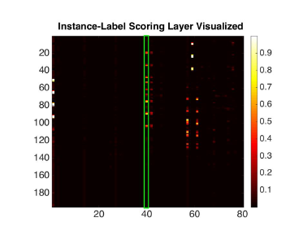
Instance-Label Relation Discovery
The first pooling layer after the 3D sub-concept layer will produce a matching score across all instances for all labels.
Can also detect which key instance triggers one particular label by back-track the instance.
Ji Feng and Zhi-hua Zhou
DeepMIML Network
http://lamda.nju.edu.cn

Slide 25
Outline
Introduction
DeepMIML Network
Experiments
Conclusion
Ji Feng and Zhi-hua Zhou
DeepMIML Network
http://lamda.nju.edu.cn

Slide 26
Dataset description
Yelp Dataset challenge [Lin, T.-Y. et al. ECCV 2014]
19,934 reviews, 100 possible labels
url: yelp.com/dataset_challenge
Skip-thought model for instance generator
MS-COCO Dataset [Lin, T.-Y. et al. ECCV 2014]
82,783 images for training , 40,504 images for testing
80 labels
MIML News: [Zhou, Z.-H. et al. AIJ 2012]
Reuters-21578 data
tf-idf features, each input bag consists of 2-26
instances, each instance is a 242-d vector
MIML Scene: [Zhou, Z.-H. et al. AIJ 2012]
SBN features, each input bag consists of nine
15-dimentional instances
1800 for training, 200 for testing
Image Task
Text Task
Non-deep
Instances
Ji Feng and Zhi-hua Zhou
DeepMIML Network
http://lamda.nju.edu.cn

Slide 27
Experiment Setup
Experiment Setup for Yelp:
Skip-thought model for instance generator
Binary cross-entropy for loss function, trained with adadelta
10 instances per document, allow zero paddings
Comparison MLP:
Same deep feature with softmax
4800-1024-512 MLP with ReLU activations
Experiment Setup for COCO-dataset:
Conv-net for instance generator
Binary cross-entropy for loss function, trained with adadelta
Comparison methods:
CNN-RNN[Wang, J. et al. CoRR 2008]
VGG-16
Ji Feng and Zhi-hua Zhou
DeepMIML Network
http://lamda.nju.edu.cn

Slide 28
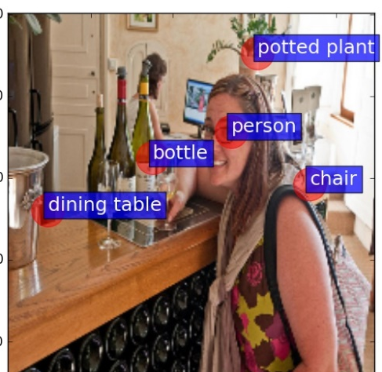

DeepMIML for image task
Instance label relation discovery on test
Each instance in the coresponding image is centered at
$\left(x,y\right)=({conv}_{x}∗16+8, {conv}_{y}∗16+8)$
Ji Feng and Zhi-hua Zhou
DeepMIML Network
http://lamda.nju.edu.cn

Slide 29
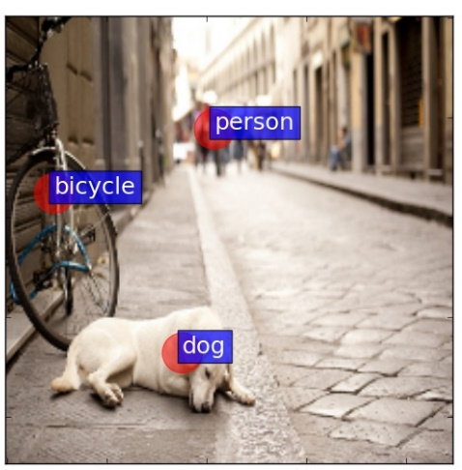
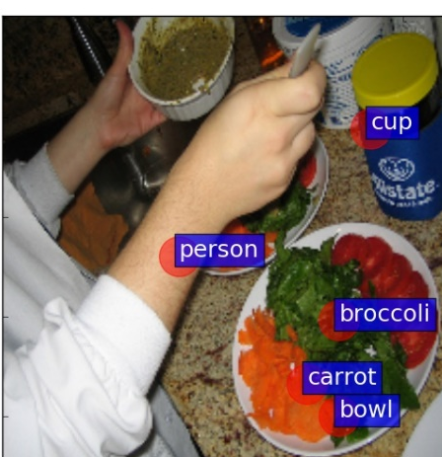
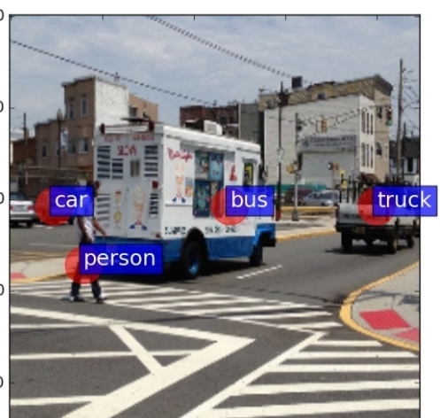
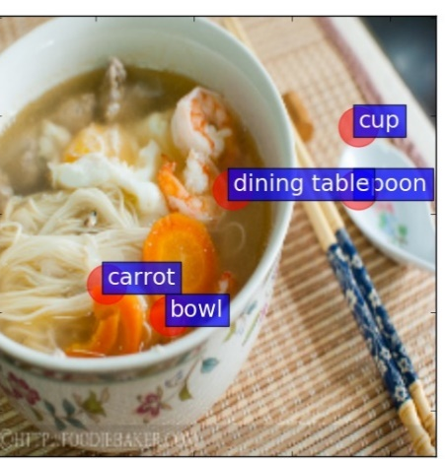
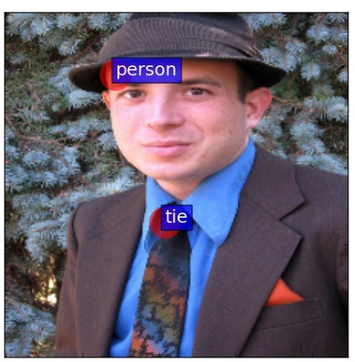
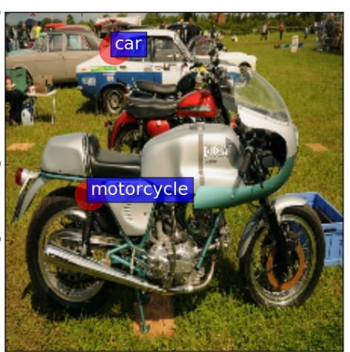
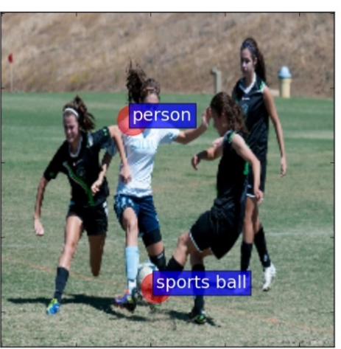
DeepMIML for image task
Predictions on test set and the attention mechanism achieved by sub-concept layer
Ji Feng and Zhi-hua Zhou
DeepMIML Network
http://lamda.nju.edu.cn

Slide 30
Experimental Results
Experimental Results on Yelp Dataset
 | mAP | Ranking loss | F1
Softmax | 0.313 | 0.083 | N/A
MLP(4800-1024-512) | 0.325 | 0.080 | N/A
DeepMIML | 0.330 | 0.078 | N/A
Experimental Results on COCO Dataset
 | mAP | Hamming loss | F1
VGG-16 | 57% | 0.025 | 0.650
CNN-RNN | 61.2% | N/A | 0.678
DeepMIML | 60.5% | 0.021 | 0.637
For a more sophisticated instance generator, DeepMIML can perform better on image dataset, there is still a margin for improvement.
Ji Feng and Zhi-hua Zhou
DeepMIML Network
http://lamda.nju.edu.cn

Slide 31
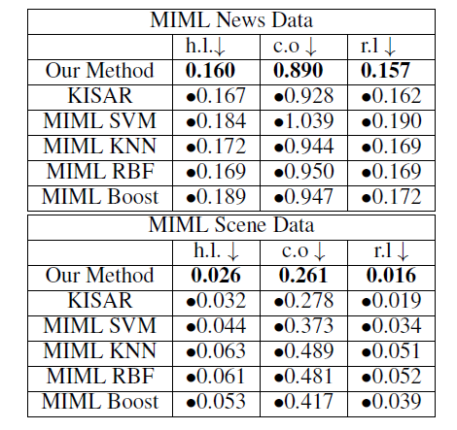
DeepMIML for non-deep instances
To validate the effectiveness of sub-concept layer, we directly use hand-coded features as input
Experiment Setup:
Directly project instances on 3D sub-concept layers
Comparison methods:
KISAR [Li et al, 2012]
MIML SVM, MIML KNN, MIML RBF, MIML Boost
[Zhou et al. 2012]
Experiment results:
Ji Feng and Zhi-hua Zhou
DeepMIML Network
http://lamda.nju.edu.cn

Slide 32
Conclusion
We propose the DeepMIML network
Learn instance representations automatically
Better performance
Portable sub-concept layer
Thanks!
Ji Feng and Zhi-hua Zhou
DeepMIML Network
http://lamda.nju.edu.cn

