Slide 1
Learning Unified Features from Natural and Programming Languages for Locating Buggy Source Code
Xuan Huo and Ming Li and Zhi-Hua Zhou

Slide 2
Introduction
Bug localization, which aims to alleviate the burden of software maintenance team by automatically locating potentially buggy files in source code bases for a given bug report, has drawn significant attention in software engineering community.
Notes:
bug reports, which are documents written in natural language specifying the situations in which the software fails to behave as it is expected or follow the technical requirements of the system

Slide 3
Introduction
Most methods: treat the source code as natural language by representing both bug reports and source files based on bag-of-words feature representations, and measure similarity in the same feature space.
Disadvantage: suffer from the loss of information when tailoring
programming language to natural language by ignoring
the program structure.
e.g.
“path = getNewPath(); File f = File.open(path);” and
“File f =File.open(path);
path = getNewPath();” may result in different program behaviors.

Slide 4
Introduction
This paper proposes a novel convolutional neural network called NP-CNN (Natural language and Programming language Convolutional Neural Network) to learn unified feature from bug report in natural language and source code in programming language, where the semantics in both lexicon and program structure are captured

Slide 5
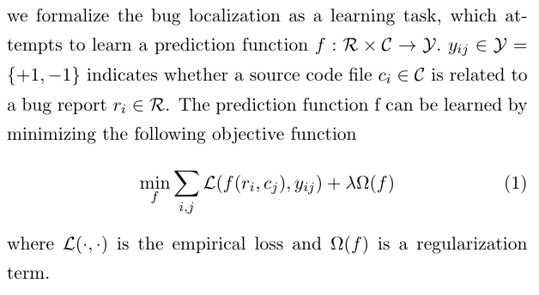
Convolutional Neural Networks for Natural and Programming Languages

Slide 6
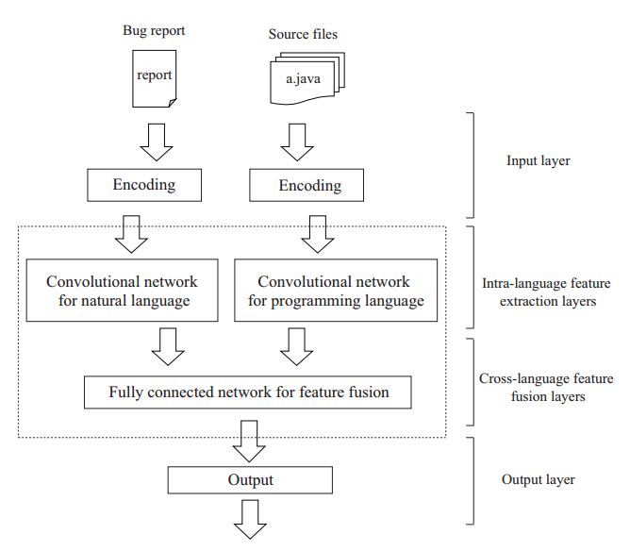
The general framework of NP-CNN

Slide 7
Convolutional networks programming language
Programming language differs from natural language in two aspects:
Semantics of the programming language can be inferred from the semantics on multiple statements plus the way how these statements interact with each other along the execution path.
Natural language organizes words in a “flat” way while programming language organizes its statements in a “structured” way to produce richer semantics.

Slide 8
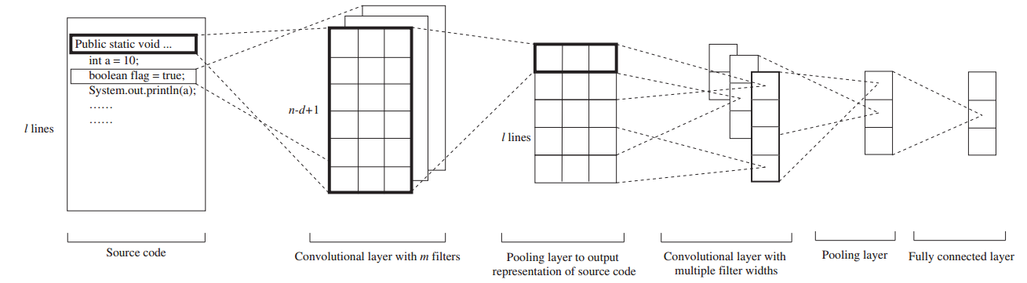
The structure of convolutional neural network for programming language

Slide 9
Convolutional networks programming language
The first convolutional and pooling layer aims to represent the semantics of a statement based on the tokens within the statement.
The subsequent convolution and pooling layers aim to model the semantics conveyed by the interactions between statements with respect to the program structure while preserving the integrity of statements.

Slide 10
Convolutional networks programming language
Vary the size of convolution windows.
Pad the window locating on the boundary of branches and loops to ensure the interactions between statements do not violate the execution path.
Notes:
For example, the first filter operates on the window of features with d = 2, which can be viewed that the information between two consecutive statements along the execution path is extracted and represented. The second filter on the window with d = 3 is viewed that the filter extracts features from three consecutive statements along the execution path, and so on.

Slide 11

Cross-language Feature Fusion Layers

Slide 12
Cross-language Feature Fusion Layers
Employ a fully connected neural network to fuse middle-level features extracted from bug reports and source files to generate a unified feature representation.
Problem: In most cases of bug localization, a reported bug may be only related to one or only a few source code files, while a large number of source code files are irrelevant to the given bug report. Such an imbalance nature increases the difficulty in learning a well-performing prediction function based on the unified feature.

Slide 13
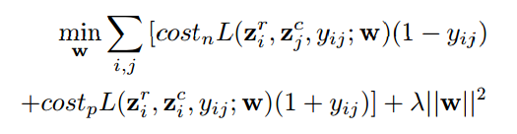
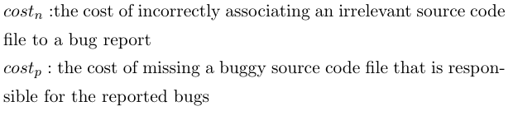
Cross-language Feature Fusion Layers
unequal misclassification cost according to the imbalance ratio

Slide 14
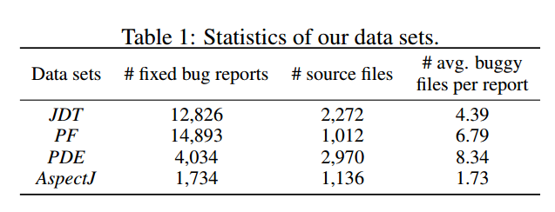
Experiments

Slide 15
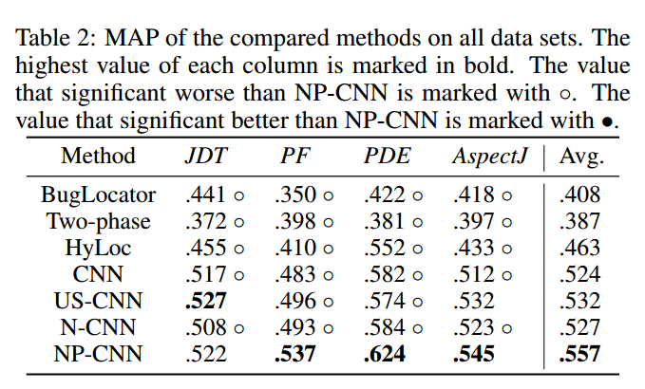
Experiments

Slide 16
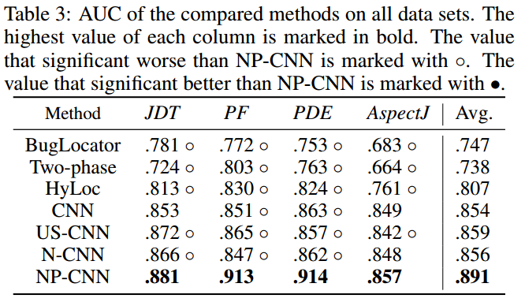
Experiments

Slide 17
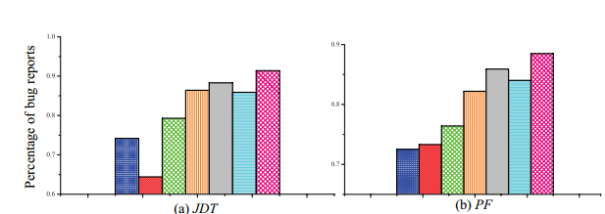
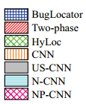
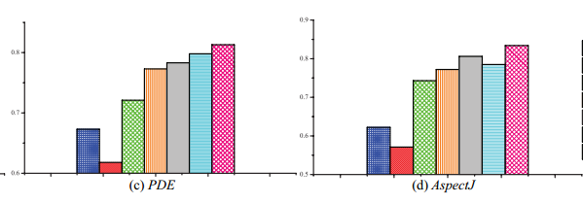
Experiments

Slide 18
Thank you!

