Slide 1
Searching Strategies and the Philosophy of Randomization
搜索策略与随机思想
殷兆恒
Open Topic 7

Slide 2
Firstly, we will look into the following searching approaches and then reach a generalized conclusion.
Random search
Deterministic search
Scramble search

Slide 3
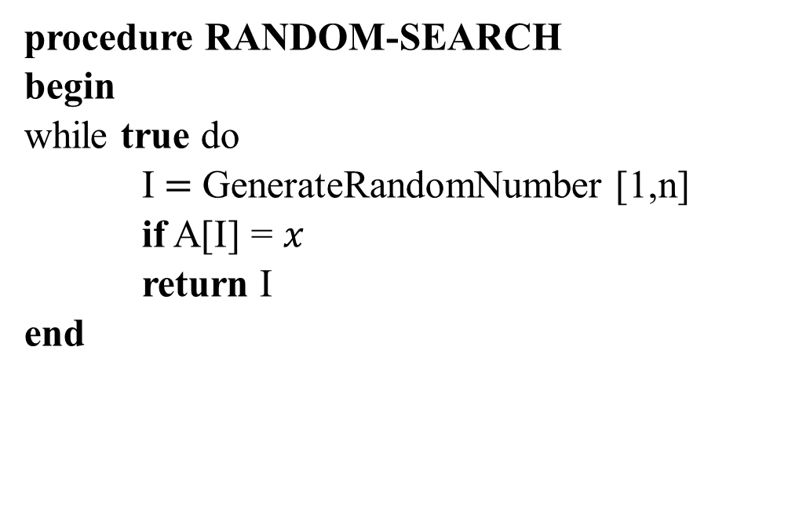
RANDOM-SEARCH
procedure RANDOM-SEARCH
begin
while true do
I$=$ GenerateRandomNumber [1,n]
if A[I] = $x$
return I
end

Slide 4
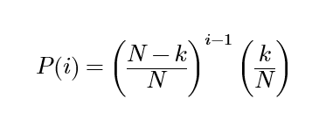
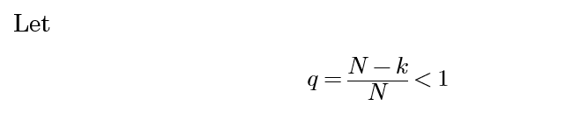
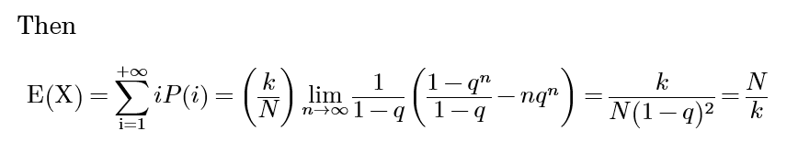
RANDOM-SEARCH
When the quantity of x is k.
The probability that we find it at ith attempt is

Slide 5

RANDOM-SEARCH
However, as we have seen, the algorithm has faint possibility that it will never end.
Worst time:

Slide 6
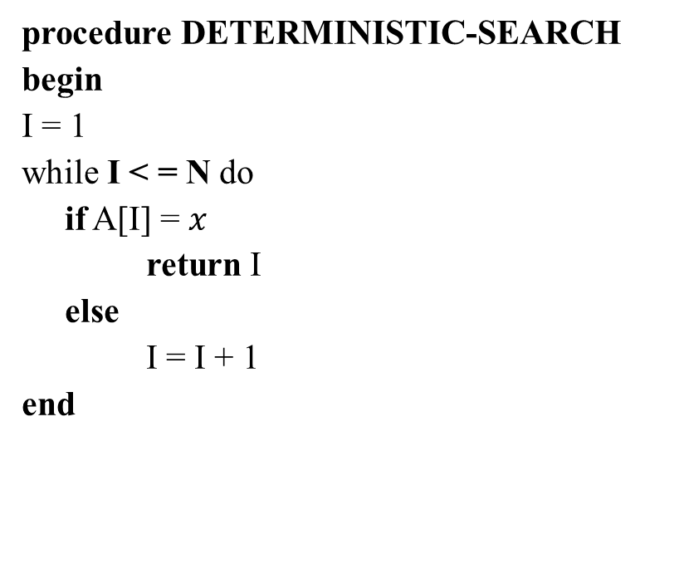
DETERMINISTIC-SEARCH
procedure DETERMINISTIC-SEARCH
begin
I = 1
while I < = N do
if A[I] = $x$
return I
else
I = I + 1
end

Slide 7
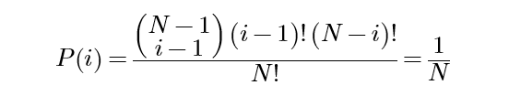


DETERMINISTIC-SEARCH
When the quantity of x is 1
The probability that we find it at ith attempt is
Then the expectation time is
The worst time, of course, is

Slide 8
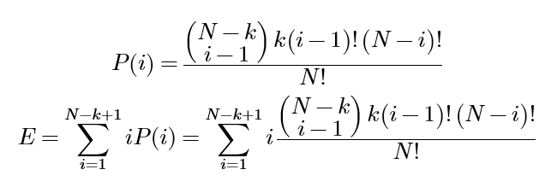
DETERMINISTIC-SEARCH
When the quantity of x is k.
The probability that we find it at ith attempt is

Slide 9
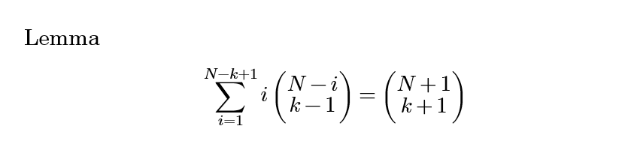

Slide 10
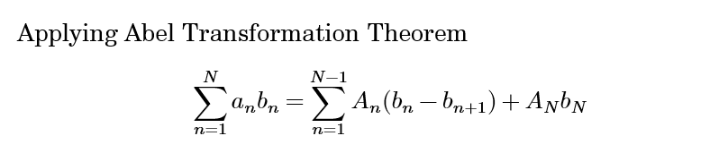
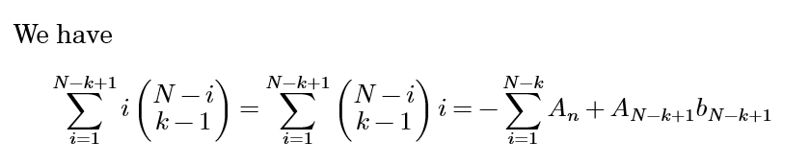

Slide 11
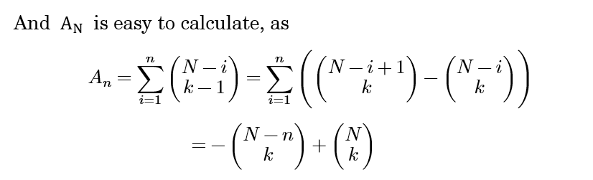
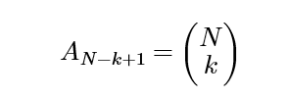

Slide 12
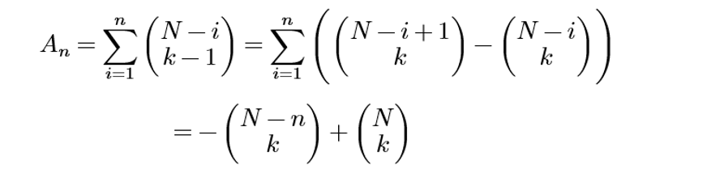
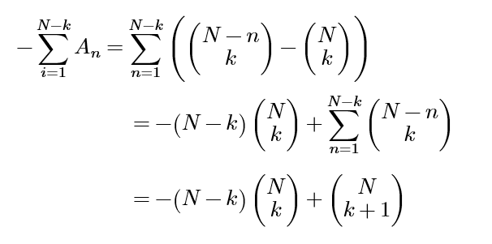

Slide 13
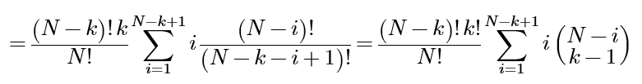


DETERMINISTIC-SEARCH
Now return to the problem, applying our lemma we have
The worst time is

Slide 14

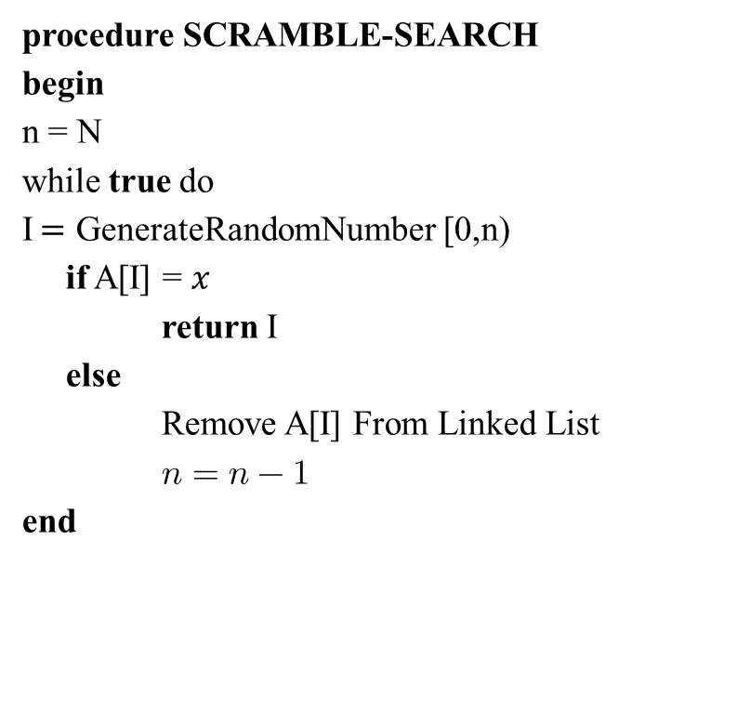
SCRAMBLE-SEARCH
procedure SCRAMBLE-SEARCH
begin
n = N
while true do
I$=$ GenerateRandomNumber [0,n)
if A[I] = $x$
return I
else
Remove A[I] From Linked List
$n=n−1$
end
begin
n = N
while true do
I$=$ GenerateRandomNumber [0,n)
if A[I] = $x$
return I
else
Remove A[I] From Array
$n=n−1$
end

Slide 15
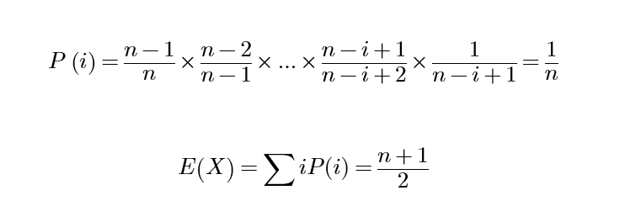
SCRAMBLE-SEARCH
The Expectation E(X)
When the quantity of x is 1.
The probability that we find it at ith attempt is

Slide 16


SCRAMBLE-SEARCH
The Expectation E(X)
When the quantity of x is k.
The probability that we find it at ith attempt is

Slide 17
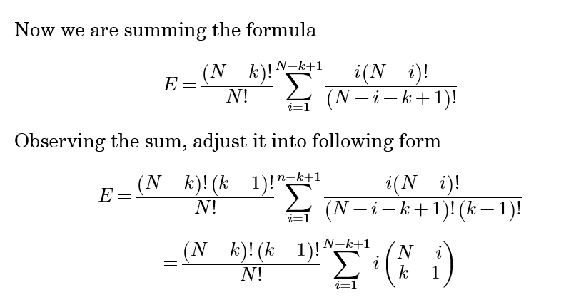
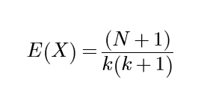
SCRAMBLE-SEARCH
The Expectation E(X)
The worst time

Slide 18
Comparison
Algorithm Average Time Worst Time
Random Search
Deterministic Search
Scramble Search

Slide 19
Philosophies The makings of a great algorithm
Low reliance on data ? Fast compression ?
Deterministic search:
It can compress the solution space, but isn’t immune from bad data!
Random search:
Totally immune from bad data! but wont compress the solution space.
Scramble search:
Totally immune from bad data! And will compress the solution space!

Slide 20
Philosophies The makings of a great algorithm
Extra…
Algorithms that could “reason” !
Binary search O(lgn) & Interpolation search O(lglgn)
B-Tree search O(lgn) & Hash Search (O(1))
We use randomization to fight with bad data when we have no knowledge (pre-defined data structure)

