Slide 1
TJ 3.22
By 陈永恒

Slide 2
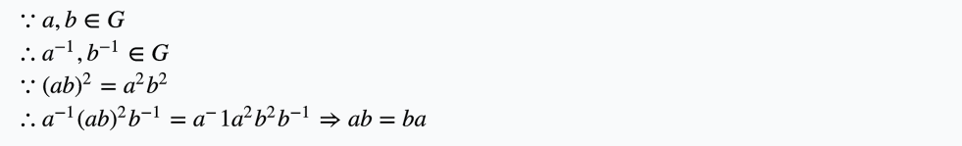

Slide 3
Thank you!
Hehe , just joking...

Slide 4
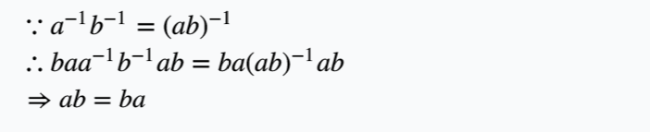
What about n of other values?
n=-1

Slide 5
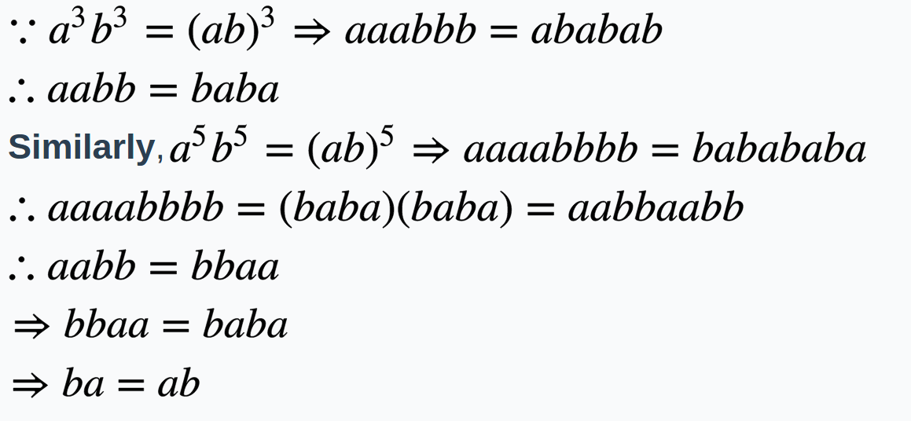
n=3
This doen't work. Consider the symmetries of an equilateral triangle.
But if we add a condition: n=5

Slide 6
n=3
Another insteresting case: 3 cannot divide the order of G.

Slide 8
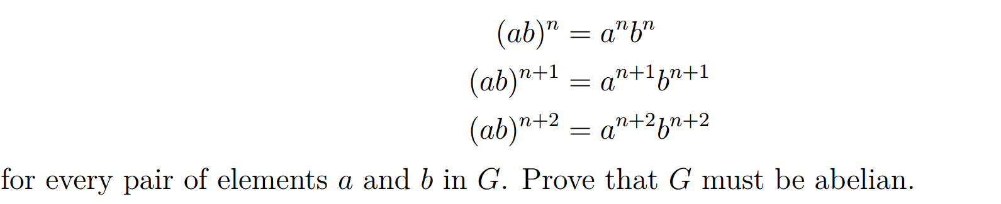
More general:

Slide 9
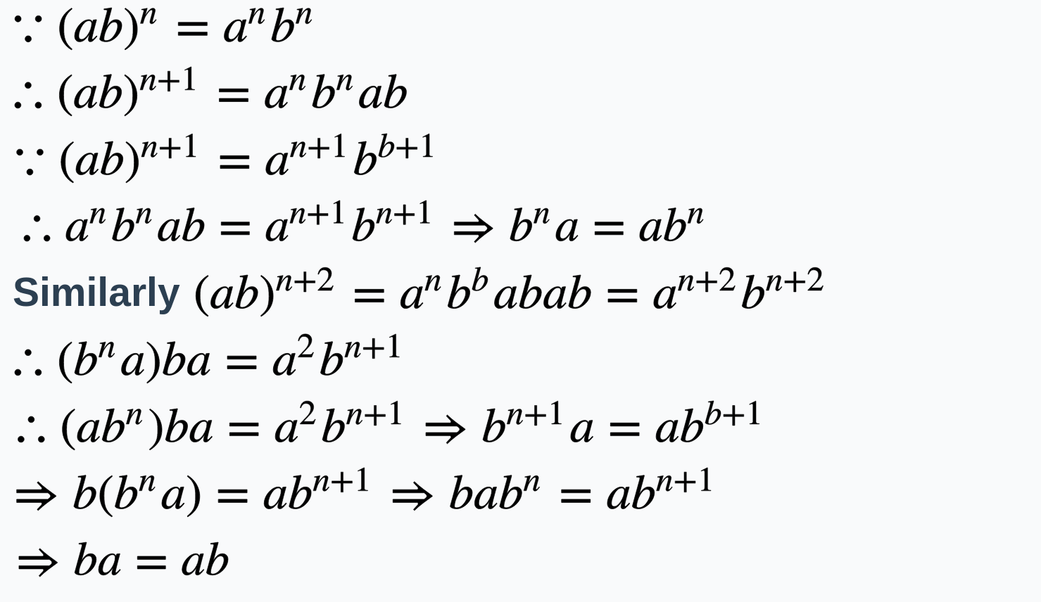

Slide 10
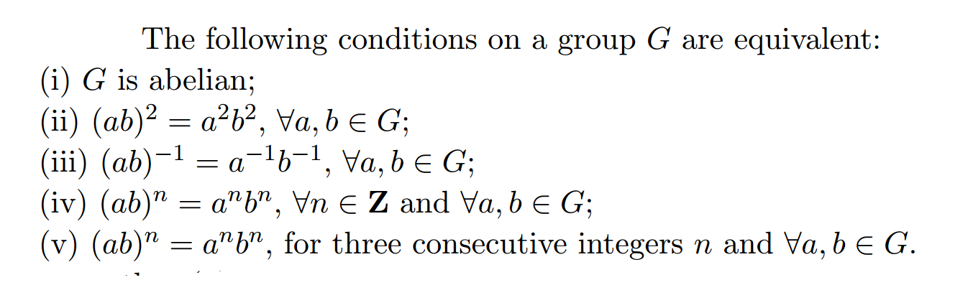
Actually

Slide 11
Thank you!

