Slide 1
Verifying Self-adaptive Applications Suffering Uncertainty
Wenhua Yang, Chang Xu , Yepang Liu ,
Chun Cao, Xiaoxing Ma, Jian Lu
presented by Hongyi Ling
27. May. 2017

Slide 2
Outline
Background
Interactive state machine
Verifying self-adaptive applications
Overview
Modeling environmental constraints
Dealing with uncertainty
Prioritizing counterexamples
Experiments
Conclusion

Slide 3
Background
Self-adaptive applications: applications continually sense their environments and make adaptation according to their predefined logics.

Slide 4
Background
Existing works verifying self –adaptive applications under real-world environments has two major limitations:
Lack of modeling environmental constraints
The constraints related each environmental sensing to its previous sensing and adaptations
Lack of modeling uncertainty (environmental sensing and flawed physical actions)
Notes:
The last distance should be equal to the summation of the new sensed distance and how far the car has walked since its last sensing.

Slide 5

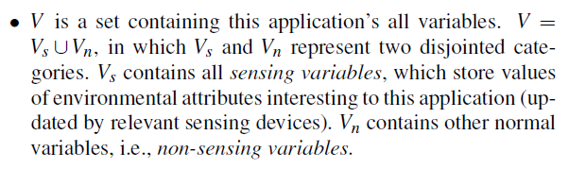
Interactive state machine

Slide 6
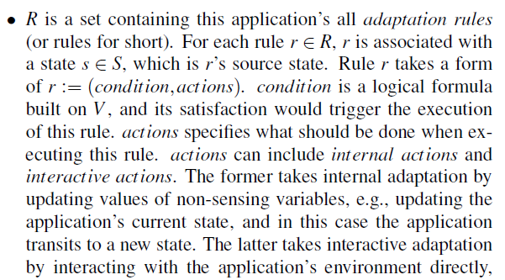
Interactive state machine

Slide 7
Interactive state machine
When a state s is set as M’s current state, rules having this state as source state are enabled, while other rules are disabled.
When an enabled rule r’s condition r.condition is satisfied, the rule is triggered for execution. If multiple rules are triggered, only one of them is selected to execute.

Slide 8


Interactive state machine
An ISM execution can be conceptually modeled by a path which is a sequence of states and rules:
path condition of execution :

Slide 9
Verifying self-adaptive applications
Overview
Modeling environmental constraints
Dealing with uncertainty
Prioritizing counterexamples

Slide 10
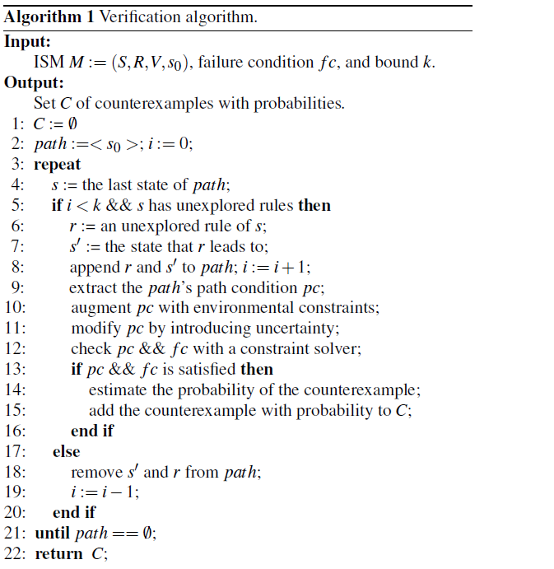
Overview of verification

Slide 11
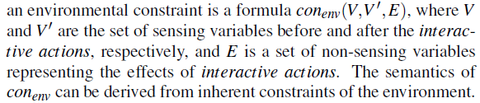
Modeling environmental constraints

Slide 12
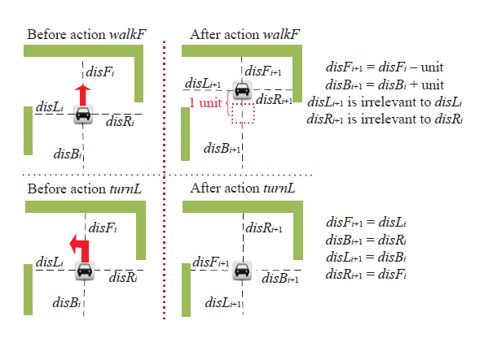
Modeling environmental constraints

Slide 13
Modeling environmental constraints
After concatenating the environmental constraints to the path condition, we get a new formula of constraints for the path , which is called the ideal condition.

Slide 14
Dealing with uncertainty
Given an ISM, to model uncertainty, we first need to identify the variables in an ideal condition that would be affected by uncertainty. Then for each of these variables, we give an error range and a distribution for its potential value, i.e., for a variable v affected by uncertainty, let [a , b] (a < b) be the error range of v. Then the lower bound and upper bound of variable v are v+a and v+b respectively. Meanwhile, we set a distribution p of the variable’s value between its lower and upper bounds.
In an ideal condition, for all its variables, there is no uncertainty
considered. Therefore, for each variable v, which is affected
by uncertainty in the ideal condition, since v does not include uncertainty, we use a new variable v′ to represent v with uncertainty.
v′ satisfies the constraint v+a < v′ < v+b, where [a,b] is the error
range of v. Then we replace v with v′ in the ideal condition, and join the constraint v+a < v′ < v+b with the ideal condition. This form a new condition named the actual condition.

Slide 15
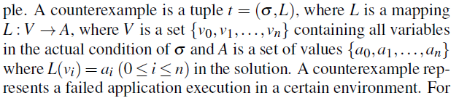
Prioritizing counterexamples

Slide 16
Prioritizing counterexamples
Estimate the probability of satisfaction of r.condition
Use an approximated solution by treating each variable independently

Slide 17
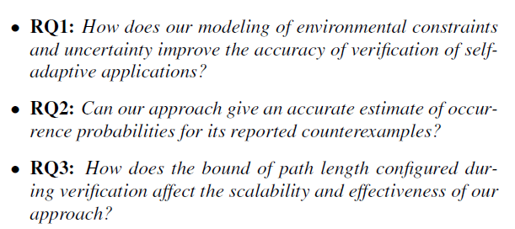
Experiments

Slide 18
Experiments for RQ1
conducted two experiments: environmental constraints and uncertainty
The first experiment applied both our approach and the naive approach to the 12 robot-car applications, and checked the reported counterexamples to see how many of them are false counterexamples.
The second experiment applied both our approach and the ideal approach to the 12 robot-car applications, and recorded their reported counterexamples

Slide 19
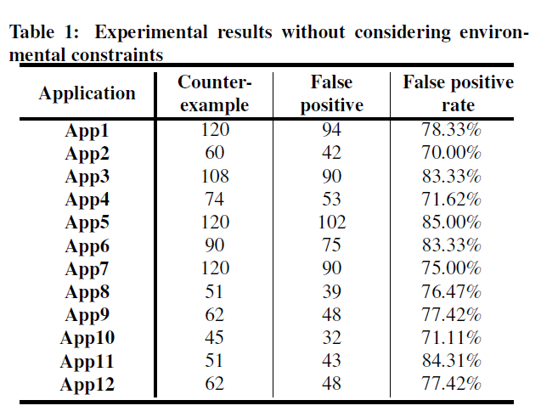
Experiments for RQ1

Slide 20
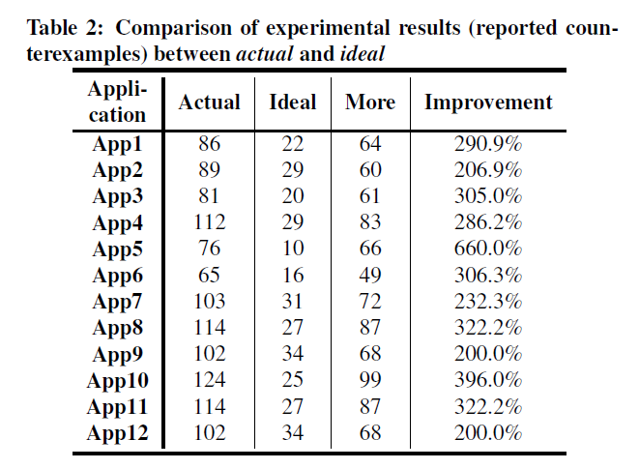
Experiments for RQ1

Slide 21

we let the concerned application to run in the environment constructed from this counter-example in field study for 100 times, and also in simulation for 1,000 times

Slide 22
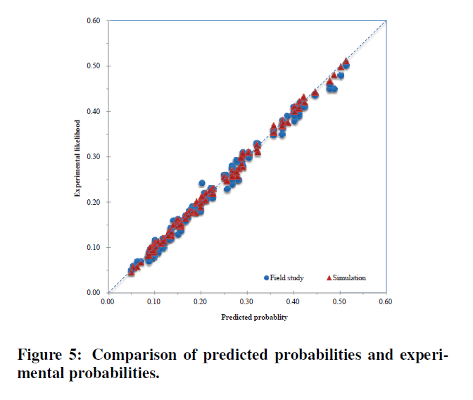

Slide 23
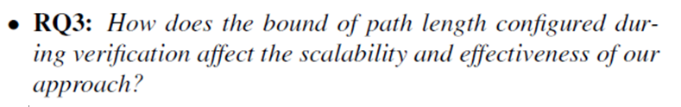
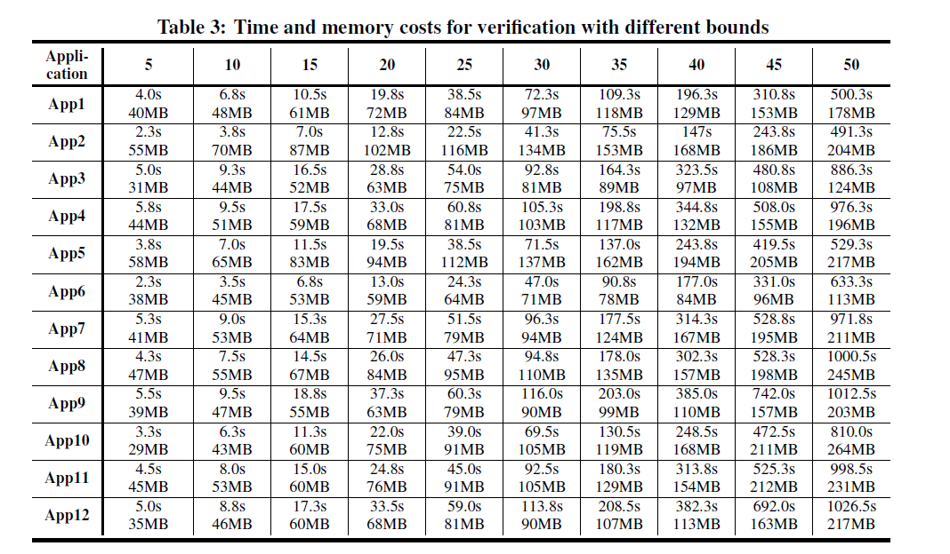

Slide 24
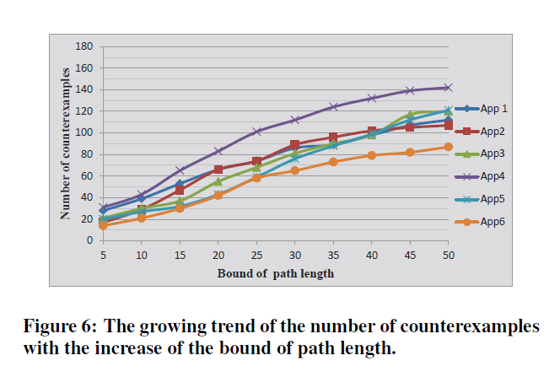

Slide 25
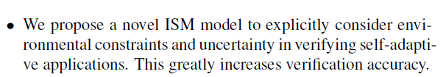
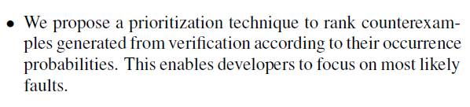
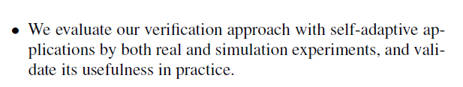
Conclusion

Slide 26
Thanks !

