Slide 1
Presentation
151220111 王睿

Slide 2
Taking up the Gaokao Challenge : An Information Retrieval Approach
Gong Cheng, Weixi Zhu, Ziwei Wang, Jianghui Cheng, Yuzhong Qu

Slide 3
Introduction
Approach
Retrieving pages
Ranking and filtering pages
Assessing options
Experiment

Slide 4
Introduction
A recently very hot AI challenge is to have the computer pass entrance examinations at different levels of education.
Answering questions in a university’s entrance examination like Gaokao in China challenges AI technology.
As a preliminary attempt to take up the Gaokao challenge, we aim to develop an approach to automatically answering multiple-choice questions in Gaokao.
A related work of Project 863

Slide 5
Introduction
Taking Wikipedia as the source of knowledge
Proposing a three-stage approach
Testing the approach on a set of real-life questions collected from recent history tests.
Using strategies to assess options

Slide 6
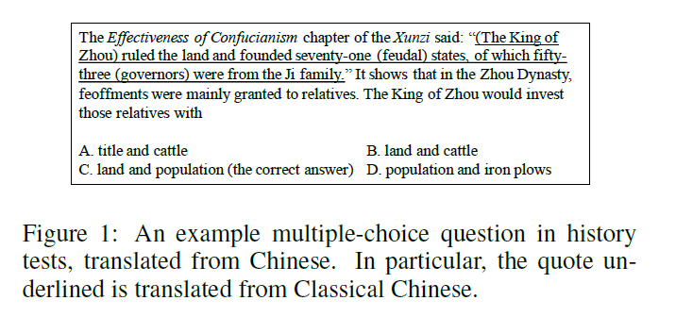
Introduction
To develop an approach to automatically answering multiple-choice questions in Gaokao.
Complex stem
background
domain-specific expression

Slide 7
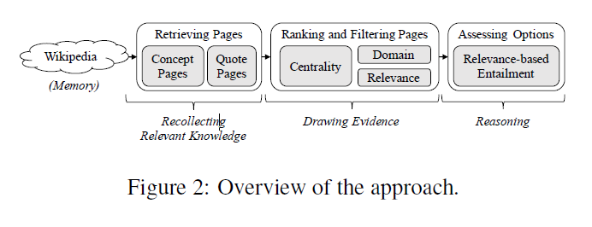
Approach
A three-stage framework
Recollecting relevant knowledge
Filtering out non-essential knowledge
Checking each option by some reasoning
Notes:
In our implementation of the framework, as shown in Fig. 2, (Chinese) Wikipedia is taken as the memory since it covers a wide range of knowledge and is freely accessible.
Relevant knowledge is recollected by retrieving a set of pages from Wikipedia that match the question in two specific ways and thus may provide useful knowledge for answering the question. The subset of pages that are truly useful are regarded as evidence, which is drawn by ranking the retrieved pages according to multiple strategies for evaluating their usefulness, and filtering out bottom-ranked ones. The contents of the remaining pages will entail each option to some extent, based on which its truth is assessed.

Slide 8
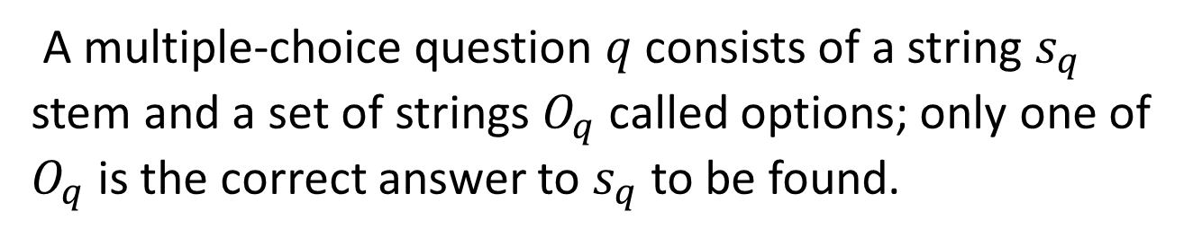
Formal Description
A multiple-choice question $q$ consists of a string $s_{q}$ stem and a set of strings $O_{q}$ called options; only one of $O_{q}$ is the correct answer to $s_{q}$ to be found.

Slide 9
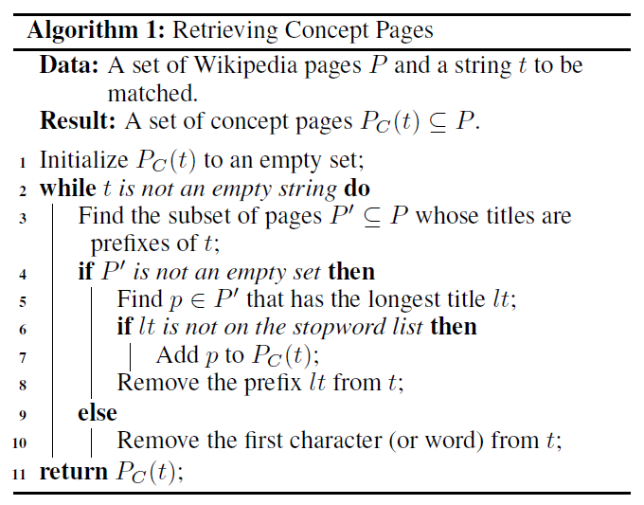
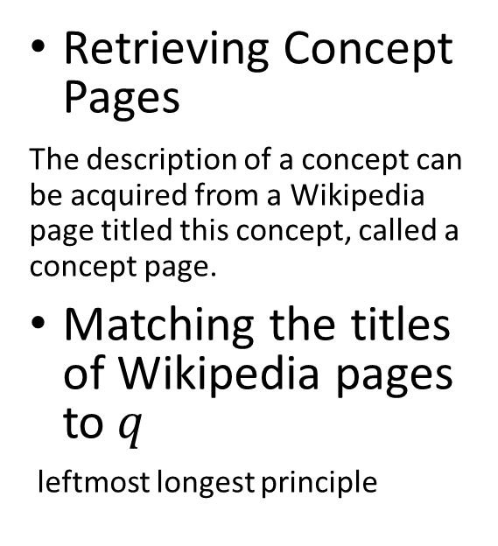
Retrieving Pages
Retrieving Concept Pages
The description of a concept can be acquired from a Wikipedia page titled this concept, called a concept page.
Matching the titles of Wikipedia pages to$q$
leftmost longest principle
Notes:
Some concepts mentioned in q can give clues about q; their descriptions may provide useful knowledge for answering q. The description of a concept can be acquired from a Wikipedia page titled this concept, called a concept page.

Slide 10
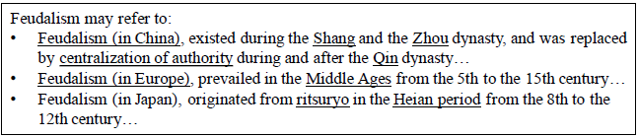
Retrieving Pages
A retrieved concept page may belong to two categories of special pages in Wikipedia: disambiguation page and redirect page. Such a page needs to be replaced by another page as follows, to acquire the description of the desired concept.
Notes:
A concept name can be ambiguous. A retrieved concept page titled such an ambiguous concept name is usually a disambiguation page.
It contains not the detailed description of any concept but links to other pages that describe concepts having the same name.
Each link is accompanied by a short description of the corresponding concept for disambiguation purposes.
A retrieved concept page can be a redirect page. Such a page simply forwards the reader to another page without providing any other information. Therefore, to acquire the description of the desired concept, a retrieved redirect page will be replaced by the page it is redirected to.

Slide 11
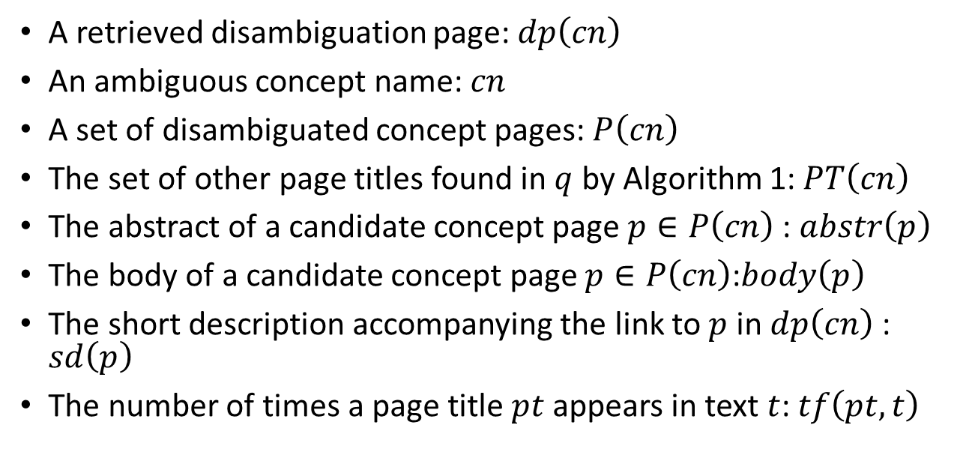
Retrieving Pages
A retrieved disambiguation page: $dp\left(cn\right)$
An ambiguous concept name: $cn$
A set of disambiguated concept pages: $P\left(cn\right)$
The set of other page titles found in $q$ by Algorithm 1:$PT\left(cn\right)$
The abstract of a candidate concept page $p∈P\left(cn\right)$: $abstr\left(p\right)$
The body of a candidate concept page $p∈P\left(cn\right)$:$body\left(p\right)$
The short description accompanying the link to $p$ in $dp\left(cn\right)$: $sd\left(p\right)$
The number of times a page title $pt$ appears in text $t$: $tf\left(pt, t\right)$

Slide 12
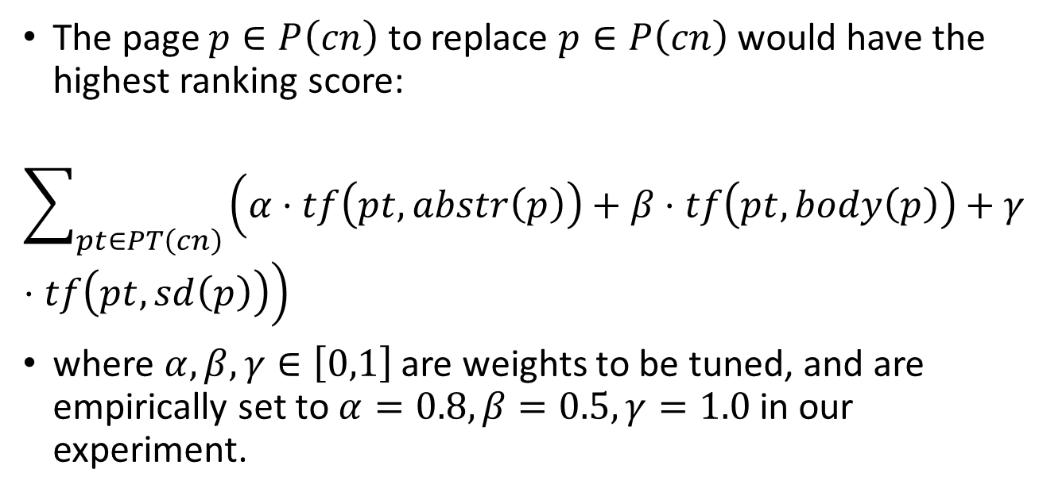
Retrieving Pages
The page $p∈P\left(cn\right)$ to replace $p∈P\left(cn\right)$ would have the highest ranking score:
$$\sum_{pt∈PT\left(cn\right)}{\left(α⋅tf\left(pt,abstr\left(p\right)\right)+β⋅tf\left(pt,body\left(p\right)\right)+γ⋅tf\left(pt,sd\left(p\right)\right)\right)}$$
where $α,β,γ∈\left[0,1\right]$ are weights to be tuned, and are empirically set to $α=0.8,β=0.5,γ=1.0$ in our experiment.

Slide 13
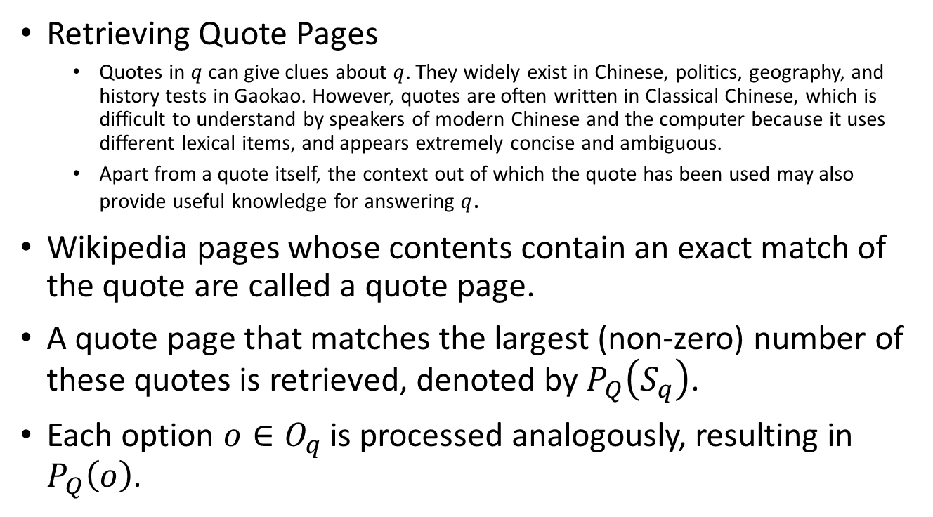
Retrieving Pages
Retrieving Quote Pages
Quotes in $q$ can give clues about $q$. They widely exist in Chinese, politics, geography, and history tests in Gaokao. However, quotes are often written in Classical Chinese, which is difficult to understand by speakers of modern Chinese and the computer because it uses different lexical items, and appears extremely concise and ambiguous.
Apart from a quote itself, the context out of which the quote has been used may also provide useful knowledge for answering $q$.
Wikipedia pages whose contents contain an exact match of the quote are called a quote page.
A quote page that matches the largest (non-zero) number of these quotes is retrieved, denoted by $P_{Q}\left(S_{q}\right)$.
Each option $o∈O_{q}$ is processed analogously, resulting in $P_{Q}\left(o\right)$.

Slide 14
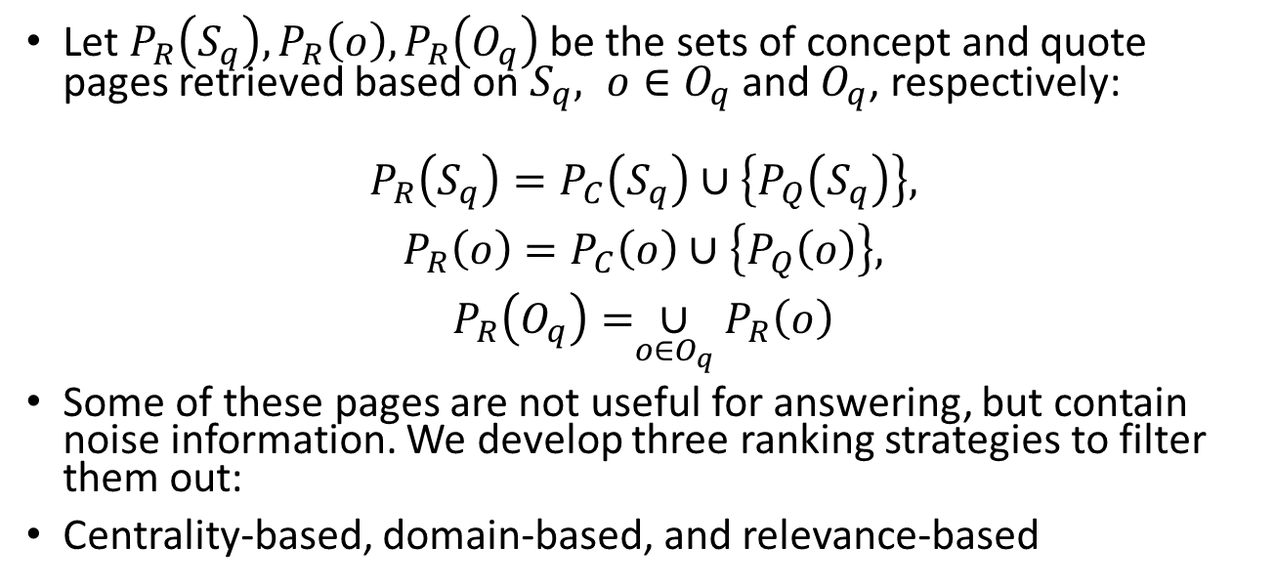
Ranking and Filtering Pages
Let $P_{R}\left(S_{q}\right),P_{R}\left(o\right),P_{R}\left(O_{q}\right)$ be the sets of concept and quote pages retrieved based on $S_{q}, o{∈O}_{q}$ and $O_{q}$, respectively:
$$\begin{matrix}P_{R}\left(S_{q}\right)=P_{C}\left(S_{q}\right)∪\left\{P_{Q}\left(S_{q}\right)\right\}, \\ P_{R}\left(o\right)=P_{C}\left(o\right)∪\left\{P_{Q}\left(o\right)\right\}, \\ P_{R}\left(O_{q}\right)=\underset{o∈O_{q}}{∪}P_{R}\left(o\right)\end{matrix}$$
Some of these pages are not useful for answering, but contain noise information. We develop three ranking strategies to filter them out:
Centrality-based, domain-based, and relevance-based

Slide 15
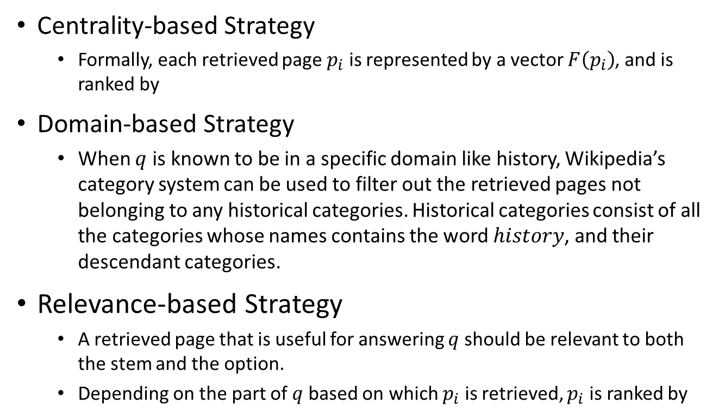
Ranking and Filtering Pages
Centrality-based Strategy
Formally, each retrieved page $p_{i}$ is represented by a vector $F\left(p_{i}\right)$, and is ranked by
Domain-based Strategy
When $q$ is known to be in a specific domain like history, Wikipedia’s category system can be used to filter out the retrieved pages not belonging to any historical categories. Historical categories consist of all the categories whose names contains the word $history$, and their descendant categories.
Relevance-based Strategy
A retrieved page that is useful for answering $q$ should be relevant to both the stem and the option.
Depending on the part of $q$ based on which $p_{i}$ is retrieved, $p_{i}$ is ranked by

Slide 16

Assessing Options
Let $P_{F}\left(S_{q}\right)⊆P_{R}\left(S_{q}\right)$ and $P_{F}\left(o\right)⊆P_{R}\left(o\right)$ be the subsets of pages that remain after filtering by using a combination of the aforementioned strategies.
We decompose the entailment into two parts:
The extent to which a combination of $S_{q}$ and $o$ can be entailed from $S_{q}$ and $P_{F}\left(S_{q}\right)$, and
The extent to which a combination of $S_{q}$ and $o$ can be entailed from $o$ and $P_{F}\left(o\right)$.

Slide 17
Experiments
Dataset
We evaluated our approach based on real-life questions appearing in recent history tests in Beijing. Specifically, 577 multiple-choice questions were collected.
Three human experts were invited to collectively answer those questions only based on the contents of Chinese Wikipedia pages.
As a result,
123 questions (21.32%), denoted by QS-A, could be successfully answered;
454 questions (78.68%), denoted by QS-B, went beyond the scope of Wikipedia, can could not be correctly answered without referring to the contents of history textbooks or other resources.
Metrics
Let G be the set of gold-standard pages used by the experts
Let A be the set of pages found by an automatic approach.
We measure the precision (P), recall (R), and F-score (F) of A:

Slide 18
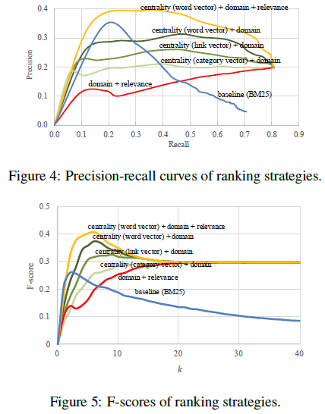
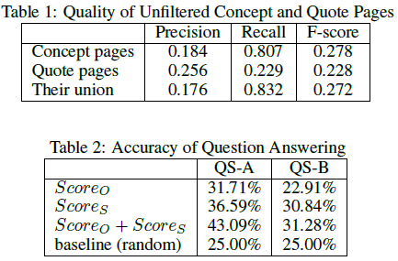

Slide 19
Thanks
Q & A

