Slide 1

更多精品PPT模板下载：https://shop162430736.taobao.com
1
Definition
Partition
2
Implementation
3
Analysis
Refinement

Slide 2
更多精品PPT模板下载：https://shop162430736.taobao.com
Definition
S∩X
……………
S\X
One big set S

Slide 3
更多精品PPT模板下载：https://shop162430736.taobao.com
Implementation 1
doubly linked list and doubly linked list

Slide 4
更多精品PPT模板下载：https://shop162430736.taobao.com
Implementation 1
doubly linked list and doubly linked list
Objects
…………………

Slide 5
更多精品PPT模板下载：https://shop162430736.taobao.com
Implementation 1
doubly linked list and doubly linked list
Objects
…………………
Elements
…………………

Slide 6
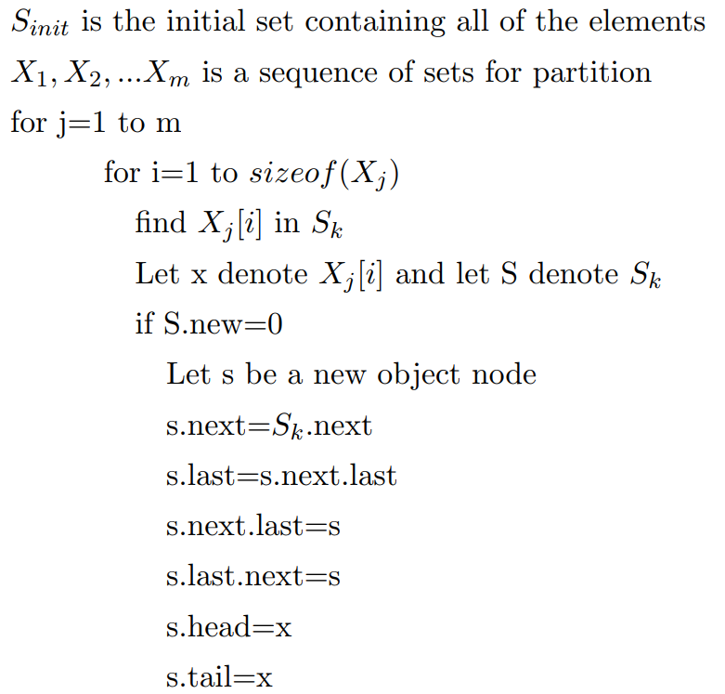
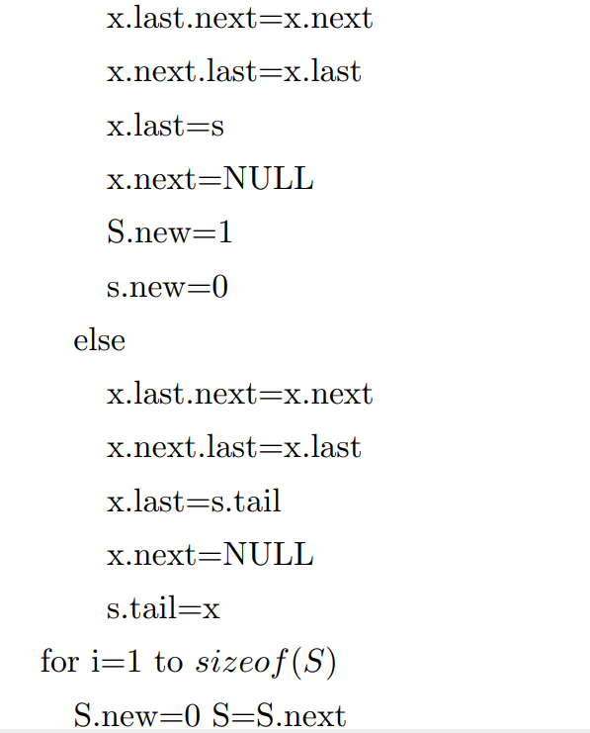
更多精品PPT模板下载：https://shop162430736.taobao.com
Implementation 1
Pseudocode implementation

Slide 7
更多精品PPT模板下载：https://shop162430736.taobao.com
Implementation 2
doubly linked list and array

Slide 8
更多精品PPT模板下载：https://shop162430736.taobao.com
Implementation 2
doubly linked list and array
Objects
…………………

Slide 9
更多精品PPT模板下载：https://shop162430736.taobao.com
Implementation 2
doubly linked list and array
Objects
…………………
Elements
…………………

Slide 10
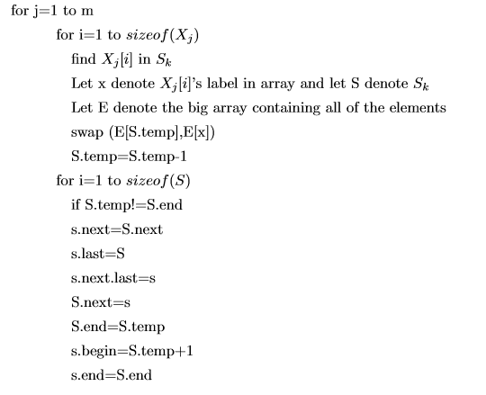
更多精品PPT模板下载：https://shop162430736.taobao.com
Implementation 2
Pseudocode implementation

Slide 11
更多精品PPT模板下载：https://shop162430736.taobao.com
Analysis
There is only one loop for each X in both of the algorithm and only a constant time consumption in each step of the loop. So, it only takes O(|N|) time to finish refinement for each X.
Using a array to store all of the elements is a bit better than using a doubly linked list in terms of constants since it avoid to maintaining the relation between nodes.

