Slide 1
Variables & Basic Types
Lecture 2

Slide 2
Variables 变量 / objects 对象
int a = 1;
double x = 1.213;
Robot walle;
A variable provides us with named storage that our program can manipulate.
Each variable in C++ has a type. (Why?)
An object is a region of memory that has a type.

Slide 3
Variable definition & initialization
int a = 1;
double x = 1.213;
Robot walle;
Variable definition = Type specifier + Variable name + Semicolon
A definition may (optionally) provide an initial value for the name it defines.
(Initialization)

Slide 4
Primitive built-in types
TYPE
unsigned int
int
short
long
float
double
char
bool
#BYTES
4
4
2
8
4
8
1
1
sizeof(…)
Tested on macOS High Sierra ver. 10.13.6 with 3.1 GHz Intel Core i7 [Sept 27, 2018]

Slide 5
Data representation: unsigned int
unsigned int some_unsigned_int = 79;
0 0 0 0 0 0 0 0 0 0 0 0 0 0 0 0 0 0 0 0 0 0 0 0 0 1 0 0 1 1 1 1
$$1×2^{6}+0×2^{5}+0×2^{4}+1×2^{3}+1×2^{2}+1×2^{1}+1×2^{0}=79$$
Range: 0 (0000_{hex}) ~ 4,294,967,295 (FFFF_{hex})

Slide 6
Data representation: int
int some_int = -79;
True code 原码
1 0 0 0 0 0 0 0 0 0 0 0 0 0 0 0 0 0 0 0 0 0 0 0 0 1 0 0 1 1 1 1
除符号外按位取反，取反结果再加1
Two’s complement 补码(绝大多数计算机所采用的表示负整数的方法)
1 1 1 1 1 1 1 1 1 1 1 1 1 1 1 1 1 1 1 1 1 1 1 1 1 0 1 1 0 0 0 1

Slide 7
Data representation: int
#include <iostream>
#include <limits>
using namespace std;
int main( ) {
int some_int = -79;
cout << static_cast<unsigned int>(some_int) << endl;
cout << numeric_limits<unsigned_int>::max( ) – 79 + 1 << endl;
return 0;
}
4294967217
4294967217
Tested on macOS High Sierra ver. 10.13.6 with 3.1 GHz Intel Core i7 [Sept 27, 2018]

Slide 8
Data representation: int
#include <iostream>
#include <limits>
using namespace std;
int main( ) {
cout << numeric_limits<int>::min( ) << endl;
cout << numeric_limits<int>::max( ) << endl;
return 0;
}
-2147483648
2147483647
Tested on macOS High Sierra ver. 10.13.6 with 3.1 GHz Intel Core i7 [Sept 27, 2018]

Slide 9
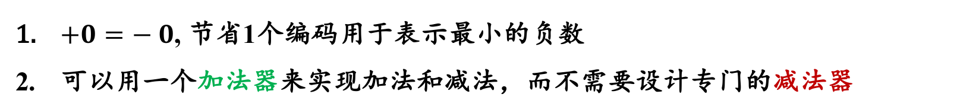
Data representation: int
-2147483648
2147483647
Why two’s complement?
$+0=− 0$, 节省1个编码用于表示最小的负数
可以用一个加法器来实现加法和减法，而不需要设计专门的减法器
[Exercise]
尝试写出10和-10的原码，采用二进制加法进行计算。你得到了什么？如果-10采用补码呢？

Slide 10
Integer overflow
整型溢出
The computation attempts to create an integer that is NOT representable.
[Exercise] Compute the Fermat numbers $F_{n}=2^{2^{n}}+1$.

Slide 11
Integer overflow
// A naïve function for computing x^n.
int pwr(int x, int n) {
int ans = 1;
for (int i = 0; i != n; ++i) ans *= x;
return ans;
}
F(0) = 3
F(1) = 5
F(2) = 17
F(3) = 257
F(4) = 65537
F(5) = 1
F(6) = 1
F(7) = 1
F(8) = 1
???
int main( ) {
// Print F(n) = pwr(2, pwr(2, n)) + 1
return 0;
}
Tested on macOS High Sierra ver. 10.13.6 with 3.1 GHz Intel Core i7 [Sept 27, 2018]

Slide 12
Integer overflow
correct values
F(0) = 3
F(1) = 5
F(2) = 17
F(3) = 257
F(4) = 65537
F(5) = 1
F(6) = 1
F(7) = 1
F(8) = 1
n | F(n)
0 | 3
1 | 5
2 | 17
3 | 257
4 | 65,537
5 | 4,294,967,297
6 | 18,446,744,073,709,551,617
7 | 340,282,366,920,938,463,463,374,607,431,768,211,457
8 | 115,792,089,237,316,195,423,570,985,008,687,907,853,269,984,665,640,564,039,457,584,007,913,129,639,937

Slide 13
Representation of real numbers
299792.458
Fixed-point representation
31
30
8
7
0
299792
458
.
Sign
Integer part
Fraction part
Is there any problem with the fixed-point representation?

Slide 14
Representation of real numbers
299792.458
Fixed-point representation
31
30
8
7
0
.
$$max positive=2^{23}−2^{−8}=8388608.99609375$$
$$min positive=2^{−8}=0.00390625$$
Usually insufficient!

Slide 15
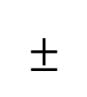
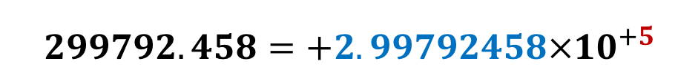
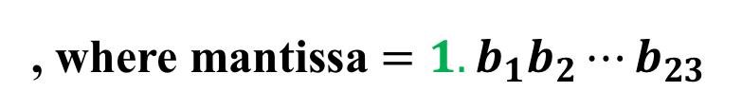


Data representation: float
299792.458
IEEE 754-2008 floating point standard
$$299792.458=+2.99792458×10^{+5}$$
指数
$$±$$
exponent
$$±$$
mantissa
$$×$$
2
, where mantissa $=1.b_{1}b_{2}⋯b_{23}$
尾数

Slide 16

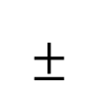
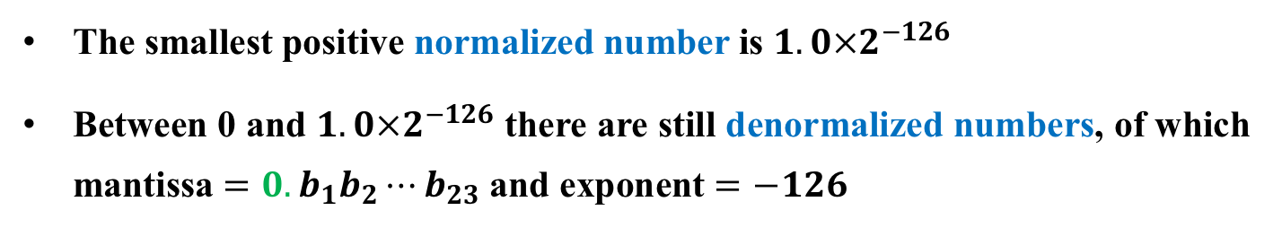

Data representation: float
指数
$$±$$
1 bit
8 bits
23 bits
exponent
$$±$$
mantissa
$$×$$
2
Exponent
Mantissa
Sign
尾数
The smallest positive normalized number is $1.0×2^{−126}$
Between 0 and $1.0×2^{−126}$ there are still denormalized numbers, of which mantissa $=0.b_{1}b_{2}⋯b_{23}$ and exponent $=−126$

Slide 17
Float / double overflow
F(0) = 3
F(1) = 5
F(2) = 17
F(3) = 257
F(4) = 65537
F(5) = 4.29497e+09
F(6) = 1.84467e+19
F(7) = 3.40282e+38
F(8) = 1.15792e+77
F(9) = 1.34078e+154
F(10) = inf
F(11) = inf
F(12) = inf
F(13) = inf
F(14) = inf
// A naïve function for computing x^n.
double pwr(double x, int n) {
double ans = 1.0;
for (int i = 0; i != n; ++i) ans *= x;
return ans;
}
int main( ) {
// Print F(n) = pwr(2, pwr(2, n)) + 1
return 0;
}
Tested on macOS High Sierra ver. 10.13.6 with 3.1 GHz Intel Core i7 [Sept 28, 2018]

Slide 18
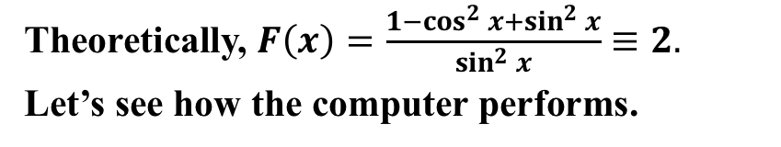
Round-off error
舍入误差
The representation of real numbers is inevitably inaccurate.
For example, 0.3333333 is not exactly 1/3.
[Exercise] Compute $F\left(x\right)=\frac{1−\cos{2x}}{\sin^{2}{x}}$. Print $F\left(x\right)$ for $x=\frac{π}{2^{n}}$, $n=1,2,⋯,20$
Theoretically, $F\left(x\right)=\frac{1−cos^{2}{x+\sin^{2}{x}}}{\sin^{2}{x}}≡2.$
Let’s see how the computer performs.

Slide 19
Round-off error
1: 2.0000000000000000
2: 2.0000000000000004
3: 1.9999999999999996
4: 2.0000000000000009
5: 2.0000000000000018
6: 1.9999999999999825
7: 1.9999999999999796
8: 1.9999999999998019
9: 2.0000000000010076
10: 2.0000000000035665
11: 1.9999999999916420
12: 2.0000000000521507
13: 1.9999999999492382
14: 1.9999999988855148
15: 1.9999999955999768
16: 1.9999999910040844
17: 1.9999999415414054
18: 2.0000003277638050
19: 1.9999987816534250
20: 2.0000049657897474
#include <iostream>
#include <iomanip> // for output formatting
#include <cmath> // defines M_PI, cos & sin
using namespace std;
int main( ) {
cout.setf(ios::fixed);
cout.precision(16);
double x = M_PI / 2.0;
for (int i = 1; i != 21; ++i, x /= 2.0) {
cout << setw(2) << i << ": "
<< (1 - cos(2*x)) / (sin(x) * sin(x)) << endl;
}
return 0;
}
Tested on macOS High Sierra ver. 10.13.6 with 3.1 GHz Intel Core i7 [Sept 28, 2018]

Slide 20
Comparing two floats
float a = 0.0, b = 0.0; // variable definition
// TODO do some calculation on variables a and b
if ( a == b ) { // this will NOT work as expected due to round-off errors
// TODO do something
}
else {
// TODO do something else
}

Slide 21
Comparing two floats
1: 2.0000000000000000 (1)
2: 2.0000000000000004 (0)
3: 1.9999999999999996 (0)
4: 2.0000000000000009 (0)
5: 2.0000000000000018 (0)
6: 1.9999999999999825 (0)
7: 1.9999999999999796 (0)
8: 1.9999999999998019 (0)
9: 2.0000000000010076 (0)
10: 2.0000000000035665 (0)
11: 1.9999999999916420 (0)
12: 2.0000000000521507 (0)
13: 1.9999999999492382 (0)
14: 1.9999999988855148 (0)
15: 1.9999999955999768 (0)
16: 1.9999999910040844 (0)
17: 1.9999999415414054 (0)
18: 2.0000003277638050 (0)
19: 1.9999987816534250 (0)
20: 2.0000049657897474 (0)
double x = M_PI / 2.0, fx = 0.0, true_fx = 2.0;
for (int i = 1; i != 21; ++i, x /= 2.0) {
fx = (1 - cos(2*x)) / (sin(x) * sin(x));
cout << setw(2) << i << ": "
<< fx << " (" << (fx == true_fx) << ")\n";
}
Tested on macOS High Sierra ver. 10.13.6 with 3.1 GHz Intel Core i7 [Sept 28, 2018]

Slide 22
Data representation: char
ASCII: American Standard Code for Information Interchange
Unicode
char c1 = 97;
char c2 = ‘a’;
cout << c1 << endl;
cout << c2 << endl;
a
a
Tested on macOS High Sierra ver. 10.13.6 with 3.1 GHz Intel Core i7 [Sept 28, 2018]

Slide 23
Type & type-checking
C++ was arguably considered a strongly typed language.
C++ is more strongly typed comparing to C.
C++ is a weakly typed language.
… due to the existence of (implicit) type-casting.
C++ is a statically typed language.
It does type-checking at compile-time instead of run-time.

Slide 24
Type casting
1 bit
31 bit
int x = 2;
double y = 3.1415926;
cout << x + y << endl;
Sign
1 bit
11 bits
52 bits
Very intuitive, but how is it done?
Sign
Exponent
Mantissa
Implicitly cast the integer 2 to float 2.0.

Slide 25
Explicit type casting
int x = 2;
double y = static_cast<double>(x); // recommended.
double z = (double)x;
double w = double(x);

Slide 26
Integer division vs float division
2 / 3
8.2 / 4.1
(double)7 / 2
double(7 / 2)
double a = 1 / 2;
int n = 11 / 3.0;
0, integer division
5 / 2
3.0 / 2
2, integer division
2.0
1.5 2 → 2.0, implicit
3.5 (1) 7 → 7.0, explicit; (2) 2 → 2.0, implicit
3.0 (1) 7 → 7.0, explicit; (2) 2 → 2.0, implicit
0.0 (1) integer division; (2) 0 → 0.0, implicit
3 (1) double division; (2) 3.xxxx → 3, implicit
Warning: converting to ‘int’ from ‘double’

Slide 27
All warnings should be treated as errors.

Slide 28
Variable definition revisited
Variable definition = Type specifier + Variable name + Semicolon
A declaration in C++ makes a name known to the program.
A definition in C++ creates the associated entity.
In order to create something we need to know
How many bytes it takes; and
How to interpret the data content.

Slide 29
Compound types: reference
A reference is an alias of an existing object.
int x = 97;
int &y = x;
cout << x << endl;
cout << y << endl;
y = 103;
cout << x << endl;
cout << y << endl;
x
y
an integer storage
97
97
103
103
Tested on macOS High Sierra ver. 10.13.6 with 3.1 GHz Intel Core i7 [Sept 28, 2018]

Slide 30
References
A reference is an alias of an existing object.
int &y;
y = 100;
error: declaration of reference variable ‘y’ requires an initializer
error: non-const lvalue reference to type 'int' cannot bind to a temporary of type 'int'
int &y = 100;

Slide 31
References
int x = 100, y = 50;
int &z = x;
z = 23;
z = y;
z = 36;
cout << x << endl;
cout << y << endl;
cout << z << endl;
Once initialized, a reference remains bound to its initial object. There is no way to rebind.
Make z an alias of y? OR
Assign the value of y to z (thus x)?
36
50
36
Tested on macOS High Sierra ver. 10.13.6 with 3.1 GHz Intel Core i7 [Sept 28, 2018]

Slide 32
References
Q:
Why do we need an alias when we have a name already?
Why do we need references at all?
A:
To avoid using pointers.

Slide 33
Compound types: pointer
A pointer holds the address of another object.
a pointer storage
p
0x7ffeee70fac8
So, what is an address?
x
int x = 100, y = 50;
cout << &x << endl;
cout << &y << endl;
an integer storage
0x7ffeee70fac8
0x7ffeee70fac4
Tested on macOS High Sierra ver. 10.13.6 with 3.1 GHz Intel Core i7 [Sept 28, 2018]

Slide 34
Pointers
int x = 100, y = 50;
cout << &x << “, “ << &y << endl;
int *p = &x;
*p = 23;
p = &y;
*p = 10;
cout << x << “, “ << y << endl;
cout << &x << “, “ << &y << endl;
0x7ffeeb9bbab8, 0x7ffeeb9bbab4
23, 10
0x7ffeeb9bbab8, 0x7ffeeb9bbab4
Tested on macOS High Sierra ver. 10.13.6 with 3.1 GHz Intel Core i7 [Sept 28, 2018]

Slide 35
Pointers
a pointer storage
p
0x7ffeee70fac8
A pointer is an object in its own right.
x
int x = 100, y = 50;
int *p = &x;
cout << &x << “, “ << &y << endl;
cout << &p << endl;
cout << sizeof(int*) << endl;
an integer storage
0x7ffee9796ac8, 0x7ffee9796ac4
0x7ffee9796ab8
8
Tested on macOS High Sierra ver. 10.13.6 with 3.1 GHz Intel Core i7 [Sept 28, 2018]

Slide 36
Pointers
a pointer storage
p
0x7ffeee70fac8
Pointers are powerful and dangerous.
[Advice] Initialize all pointers.
x
an integer storage
int x = 100, y = 50;
int *p = &x; // ok. initialized to point to x.
int *q = nullptr; // ok. null pointer.
int *s; // uninitialized. compilable but dangerous.

Slide 37
Pointers
Q:
Why do we need an alias when we have a name already?
Why do we need references at all?
A:
To avoid using pointers.
Q:
So, why do we need pointers?
A:
To avoid assignments.

Slide 38
The copy-in-copy-out mechanism
Some black box that does something with x
Object x
Object y
一个机制设计问题：是否允许黑盒子更改x？

Slide 39
The copy-in-copy-out mechanism
Object x
Object x_copy
Object y
Object y_copy
Calculation
优点：防止副作用（side effects），内部计算过程与外界无关
缺点：低效

Slide 40
Copy-in-copy-out with pointers
Object x
Object y
Object y_copy
0x7ffeee70fac8
0x7ffeee70fac8
Pointer p
Pointer p_copy

Slide 41
Object x
0x7ffeee70fac8
0x7ffeee70fac8
Pointer p
Pointer p_copy
Calculation
Pointer q
Pointer q_copy
0x7ffeee70fac4
0x7ffeee70fac4
Object y

Slide 42
& and *
符号&和*有多种语法含义，需要注意辨析。
int x = 97, y = 23;
int &r = x;
cout << &x << endl;
cout << (x & y) << endl;
定义引用
取地址（address-of operator）
按位与（bitwise-and operator）
int *p = &x;
int **q = &p;
cout << *p << endl;
cout << x * y << endl;
*定义指针，&取地址
解引用（dereference operator），取指针所指向的值
乘法（multiplication operator）

Slide 43
const
const int x = 3;
The const qualifier defines a variable whose value cannot be changed.
既然知道是常量，那么让程序员小心一些不要去修改就是了。为什么还要用const？

Slide 44
const
变量
int x = 4;
const int y = 3;
常量
const int &r = x;
// 用r不可以修改x的内容（但用x可以）
常量引用
const int &s = y;
// 用s不可以修改y的内容
常量指针
const int *p = &x;
// p可以指向不同的变量，但不可以利用*p修改变量内容
指针常量
int* const p = &x;
// 可以利用*p修改变量内容，但p不可以再指向其他变量
const int* const p = &x;
// ……

Slide 45
Next lecture
C++ Primer, Chapter 3

