Slide 1
Working Memory Shapes State-Space for Policy Formation in Reinforcement Learning
Huang Ham
Samuel D. McDougle
Anne G. E. Collins
Notes:
Hello! My name is Ham and thanks for listening to our research presentation.

Slide 2
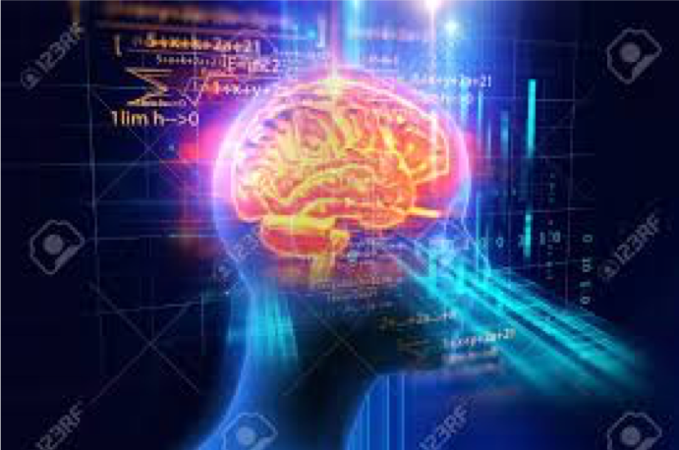
RL(Reinforcement Learning)
WM(Working Memory)
Slow
Long-lasting
Capacious
Fast
Transitory
Space-Limited
Notes:
Human beings possess many cognitive systems that help them maneuver in this complex world. One of them is called the reinforcement learning system.
reinforcement learning allows one to learn from rewards and punishments in a robust and yet slow way. For example, you may learn to go visit your guidance counselor more often, because there are candies in her office to reward you.
This learning of reward can take place, even without explicit awareness of the presence of the reward. However, humans can also learn the rewards explicitly using cognitive systems such as working memory.
For example, you may simply remember the delicious candies in the guidance counselor's office and thus go there more often for the reward, namely the candy.

Slide 3


RLWM Trial Structure (single-task)
P.s. If rt>1.5 or <.15, invalid
+1
++
1.5s or key press
1s
1.5-rt
Key picture: https://www.touchtypingtutor.net/beginner-typing-tutorial-1-a
Notes:
Past research studied the interplay between these two processes using a computerized learning task called RLWM task where participants try to learn which key press is rewarded for which image they see on the screen. This is an example of a RLWM trial. an image appears, participant presses a key in response, and then receives feedback.

Slide 4
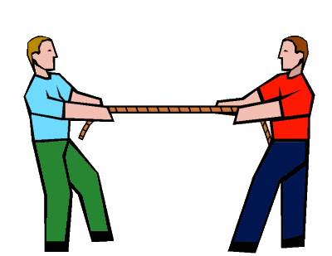

How do WM and RL interact?
Competition Account: WM and RL operate independently and compete for choice.
Competitive Dependence Account: WM and RL interact while operation and then compete for choice.
Notes:
Using computational models, it's discovered that both reinforcement learning and working memory are involved in learning which key is rewarding for which image and they vie for the decision participants make as to which key to press.
However, we don't know if reinforcement learning and working memory just compute separately and then vie for the final decision at the end, like playing a tug of war, or somehow one depends on another computationally.
We argue in this study that reinforcement learning actually relies on working memory. Reinforcement learning is like this person on top, and working memory is like the person below. Although they still fight for the final decision, the judgement of the person on top would be harmed without support from the other person.

Slide 5
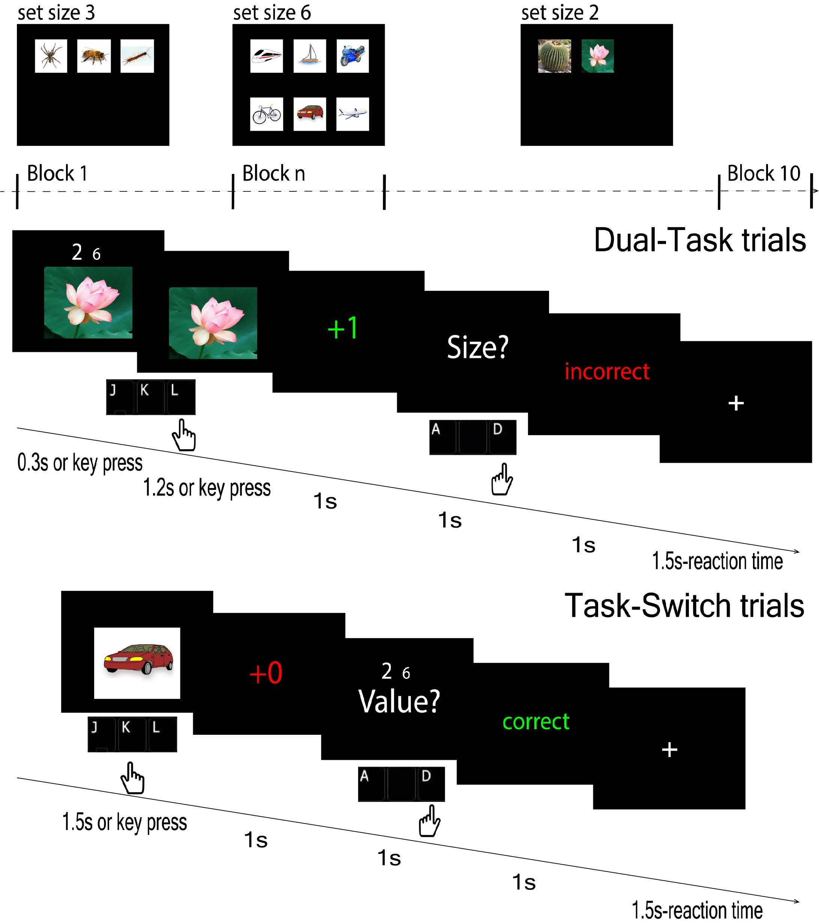
Task Protocol
Notes:
To test this, we recruited participants to perform a computerized task. Our task inherits the set size condition from the original RLWM task which was the amount of images they would have to learn in each block. But the trial structures are more complex and there are two types of them.

Slide 6

Dual-Task Trial Structure
2 6
P.s. If rt>1.5 or <.15, invalid
Two potential questions:
Value?: which number is larger in value.
Size?: which number is larger in font size.
+1
0.3s
Value?
incorrect
++
1.5s or key press
1s
1s
1s
A for left number,
D for right number
1.5-rt
Key picture: https://www.touchtypingtutor.net/beginner-typing-tutorial-1-a
Notes:
In the Dual-Task condition the participants have to remember two numbers, while reacting to the images. They see the image and the numbers. Numbers disappear early. They react to the image, get feedback, and A question about the two numbers was asked at the end, after they respond to the image to make sure that they remember the numbers.

Slide 7

With the Dual Tasking….
WM
2 6
RL
Notes:
The idea is that working memory would be overloaded by these numbers and thus cannot perform as efficiently for the learning task. If RL operates more “unhealthily” in the Dual-Task condition, it’d be a strong evidence suggesting that RL somewhat relies on a functional WM which is our hypothesis.

Slide 8
Task-Switch Trial Structure
P.s. If rt>1.5 or <.15, invalid
Two potential questions:
Value?: which number is larger in value.
Size?: which number is larger in font size.
+1
Value?
2 6
+incorrect
++
1.5s or key press
1s
1s
1s
A for left number,
D for right number
1.5-rt
Key picture: https://www.touchtypingtutor.net/beginner-typing-tutorial-1-a
Notes:
In the control condition, the task-switch condition, they don't have to remember the numbers. They only need to answer the questions while looking at the numbers. Now let’s move on to the results.

Slide 9
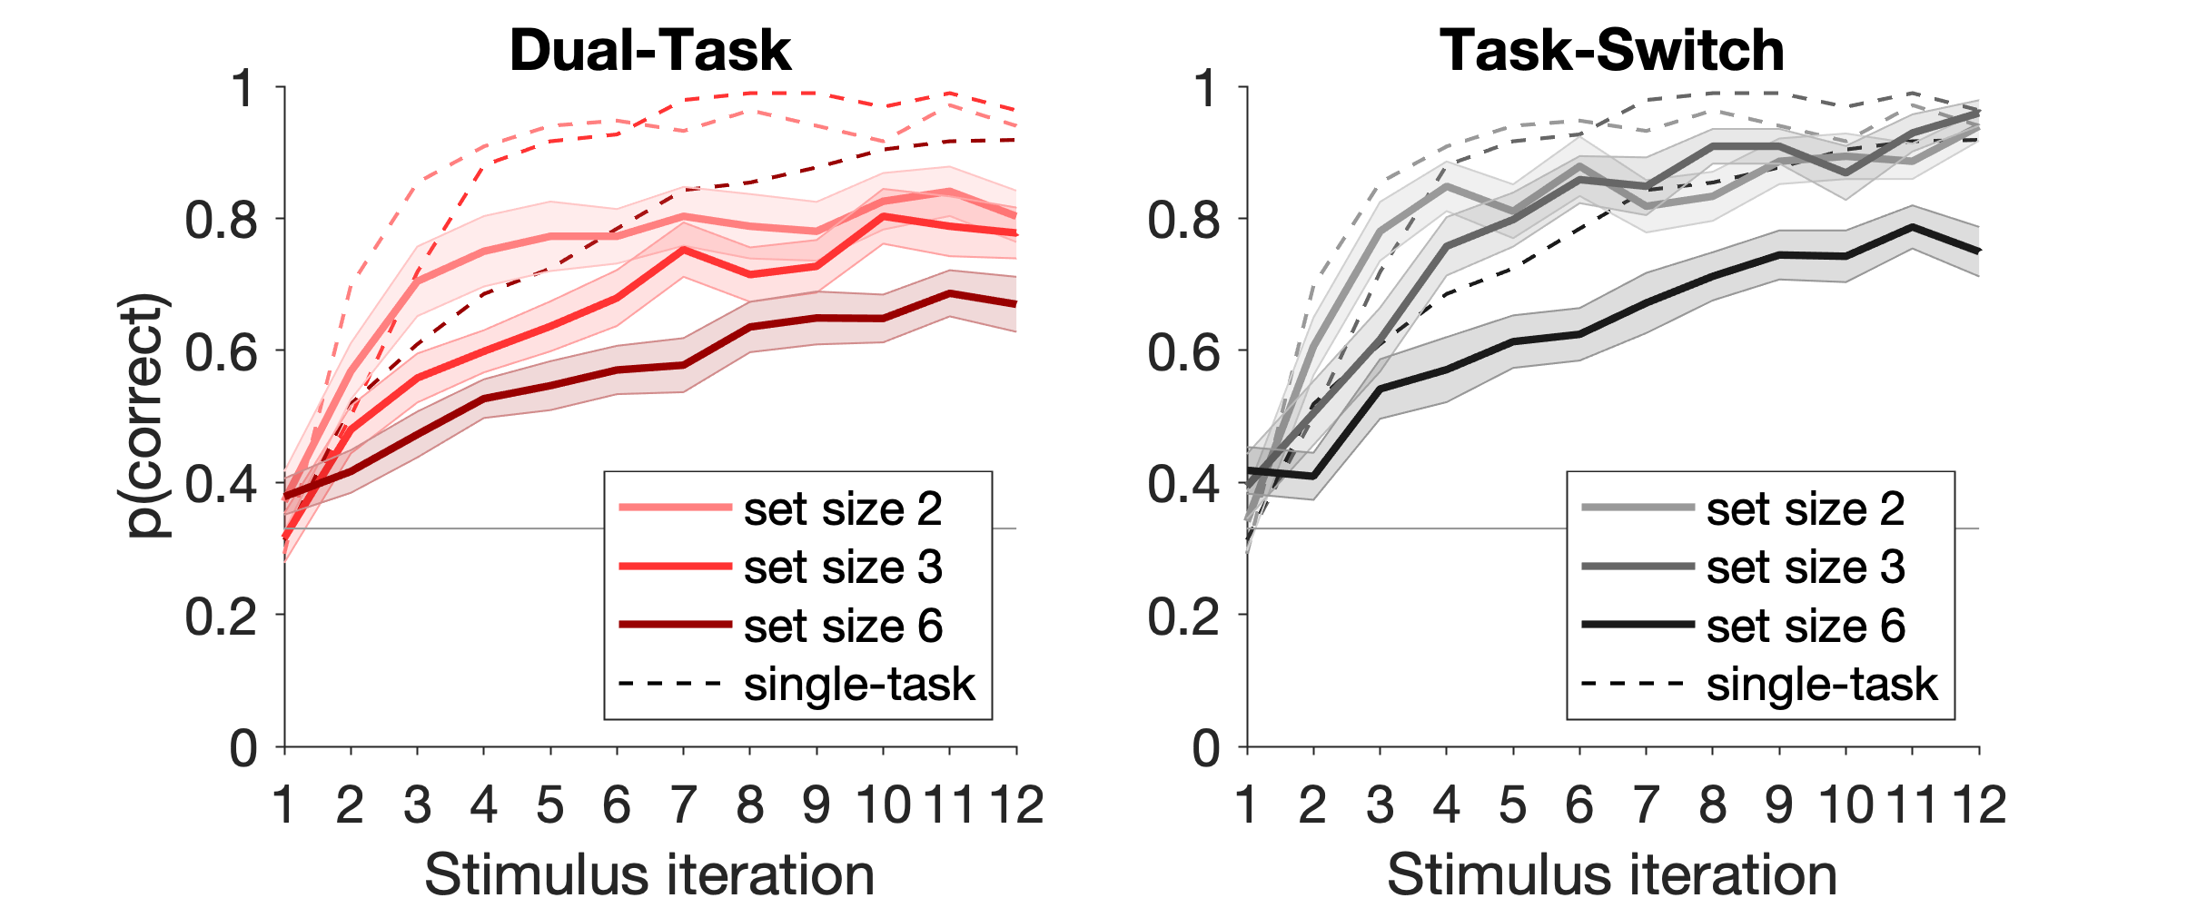
Learning Curve
Notes:
First, let's look at the learning curves. From the learning curves, we can tell that learning is taking place and the learning is slower in higher set sizes which is consistent with previous findings. Unsurprisingly, learning is slower in the Dual-Task condition where WM is overloaded by the numbers. The dotted lines come from a separate dataset of the original RLWM trial just for reference. Now, I will present two main evidence suggesting that RL gets harmed by WM overload.

Slide 10
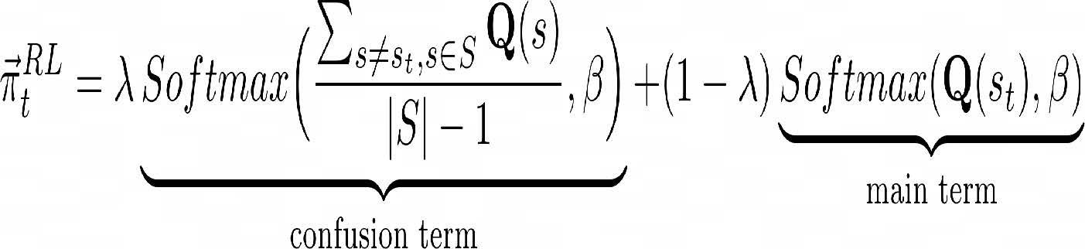

The Winning Model
Saying that irrelevant stimuli interfere with RL action choice due to WM overload.
Introduce the λ parameter to weight the influence.
λ is greater in the Dual-Task condition.
Action-Confusion Model
Notes:
The first evidence comes from computational modeling. Reinforcement learning system chooses its action according to how rewarding the action has been. However, this “rewardingness” is contingent on the image stimulus being reacted on. For example, the key “j” may have been rewarding for the lotus image and yet unrewarding for the cactus image. A “healthy” RL system would choose actions only using their rewardingness with respect to the relevant image stimulus. The action-confusion model describes an “unhealthy” RL who confuses such a contingency. Let’s look at the equation here. The main term captures how the information of action-rewardingness contingent on the correct image stimulus influences final action choice, where as the confusion term captures the influence from the irrelevant image stimuli. Lambda weights these two forces of influence. The less the lambda, the “healthier” the RL is. This model fits the best and Supporting our hypothesis, lambda is significantly larger in the Dual-Task condition where WM is overloaded. This is our first main evidence.

Slide 11
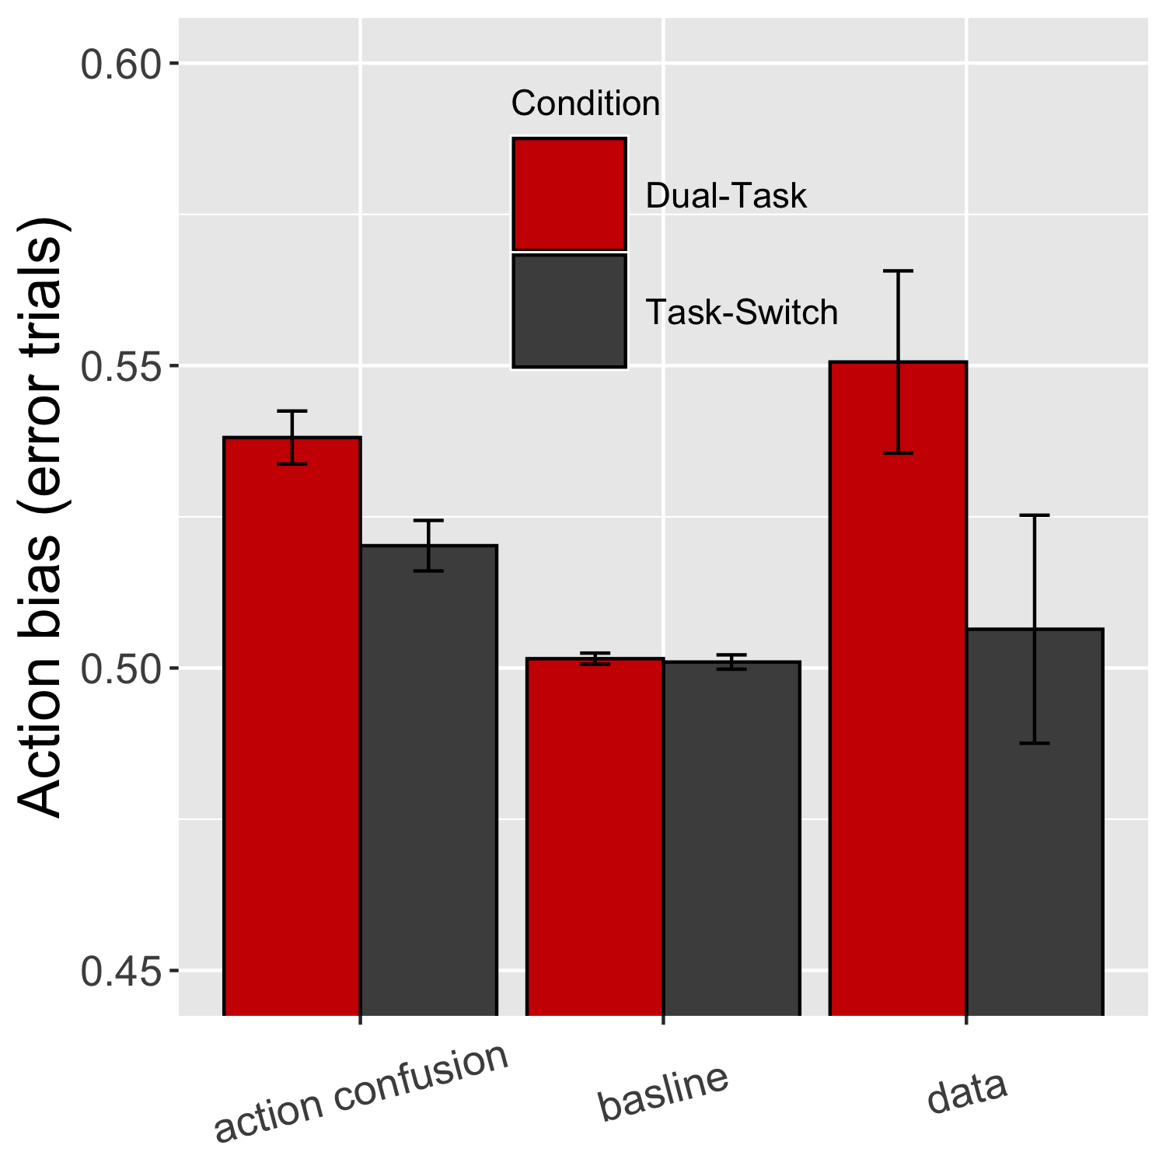
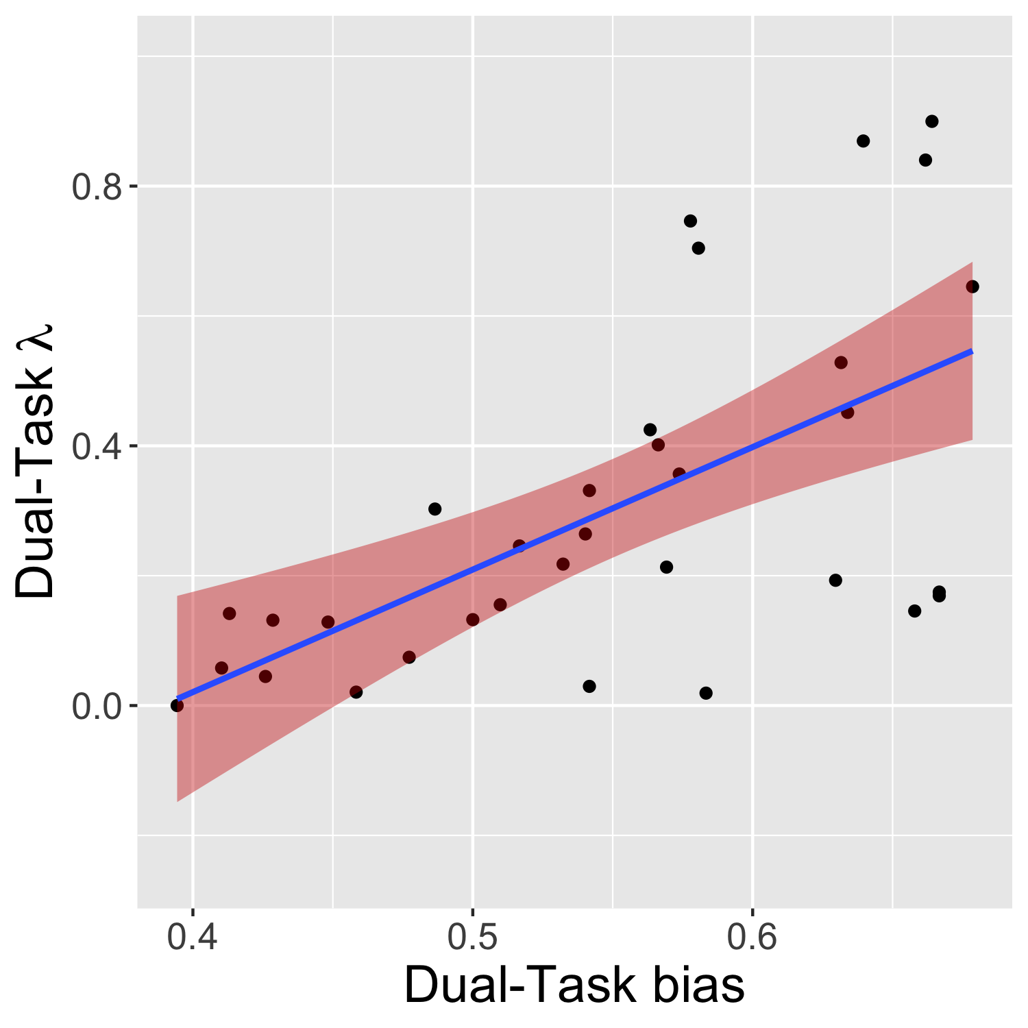
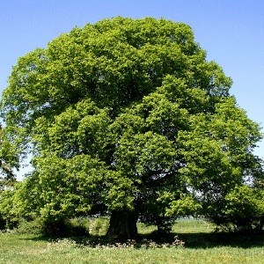
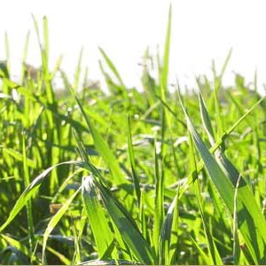
Action Bias
Notes:
This model also would predict the presence of an action bias in the Dual-Task condition, namely, when participants make a wrong key reaction, in this case K or L, It tends to be the key that had the highest reward rate in the past averaged across ALL image stimuli including the irrelevant ones. For example if the participant has seen these images and respectively find these keys most rewarding for them, she would be biased to choose K over L. On the contrary, a healthy RL would not produce such a bias because the reward rate of Irrelevant stimuli remains irrelevant. The action confusion model validates the action bias in the dual task condition as shown in this bar graph. The bias is also correlated with the lambda parameter which, remember, is the parameter controlling the strength of the influence from irrelevant stimuli. The existence of such a behavioral signature is the second evidence supporting our hypothesis that RL computation gets harmed by WM overload.

Slide 12
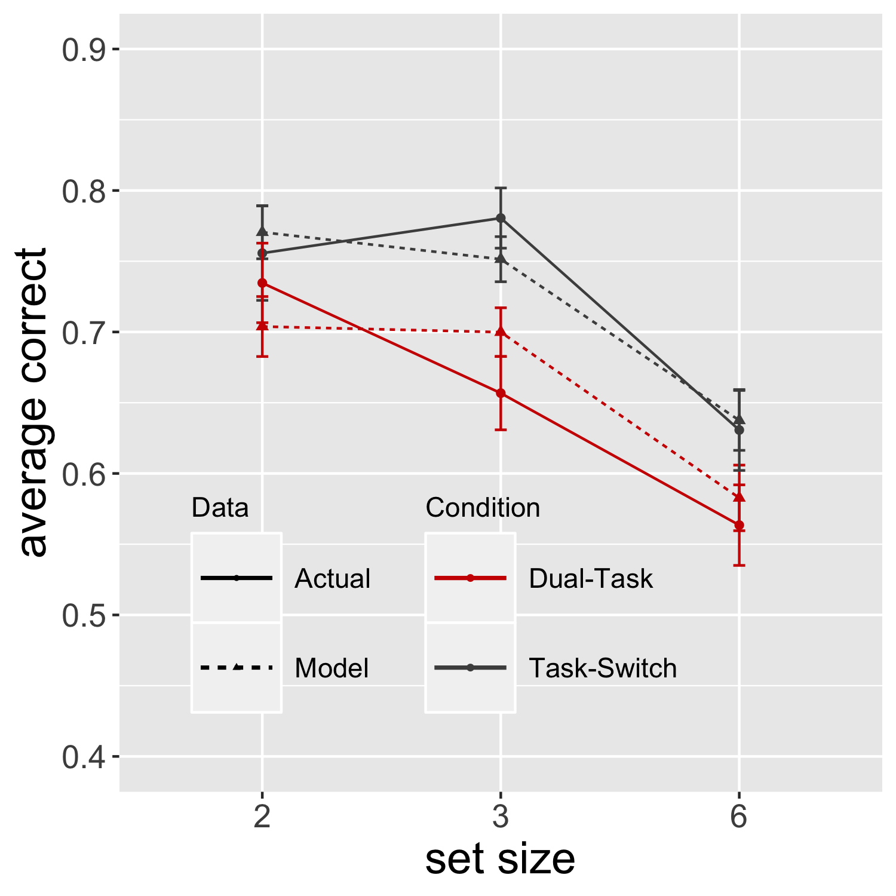
Qualitative Model Validation
Notes:
Lastly as a sanity check, this model validates the learning trend well.

Slide 13
Conclusion
Best fitting Action-Confusion model suggests: RL’s computation is more “unhealthy” when WM is overloaded. Particularly, more action confusion occurs.
Hence RL relies on WM to function “healthily”.
Notes:
So according to these results, reinforcement learning and working memory do seem to interact and particularly reinforcement learning somehow relies on working memory to match the rewardingness of actions with the correct stimuli.

Slide 14
Thank You!
Notes:
Thank you for your attention and we wish you and your family are safe and well

