Slide 1
第1讲 计算机安全导论概述

Slide 2
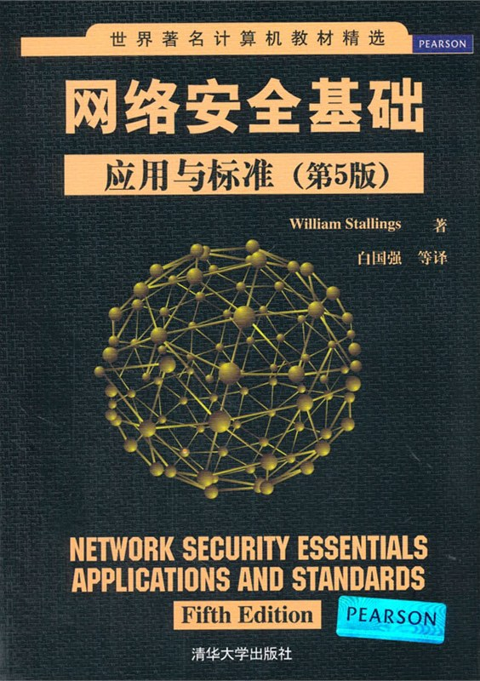
教材信息

Slide 3
大 纲
计算机安全的概念
计算机安全研究的意义
计算机安全导论的学习内容
计算机安全导论的学习目的

Slide 4
1.计算机安全的概念
1.1 什么是计算机安全
计算机安全是指计算机系统保护机制的集合。
计算机安全目的是保障计算机系统或信息系统资源安全的基本属性，包括完整性、可用性和机密性等（包括硬件，软件，固件，信息/数据和通信）

Slide 5
1.计算机安全的概念
1.2 信息系统资源安全的基本属性
保密性(Confidentiality) ：确保信息不暴露给未授权的实体或进程。加密机制。防泄密
完整性(Integrity) ：要求信息在存储或传输过程中保持不被修改、不被破坏和不丢失的特性。防篡改
可用性(Availability) ：信息可被合法用户访问并按要求的特性使用而不遭拒绝服务。防中断

Slide 6
1.计算机安全的概念
1.2 信息系统资源安全的基本属性
可控性(Controllability) ：指对信息的内容及传播具有控制能力。
不可抵赖性(Non-repudiation) ：不可抵赖性通常又称为不可否认性，是指信息的发送者无法否认已发出的信息，信息的接收者无法否认已经接收的信息。

Slide 7
2.计算机安全研究的意义
2.1 计算机安全是国家安全的重要保障
习近平主席在2014年指出：“没有网络安全就没有国家安全，没有信息化就没有现代化”

Slide 8

2.计算机安全研究的意义
2.1 计算机安全是国家安全的重要保障
棱镜计划（PRISM）是一项由美国国家安全局（NSA）自2007年小布什时期起开始实施的绝密电子监听计划，该计划的正式名号为“US-984XN”。
2013年6月6日英国《卫报》和美国《华盛顿邮报》报道，美国国家安全局（NSA）和联邦调查局（FBI）于2007年启动了一个代号为“棱镜”的秘密监控项目 ，直接进入美国网际网路公司的中心服务器里挖掘数据、收集情报，包括微软、雅虎、谷歌、苹果等在内的9家国际网络巨头皆参与其中。
2013年6月，前中情局（CIA）职员爱德华·斯诺登爆料棱镜计划。

Slide 9
2.计算机安全研究的意义
2.1 计算机安全是国家安全的重要保障
自古以来通信安全就是军事行动胜利的保障：早在公元前100年左右凯撒密码就为恺撒的军事胜利奠定了基础。
第二次世界大战：德国的谜密码机（恩尼格玛密码机）的使用和破译改变了战争的进程。
美国电影 猎杀U-571 讲述盟军获得谜密码机的艰辛过程
美国电影 模仿游戏 讲述图灵破解谜密码机的故事
现今世界：国家直接进入网络安全的对抗。比如一个席卷全球工业界的病毒震网病毒（Stuxnet病毒），于2010年6月首次被检测出来，它是第一个专门定向攻击真实世界中基础（能源）设施比如核电站，水坝，国家电网的“蠕虫”病毒。 伊朗核电站受到该病毒严重影响。“震网”病毒结构非常复杂，计算机安全专家在对软件进行反编译后发现它不可能是黑客所为，应该是一个“受国家资助的高级团队研发的结晶”。美国《纽约时报》称，美国和以色列情报机构合作制造出“震网”病毒。
Notes:
模仿游戏 The Imitation Game该片改编自安德鲁·霍奇斯编著的《艾伦·图灵传》，上映后获得了第87届奥斯卡最佳改编剧本奖。讲述有关二战期间图灵破解恩尼格玛密码机的过程。
美国电影U-571（第二次世界大战，德军高人一等的密码通讯能力，常常出奇制胜，这场通讯战争可说是大规模潜艇战争决胜负的致命关键，这一次，盟军侦察到在北大西洋有一艘德军的受创潜舰U-571，正向德军发出求救信号，于是盟军迅速且秘密地将一艘军舰改装成德军的维修舰，准备以维修U-571作为掩护，强行夺取舰上的密码解码机，海军军官泰勒奉命执行这次夺舰任务，拼了命最后终于把密码机送回了基地。）

Slide 10
2.计算机安全研究的意义
2.2 计算机安全与人们的工作生活密切相关
商业机密的泄露（破坏了计算机系统安全的保密性）
网站被篡改 （破坏了计算机系统安全的完整性）
大型网站遭受拒绝服务攻击（破坏了计算机系统安全的可用性）
账户密码被盗
信用卡被盗刷
被别人蹭网
电脑染上病毒
钓鱼网站
因此计算机安全与大到国家安全小到个人利益都休戚相关。

Slide 11
3.计算机安全导论的学习内容
密码学基础
分组密码、流密码、公钥密码、消息认证、秘钥分配和用户认证。
网络安全
物理安全、无线安全、IP层安全、传输层安全、应用层安全（电子邮件、数据库和WEB安全）
系统安全
恶意软件、攻击、操作系统安全、防火墙和入侵检测系统
安全新进展
云安全、物联网安全、软件定义网络安全、区块链安全

Slide 12
4.计算机安全导论的学习目的
掌握计算机安全的基本概念。理解和掌握常用密码算法的加密和解密原理，认证理论的概念以及常见的安全协议、安全术语、攻击类型和安全设备。
了解安全方面的最新进展。
建立网络空间安全的基本框架。
提高其网络安全保护的意识和面对安全攻击时分析、解决问题的能力。为今后分析和设计计算机系统、网络系统、应用系统的安全性打下坚实的基础。
为培养网络空间安全方面的人才奠定基础。

Slide 13
OSI Security Architecture
ITU-T X.800 “Security Architecture for OSI”
defines a systematic way of defining and providing security requirements
for us it provides a useful, if abstract, overview of concepts we will study
Notes:
To assess effectively the security needs of an organization and to evaluate and choose various security products and policies, the manager responsible for security needs some systematic way of defining the requirements for security and characterizing the approaches to satisfying those requirements. This is difficult enough in a centralized data processing environment; with the use of local and wide area networks the problems are compounded. ITU-T Recommendation X.800, Security Architecture for OSI, defines such a systematic approach. The OSI security architecture is useful to managers as a way of organizing the task of providing security.

Slide 14
Aspects of Security
consider 3 aspects of information security:
security attack
security mechanism
security service
note terms
threat – a potential for violation of security
attack – an assault on system security, a deliberate attempt to evade security services
Notes:
The OSI security architecture focuses on security attacks, mechanisms, and services. These can be defined briefly as follows:
• Security attack: Any action that compromises the security of information owned by an organization.
• Security mechanism: A process (or a device incorporating such a process) that is designed to detect, prevent, or recover from a security attack.
• Security service: A processing or communication service that enhances the security of the data processing systems and the information transfers of an organization. The services are intended to counter security attacks, and they make use of one or more security mechanisms to provide the service.
In the literature, the terms threat and attack are commonly used to mean more or less the same thing. Table 1.1 provides definitions taken from RFC 2828, Internet Security Glossary.
Threat - A potential for violation of security, which exists when there is a circumstance, capability, action, or event that could breach security and cause harm. That is, a threat is a possible danger that might exploit a vulnerability.
Attack - An assault on system security that derives from an intelligent threat; that is, an intelligent act that is a deliberate attempt (especially in the sense of a method or technique) to evade security services and violate the security policy of a system.

Slide 15
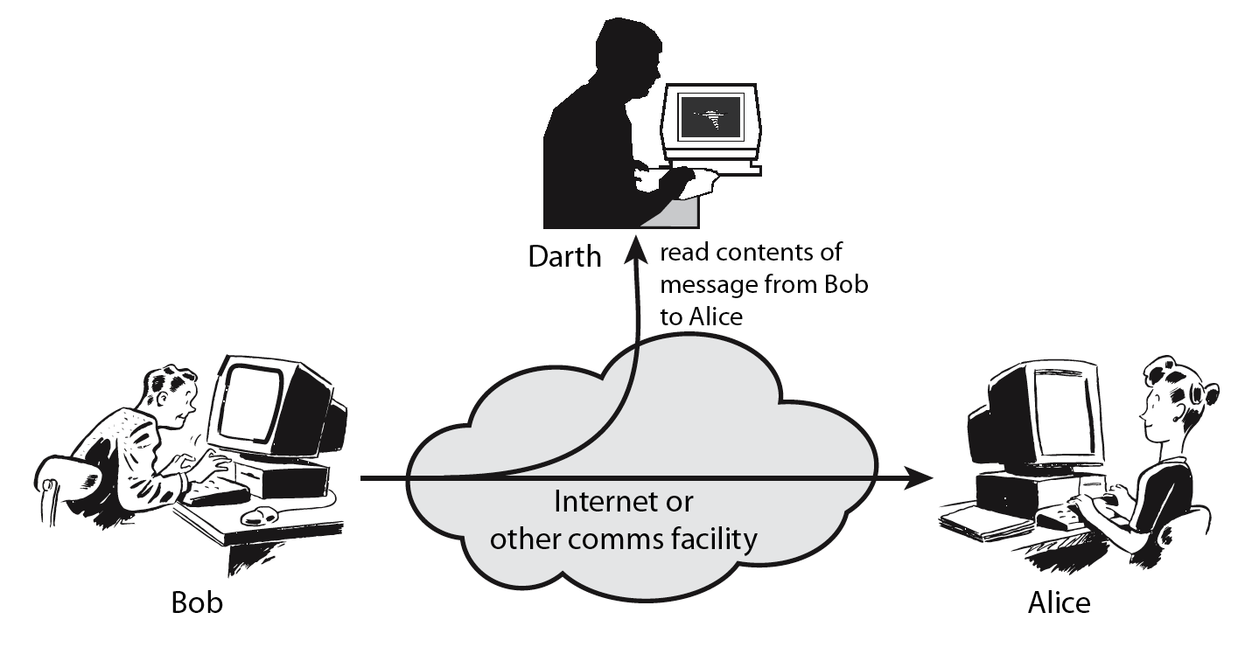
Passive Attacks
Notes:
A useful means of classifying security attacks, used both in X.800 and RFC 2828, is in terms of passive attacks and active attacks. A passive attack attempts to learn or make use of information from the system but does not affect system resources.
Passive attacks are in the nature of eavesdropping on, or monitoring of, transmissions. The goal of the opponent is to obtain information that is being transmitted. Two types of passive attacks are:
+ release of message contents - as shown above in Stallings Figure 1.2a here
+ traffic analysis - monitor traffic flow to determine location and identity of communicating hosts and could observe the frequency and length of messages being exchanged
These attacks are difficult to detect because they do not involve any alteration of the data.

Slide 16
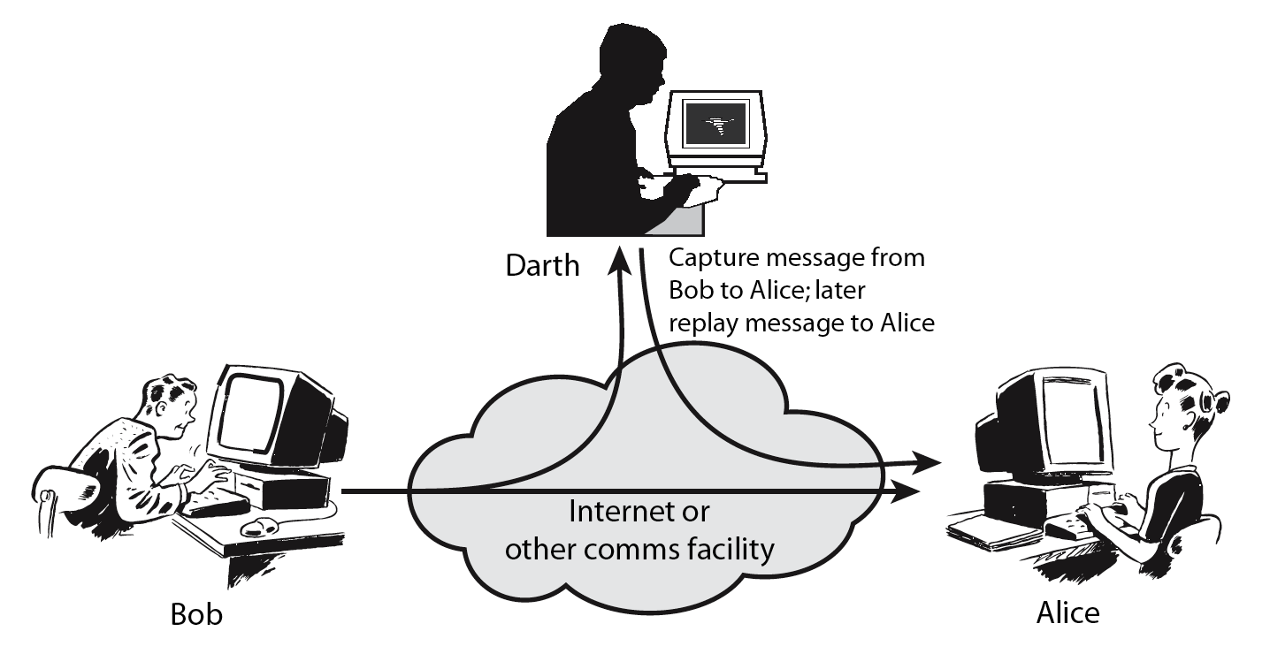
Active Attacks
Notes:
Active attacks involve some modification of the data stream or the creation of a false stream and can be subdivided into four categories: masquerade, replay, modification of messages, and denial of service:
masquerade of one entity as some other
replay previous messages (as shown above in Stallings Figure 1.3b)
modify/alter (part of) messages in transit to produce an unauthorized effect
denial of service - prevents or inhibits the normal use or management of communications facilities
Active attacks present the opposite characteristics of passive attacks. Whereas passive attacks are difficult to detect, measures are available to prevent their success. On the other hand, it is quite difficult to prevent active attacks absolutely, because of the wide variety of potential physical, software, and network vulnerabilities. Instead, the goal is to detect active attacks and to recover from any disruption or delays caused by them.

Slide 17
Security Service
enhance security of data processing systems and information transfers of an organization
using one or more security mechanisms
often replicates functions normally associated with physical documents
which, for example, have signatures, dates;
need protection from disclosure, tampering, or destruction;
be notarized or witnessed; be recorded or licensed
Notes:
Consider the role of a security service, and what may be required.
Note both similarities and differences with traditional paper documents, which for example:
have signatures & dates;
need protection from disclosure, tampering, or destruction;
may be notarized or witnessed;
may be recorded or licensed

Slide 18
Security Services (X.800)
Authentication - assurance that communicating entity is the one claimed
have both peer-entity & data origin authentication
Access Control - prevention of the unauthorized use of a resource
Data Confidentiality –protection of data from unauthorized disclosure
Data Integrity - assurance that data received is as sent by an authorized entity
Non-Repudiation - protection against denial by one of the parties in a communication
Availability – resource accessible/usable
Notes:
This list is taken from Stallings Table 1.2 which provides details of the 5 Security Service categories and the 14 specific services given in X.800.
This list includes the various "classic" security services which are traditionally discussed. Note there is a degree of ambiguity as to the meaning of these terms, and overlap in their use. The broad service categories are:
authentication is concerned with assuring that a communication is authentic. Two specific authentication services are defined in X.800: Peer entity authentication: provides corroboration of the identity of a peer entity in an association; and Data origin authentication: provides corroboration of the source of a data unit.
access control is the ability to limit and control the access to host systems and applications via communications links.
confidentiality is the protection of transmitted data from passive attacks, and the protection of traffic flow from analysis.
integrity assures that messages are received as sent, with no duplication, insertion, modification, reordering, replay, or loss.
availability is the property of a system / resource being accessible and usable upon demand by an authorized system entity, according to performance specifications for the system.

Slide 19
Security Mechanism
feature designed to detect, prevent, or recover from a security attack
one particular element underlies many of the security mechanisms in use:
cryptographic techniques
hence our focus on this topic
Notes:
Now introduce “Security Mechanism” which are the specific means of implementing one or more security services. Note these mechanisms span a wide range of technical components, but one aspect seen in many is the use of cryptographic techniques.

Slide 20
Security Mechanisms (X.800)
specific security mechanisms:
encipherment, digital signatures, access controls, data integrity, authentication exchange, traffic padding, routing control, notarization
pervasive security mechanisms:
trusted functionality, security labels, event detection, security audit trails, security recovery
Notes:
Some examples of mechanisms from X.800. Note that the “specific security mechanisms” are protocol layer specific, whilst the “pervasive security mechanisms” are not. We will meet some of these mechanisms in much greater detail later.
See Stallings Table 1.3 for details of these mechanisms in X.800, and Table 1.4 for the relationship between services and mechanisms.

Slide 21
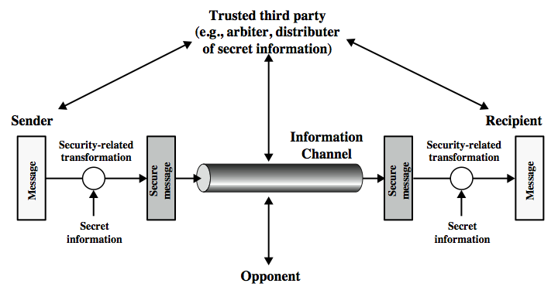
Model for Network Security
Notes:
In considering the place of encryption, its useful to use the following two models from Stallings section 1.6.
The first, illustrated in Figure 1.4, models information being transferred from one party to another over an insecure communications channel, in the presence of possible opponents. The two parties, who are the principals in this transaction, must cooperate for the exchange to take place. They can use an appropriate security transform (encryption algorithm), with suitable keys, possibly negotiated using the presence of a trusted third party. Parts One through Four of this book concentrates on the types of security mechanisms and services that fit into the model shown here.

Slide 22
Model for Network Security
using this model requires us to:
design a suitable algorithm for the security transformation
generate the secret information (keys) used by the algorithm
develop methods to distribute and share the secret information
specify a protocol enabling the principals to use the transformation and secret information for a security service
Notes:
This general model shows that there are four basic tasks in designing a particular security service, as listed.

Slide 23
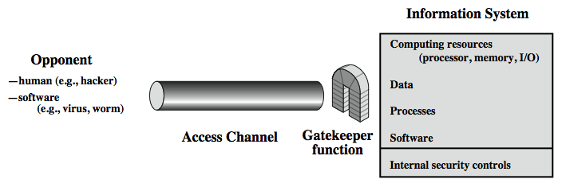
Model for Network Access Security
Notes:
The second, illustrated in Figure 1.5, model is concerned with controlled access to information or resources on a computer system, in the presence of possible opponents. Here appropriate controls are needed on the access to and within the system, to provide suitable security.
The security mechanisms needed to cope with unwanted access fall into two broad categories (as shown in this figure). The first category might be termed a gatekeeper function. It includes password-based login procedures that are designed to deny access to all but authorized users and screening logic that is designed to detect and reject worms, viruses, and other similar attacks. Once either an unwanted user or unwanted software gains access, the second line of defense consists of a variety of internal controls that monitor activity and analyze stored information in an attempt to detect the presence of unwanted intruders. These issues are explored in Part Four.

Slide 24
Model for Network Access Security
using this model requires us to:
select appropriate gatekeeper functions to identify users
implement security controls to ensure only authorised users access designated information or resources
Notes:
Detail here the tasks needed to use this model.

