Slide 1
LAB GROUP MEETING · PLATFORM INTRODUCTION · BETA TEST INVITATION
Meta2bAnalyst
One-stop statistical analysis for 2bRAD microbiome & multi-omics data —
in the browser, with real R statistics behind every figure.
4 analysis modules
species · function · strain · multi-omics
6 input formats
2bRAD-M · Strain2bScan · Tag2bMap · QIIME · Mothur · CSV
Zero install
runs in the browser on the lab intranet
http://10.64.168.98
live now on the lab intranet — every one of you is invited to test it
Notes:
Good afternoon everyone. Today I want to introduce Meta2bAnalyst — the analysis platform our lab has been building for 2bRAD microbiome and multi-omics data. [pause]
The short version: it takes the abundance tables our tools produce — 2bRAD-M, Strain2bScan, Tag2bMap, but also standard QIIME or Mothur output — and turns them into publication-ready statistics and figures, entirely in the browser.
The real headline is at the bottom: it is already deployed on our intranet, at this address. By the end of this talk I'll ask each of you to log in and try to break it. Let's start with why we built it.

Slide 2
WHY WE BUILT IT
Downstream analysis is where 2bRAD projects stall
QIIME
R scripts
A fragmented toolchain
one figure means moving tables through QIIME, R scripts and ad-hoc Python — every hand-off is a chance to break sample names or normalization.
Python
A coding barrier
the people who generate the data can't run the statistics; every analysis queues behind one person who writes the scripts.
spreadsheets
Meta2bAnalyst
one platform, one workflow
Inconsistent methods
tests, filters and parameters drift from project to project — results stop being comparable across the lab.
Sound familiar? These are the three complaints that came up every time we discussed downstream analysis.
02
Notes:
Why did we build this? Three reasons. [point at each row]
First, the toolchain. Getting one PCoA figure today means the data travels through QIIME, then someone's R script, then some Python glue. Every hand-off risks breaking sample names or silently changing normalization.
Second, the coding barrier. The colleagues who actually generated the samples can't run the statistics themselves — everything queues behind whoever writes the scripts. Usually me. [smile]
Third, consistency. Filters and test choices drift between projects, so results from two students in the same lab aren't really comparable.
So the goal was simple: one platform, one workflow, web-based.

Slide 3
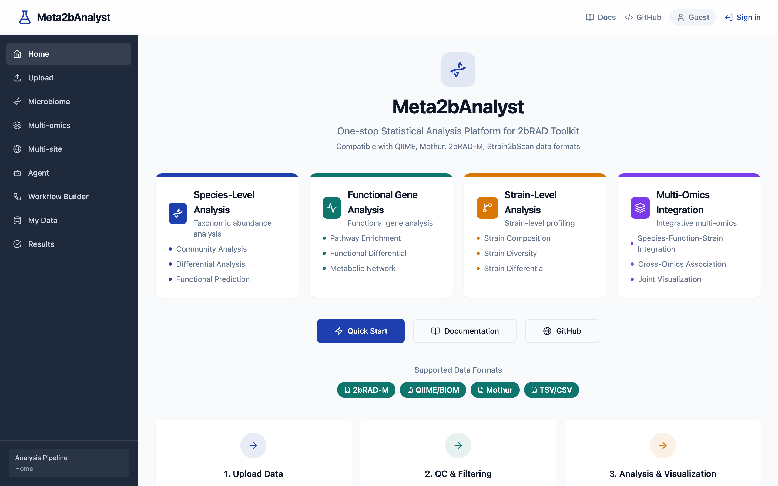
THE PLATFORM
One web workflow — from upload to export
01
Upload
drag in feature tables + metadata; format and sample validation runs automatically
02
Inspect
sample matching, library sizes, sparsity, group balance — checked before any analysis
03
Analyze
pick analysis modules yourself, or let the built-in Agent plan the whole run
04
Interpret
every figure comes with a written interpretation grounded in the method knowledge base
05
Export
figures as PNG / SVG, results as tables — ready for the manuscript
Real statistics, not approximations — DESeq2, edgeR, ANCOMBC, ALDEx2, mixOmics run on a genuine R engine.
03
Notes:
Here is the shape of the platform. [point at the steps, left to right]
You upload your tables — validation happens immediately, before anything else. Then an inspect step: do the sample names match between table and metadata? Are library sizes reasonable? How sparse is the data? Problems surface here, not halfway through a analysis.
Then analysis — either module by module, or you just ask the Agent, which I'll show in a minute. Every figure comes with a written interpretation, and everything exports as PNG, SVG or tables.
One thing I want to stress, bottom left: these are the real R packages — DESeq2, edgeR, ANCOMBC — not reimplementations. If a method is missing, the platform says so; it never silently swaps in a different test.
[point at screenshot] This is the live home page — the four analysis modules you see there structure the rest of this talk.

Slide 4
DATA IN
Bring your data as-is
2bRAD-M
Species-level analyses
Strain2bScan
Upload +
auto-validation
Tag2bMap
Function-gene analyses
QIIME / BIOM
Mothur
Strain-level analyses
generic CSV / TSV
Validation catches the classics: mismatched sample names · library-size outliers · sparse features · missing group variables — with a report before a single test runs.
04
Notes:
What goes in? [gesture across the chips] Everything our own tools output — 2bRAD-M species and function tables, Strain2bScan results, Tag2bMap mappings — plus the community standards: QIIME artefacts, BIOM, Mothur shared files, and honestly any CSV or TSV abundance matrix.
No reformatting, no conversion scripts. The upload step auto-detects the format and runs validation: sample names matched against metadata, library sizes, sparsity, group variables. If something looks wrong you get a report immediately — before a single statistical test has run, not after.
From one validated upload, all three analysis levels on the right are available on the same data.

Slide 5
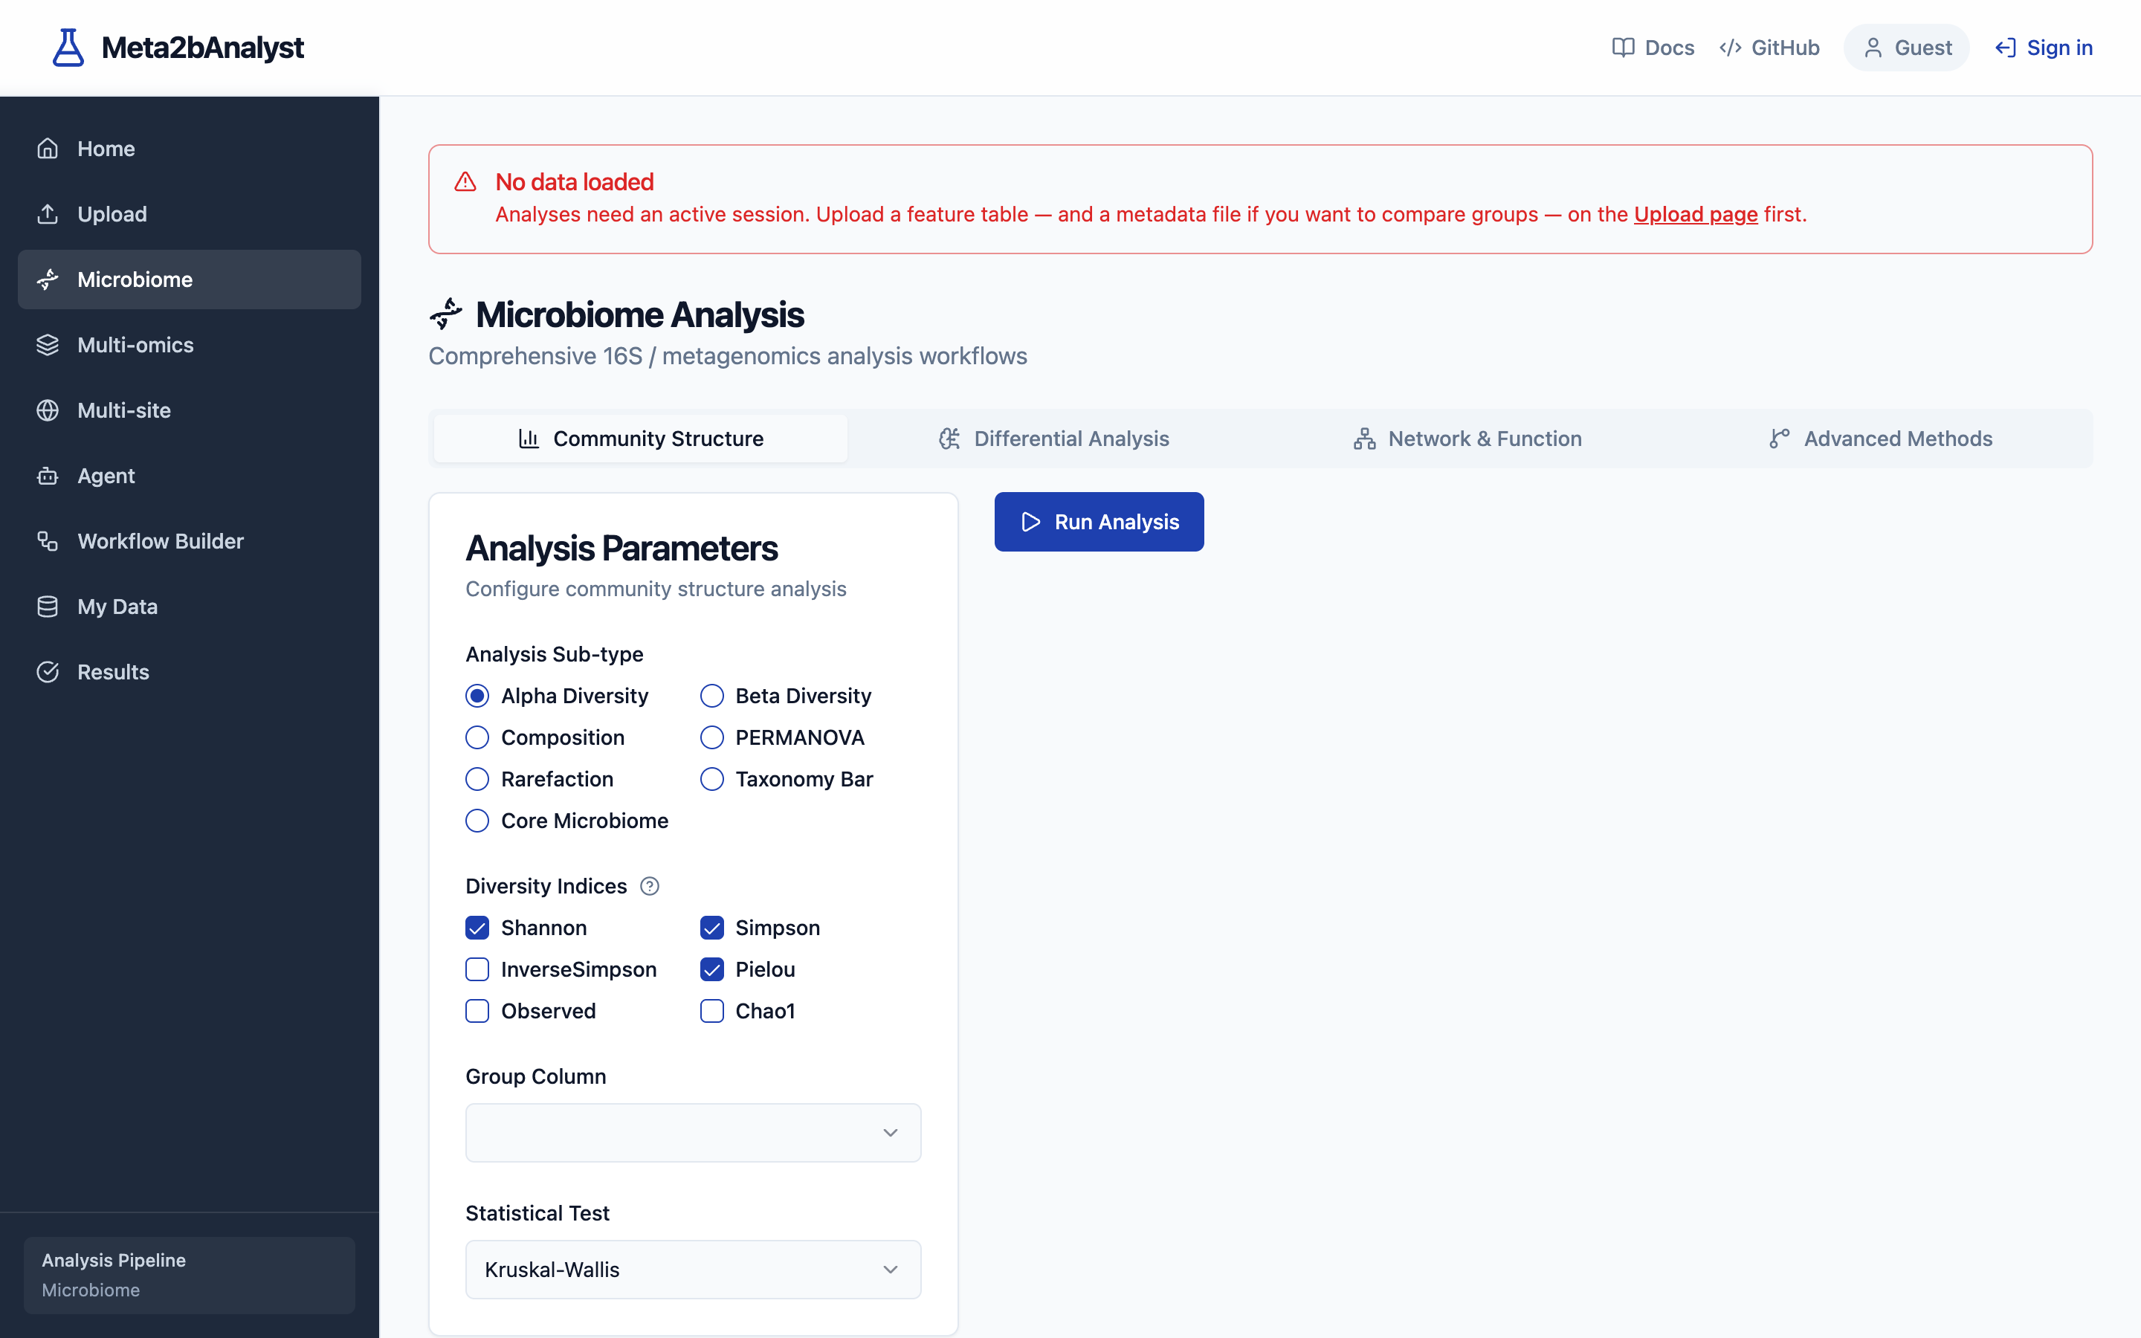
MODULE 1 · SPECIES LEVEL
Community statistics, end to end
Diversity
Alpha — Shannon · Simpson · Chao1 · ACE · Pielou
Beta — Bray-Curtis · Jaccard · Euclidean, with PCoA & NMDS ordination
Discovery
Group tests — t-test · Wilcoxon · ANOVA · Kruskal-Wallis
LEfSe — biomarker discovery with effect sizes (LDA)
Random Forest — classification & feature importance
Every result carries its statistics
p-values, test details and figure data are attached to each output — nothing is a bare image.
05
Notes:
Module one, species level — the bread and butter. [left column]
Diversity: all the standard alpha indices, beta diversities with PCoA and NMDS ordination. Discovery side: parametric and non-parametric group tests, LEfSe for biomarker discovery, and Random Forest when you want classification or feature importance.
One design rule worth mentioning: every figure comes with its statistics attached — the test, the p-values, the underlying numbers. Nothing is just a pretty picture; you can always check what the figure claims.
[point at screenshot] This is the microbiome module page — you pick the analysis, adjust parameters if you want, and run.

Slide 6
MODULE 2 · STRAIN LEVEL — WHAT MAKES US DIFFERENT
Strain analytics you won't find in QIIME
2bRAD resolves below the species level — so the platform treats strains as first-class citizens, working directly on Strain2bScan output.
Composition
per-species strain profiles across all samples
Richness & alpha
strain diversity within each species
Replacement Score
quantifies strain turnover between groups
Dominance Index
flags which strain prevails per species
Networks
strain co-occurrence & mutual-exclusion structure
Why it matters: two groups can share every species yet differ completely in strains — species-level analytics alone cannot see that.
06
Notes:
This is the module I'm proudest of, and the reason the platform is named Meta2b-Analyst. [pause]
Our 2bRAD approach resolves below species level, so strain-level output from Strain2bScan goes in directly — and the platform treats strains as first-class citizens.
[walk the cards] Per-species strain composition. Strain richness and diversity. Then two indices we designed: the Replacement Score, which quantifies how much the strain population turned over between two groups — think health versus disease — and the Dominance Index, which flags which strain is winning within each species. Plus co-occurrence and mutual-exclusion networks.
Why does this matter? Because two groups can have identical species profiles and completely different strains. Species-level tools are blind to that. This isn't in QIIME, Mothur or any of the standard platforms — it's specific to our data type.

Slide 7
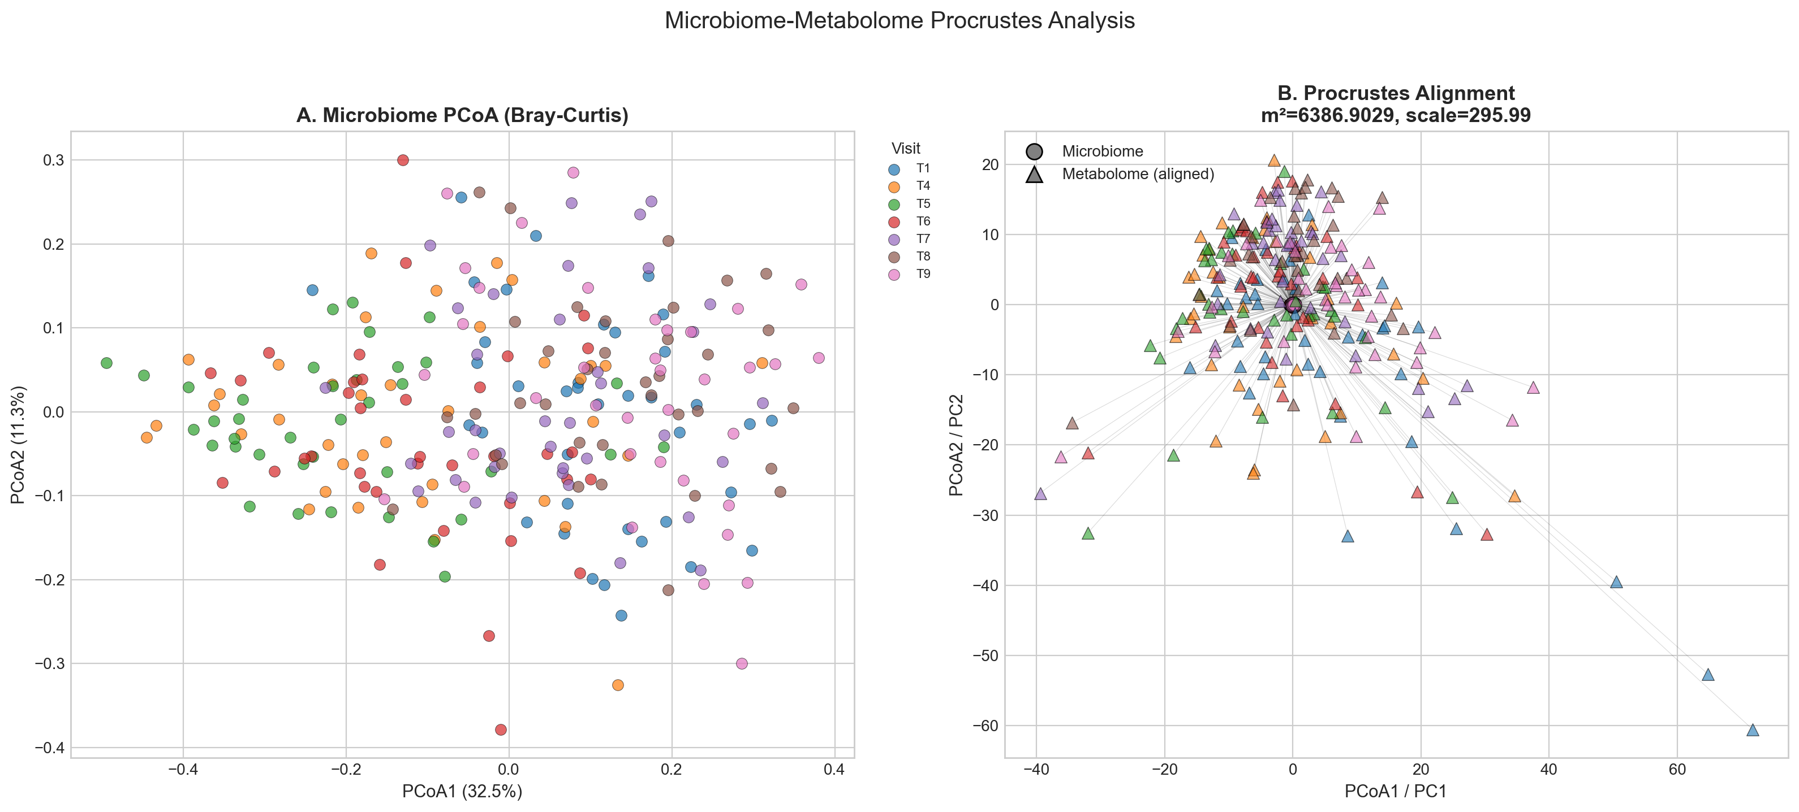
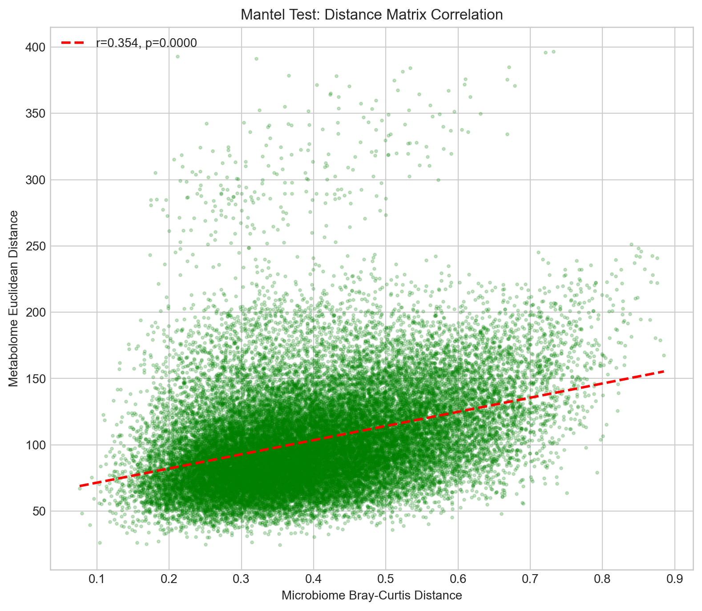
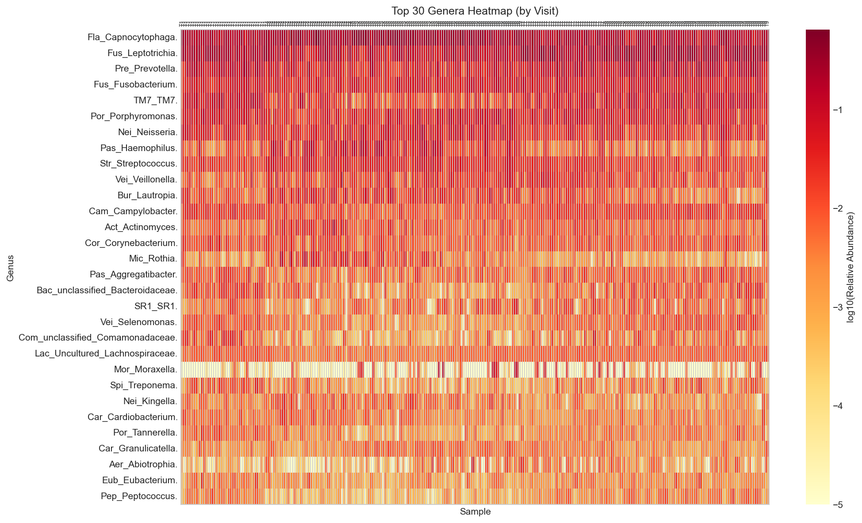
MODULE 3 · MULTI-OMICS
Integrate species, function & strain layers
Linking layers
cross-omics correlation matrices (Spearman / Pearson) with FDR control
Global tests
Procrustes analysis & Mantel tests tie ordinations of two omics together
Procrustes — microbe & metabolite ordinations, linked sample-by-sample
Joint views
three-layer integrated heatmaps and species–function–strain networks
Mantel correlation
Differential abundance heatmap
07
Notes:
Module three brings the layers together — species, function genes and strains.
Three families of methods. Cross-omics correlation matrices with multiple-testing control. Global tests — Procrustes and Mantel — that statistically tie the ordination of one omics to another. And joint views: three-layer heatmaps and networks.
[point at figures] And these are real outputs from the platform, not mock-ups: a Procrustes linking the microbe and metabolite ordinations sample by sample, a Mantel correlation, and a differential-abundance heatmap. All from the built-in demo dataset, which I'll show you in two slides.
For anyone doing multi-omics, the point is this: the integration steps that normally take a week of scripting are menu items here.

Slide 8
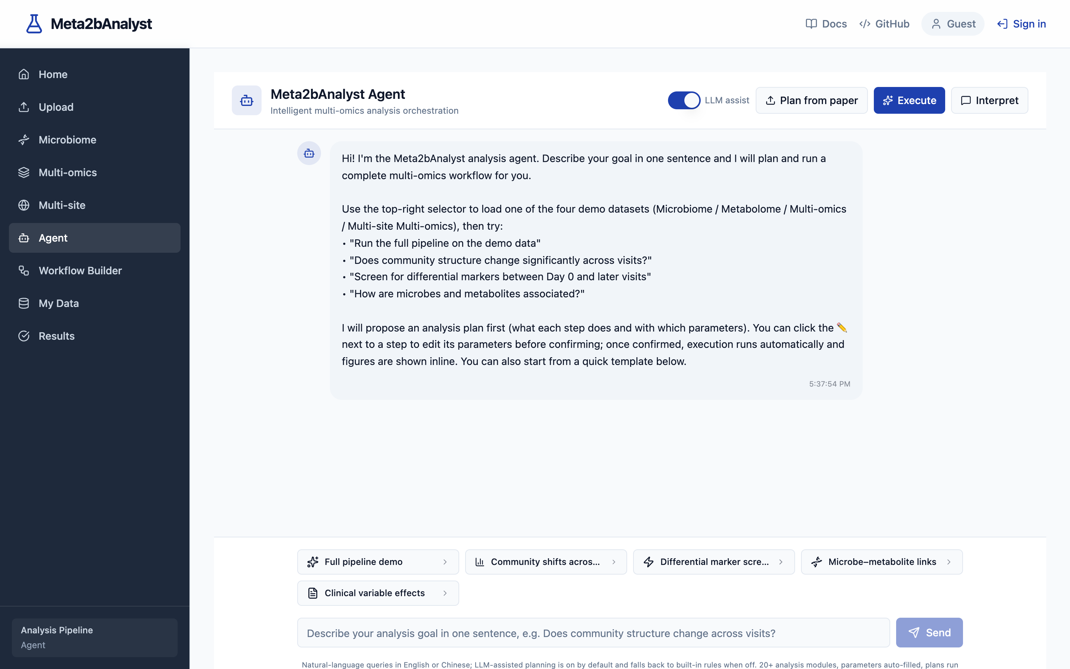
AI ASSISTANT
Ask in plain language — the agent runs the stats
01
Ask
“PCoA coloured by Visit, point size by Bleeding” — English or Chinese, your words
02
Plan
the agent drafts the full method chain with parameters — you review and approve
03
Execute
runs on the real R / Python engine, streaming live progress
04
Interpret
figures plus a written interpretation of what the numbers mean
Also on this page
one-click demo datasets · available in guest mode · optional LLM assist with a knowledge-base-only fallback
08
Notes:
Now my favourite part — the AI Agent. [point at screenshot]
You type what you want in plain language, English or Chinese. “PCoA coloured by Visit, point size by Bleeding.” The agent drafts an analysis plan — which methods, which parameters, in which order. You review it, approve it, and it executes on the real engine, streaming progress as it goes. Then you get the figures plus a written interpretation of the results.
Two things to note. It's a planner and orchestrator, not a replacement for the statistics — the actual tests are still the R packages from slide three. And it works in guest mode, so you can all try it the moment you open the site, no account needed.
This is the part I most want feedback on — if it misunderstands your question, that's exactly what I need to hear.

Slide 9
BUILT-IN DATA
Real published data, one click away
261
44 + 1,125
20
plaque samples, longitudinal
genera + metabolites quantified
clinical & visit variables
Huang et al., mBio 2021 · doi 10.1128/mbio.03281-20 — a longitudinal gingivitis cohort study
Microbiome
genera table + metadata
Metabolome
metabolite table + metadata
Multi-omics
four matched files, one session
Multi-site multi-omics
saliva + urine, 8 files
Load one from the Agent page “Load demo dataset” menu — a validated session with all files is created in seconds.
09
Notes:
You don't need your own data to test the platform — it ships with real published data.
This is the Huang mBio 2021 gingivitis study: 261 plaque samples followed over time, 44 genera, over eleven hundred metabolites, and 20 clinical variables including bleeding scores. A genuinely hard dataset, not a toy.
It comes pre-packaged in four flavours matching the modules: microbiome only, metabolome only, the full multi-omics set, and a multi-site version with saliva and urine.
From the Agent page, one click on ‘Load demo dataset’ creates a session with everything uploaded and validated. Which means — and this is the practical point — every analysis you saw in this talk is reproducible by you in about thirty seconds.

Slide 10
GETTING IN
Live on the lab intranet — nothing to install
http://10.64.168.98
any modern browser · from the lab network · no client, no VPN, no setup
Guest mode
open the URL and go — browse every page, run demo datasets, chat with the Agent. Zero setup.
Student account
upload your own tables, private analysis sessions, 500 MB storage quota, changeable password.
Test accounts
student01–student10, password Meta2b-2026 — log in and start uploading your own data right away.
Note: reachable from the lab intranet only — not from home. Data lives on our own server.
10
Notes:
Or use one of the shared test accounts: student01 to student10, password Meta2b-2026 — they are pre-created, log in and you can upload your own data immediately; change the password any time from the profile menu.

Slide 11
THE ASK
What I'd love you to try this week
01
Run your usual analysis
load a demo dataset, do what you normally do, and compare the output with your current pipeline.
When something breaks
send me a screenshot plus one line:
which page · what you clicked · what happened
That's the whole bug report. Agent misunderstandings are especially welcome — they teach the planner.
02
Upload your own tables
format validation is the part that most needs stress-testing with real-world data.
03
Ask the Agent a real question
something from your actual project, in English or Chinese — tell me when it misunderstands.
04
Try to break it
weird formats, tiny cohorts, missing values — edge cases are exactly what I need to see.
11
Notes:
And here is what I'm actually asking for. [walk the four items]
One: take a demo dataset and run an analysis you'd normally do — then tell me how the output compares to your usual pipeline. Two: upload your own abundance tables. The validation layer is what most needs real-world, messy data. Three: ask the Agent a question from your actual project, in either language — when it misunderstands you, that's not a failure, that's the most valuable feedback I can get. Four: genuinely, try to break it. Weird formats, three-sample groups, all-missing columns.
[point at the card] And reporting couldn't be simpler: a screenshot plus one line — which page, what you clicked, what happened. Thirty seconds of your time, and every one of those reports makes the platform better for all of us.

Slide 12
Try it this week.
http://10.64.168.98
guest mode works right now — no account needed · student accounts from me on request
Thank you — questions welcome.
12
Notes:
That's the platform. [pause]
One ask before we close: open this address this week — guest mode, no account, thirty seconds to load a demo dataset. And if you want to put your own data through it, come find me for an account.
Everything you saw — the four modules, the strain analytics, the multi-omics figures, the Agent — is running on that URL right now, on our own server.
Thank you. Happy to take questions — and equally happy to take bug reports. [smile]

