Slide 1

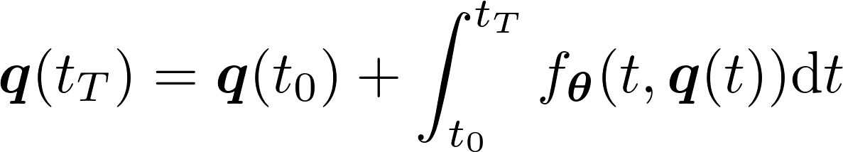



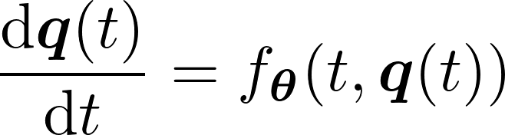






ODE module
FC
optimization trajectory
...
SE module
Backbone
time invariant property

Slide 2


ODE module
optimization trajectory
SE module
Backbone
time invariant property

Slide 3



PODE module
optimization trajectory
Images
Backbone
SSE module
time invariant property

Slide 4





PODE module
optimization trajectory
SSE module
Images
Backbone
time invariant property

Slide 5
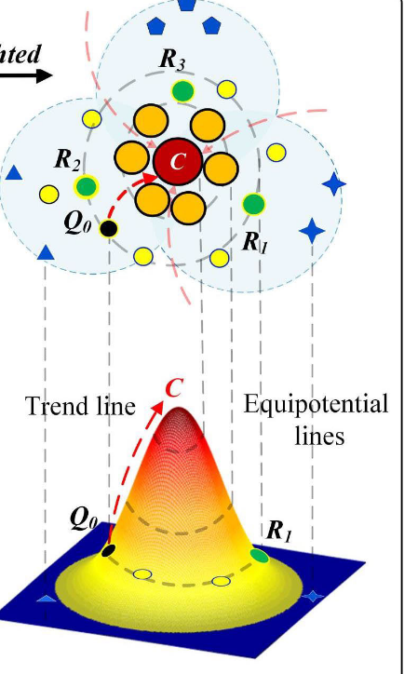
PODE module
optimization trajectory
Backbone
time invariant property
Feature
Extractor
GeM+BN
Images
optimization trajectory
SSE module
PODE module

Slide 6
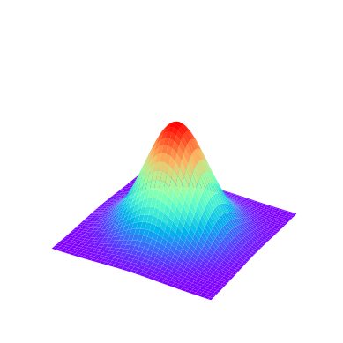
C
C
Equipotential lines
C
Trend line
Perturbation

Slide 7


C
Backbone
GAP : Global average pooling
: Person-1 : Person-2 : Person-3
: Time invariant property
Feature
Extractor
GAP
H
W
Images
Q
Optimization trajectory
Equipotential lines
Trend line
PODE module
SSE module

Slide 8
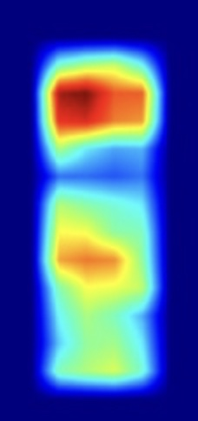




C
Backbone
GAP: Global average pooling
BN: Batch normalizati
: Forward propagation
Feature
Extractor
GAP+BN
H
W
Images
Q
STE
DFE
DFE
DFE
...
...

Slide 9
C
Backbone
GAP: Global average pooling
BN: Batch normalizati
: Forward propagation
Feature
Extractor
GAP+BN
H
W
Images
Q
STE
DFE
DFE
DFE
...
...

Slide 10
C
Backbone
GAP: Global average pooling
BN: Batch normalization
: Forward propagation
Feature
Extractor
H
GAP+BN
Images
Q
W
DFE
DFE
DFE
STE
...
...

Slide 11
C
Backbone
GAP: Global average pooling
BN: Batch normalization
: Forward propagation
Feature
Extractor
H
GAP+BN
Images
Q
W
DFE
DFE
DFE
STE
...
...

Slide 12

C
Backbone
GAP: Global average pooling
BN: Batch normalization
TE: Temporal evolution
Feature
Extractor
GAP+BN
H
W
Images
Q
Consistency regularization loss
Identity loss
TE
TE
...
TE
TE
...
TE
STE
module
Triplet loss
Center loss
DFE module

Slide 13
C
Backbone
GAP: Global average pooling
BN: Batch normalization
DFE: Dynamic feature extraction
STE: Stable trajectory evolution
Feature
Extractor
GAP+BN
H
W
Images
Q
Identity loss
DFE module
...
...
Triplet loss
Center loss
STE module
Consistency regularization loss

