Slide 1


The Pulse of Your Network AI-Powered Community Health Scoring for Viva Engage
2025.08.02
Abhishek Bagepalli
HuangKun Chen
Navya Kondaveeti
Vandana Brahmasa
Yash Kothari​
Yi Shiuan Chiang​
Yingtong Wang

Slide 2
Introduction
Problem Statement:
Enterprise leaders lack visibility into the health of internal communities. There is no standardized, automated way to surface early warning signs like disengagement, silos, or declining thread activity.
Goal:
Build a Community Health Score (CHS) framework using public data (Reddit) to simulate Yammer-style behavior — and visualize risks and strengths in community engagement.

Slide 3
What Does “Healthy” Mean in Enterprise Communities?
Prompt replies (low latency)
Diverse voices (not just same users)
Content relevance (no off-topic drift)
Supportive tone (civility, empathy)
Dynamic interaction (depth & back-and-forth)
(Based on research from Lithium’s CHI model + enterprise social network literature)

Slide 4
Our Approach
Step | Description
Subreddit Selection | 15 subreddits mapped to Viva-like use cases (support, feedback, team spaces, ERGs)
Quantitative Analysis | Metrics: responsiveness, volume, interaction
Qualitative Analysis | LLM-powered post-level evaluation (tone, civility, helpfulness)
Dashboard | Power BI dashboard highlighting high/low CHS areas
Outcome | A modular scoring model + prototype dashboard usable for Viva Engage

Slide 5
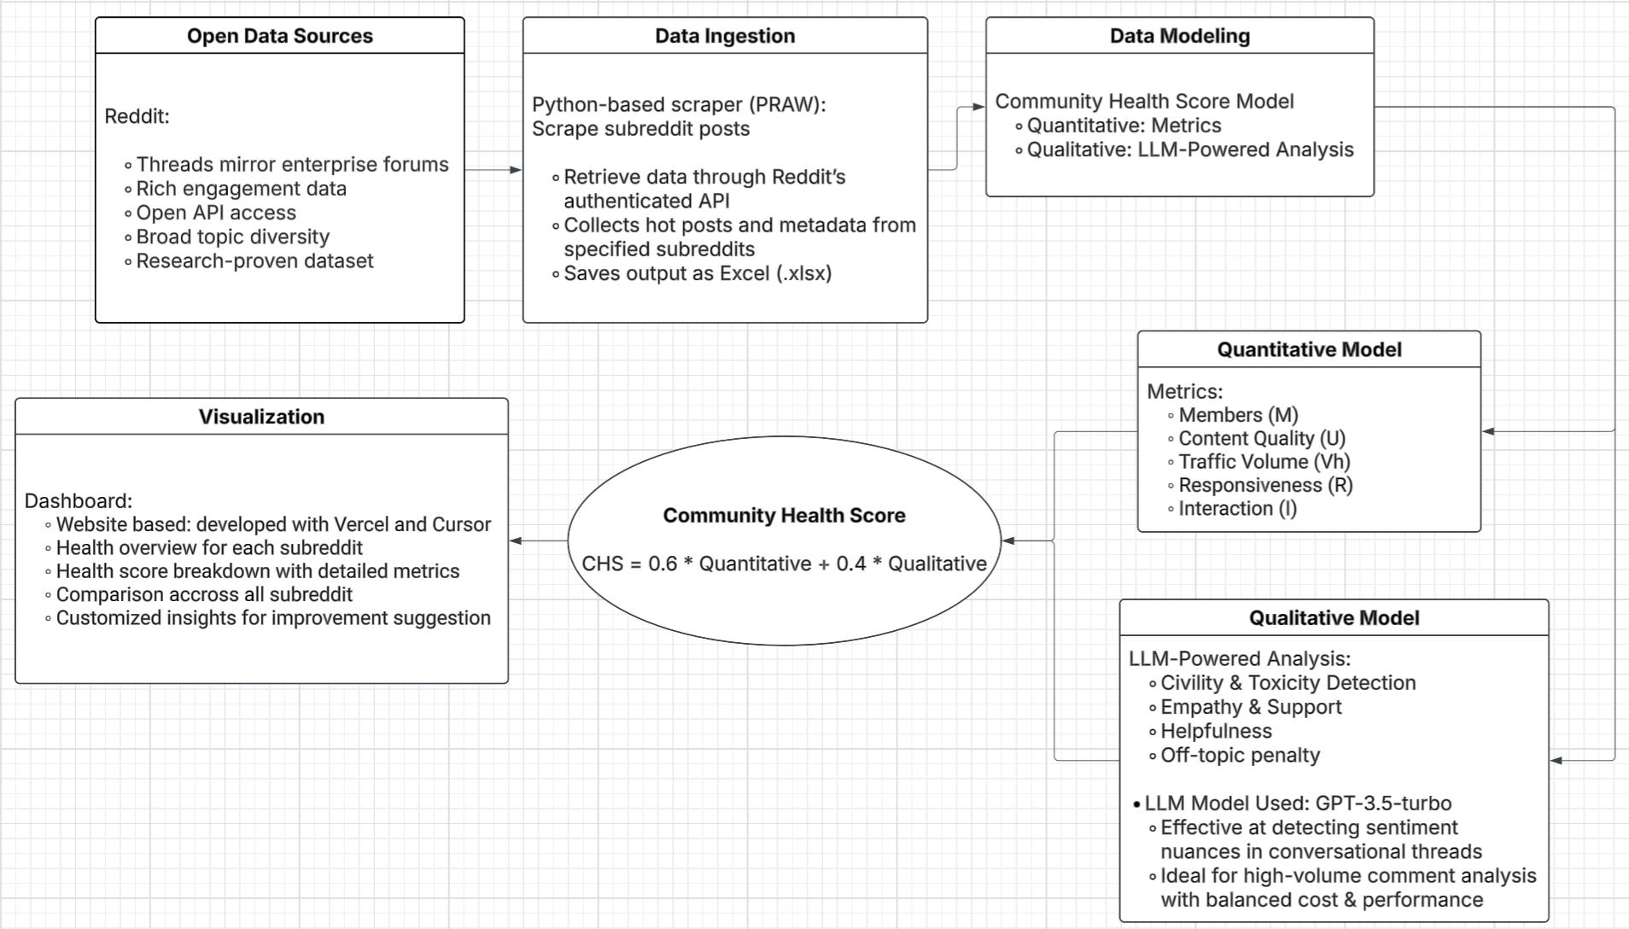
Architecture Overview

Slide 6
Subreddit Selection
To simulate the structure and dynamics of Microsoft Viva Engage communities, subreddit selection can be categorized into three core communication types.
Department-based (e.g., r/marketing, r/sysadmin)
Peer support (e.g., r/lgbt, r/depression)
Knowledge spaces (e.g., r/datascience, r/productmanagement)

Slide 7
Quantitative Model
Health Factor | Formula Component | Meaning (Reddit context)
Members (M) | log10(max(subscriber_count, 1)) | Captures community size
Content Quality (U) | post_count * log10(max(total_upvotes, 1)) | High-quality, highly-upvoted content
Traffic Volume (Vh) | log10(max(engagement_score + total_comments * 0.5, 1)) | Measures active participation, comments as proxies
Responsiveness (R) | min(expected_response_time / avg_response_time, 10.0) | Faster replies = better community responsiveness
Interaction (I) | min(sqrt(avg_contributors_per_thread * avg_comments_per_thread), 10.0) | Captures thread depth and diversity of contributors

Slide 8
Quantitative Score Calculation (CHS)
Calculation Step | Formula | Theoretical Foundation | Practical Justification
Health Function | sqrt(M * U * Vh * R * I) | Geometric Mean Principle: Multiplicative combination ensures balanced health across all dimensions. No single factor can compensate for complete failure in another. | Communities need strength across all areas. High membership with zero responsiveness indicates unhealthy community dynamics.
Age Normalization | log_health * (1 + 0.1 * age_factor) | Community Lifecycle Theory: Mature communities may have different growth patterns than new ones. Age adjustment provides fair comparison. | Older communities may have slower growth but higher stability. New communities may show rapid growth that stabilizes over time.
Final Scaling | max(0, min(1000, normalized_health * 200)) | Bounded Score Interpretation: 1000-point scale provides intuitive interpretation similar to credit scores or standardized tests. | Stakeholders understand percentage-based and bounded scoring systems better than unbounded mathematical outputs.

Slide 9
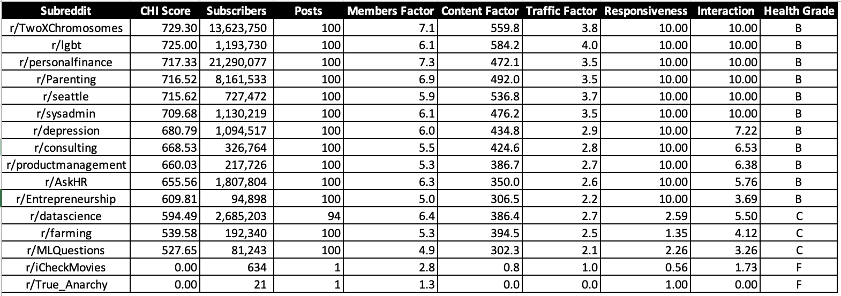
Quantitative Score Results

Slide 10
Qualitative Model Overview
LLMs used to assess:
Civility / Toxicity
Empathy & Support
Helpfulness
Off-topic penalty
Each post scored on 0–100
Top 5 comments used per post
LLM: GPT-3.5-turbo

Slide 11
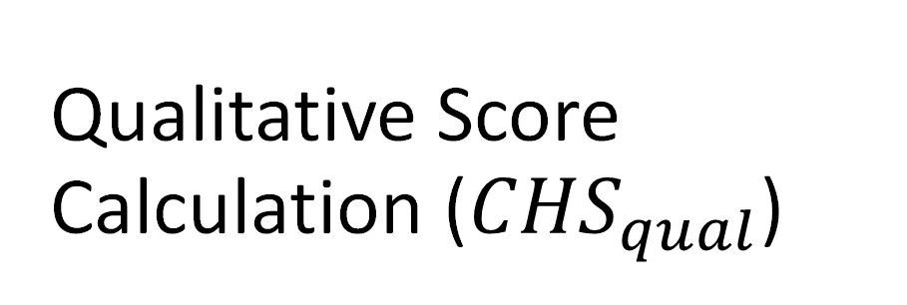
Qualitative Score Calculation (${CHS}_{qual}$)
Post Score(i​) = w1​S+w2​C+w3​E+w4​H+w5​T, where
Averaged over all posts and capped at 1000
Component | Meaning | Scoring Approach
S = Sentiment | Overall tone (positive/neutral/negative) | e.g., OpenAI sentiment classifier
C = Civility | Toxicity, politeness, no personal attacks | e.g., OpenAI moderation or Perspective API
E = Empathy | Presence of supportive/emotional content | LLM prompt-based score
H = Helpfulness | Does it answer or add value? | LLM prompt-based score
T = Topic Relevance | Is it relevant to the community’s theme? | LLM or keyword-matching prompt

Slide 12

Combined Health Score Calculation
$${CHS}_{combined}= {CHS}_{quan}^{β} . {CHS}_{qual}^{1−β}$$
Why Geometric Mean?
Penalizes imbalance: a community strong in one area but weak in another will not rank highly overall.
Better aligns with Lithium’s “No single factor can compensate for failure elsewhere” philosophy.

Slide 13
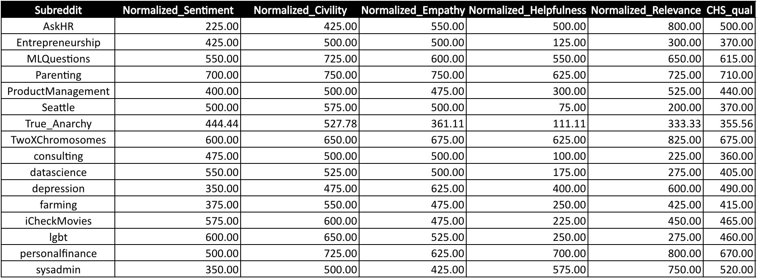

Qualitative Score Results

Slide 14
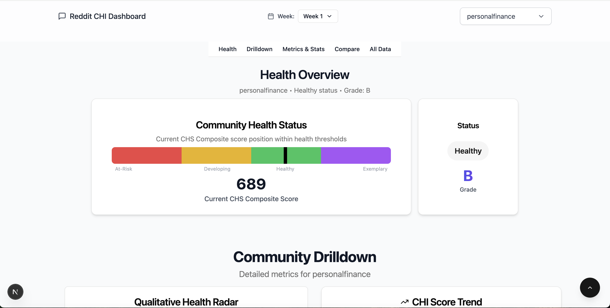
Dashboard

Slide 15
Macro Insights
1. Community health can be measured
→ Use data (activity, civility, empathy) to build dashboards—no more relying on gut feel.
2. Low engagement ≠ low risk
→ “Ghost posts” (no replies) signal decline even when post volume looks fine.
3. AI scales tone and safety
→ GPT can detect toxicity and support moderators across large communities.
4. One-size metrics don’t fit all
→ Support groups, work teams, and learning hubs need different scoring priorities.
5. Reddit is a good proxy—if adapted
→ Public data gives great signals, but needs tuning for enterprise context.
6. Community health drives business KPIs
→ Stronger communities boost onboarding, retention, and internal mobility.
7. Decline is predictable—and fixable
→ Watch for reply delays and fading voices—intervene early with smart signals.

Slide 16
Data Insights 1
Content Quality Drives Health
Semantic depth and post utility have greater impact on subreddit health than activity volume alone.
CHI gains correlate closely with Content Factor increases.
r/AskHR: +7.64 CHI gain from +4.60 in Content Factor → More structured, actionable posts (e.g., resume, interview advice).
r/personalfinance: +0.66 CHI from +2.96 in Content Factor → Shift toward long-form financial planning tips.
CHS Tier Movement (7/17 vs 7/25)
CHI Tier Movement (7/17 vs 7/25)
Engagement Saturation
Identifying “Pseudo-Active” Communities

Slide 17
Data Insights 2
Content Quality Drives Health
CHS Tier Movement (7/17 vs 7/25)
Some subreddits improved civility and relevance enough to advance tiers.
CHI Tier Movement (7/17 vs 7/25)
Engagement Saturation
Identifying “Pseudo-Active” Communities
Subreddit | CHS (7/17) | CHS (7/25) | Health Status
r/Entrepreneurship | 512.5 | 370.0 | Health ➞ Developing
subreddit | NormalizedSentiment | NormalizedCivility | Normalized Empathy | Normalized Helpfulness | Normalized Relevance | CHS qual
R/Entrepreneurship '17 → 25 | -62.5 | -50 | 175 | -437.5 | -337.5 | -142.5

Slide 18
Data Insights 3
Subreddit | CHI Change | Subscribers Change | Member Factor Change | Content Factor Change | Post Change | Health Grade Change
r/datascience | -11.40 | +1203 | +0.0002 | -31.83 | -6 | B → C
Content Quality Drives Health
CHS Tier Movement (7/17 vs 7/25)
CHI Tier Movement (7/17 vs 7/25)
CHI framework successfully flags value loss even with surface-level engagementgrowth.
Engagement Saturation
Identifying “Pseudo-Active” Communities

Slide 19
Data Insights 4
Content Quality Drives Health
CHS Tier Movement (7/17 vs 7/25)
CHI Tier Movement (7/17 vs 7/25)
Engagement Saturation
here is a ceiling to participation-based growth. Next-stage improvementdependson empathy and semantic value.
Some subreddits hit 100 in both Responsiveness and Interaction, yet remain non-healthy.
r/lgbt: Maintains high activity, but Content Factor dropped (-2.5), indicating reactive but not constructive participation.
Identifying “Pseudo-Active” Communities

Slide 20
Data Insights 5
Content Quality Drives Health
CHS Tier Movement (7/17 vs 7/25)
CHI Tier Movement (7/17 vs 7/25)
Engagement Saturation
Identifying “Pseudo-Active” Communities
CHS model effectively detects low-quality or emotionally disconnected communities, even when surface metrics are high.
Subreddits with high post volume received low CHS due to toxic tone or poor topic alignment.
r/depression: High activity, but harsh or non-supportive language → Low empathy and civility.

Slide 21
Recommendations
1. AI-Powered Tone Coaching
Use GPT to provide real-time civility and empathy suggestions as users write posts.
Encourages respectful, constructive conversations.
2. Community Health Tiers & Playbooks
Label communities as At Risk / Developing / Healthy / Exemplar.
Offer tier-specific nudges, onboarding kits, and content templates.
3. Early Warning System
Detect drops in civility, engagement quality, or helpfulness.
Trigger moderator alerts and auto-suggested interventions.
4. Adaptive Scoring by Community Type
Customize CHI/CHS weights by group focus:
Product Teams → Relevance, Responsiveness
ERGs (e.g., r/lgbt) → Empathy, Civility
Knowledge Hubs → Helpfulness, Clarity

Slide 22

Thank You

