Slide 1
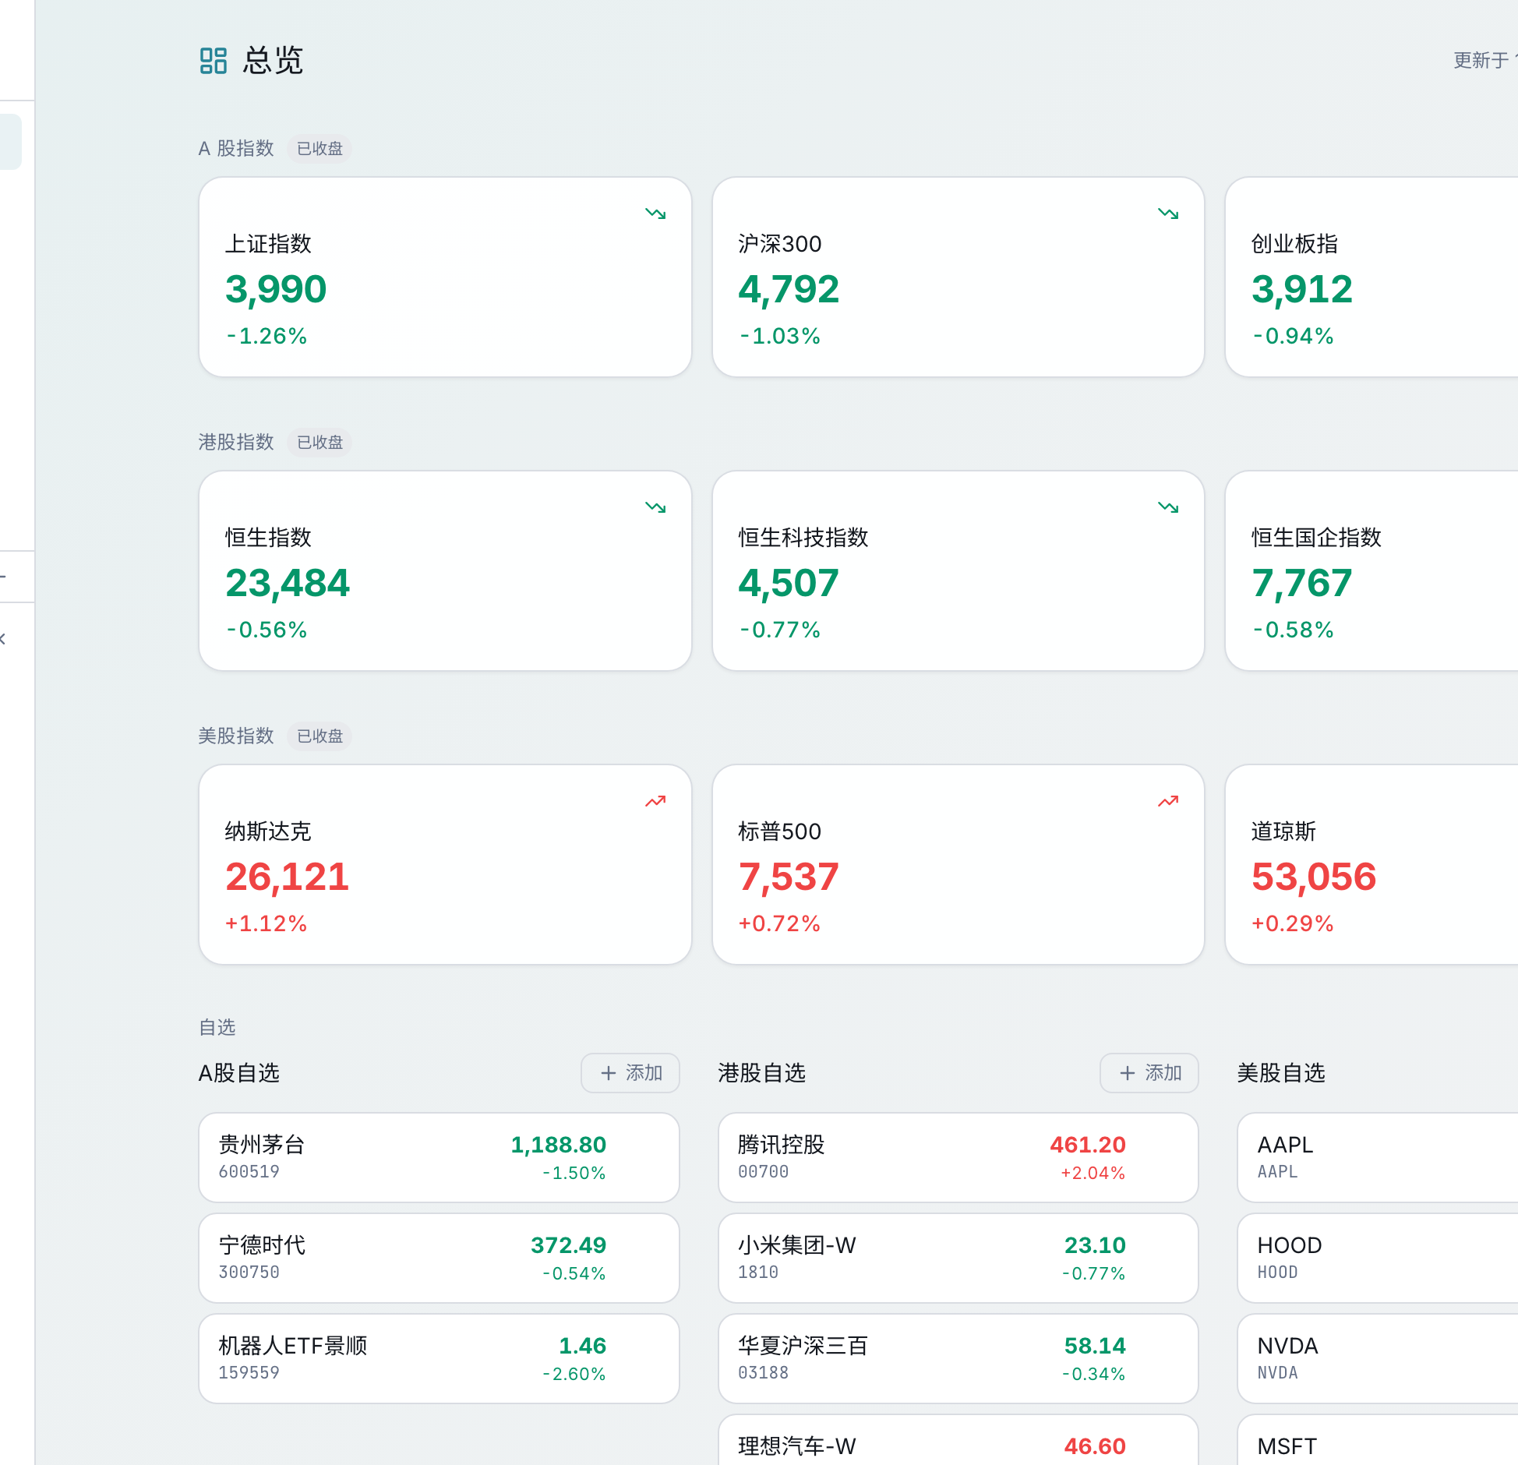
PRIVATE INVESTOR BRIEFING · JUL 2026
Alpha Mind
The AI-native research OS
for systematic investors
Turn market noise into testable, risk-aware decisions—inside one local-first workflow.
DISCOVER → TEST → LEARN
Built for research. Designed to earn trust before capital is deployed.
Software for research and education; not investment advice.

Slide 2
ALPHA MIND
THE PROBLEM
The bottleneck is not another AI answer.
It is a repeatable chain of evidence from signal to decision.
01
02
03
Research is fragmented
Narratives outrun evidence
Risk arrives too late
Market data, screening, news, forecasting and backtests live in separate tools and contexts.
AI can sound confident while provenance, timing, costs and regime sensitivity remain hidden.
Most workflows optimize for upside first—then bolt on drawdown controls after the fact.
Investment thesis
The winning product will make quantitative rigor feel like a daily operating habit—not a specialist project.
02

Slide 3
ALPHA MIND
PRODUCT THESIS
One closed loop from market noise to strategy evidence.
Every module feeds a shared research history, so the system improves through use.
01
02
03
04
05
DISCOVER
ANALYZE
COMPARE
SIMULATE
LEARN
Multi-market overview
Opportunity scanner
Daily news synthesis
Agentic research
Unified baselines
Historical regimes
Costs, timing, drawdown
Cash allocation
Forward outcomes
Quality analytics
Compounding asset: an auditable library of signals, assumptions, tests and outcomes.
03

Slide 4
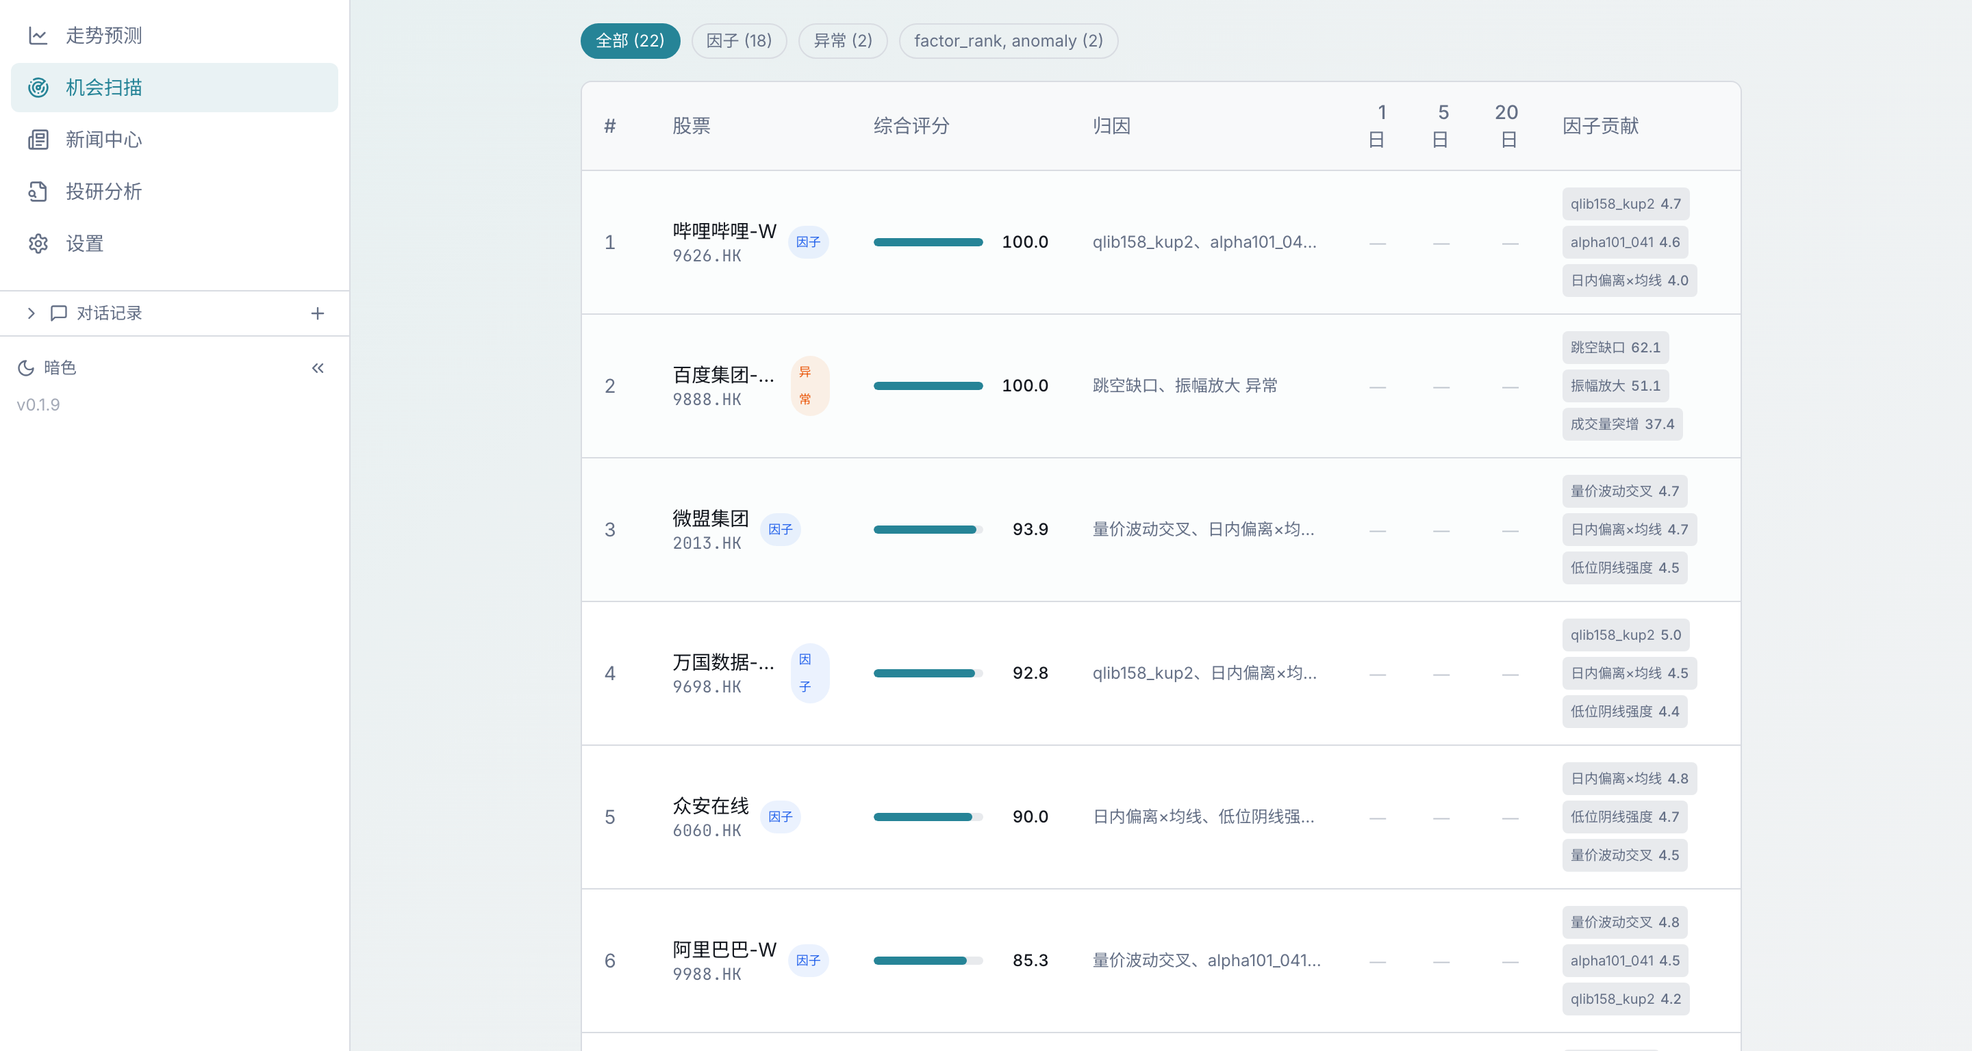
ALPHA MIND
PRODUCT PROOF
Explainable discovery—not a black-box stock list.
Factor, anomaly and event signals are ranked with visible attribution and forward outcome tracking.
WHY IT MATTERS
Transparent ranking
Show the score, factor contribution and reason—not just the ticker.
Multi-market by design
A-shares, Hong Kong and U.S. equities share one research surface.
Self-validation
Recommended names can be checked against subsequent 1 / 5 / 20-day outcomes.
04

Slide 5
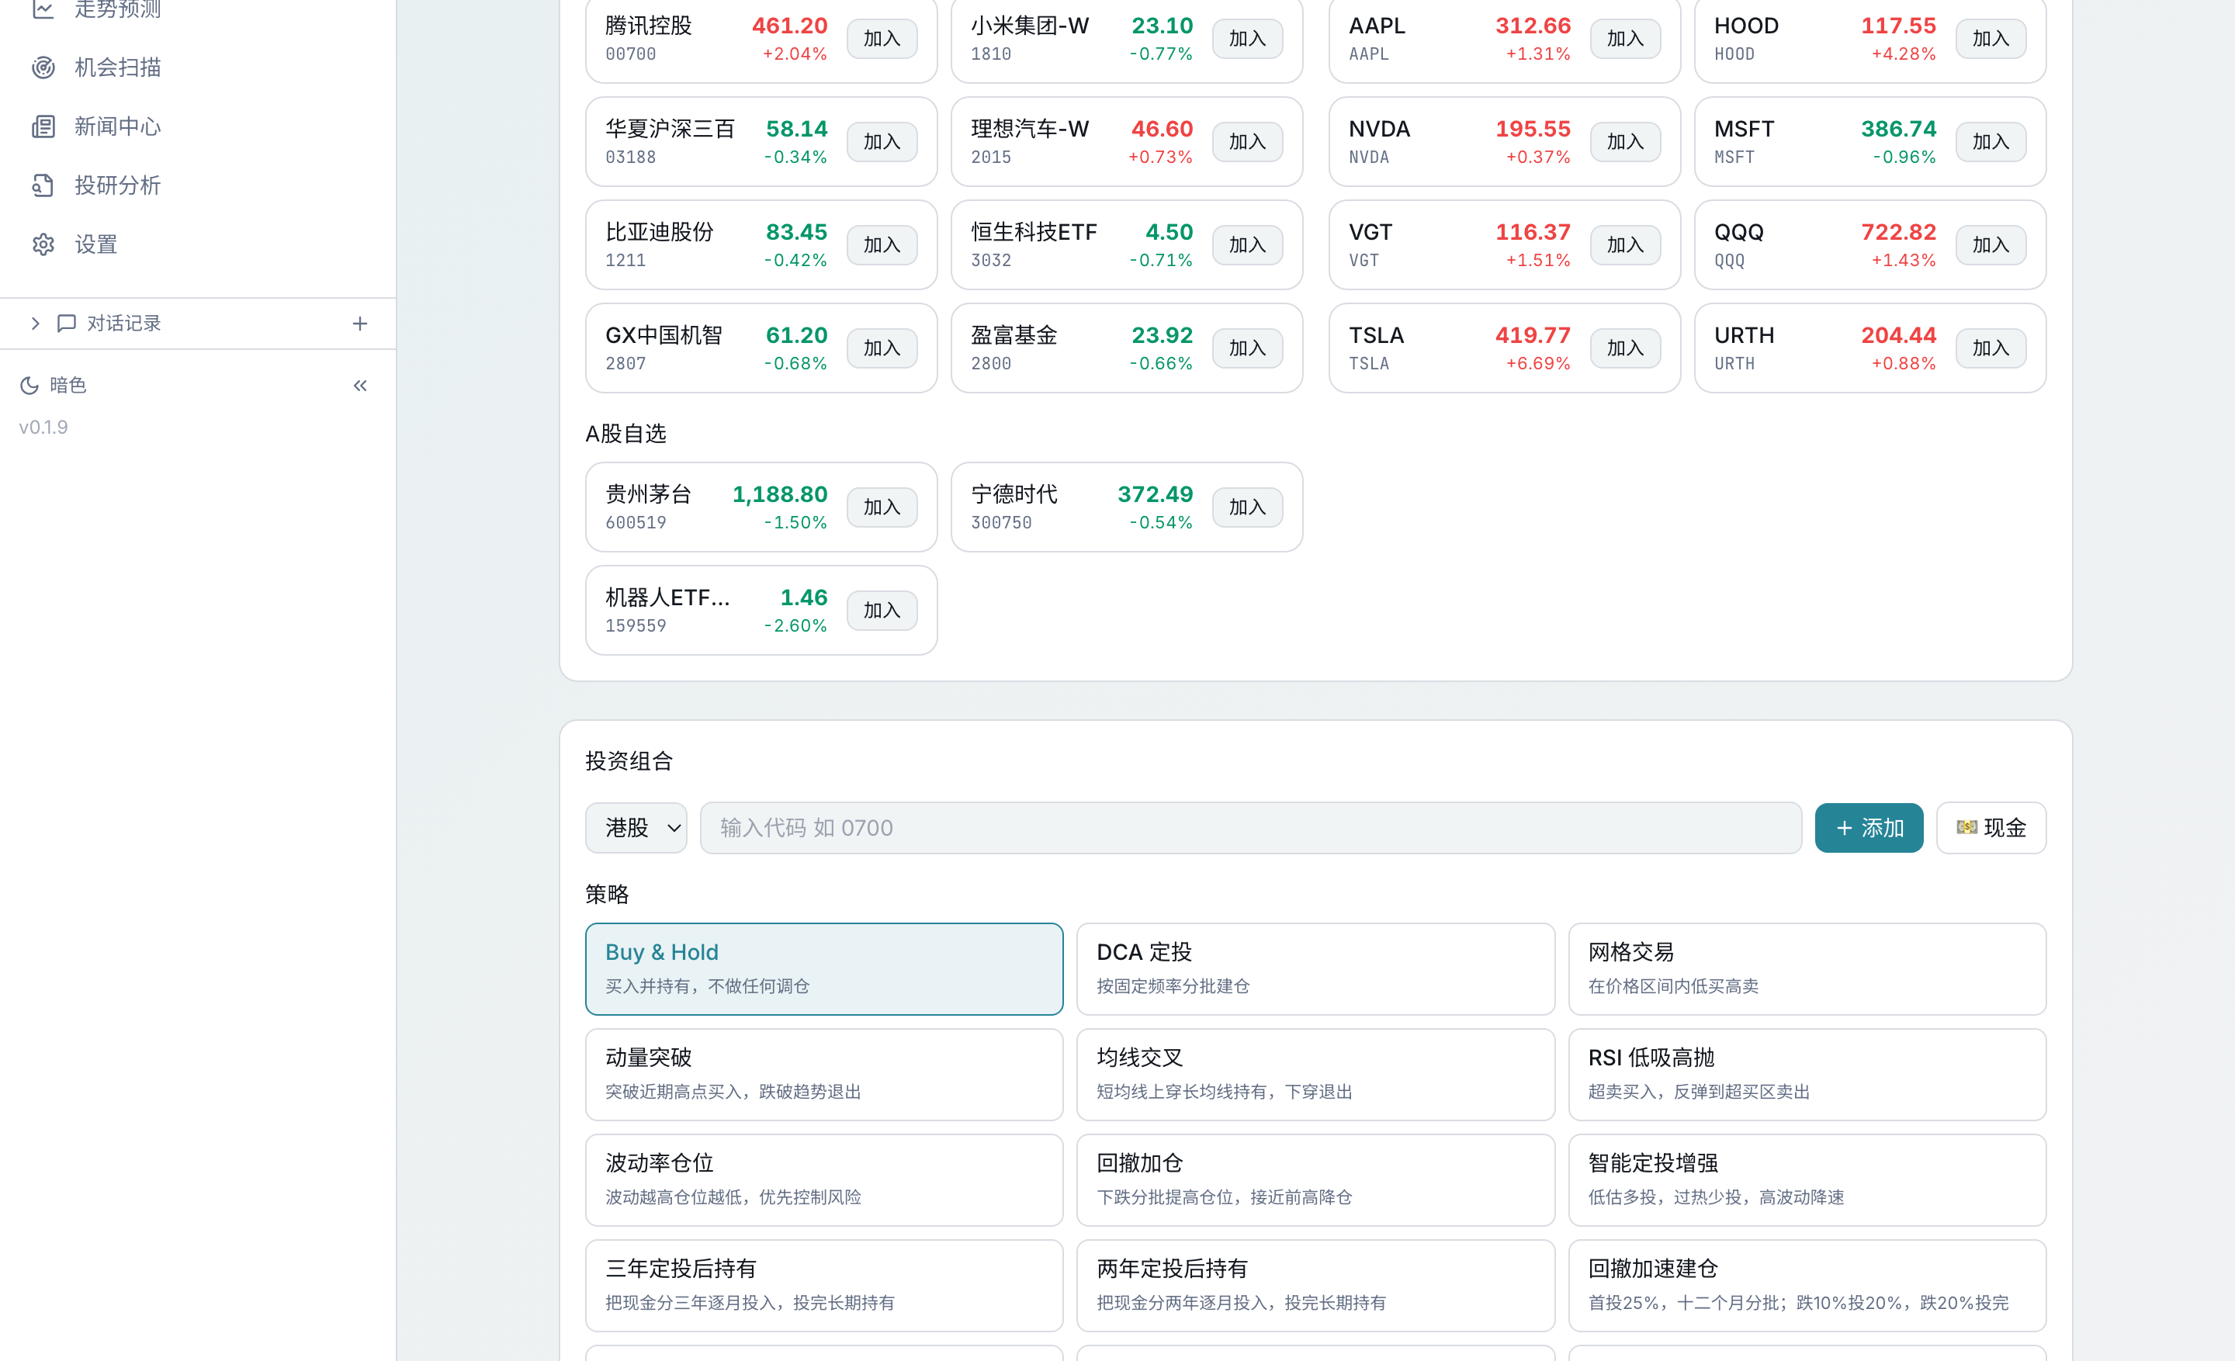
ALPHA MIND
VALIDATION WEDGE
Make every strategy beat a common standard of proof.
The default workflow compares alternatives on the same dates, capital, costs and execution assumptions.
SPY
BUY & HOLD
The market baseline
200-DAY
SPY / CASH
Explicit defensive rotation
V0
DEFENSIVE MOMENTUM
Research candidate
Default: trailing 5 years · Optional historical stress regimes
05

Slide 6
ALPHA MIND
RISK DISCIPLINE
The product is built to disprove strategies before capital is deployed.
Cash is a position. Drawdown is a design input. Backtests are hypotheses—not marketing.
NO LOOK-AHEAD
Signal at close; execution at next open.
RISK-FIRST SCORECARD
FRICTION INCLUDED
Shared capital, transaction costs and benchmark dates.
Return
Is upside repeatable?
Drawdown
Can the investor stay in?
REGIME SLICES
Evaluate behavior across crises, rebounds and sideways markets.
Robustness
Does it survive assumptions?
KNOWN BIASES
Survivorship and data limitations are surfaced, not hidden.
Cash
Is defense explicit?
Goal: stable decision quality—not a beautiful backtest.
06

Slide 7
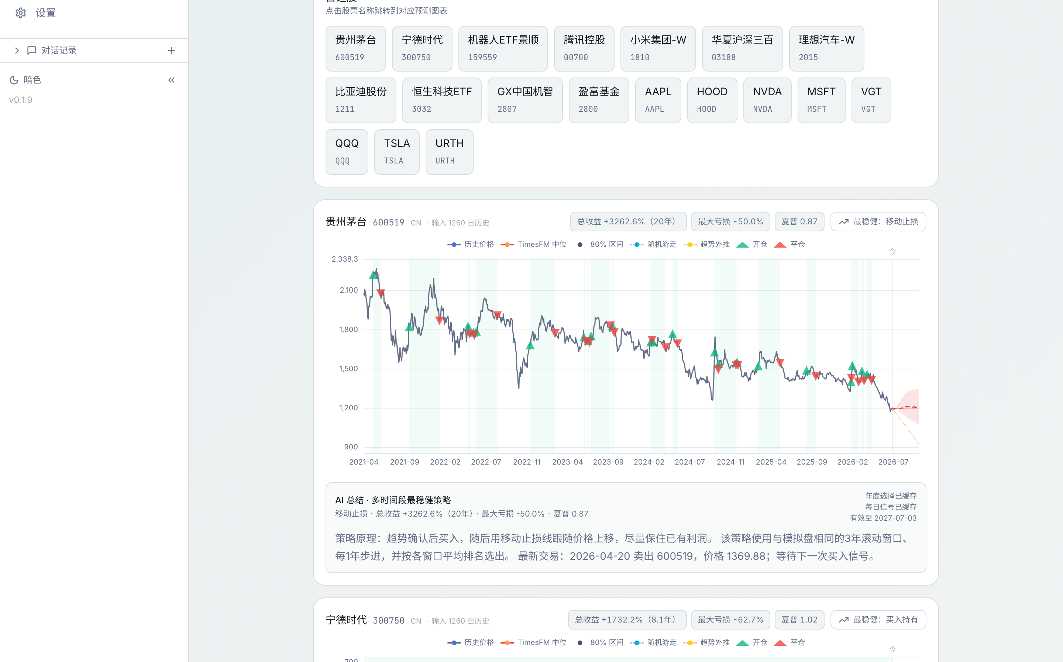
ALPHA MIND
AI ADVANTAGE
AI accelerates synthesis. Engines guard the evidence.
Forecast uncertainty, research provenance and cached daily news keep speed from eroding trust.
DATA
yfinance · akshare · ccxt
↓
ENGINES
factors · backtests · TimesFM
↓
AI LAYER
research · debate · news synthesis
↓
MEMORY
runs · outcomes · analytics
Two-stage news digest: fast local summary first, web enrichment in the background.
07

Slide 8
ALPHA MIND
EXECUTION
A broad product surface—already under active test.
Repository snapshot, 15 Jul 2026. Engineering activity is evidence of execution, not customer traction.
535
307
76
288
TOTAL COMMITS
COMMITS SINCE JUN 1
API ROUTES
TEST FILES
RECENT SHIPPING CADENCE
JUL 15
TimesFM volatility forecasting + automatic first-load
JUL 15
Two-stage AI news digest with background web enrichment
JUL 14
Faster research analysis + daily market preload
JUL 14
Analytics moved into settings with R&D / version visibility
08

Slide 9
ALPHA MIND
MARKET ENTRY
Start with power users. Expand through shared research workflows.
The wedge is personal systematic research; the platform opportunity is team-scale evidence management.
01
02
03
SELF-DIRECTED
SYSTEMATIC INVESTORS
EMERGING FUND
MANAGERS
RIA / FAMILY OFFICE
RESEARCH TEAMS
Unified research workspace
Repeatable strategy scorecards
Auditability + private deployment
PRO SUBSCRIPTION
TEAM WORKSPACE
ENTERPRISE LICENSE
Business model shown as a go-to-market hypothesis; no revenue or customer claims are implied.
09

Slide 10
ALPHA MIND
ROADMAP
The next milestone is not more features. It is stronger strategy evidence.
A focused 12-month plan turns product breadth into an investable validation and distribution engine.
NOW → 90 DAYS
3 → 6 MONTHS
6 → 12 MONTHS
1
2
3
EVIDENCE ENGINE
DESIGN PARTNERS
TEAM PLATFORM
Walk-forward scorecards
Regime library
Bias and cost audits
Small investor cohort
Decision journals
Retention + trust signals
Shared research history
Private deployment
Repeatable distribution
North star: evidence quality × weekly research habit × trusted capital decisions
10

Slide 11
ALPHA MIND
The product is built.
The next milestone is proof.
We are looking for partners who value rigorous iteration over unverified alpha claims.
STRATEGIC CAPITAL
DESIGN PARTNERS
DATA + DISTRIBUTION
Fund the evidence engine and focused go-to-market.
Stress-test the workflow with real investment decisions.
Expand coverage and reach without diluting trust.
Alpha Mind · AI-driven quantitative research assistant
Historical research only. No live performance claims.

