Slide 1
ATSC 3.0 matrix, encoding and decoding
Editor: Yifan Huang
Date: Sep, 9th, 2020

Slide 2
ATSC 3.0 matrix
LDPC (low density parity-check) matrix is adopted for the physical layer of Advanced television System Committee(ATSC)3.0
Two structure: irregular repeat accumulate(IRA) structure and multi-edge type (MET) structure
Code length: 16200 bits and 64800 bits

Slide 3
ATSC 3.0 matrix
IRA structure matrix is tested for code rate from 6/15 to 13/15 of short length code(16200 bits)
M x N matrix, N = 16200, M = N*(1-code rate) is parity length, K is information length
Parity part M x M, dual diagonal, information part M x K, constructed by (b0, b1, b2…bk-1) for the first column of each block, rest columns in each block do the cyclic shift.

Slide 4
Encoding and Decoding
input
encoding
mapping
Add White Guassian noise
decoding
Information output

Slide 5
Encoding and Decoding
General LDPC encoding
Encoding type is systematic as C=[Cr, Ci], which means that ATSC matrix need to swapped for information part and parity part,[Hi, Hp] =>[Hp, Hi]
Decompose Hp to Low triangular and high triangular matrix,(L U)
Cr*Hp’ + Ci*Hi’ = 0 => Cr*L’*U’ + Ci*Hi’ = 0
Cr*L’*U’ = Ci*Hi’ => L’*(Cr*U’) = Ci*Hi’
Cr = [(Ci*H’)/L’]/U’
all the operations are using GF(2)
Higher complexity of operation in hardware

Slide 6
Encoding and Decoding
ATSC3.0 Encoding
Accumulate each Ci to Cr(b(j,l)+q1*z), and Cr(k)=Cr(k)+Cr(k-1), C= [Ci, Cr]
All the accumulation is using GF(2)

Slide 7
Encoding and Decoding
Mapping
Binary mapping: 0 => 1and 1 = > -1, 0+ => 0 and 0- =>1
LLR mapping: LLR+ => 0 and LLR- =>1(log likely-hood ratio)
Message passing
Bipartite graph with edges representing nonzero elements in H matrix, N variable nodes connect M check nodes. Initialize the message (Posteriori probability) from channel, calculate N variable nodes outgoing message, pass these message to M check nodes, and calculate the outgoing message at M check nodes, then pass back to N nodes, which completes one iteration. Iterate multiple times until the syndrom reaches ‘0’ or the iterations time reaches max number.

Slide 8
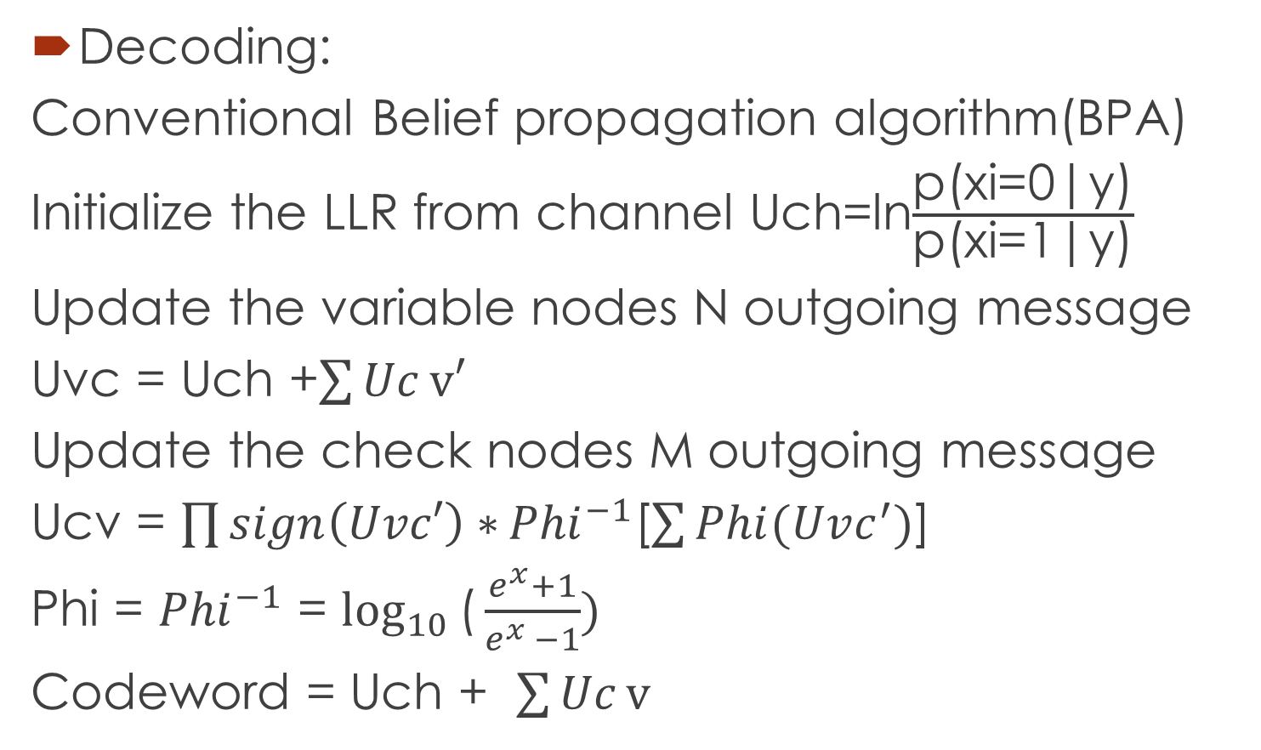
Encoding and Decoding
Decoding:
Conventional Belief propagation algorithm(BPA)
Initialize the LLR from channel Uch=ln$\frac{\text{p}\text{(}\text{xi}\text{=0|}\text{y}\text{)}}{\text{p}\text{(}\text{xi}\text{=1|}\text{y}\text{)}}$
Update the variable nodes N outgoing message
Uvc = Uch +$\sum{Uc}v′$
Update the check nodes M outgoing message
Ucv = $\prod{sign\left(Uvc′\right)∗}{Phi}^{−1}$[$\sum{Phi(Uvc^{′})}$]
Phi = ${Phi}^{−1}$ = $\log_{10}{\text{(}\frac{e^{x}+1}{e^{x }−1}) }$
Codeword = Uch + $\sum{Uc}v$

Slide 9
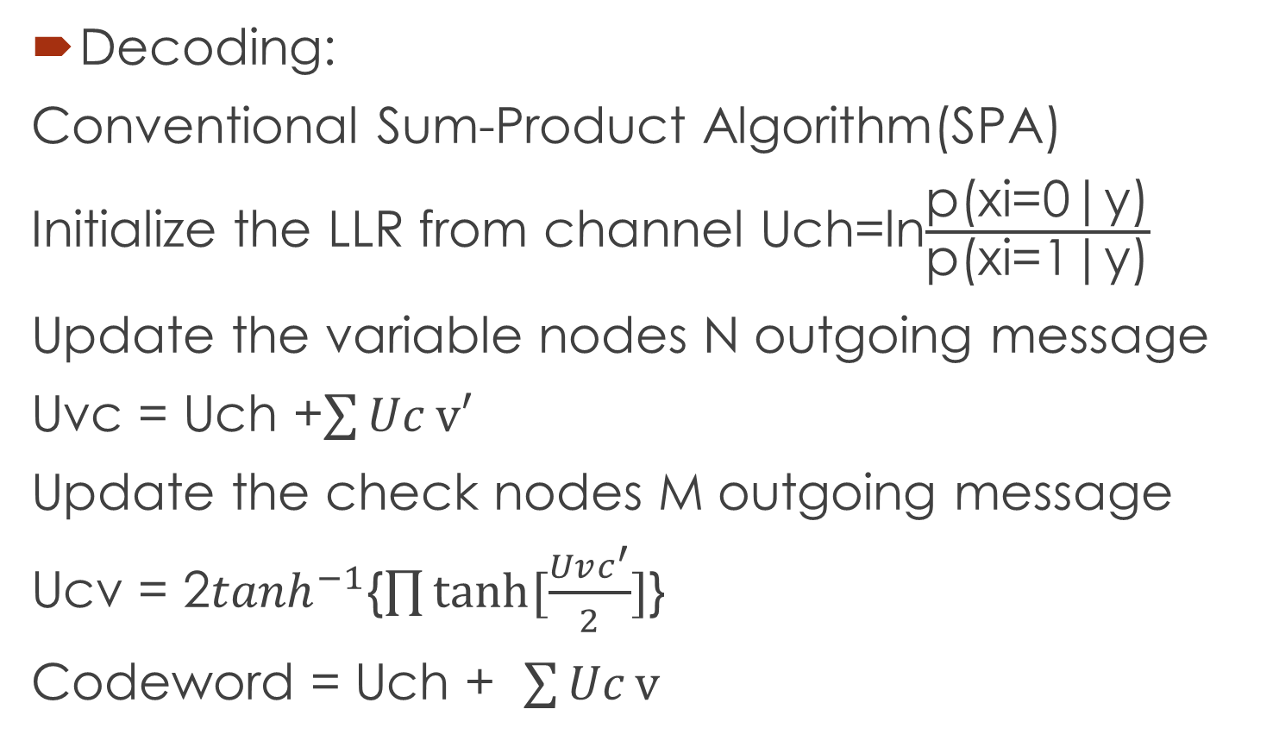
Encoding and Decoding
Decoding:
Conventional Sum-Product Algorithm(SPA)
Initialize the LLR from channel Uch=ln$\frac{\text{p}\text{(}\text{xi}\text{=0|}\text{y}\text{)}}{\text{p}\text{(}\text{xi}\text{=1|}\text{y}\text{)}}$
Update the variable nodes N outgoing message
Uvc = Uch +$\sum{Uc}v′$
Update the check nodes M outgoing message
Ucv = 2$\tanh^{−1}${$\prod{tanh⁡[\frac{Uvc^{′}}{2}]}$}
Codeword = Uch + $\sum{Uc}v$

Slide 10
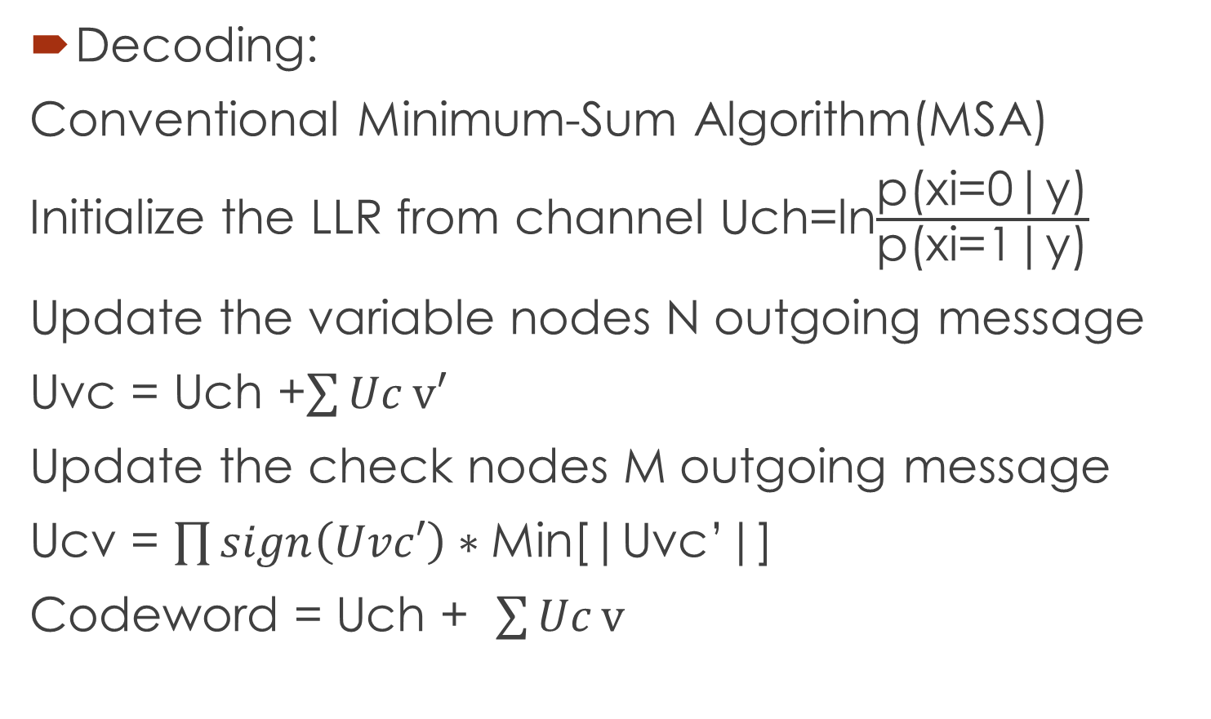
Encoding and Decoding
Decoding:
Conventional Minimum-Sum Algorithm(MSA)
Initialize the LLR from channel Uch=ln$\frac{\text{p}\text{(}\text{xi}\text{=0|}\text{y}\text{)}}{\text{p}\text{(}\text{xi}\text{=1|}\text{y}\text{)}}$
Update the variable nodes N outgoing message
Uvc = Uch +$\sum{Uc}v′$
Update the check nodes M outgoing message
Ucv = $\prod{sign\left(Uvc′\right)∗}$Min[|Uvc’|]
Codeword = Uch + $\sum{Uc}v$

Slide 11
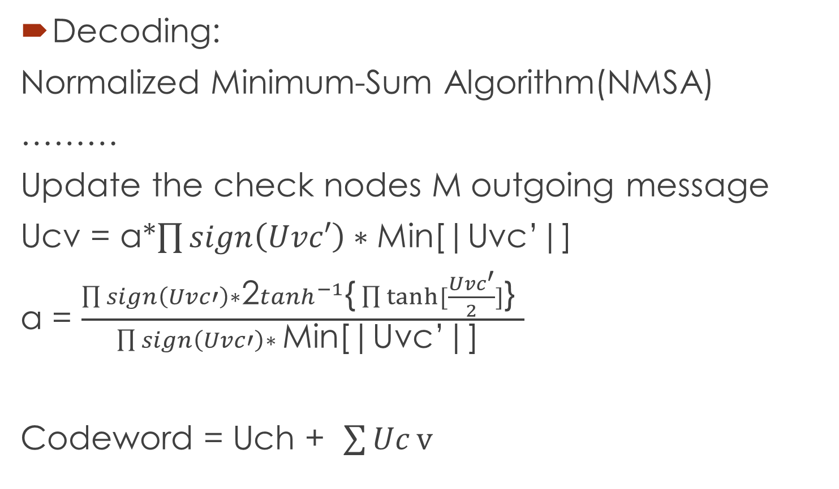
Encoding and Decoding
Decoding:
Normalized Minimum-Sum Algorithm(NMSA)
………
Update the check nodes M outgoing message
Ucv = a*$\prod{sign\left(Uvc′\right)∗}$Min[|Uvc’|]
a = $\frac{\prod{sign\left(Uvc′\right)∗}\text{2}\tanh^{−1}\text{\{}\prod{tanh⁡[\frac{Uvc^{′}}{2}]}\text{\} }}{\prod{sign\left(Uvc′\right)∗} \text{Min}\text{[|}\text{Uvc}\text{’|] }}$
Codeword = Uch + $\sum{Uc}v$

Slide 12
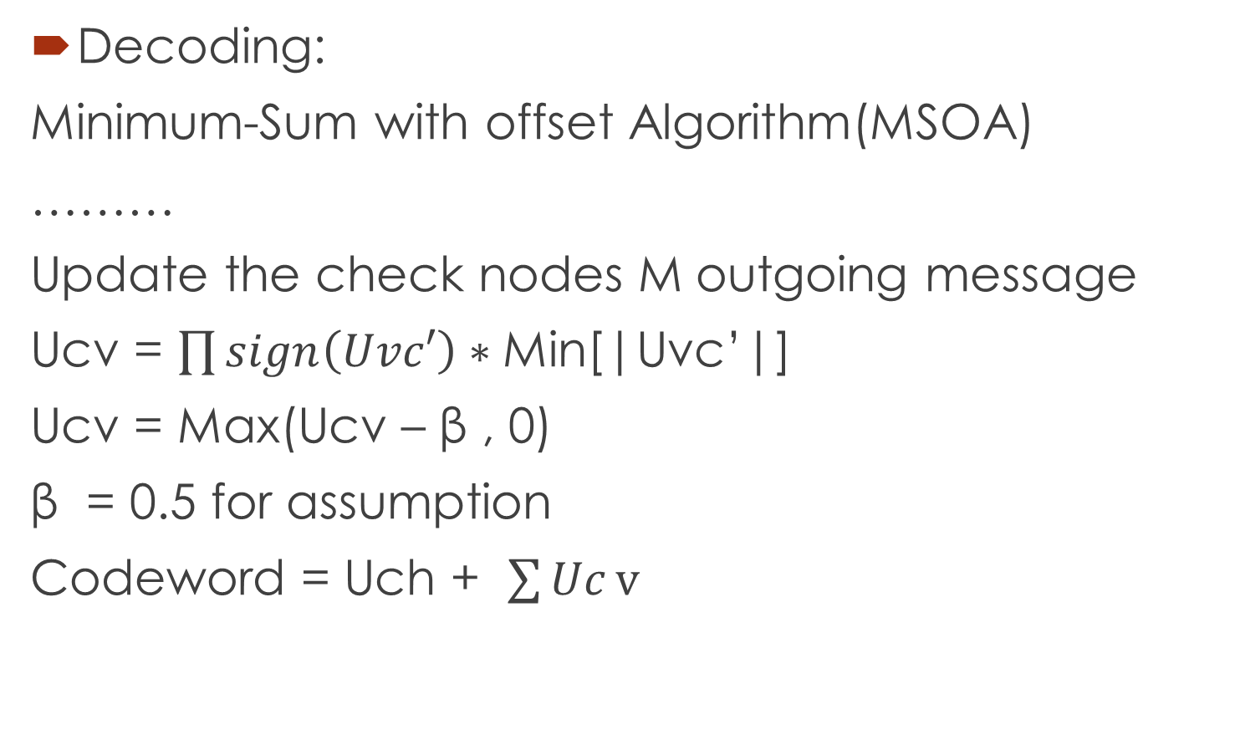
Encoding and Decoding
Decoding:
Minimum-Sum with offset Algorithm(MSOA)
………
Update the check nodes M outgoing message
Ucv = $\prod{sign\left(Uvc′\right)∗}$Min[|Uvc’|]
Ucv = Max(Ucv – β , 0)
β = 0.5 for assumption
Codeword = Uch + $\sum{Uc}v$

Slide 13
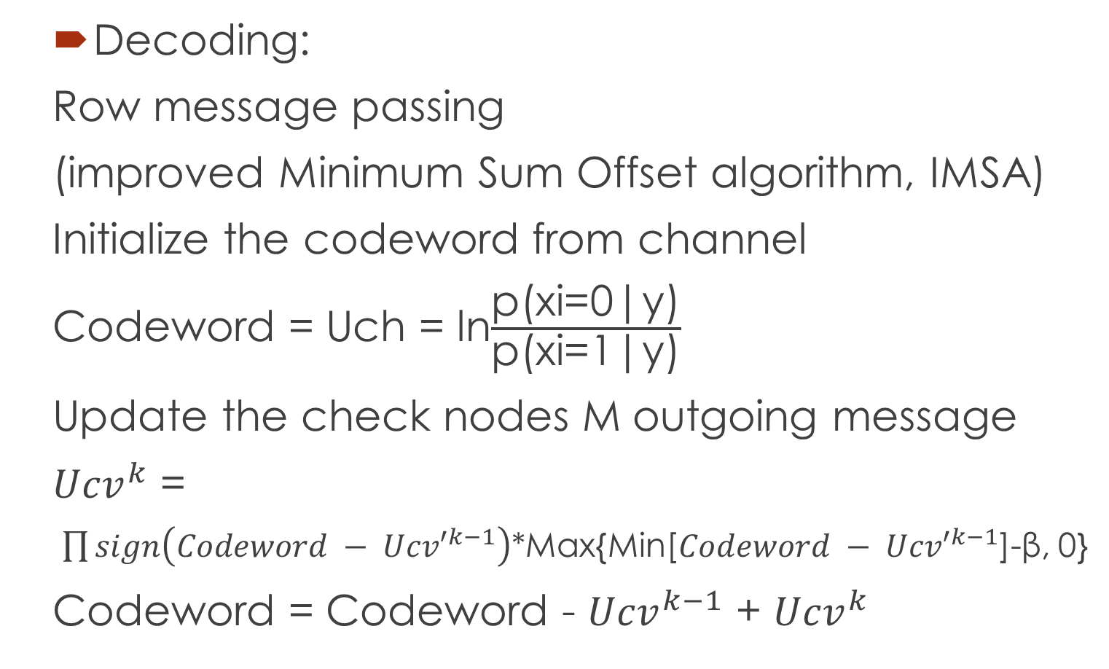
Encoding and Decoding
Decoding:
Row message passing
(improved Minimum Sum Offset algorithm, IMSA)
Initialize the codeword from channel
Codeword = Uch = ln$\frac{\text{p}\text{(}\text{xi}\text{=0|}\text{y}\text{)}}{\text{p}\text{(}\text{xi}\text{=1|}\text{y}\text{)}}$
Update the check nodes M outgoing message
${Ucv}^{k}$ =
$\prod{sign\left(Codeword − {Ucv′}^{k−1}\right)}$*Max{Min[$Codeword − {Ucv′}^{k−1}$]-β, 0}
Codeword = Codeword - ${Ucv}^{k−1}$ + ${Ucv}^{k}$

Slide 14
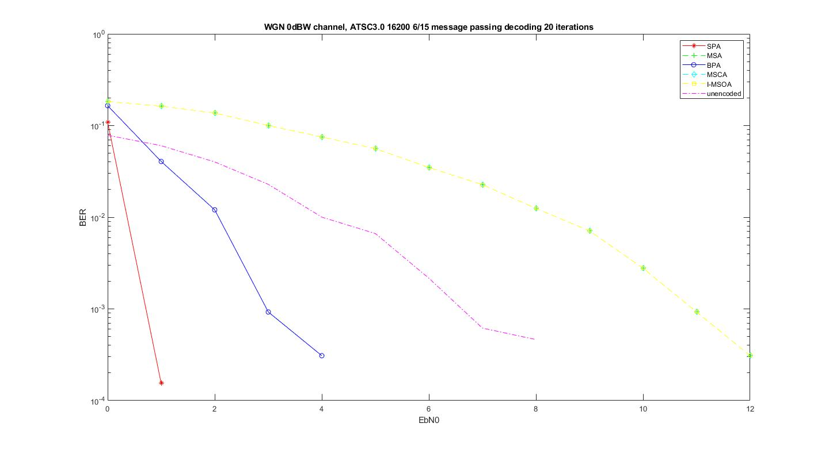
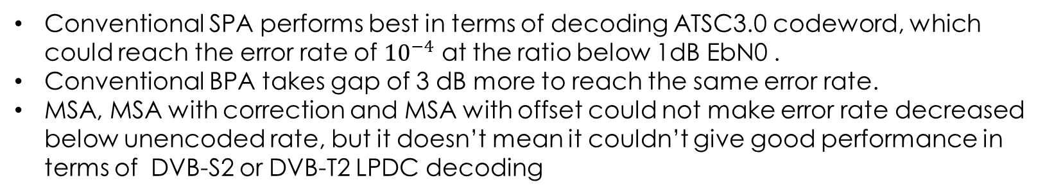
Encoding and Decoding
Conventional SPA performs best in terms of decoding ATSC3.0 codeword, which could reach the error rate of ${10}^{−4}$ at the ratio below 1dB EbN0 .
Conventional BPA takes gap of 3 dB more to reach the same error rate.
MSA, MSA with correction and MSA with offset could not make error rate decreased below unencoded rate, but it doesn’t mean it couldn’t give good performance in terms of DVB-S2 or DVB-T2 LPDC decoding

Slide 15
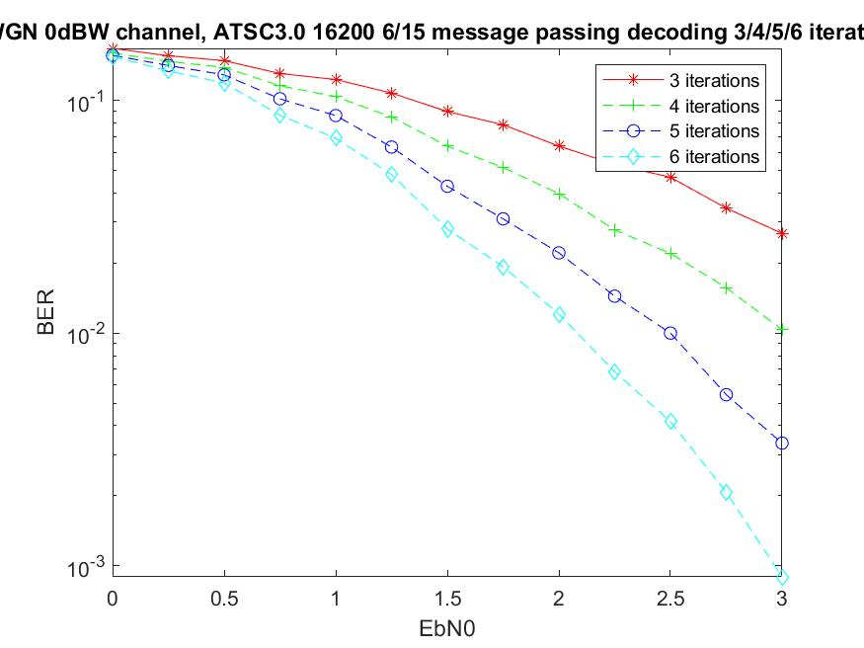
Encoding and Decoding
Message passing iteration increases, the bit error rate could decrease.

Slide 16
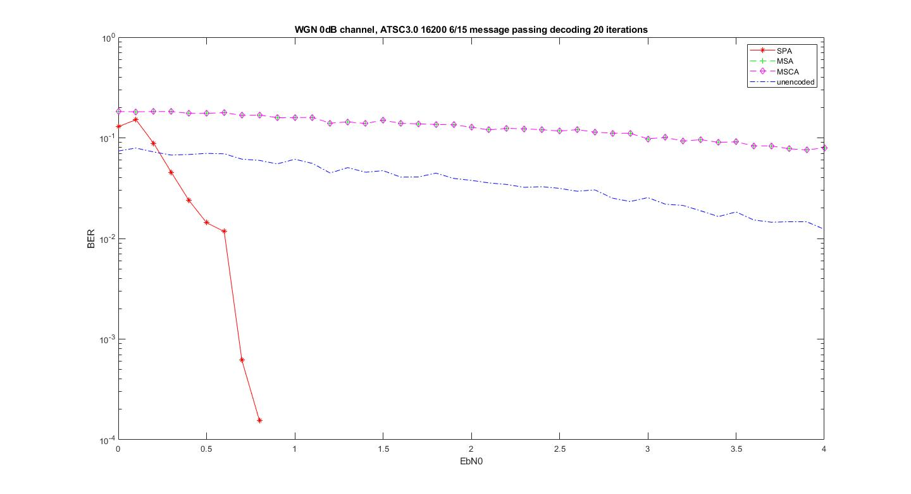
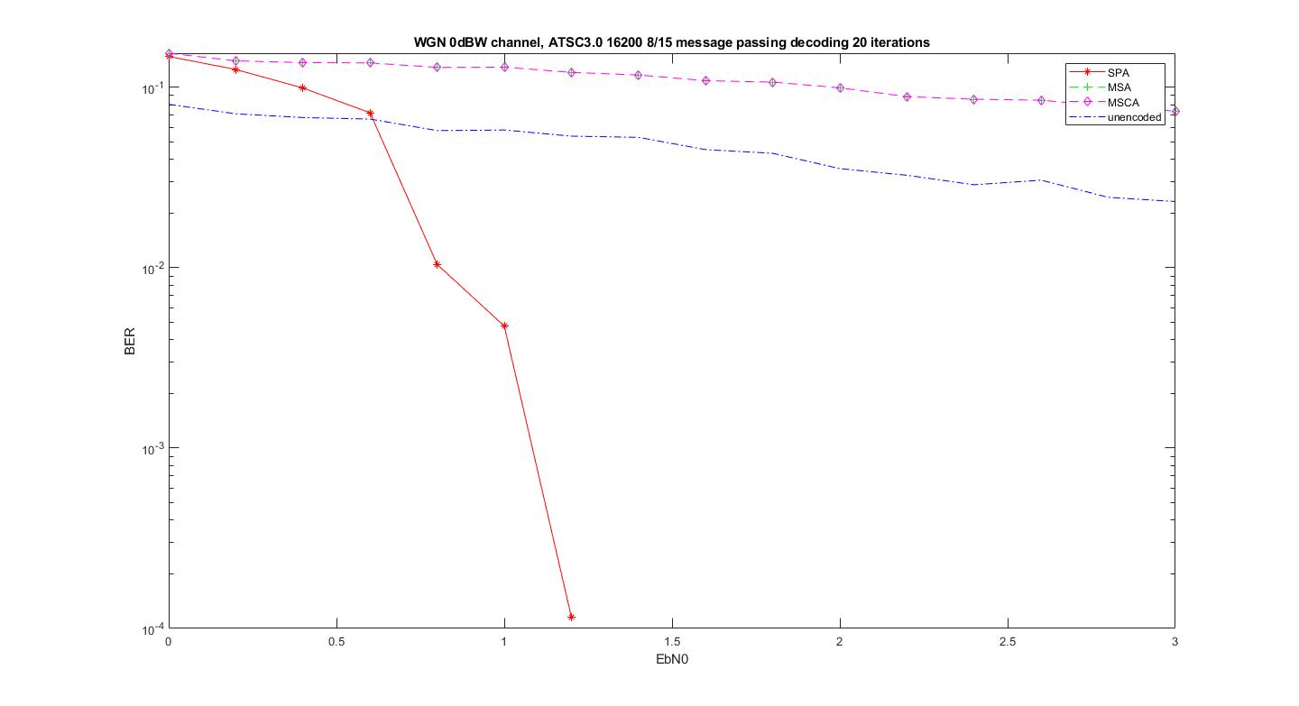
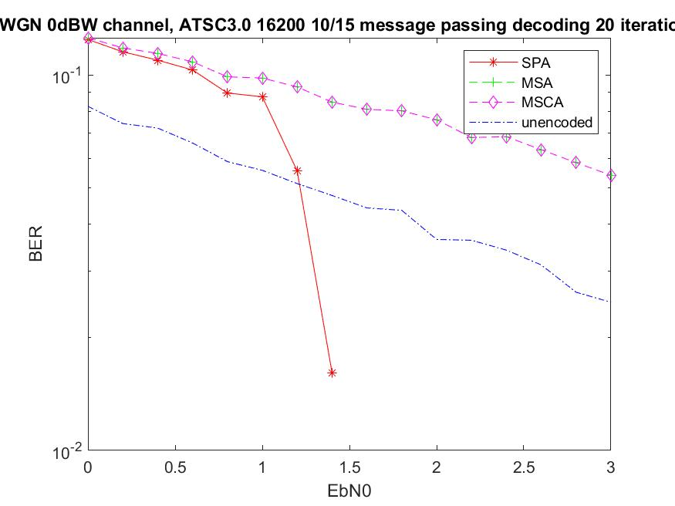
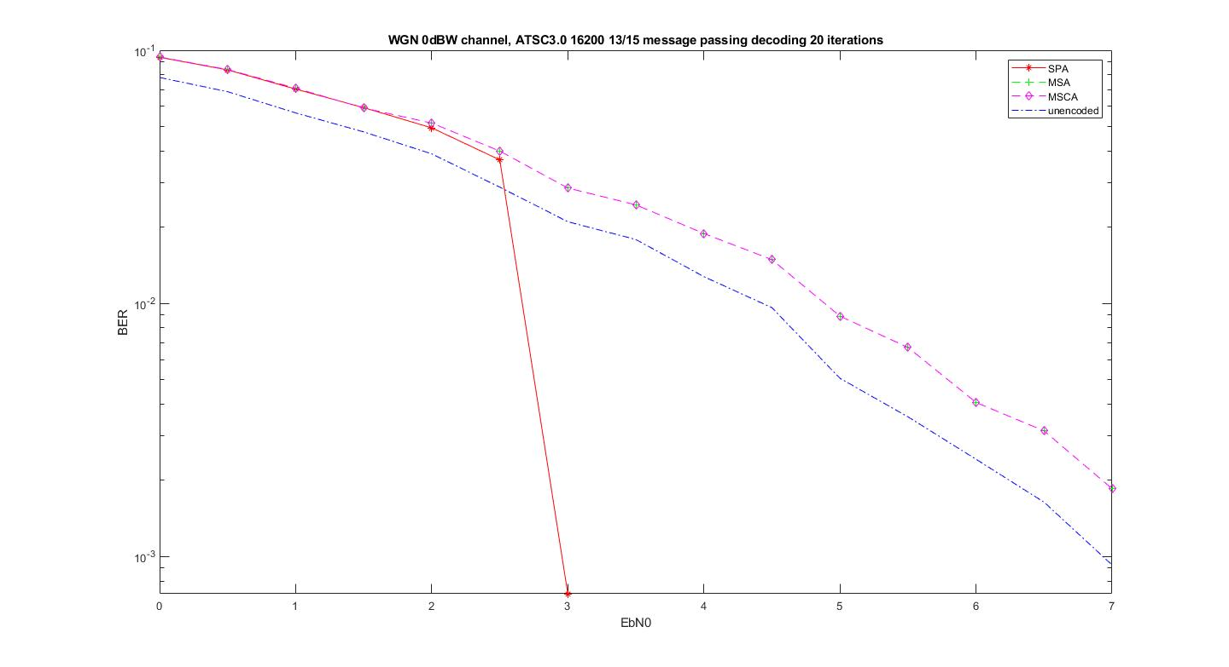
Encoding and Decoding
As the code rate increases, the error rate decreases as well for specific EbN0.
Code rate : 6/15 , 8/15, 10/15 13/15

Slide 17
Reference
IEEE TRANSACTIONS ON BROADCASTING, VOL. 62, NO. 1, MARCH 2016
ATSC Standard Physical layer Protocol , Doc. A/322 2020, 23 January 2020
High performance short-block binary regular LDPC codes, Latifa Mostari a,*, Abdelmalik Taleb-Ahmed b, Alexandria Engineering Journal (2018) 57, 2633–2639
Message Passing Algortihm and Linear Programming Decoding for LDPC and Linear Block Codes , author: Nana Traore,Shashi Kant and Tobias Lindstrøm Jensen, Aalborg University, 2007.
Modified Decoding Algorithm of LDPC Codes, by CHEN Xu-can and LIU Dong-pei , Computer School, National University of Defense Technology Changsha 410073.
Efficient Encoding of Low-Density Parity-Check Codes, Thomas J. Richardson and Rüdiger L. Urbanke

Slide 18
Reference
Introduction to Low-Density Parity Check Codes by Brian Kurkoski kurkoski@ice.uec.ac.jp
Efficient Implementations of the Sum-Product Algorithm for Decoding LDPC Codes, by Xiao–Yu Hu, Evangelos Eleftheriou, Dieter–Michael Arnold, and Ajay Dholakia, IBM Research, Zurich Research Laboratory, CH-8803 R¨uschlikon, Switzerland, 2014
Low-Density Parity-Check Codes for ATSC 3.0.Author: Kyung-Joong Kim, Seho Myung, Sung-Ik Park, Senior Member, IEEE, Jae-Young Lee, Member, IEEE, Makiko Kan, Yuji Shinohara, Jong-Woong Shin, and Jinwoo Kim, IEEE TRANSACTIONS ON BROADCASTING, VOL. 62, NO. 1, MARCH 2016
An Improved Normalized Min-Sum Algorithm for LDPC Codes, Jinlei Chen, Yan Zhang and Ruiyi Sun Key Laboratory of Network Oriented Intelligent Computation Shenzhen Graduate School, Harbin Institute of Technology HIT Campus of Shenzhen University Town Shenzhen, China, 518055

