Slide 1
ELEC 413 PROJECT
BY: YIFAN HUANG (40068609)

Slide 2
Introduction
4-to-1 multiplexer
CML driver and SST driver
Feed Forward Equalizer
Transmission line
Continuous Time Linear Equalizer

Slide 3
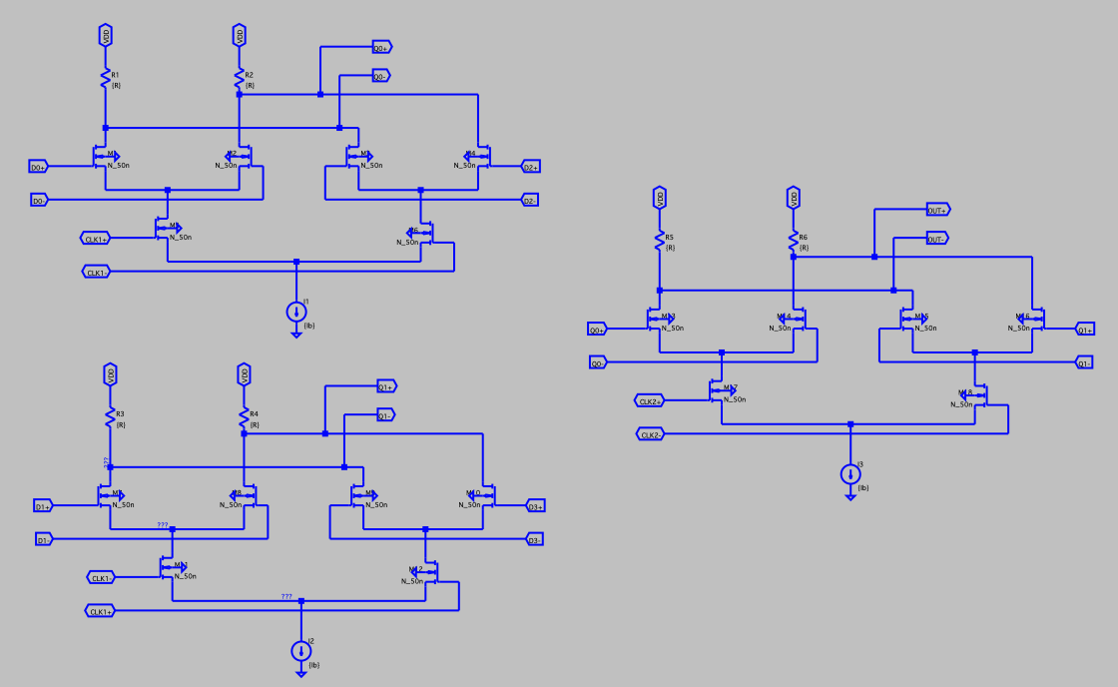
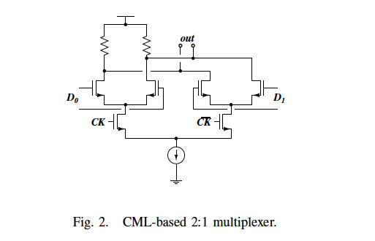
multiplexer
Four sets of Random 2.5 Gb/s signals passing through 4-1 multiplexer
4-1 mux composed by three 2-1 multiplexer

Slide 4
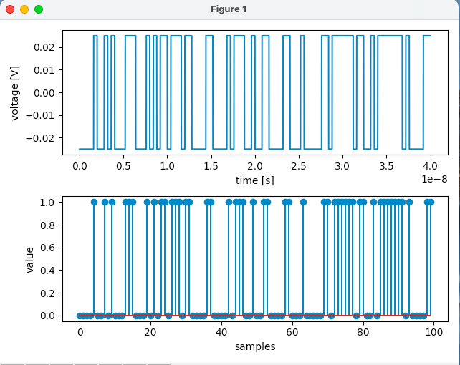
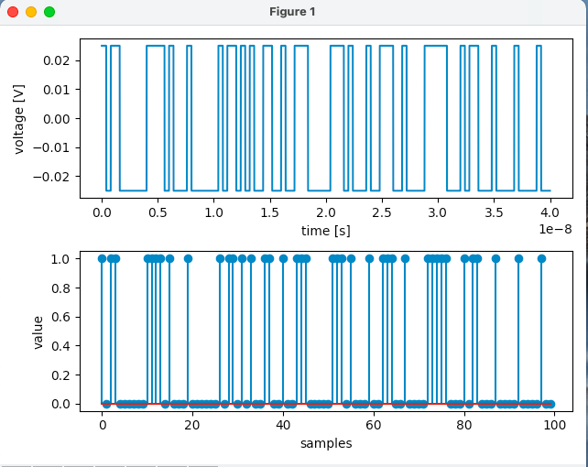
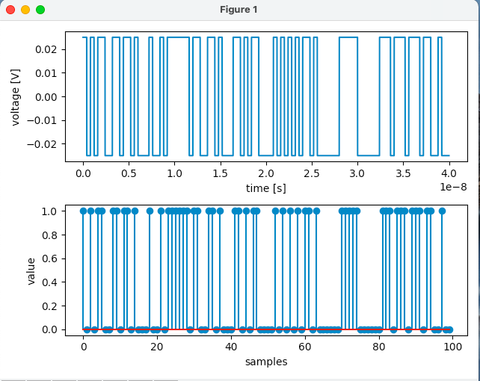
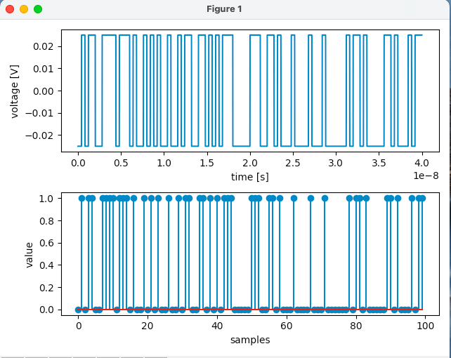
multiplexer
Input signal is random selected pulse using python script

Slide 5
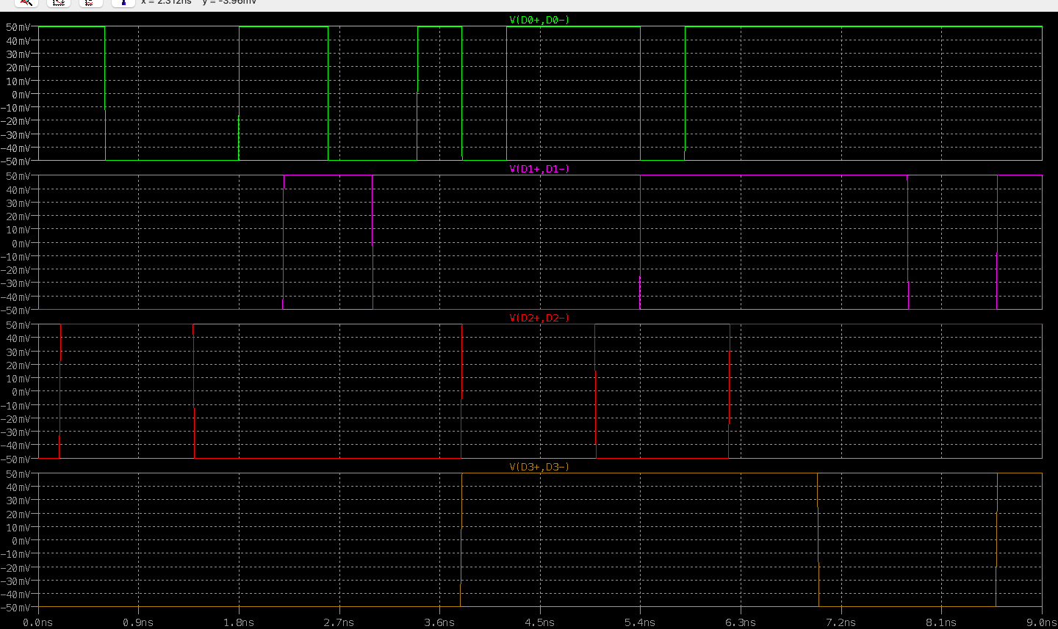
Multiplexer output

Slide 6
Multiplexer Clock
5 GHz for stage one
10 GHz for sage two

Slide 7
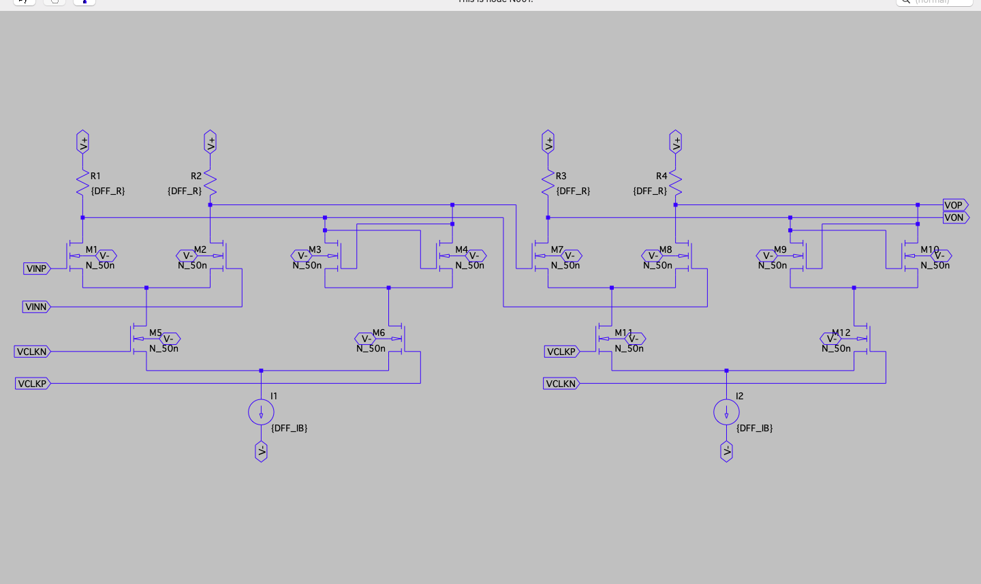
DFF pair

Slide 8
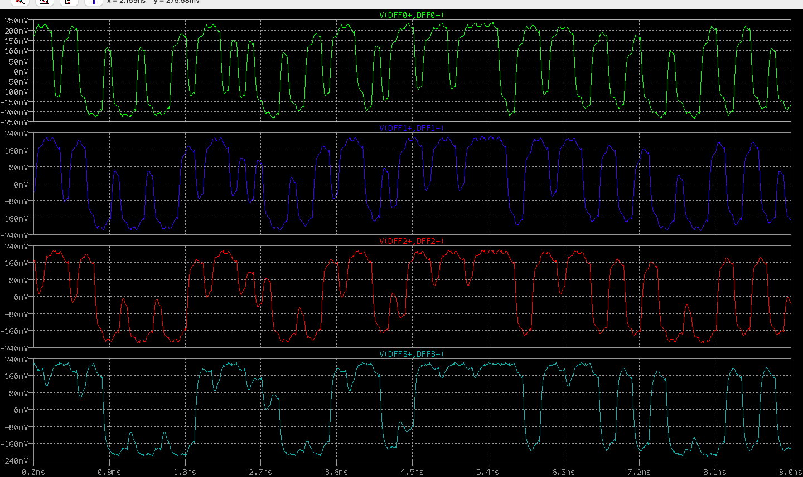
Decision circuit transient signal

Slide 9
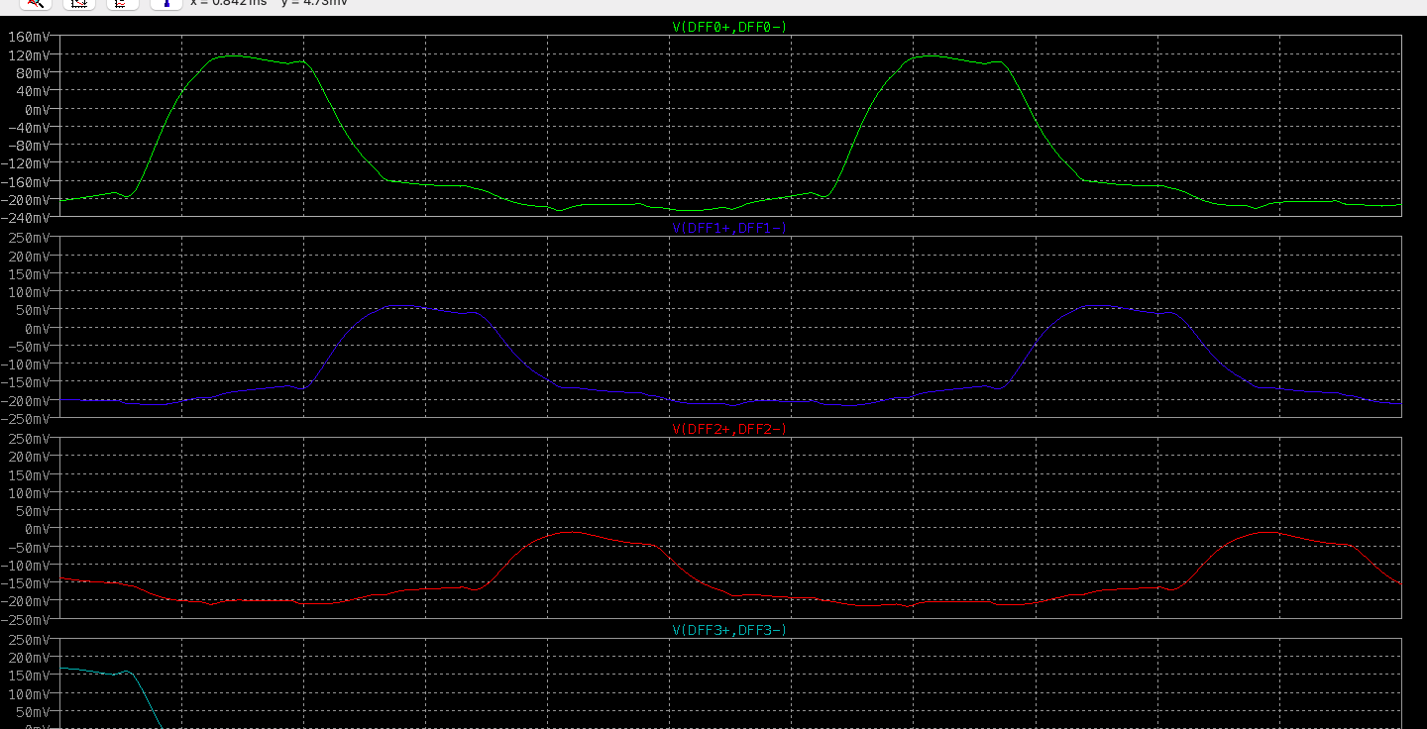

Slide 10
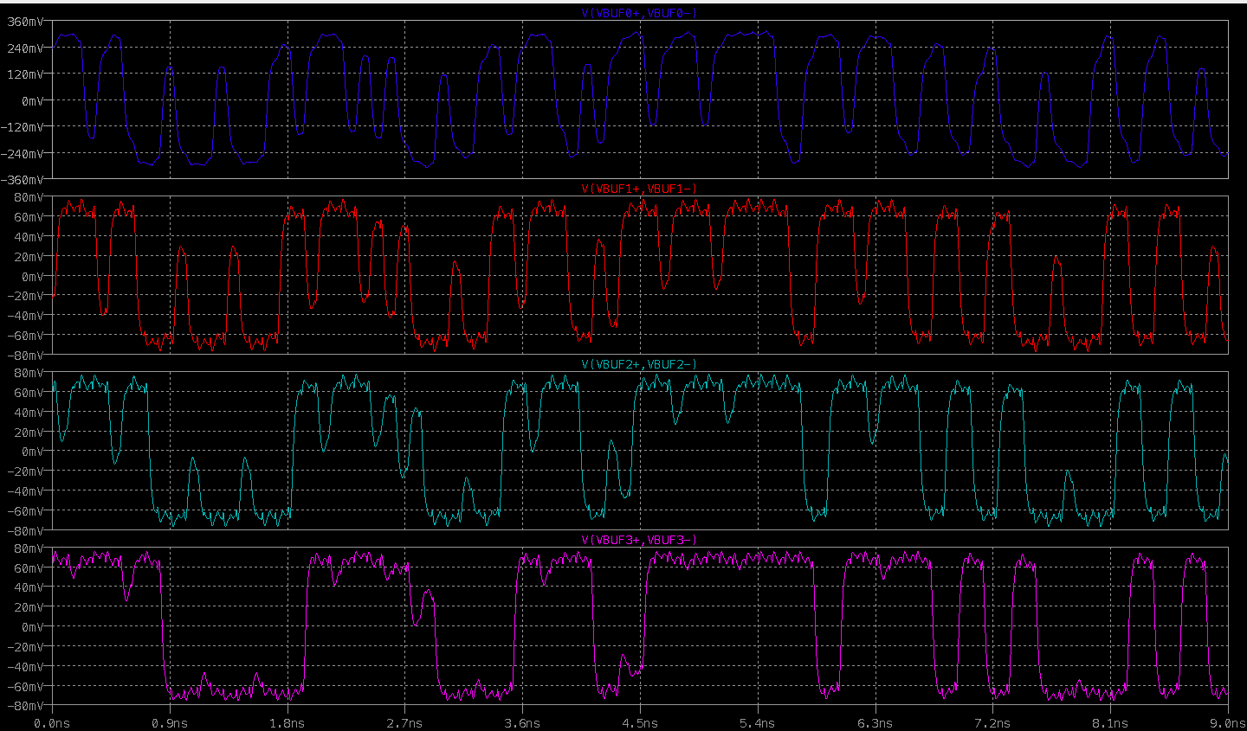
Before subtraction

Slide 11
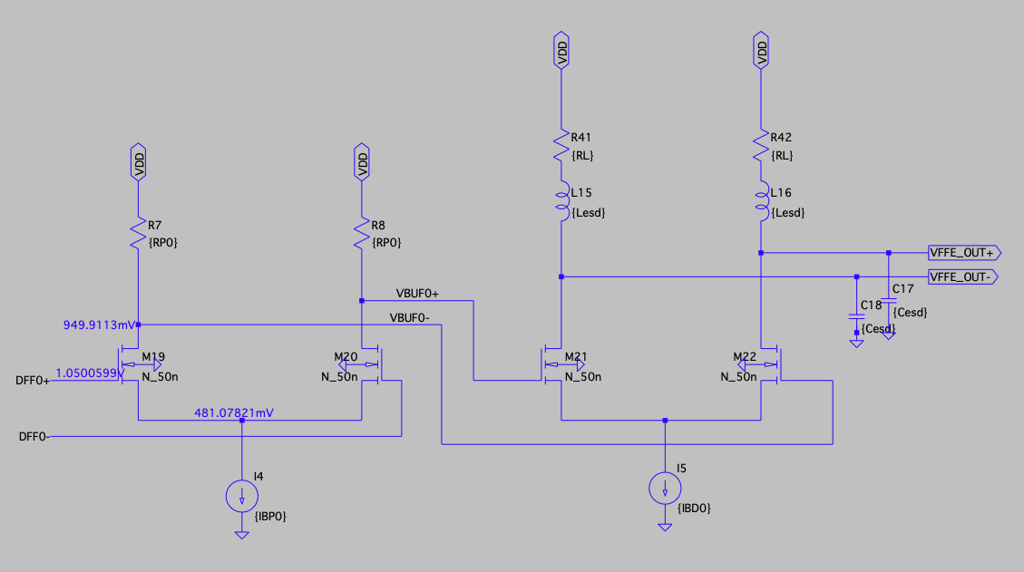
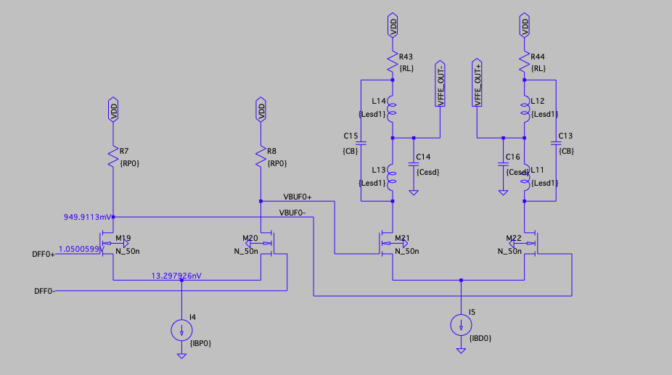
CML driver with inductive peaking

Slide 12
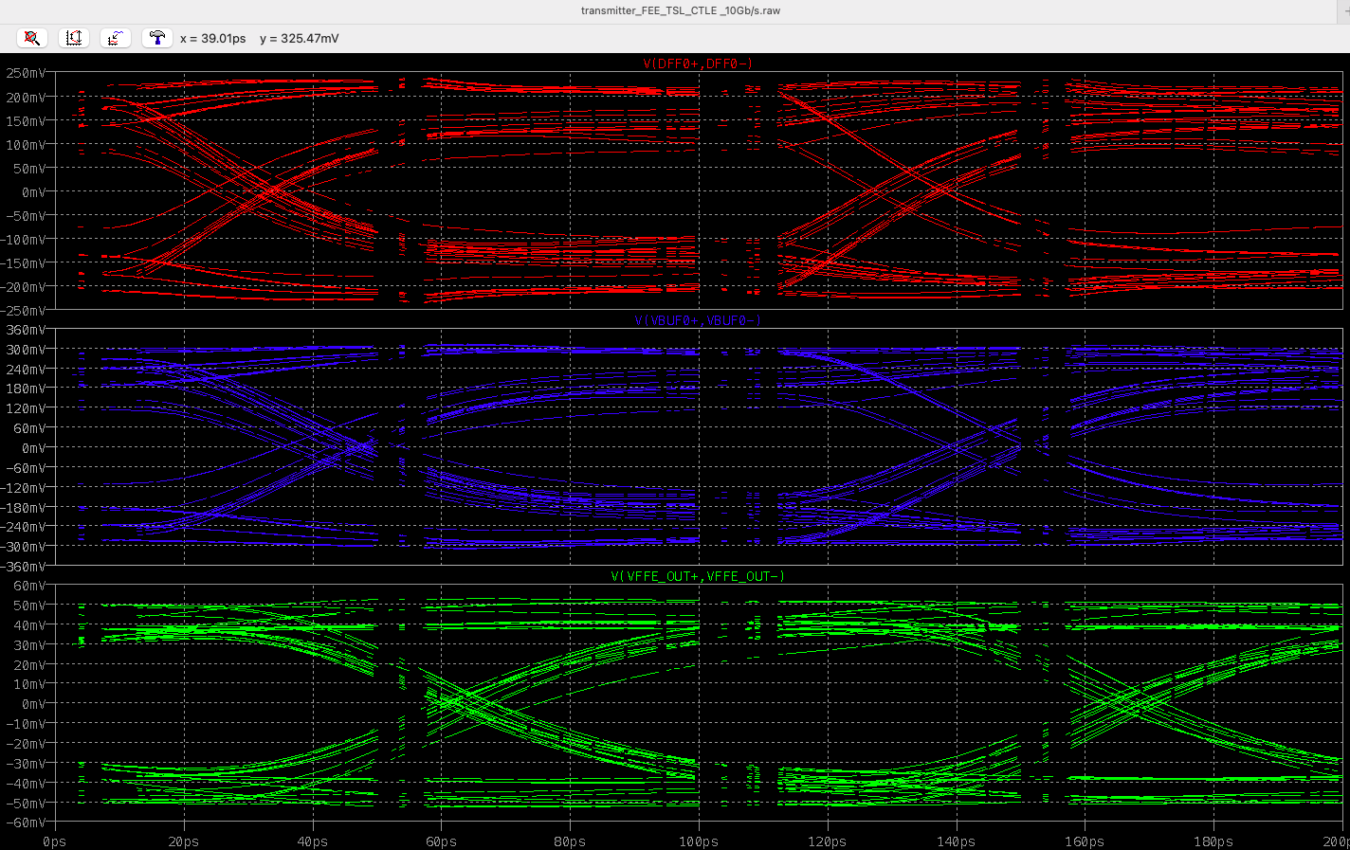
CML driver with RC load

Slide 13
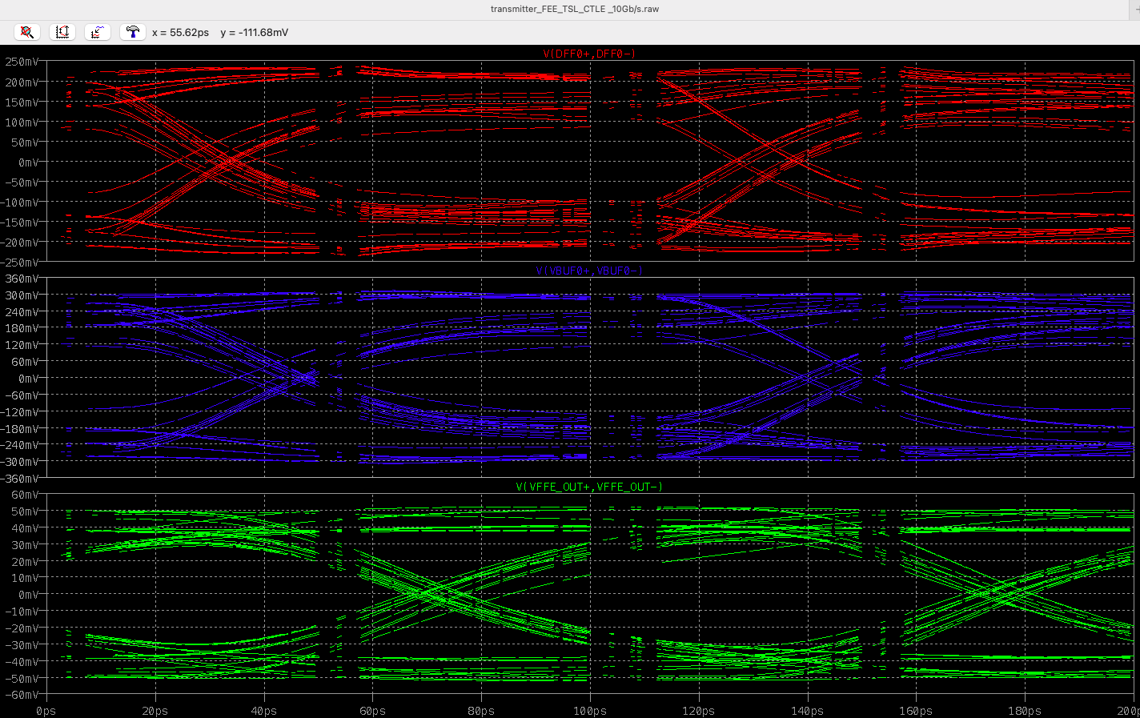
CML driver with shunt peaking damping ≈ 0.99

Slide 14
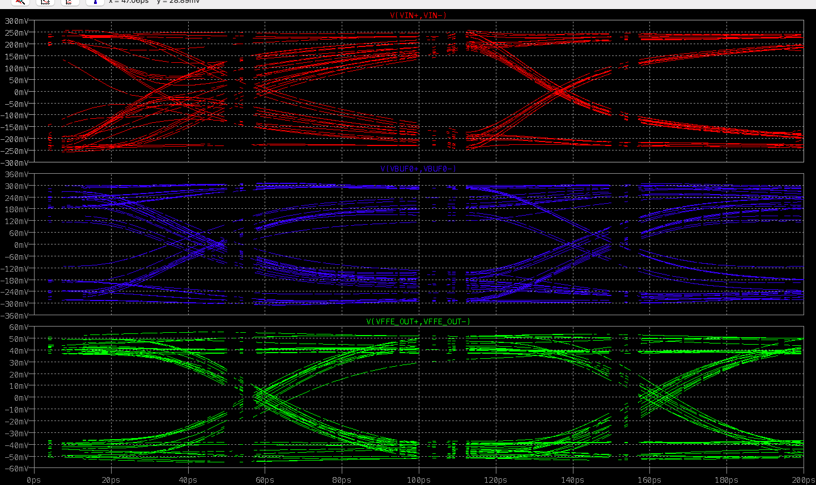
CML driver with shunt peaking damping ≈ 0.707

Slide 15
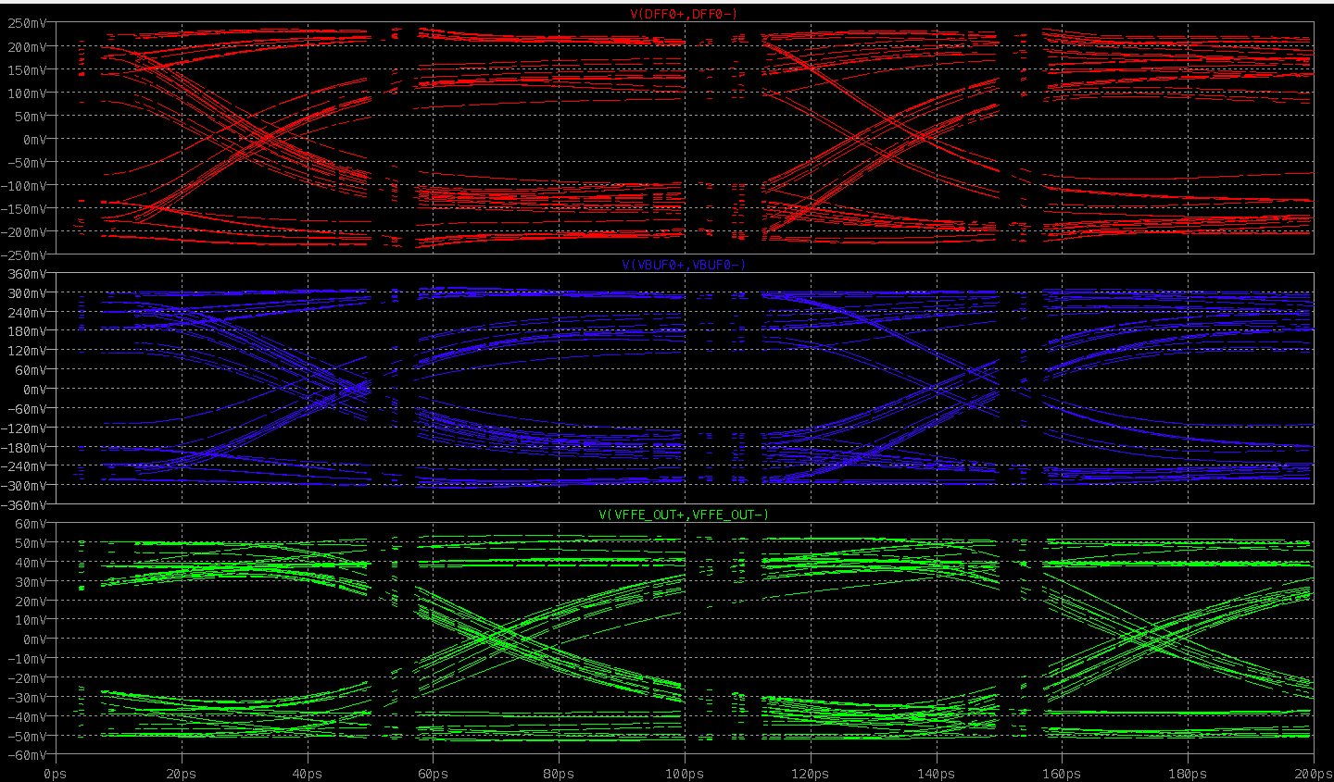
CML driver with T-coil bridge damping ≈0.99

Slide 16
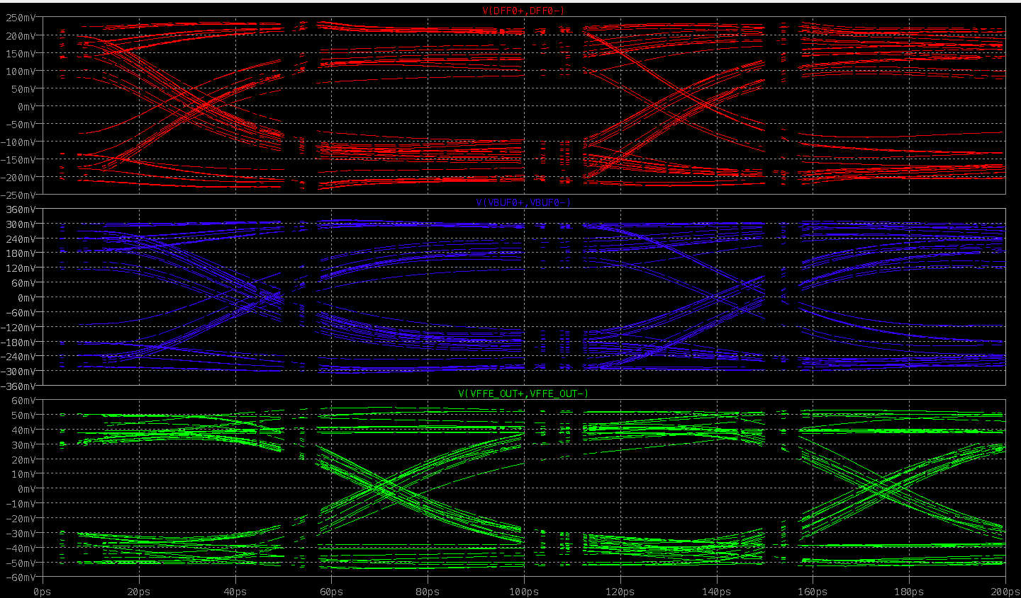
CML driver with T-coil bridge damping ≈0.707

Slide 17
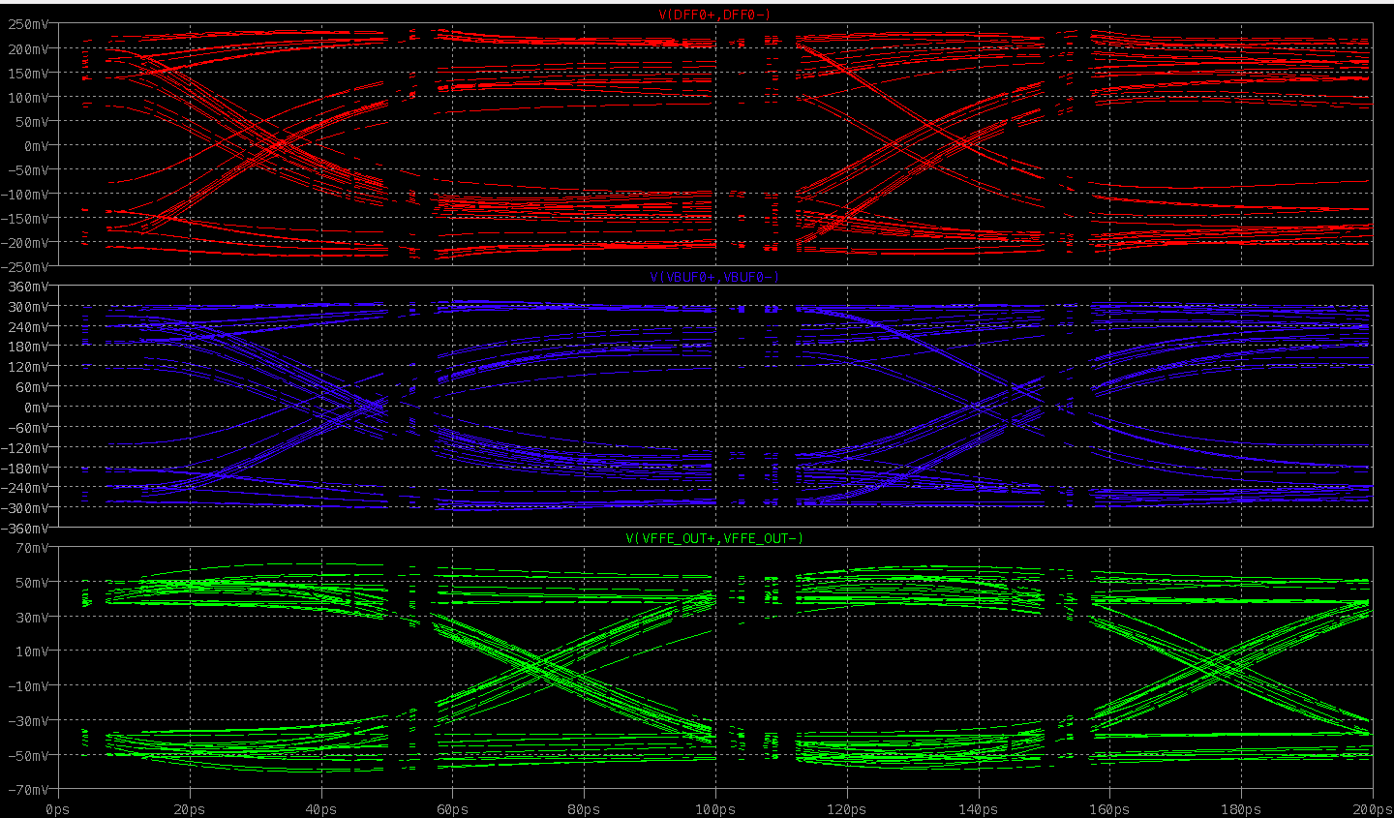
CML driver with T-coil bridge damping ≈0.5

Slide 18
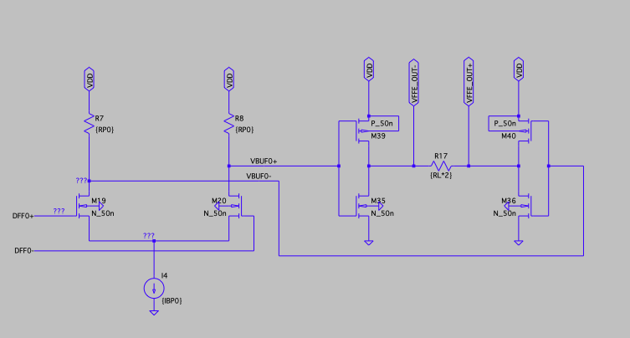
SST driver

Slide 19
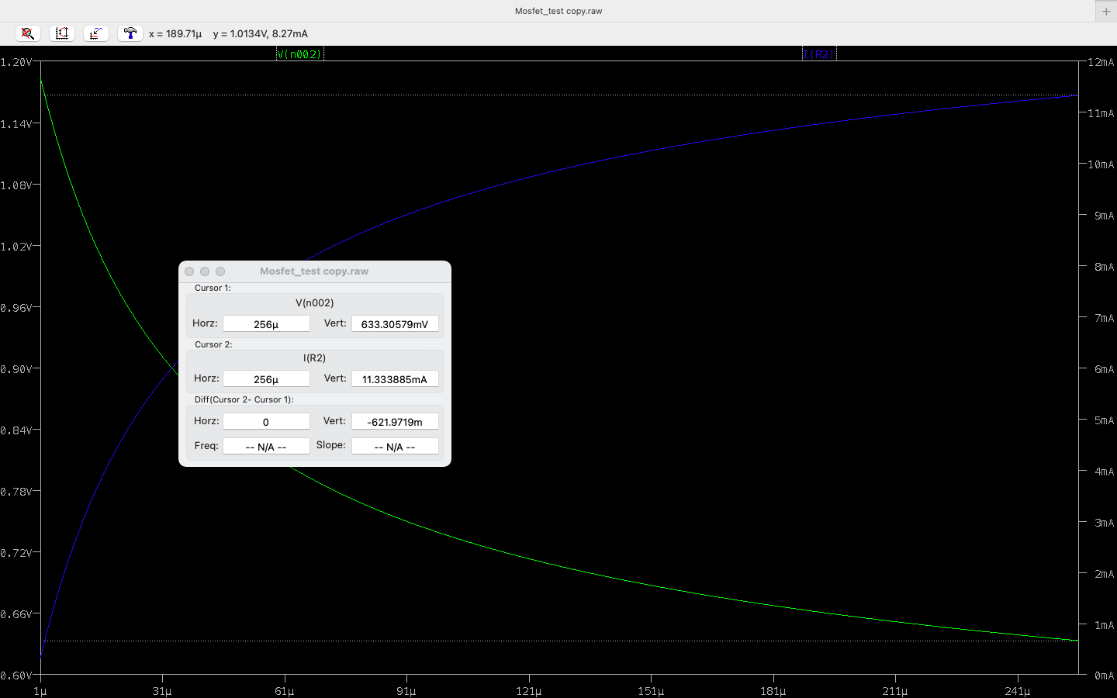
SST driver MOSFET impedance ≈55Ω

Slide 20
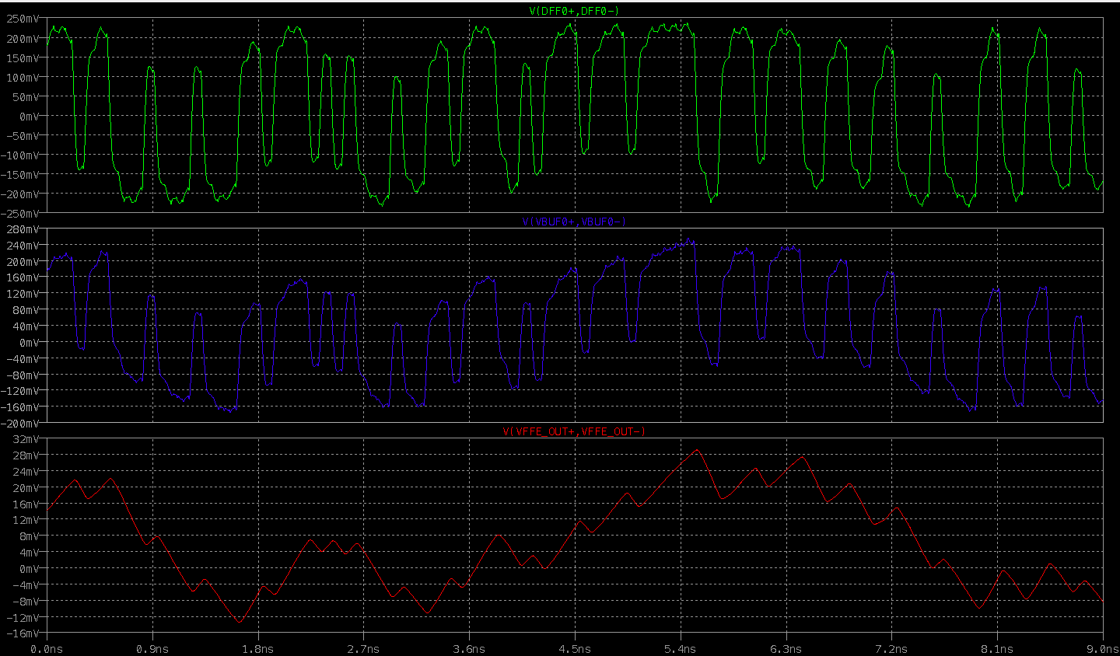
SST driver Z(mosfet) ≈ 55Ω

Slide 21
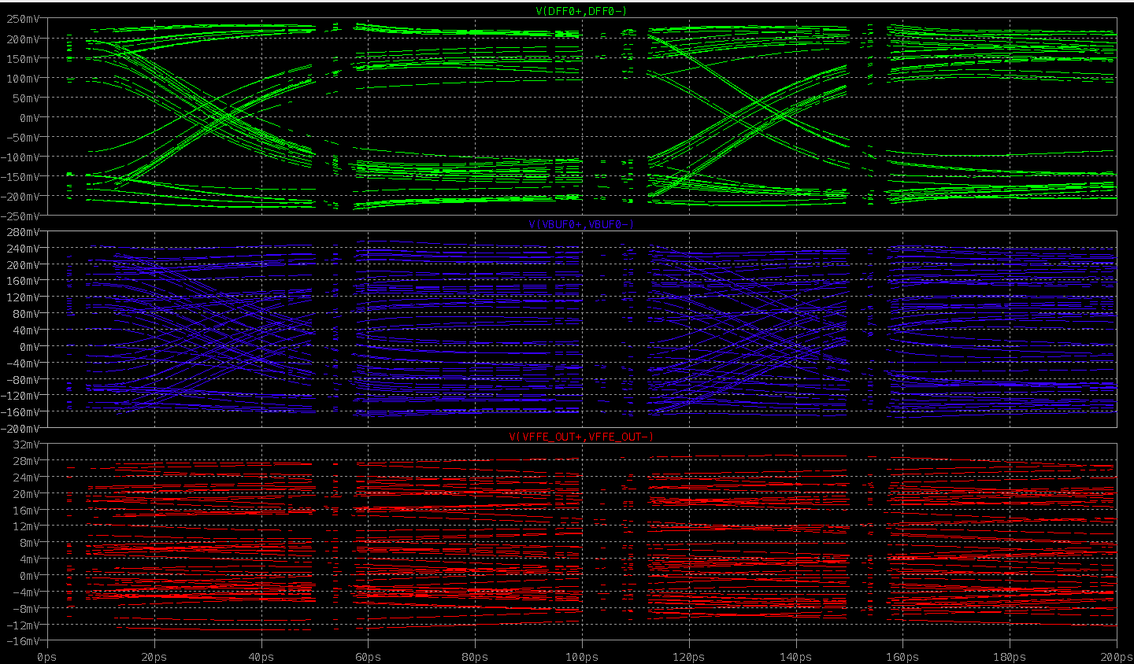
SST driver z(mosfet)≈55Ω

Slide 22
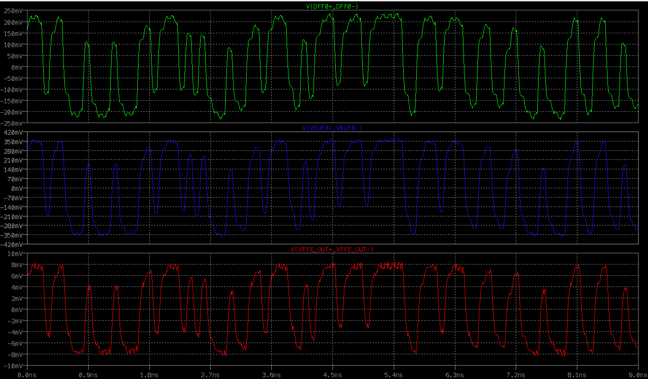
SST driver z(mosfet) ≈ 900Ω

Slide 23
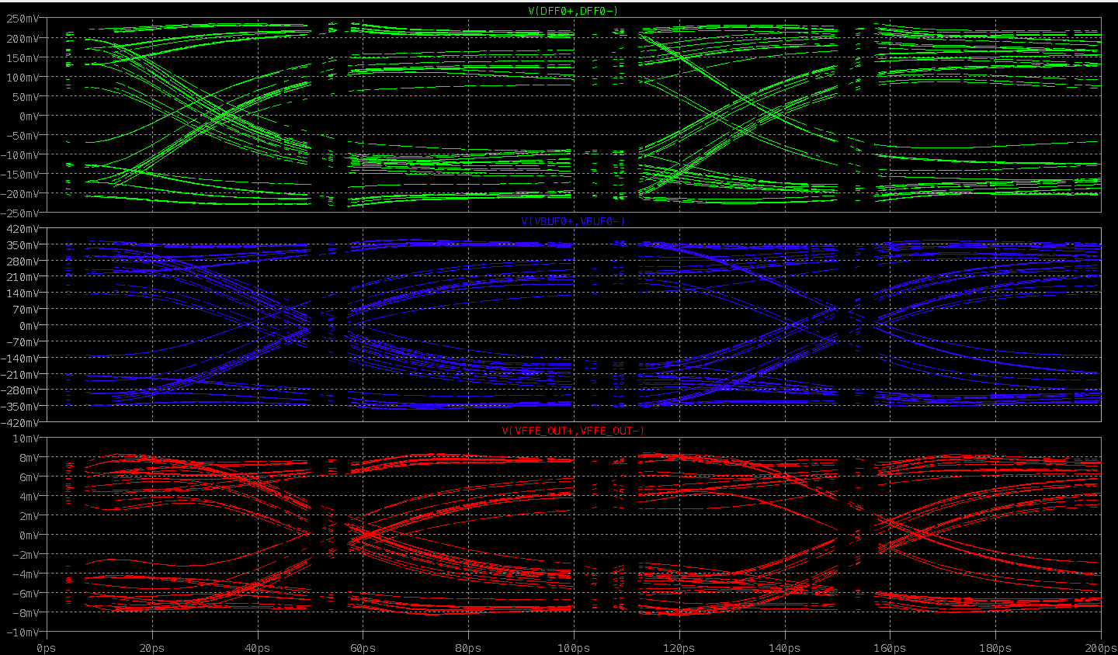
SST driver z(mosfet) ≈ 900Ω

Slide 24
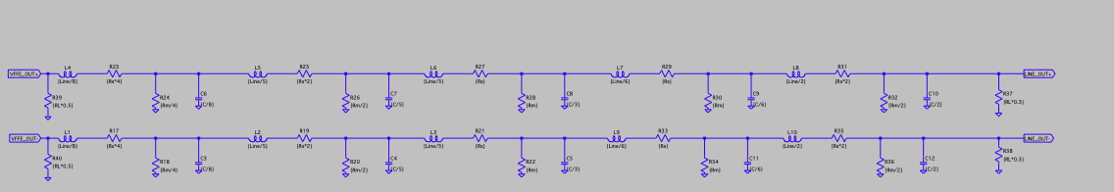
TS line

Slide 25
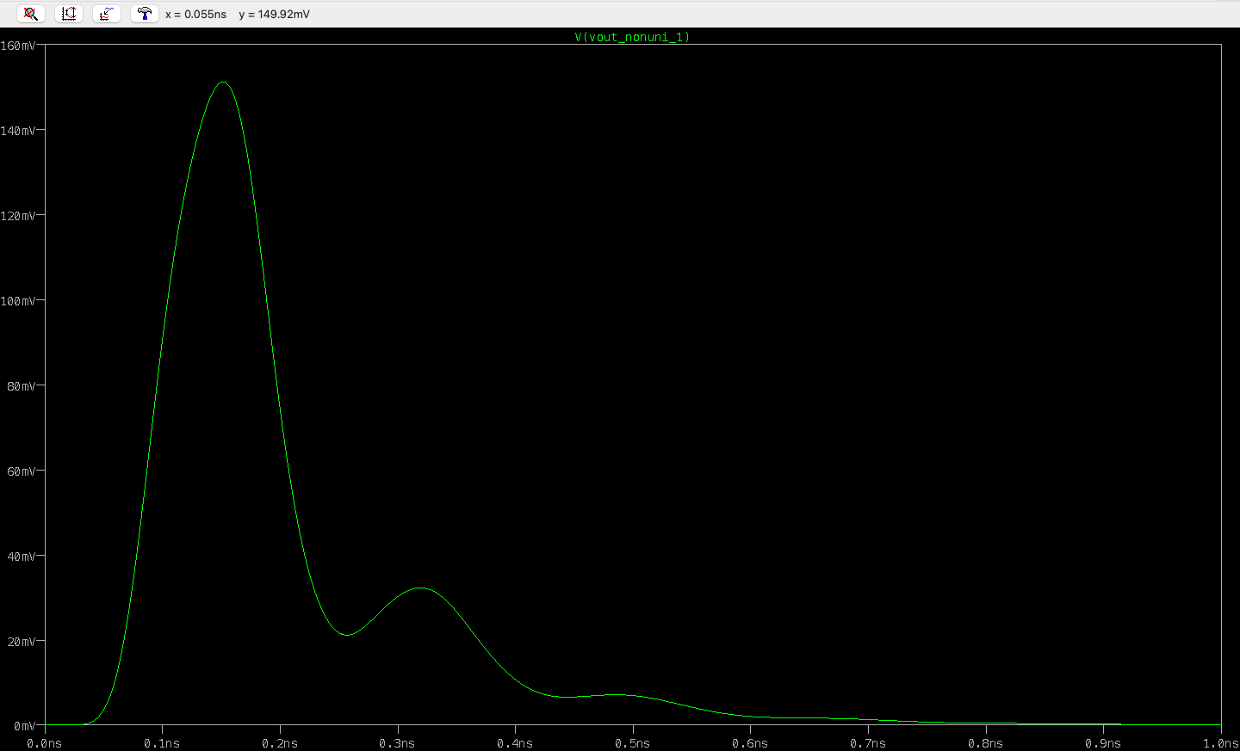
Pulse response

Slide 26
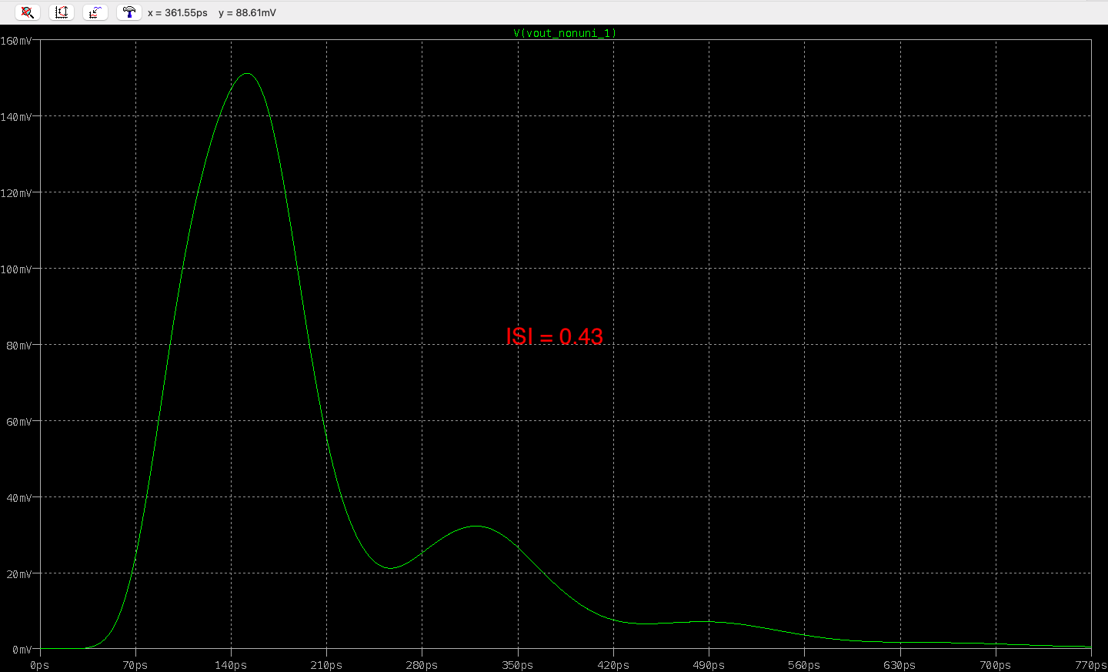
Pulse response

Slide 27
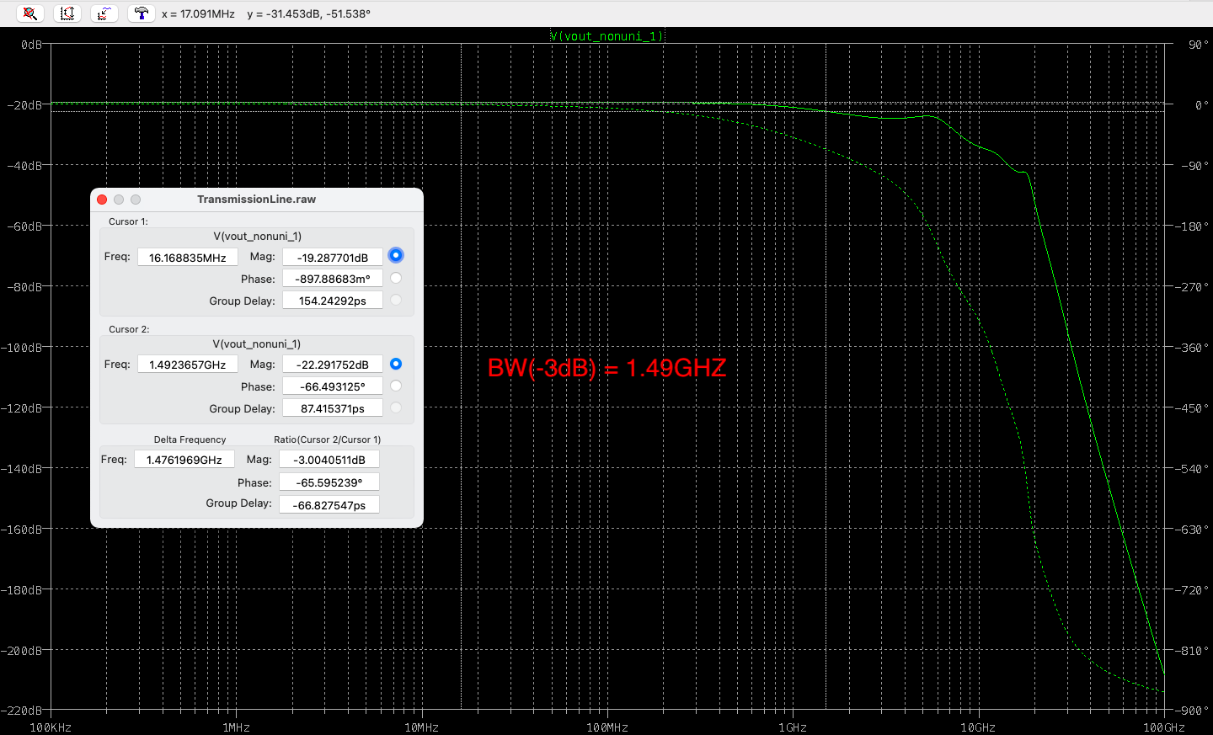
Freq response

Slide 28
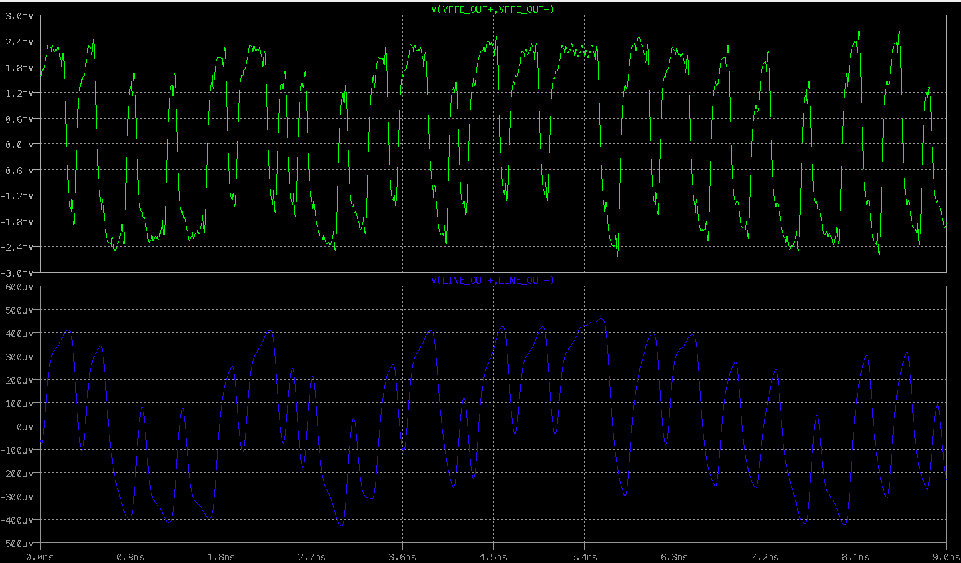
TS line Signal plot

Slide 29
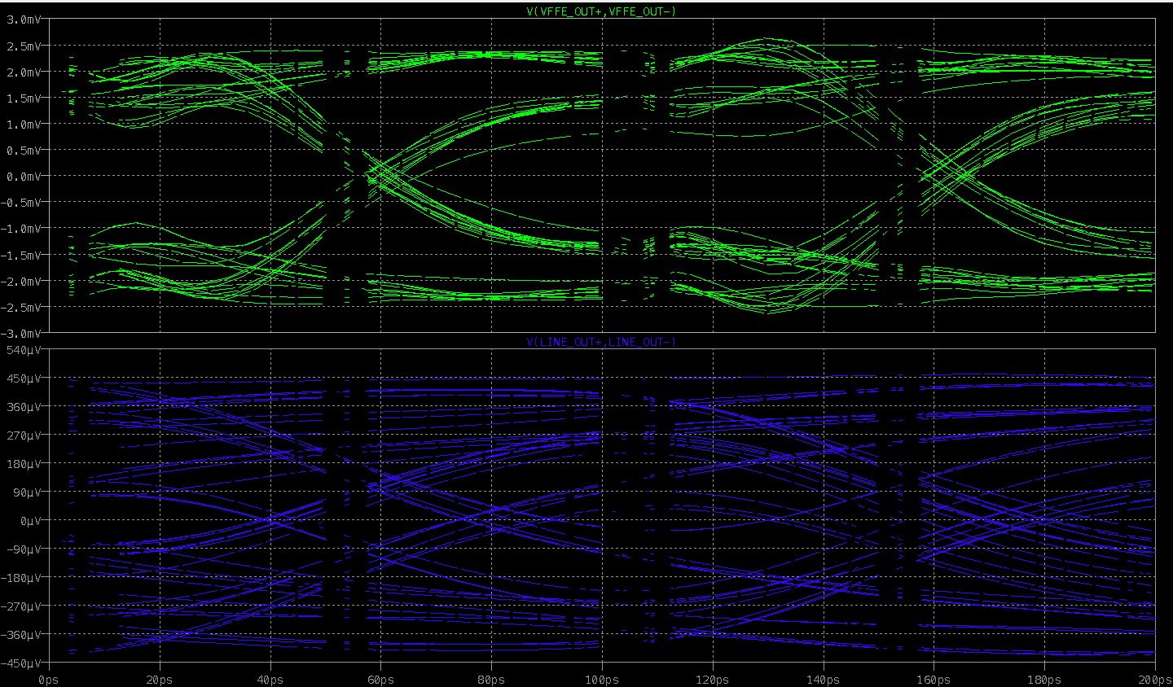
TS line Signal plot

Slide 30
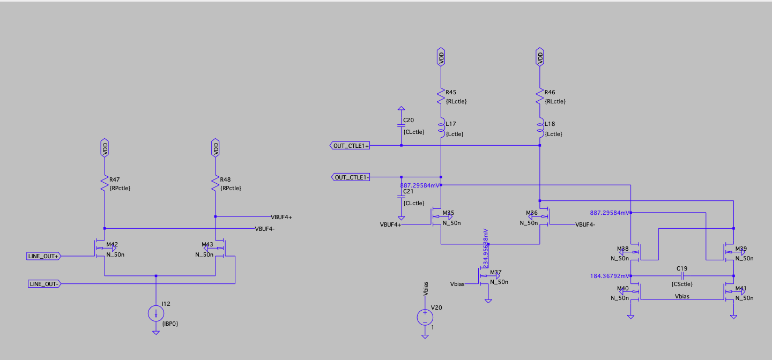
CTLE with negative impedance

Slide 31
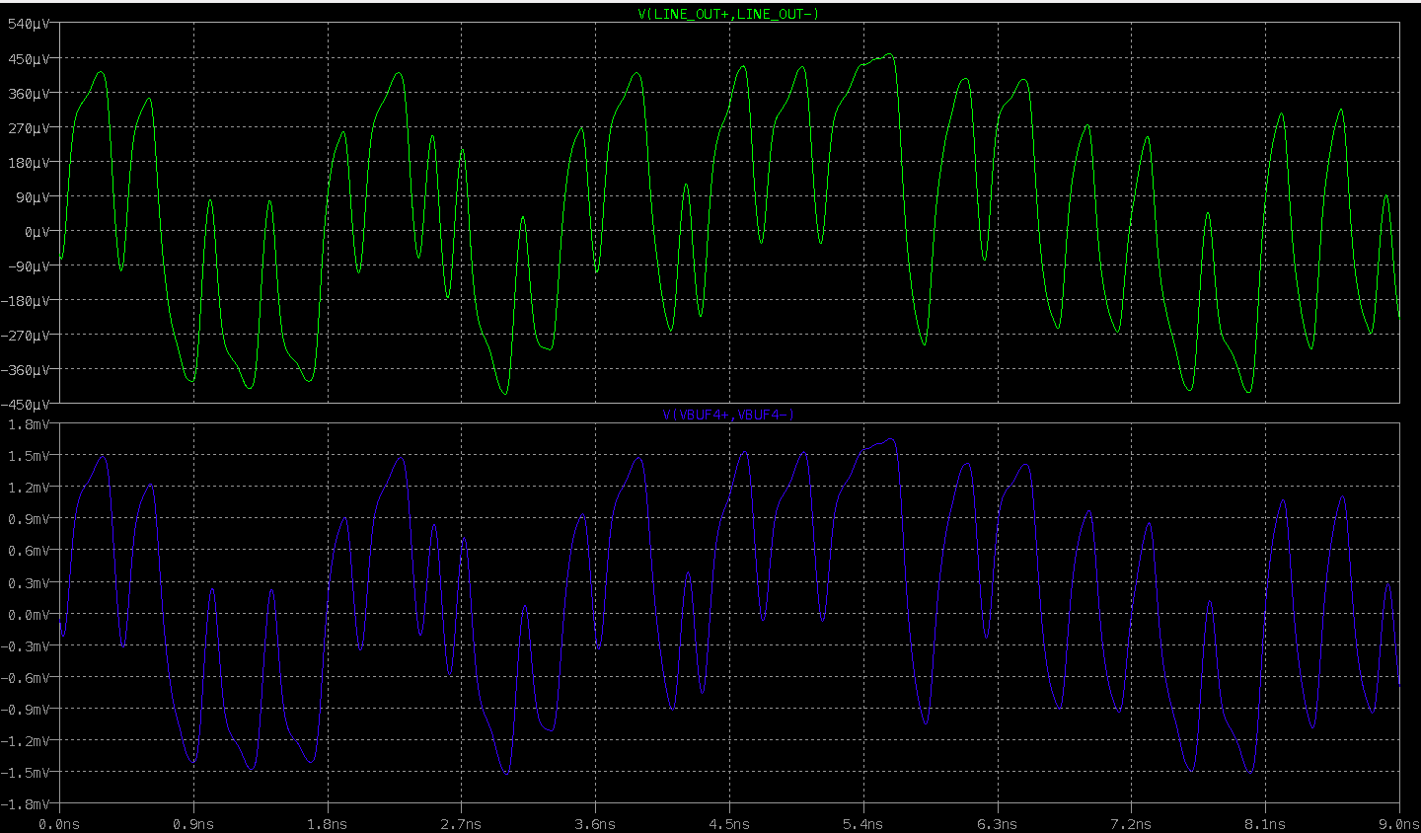
CTLE stage one A ≈ 4

Slide 32
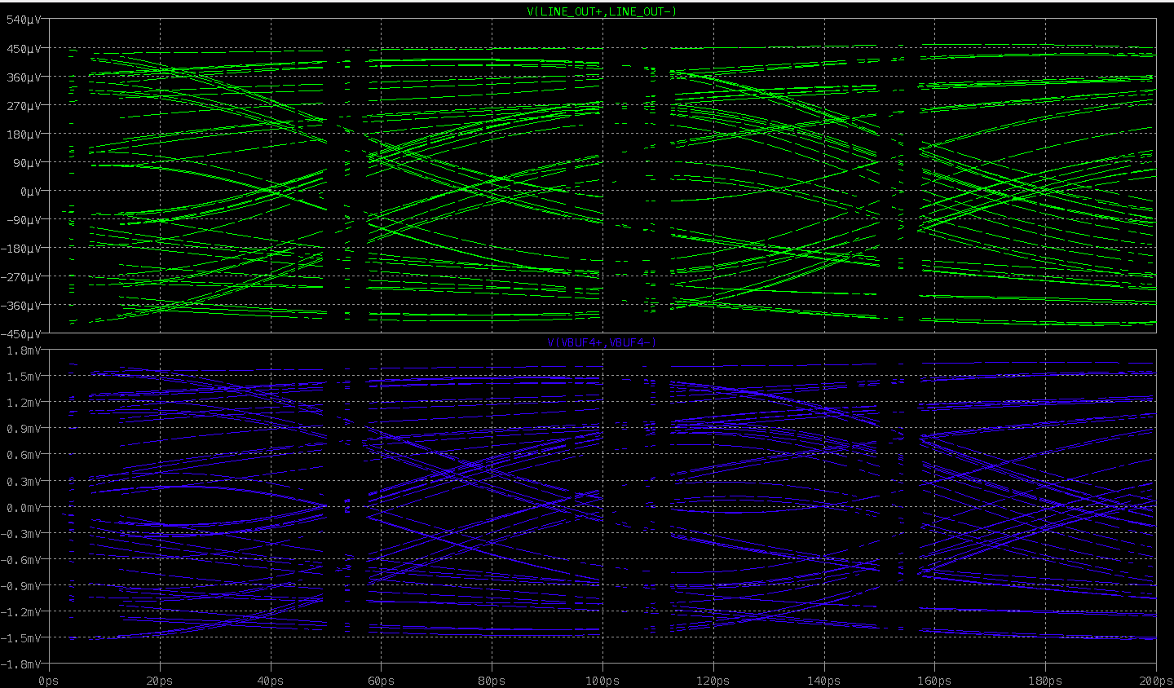
Stage one

Slide 33
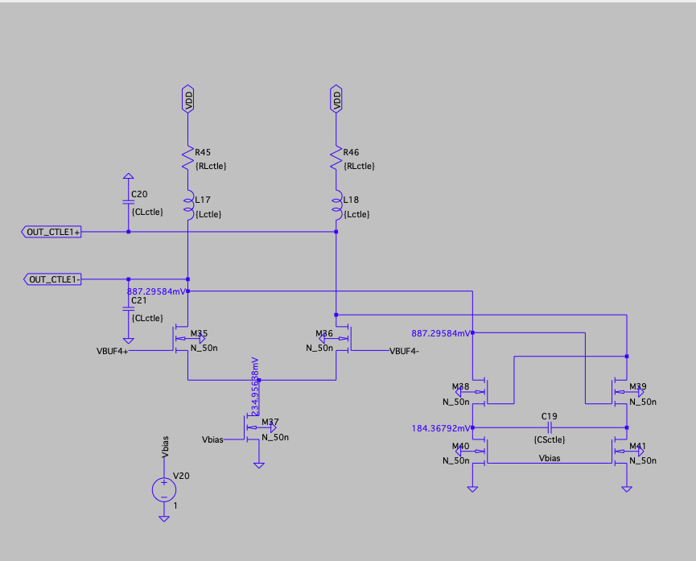
Stage two and three

Slide 34
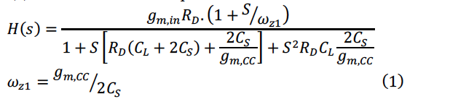
Negative impedance
Shunt peaking, damping ≈ 0.707, capture higher freq data
Negative capacitor Cs ≈ [1pf , 2.5pf], choose c = 2pf
Gm3*Rd < 1, capture lower freq data
Less headroom, and less lower freq gain degeneration and attenuation

Slide 35
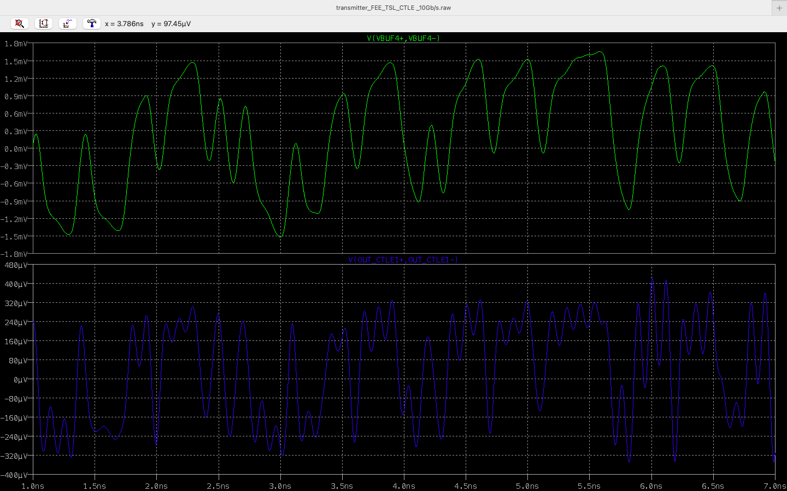
Shunt peaking
With no extra C on the load

Slide 36
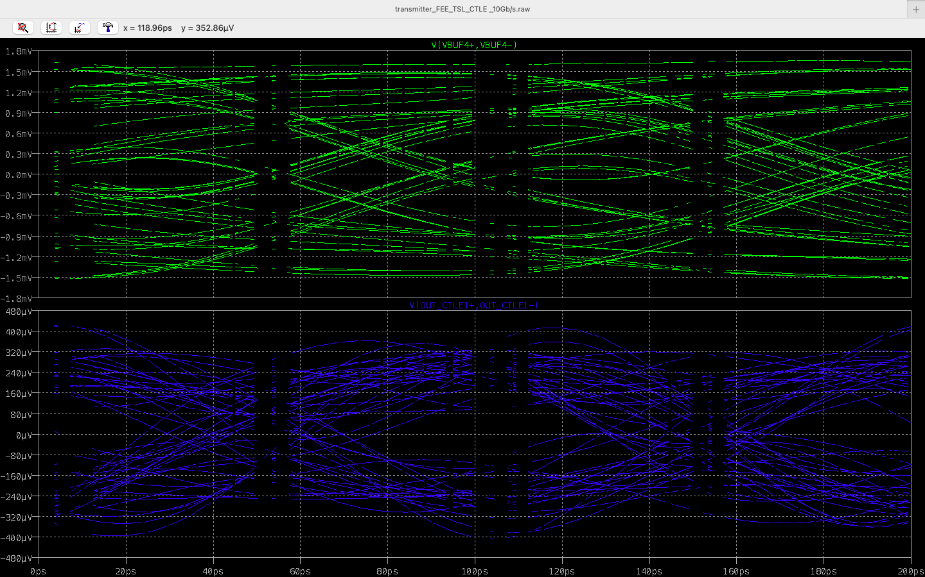
No C on the load

Slide 37
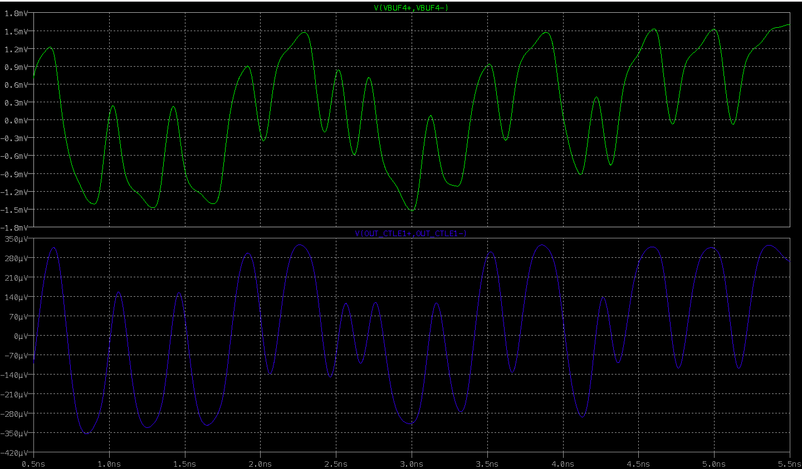
CTLE output with full shunt peaking

Slide 38
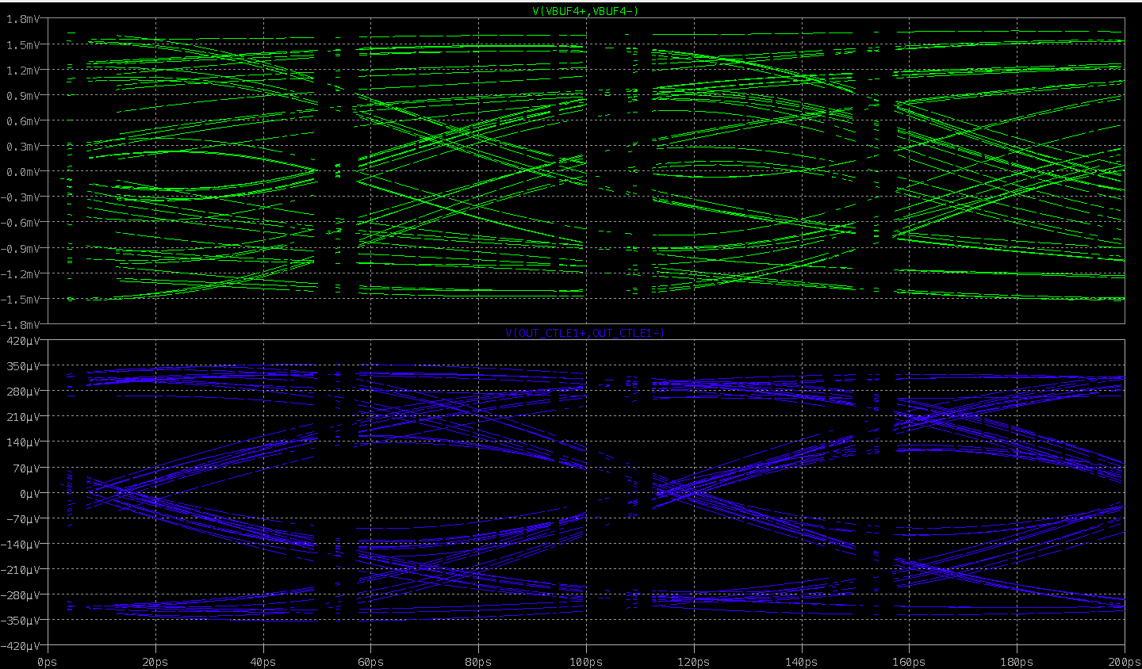
CTLE output

Slide 39
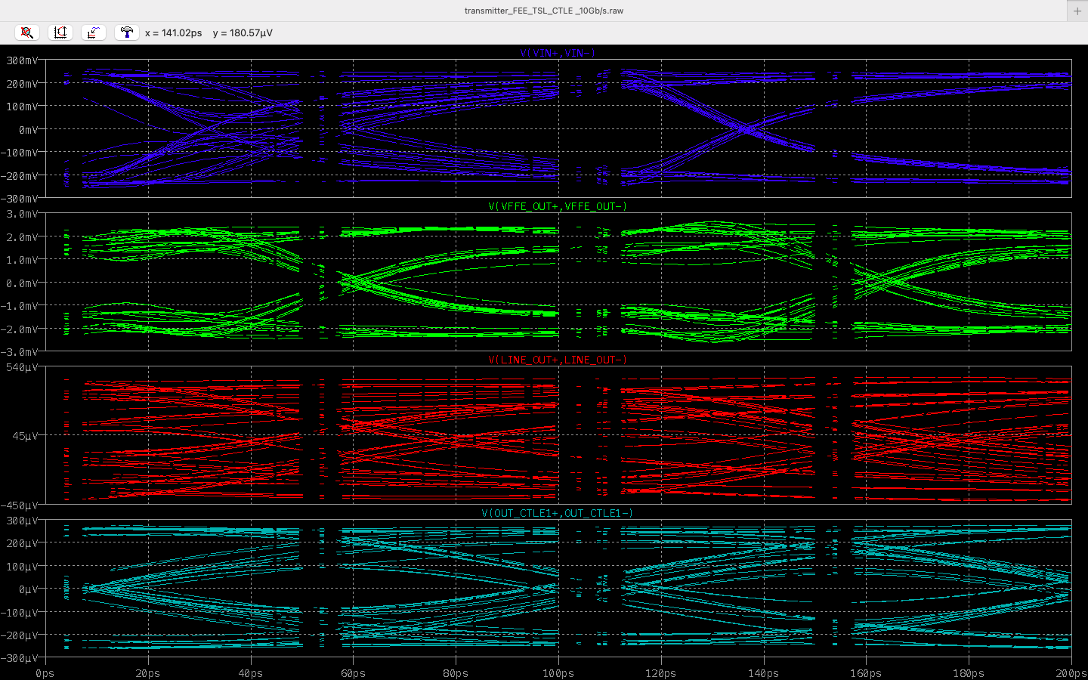
In - OUT

Slide 40
 | FEE | CTLE
ISI(normalized) | 0.5 | 0.625
VEO | 0.6mV | 0.6mV
swing | -0.6mV, +0.6mV | -0.8mV, +0.8mV

