Slide 1
King of the Mountain:
The Shiller P/E and Macroeconomic Conditions

Slide 2


Shiller P/E (CAPE)
Introduced by Robert Shiller and John Campbell in 1988.
Robert Shiller
Yale University
John Campbell
Harvard University

Slide 3
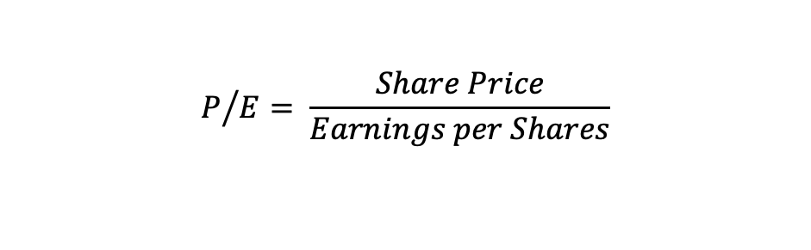
Normal P/E vs Shiller P/E
$$P/{E= \frac{Share Price}{Earnings per Shares}}$$
Normal P/E | Shiller P/E
Current share price | Real price
Earnings per share for the most recent 12-month period | 10-year average and Inflation adjusted earnings
Better predictor of shorter-term returns of one month to one year | Excellent predictor of long-term returns over 3 to 10 years

Slide 4

Macroeconomic Conditions
How do inflation and real interest rates affect stock price?
$P_{t}=\sum_{τ=1}^{∞}{\frac{E\left[D_{t}\right]}{{\left(1+r_{t→t+τ}\right)}^{τ}}}$
$π↓ → P↑$
$r_{real}↓ → P↑$
Notes:
r_t is the sum of expected inflation, real interest rates, and an equity risk premium.
The relationship between stock prices and either inflation or real interest rates is monotonically inverse.

Slide 5
In real world
Peaks at medium levels of inflation and real interest rates
Slopes downward in any direction
Mountain-shaped relationship

Slide 6
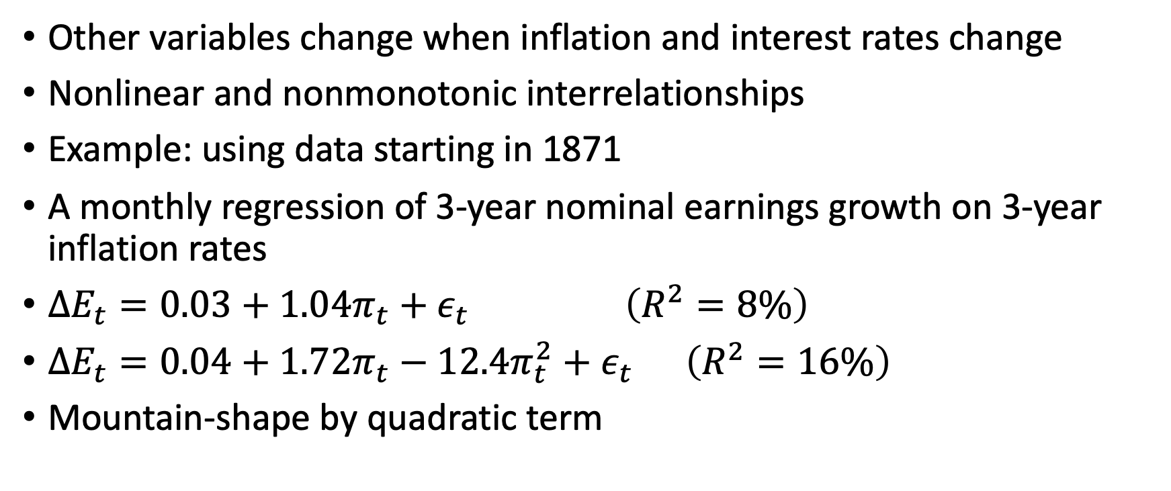
Explanation?
Other variables change when inflation and interest rates change
Nonlinear and nonmonotonic interrelationships
Example: using data starting in 1871
A monthly regression of 3-year nominal earnings growth on 3-year inflation rates
$ΔE_{t}=0.03+1.04π_{t}+ε_{t} \left(R^{2}=8\%\right)$
$ΔE_{t}=0.04+1.72π_{t}−12.4π_{t}^{2}+ε_{t} \left(R^{2}=16\%\right)$
Mountain-shape by quadratic term

Slide 7

Interest rates similar to inflation
Low interest rates suggest a slow macroeconomic growth expectation , which require a higher equity risk premium
Hence lower the stock price valuation
$σ_{t}^{π}=0.02+0.23y_{t}+1.23y_{t}^{2}+ε_{t} (R^{2}=27\%)$

