Slide 1
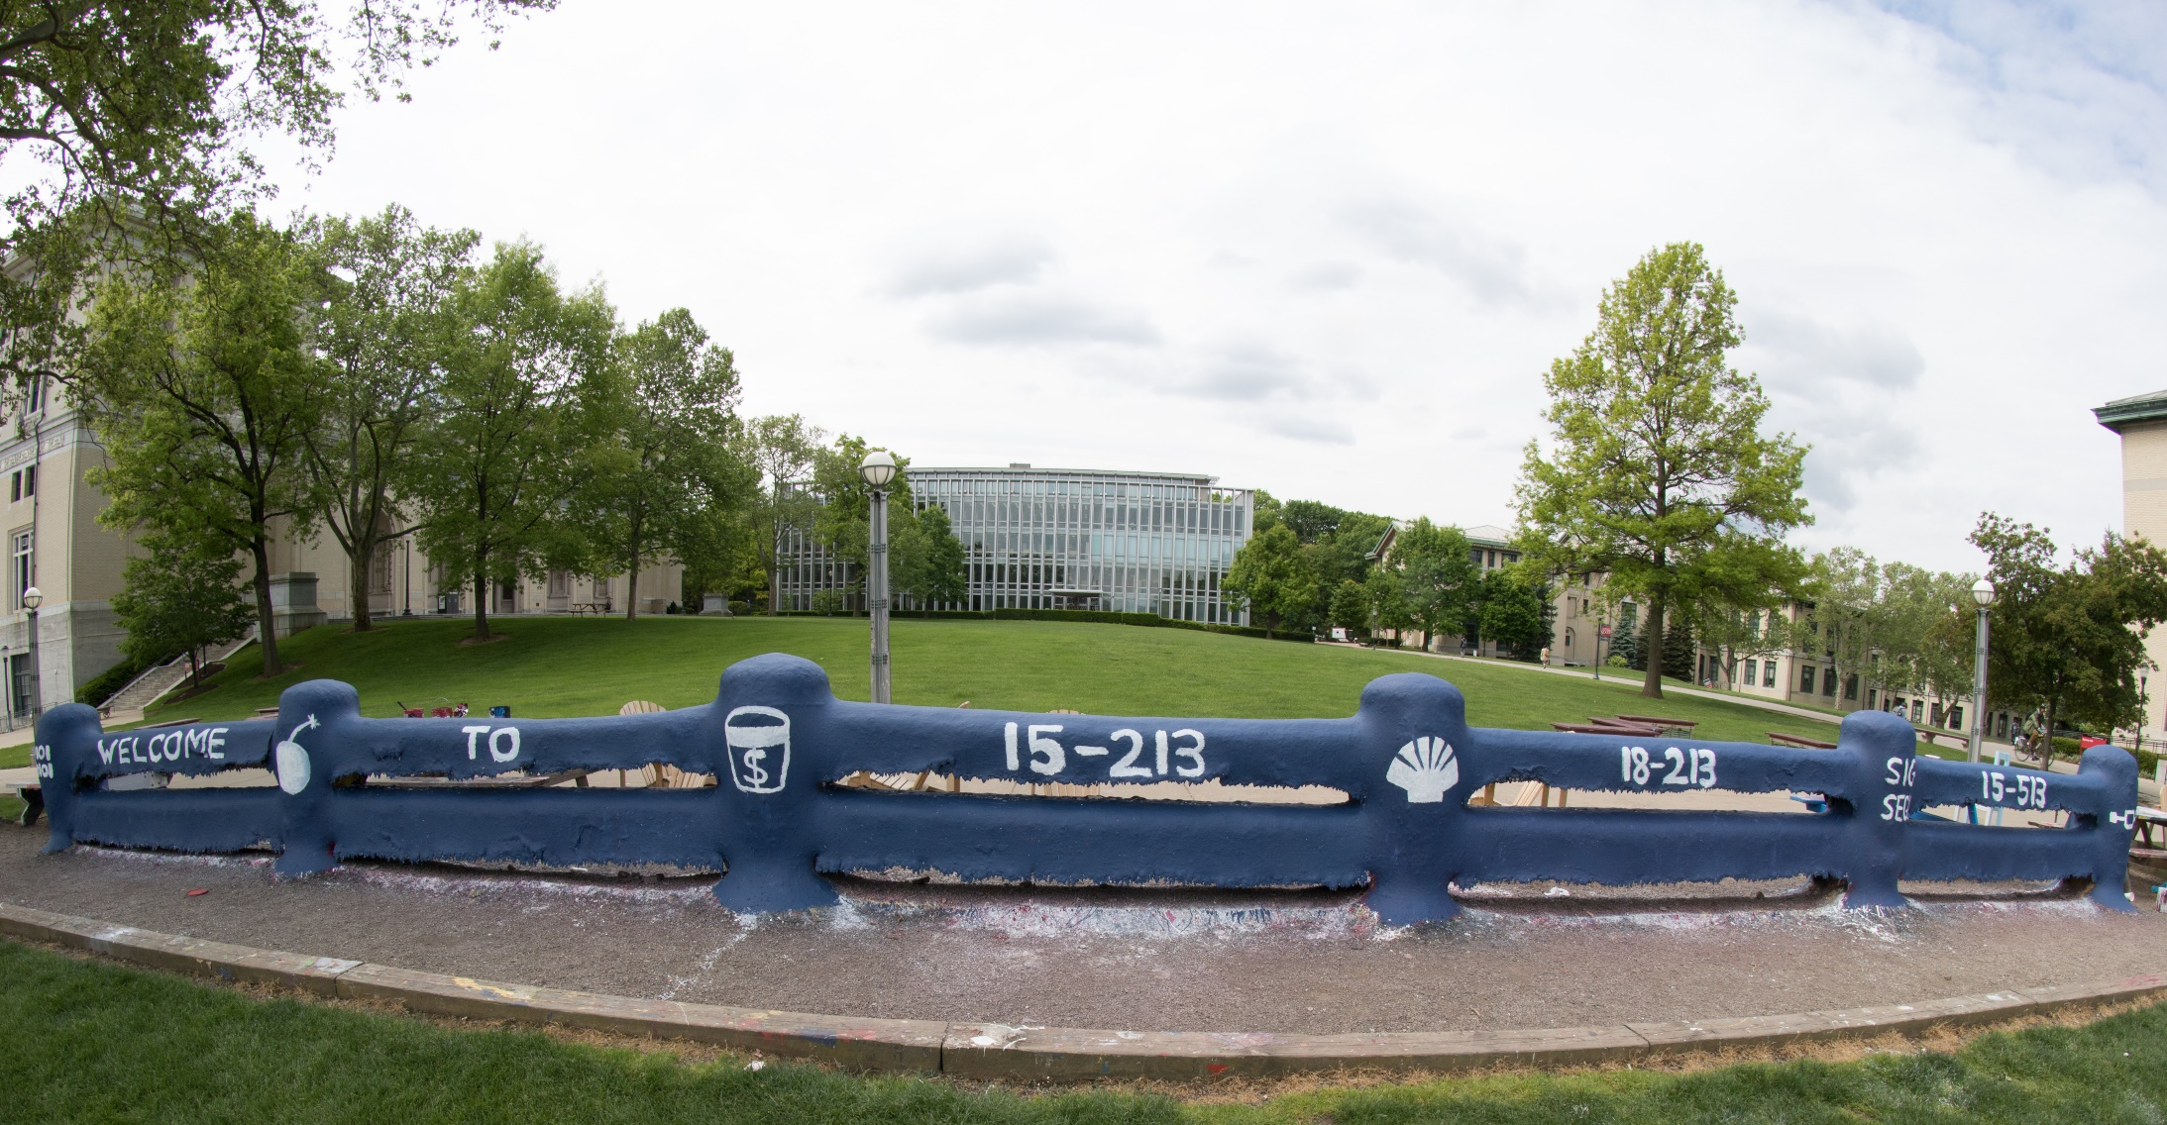
14-513
18-613

Slide 2
Bits, Bytes, and Integers – Part 2 15-213/18-213/14-513/15-513/18-613: Introduction to Computer Systems 3rd Lecture, September 8, 2020

Slide 3
Assignment Announcements
Lab 0 available via course web page and Autolab.
Due Thurs. Sept. 10, 11:59:59pm ET
No grace days. No late submissions!
Lab 1 available after 5 pm via Autolab
Due Thurs, Sept. 17, 11:59:59pm ET
Read instructions carefully: writeup, bits.c, tests.c
Quirky software infrastructure
Based on lectures 2, 3, and 4 (CS:APP Chapter 2)
After today you will know everything for the integer problems
Floating point covered Thursday Sept. 10
In-Person Recitations
We will email students with their in-person recitation status based on the survey on Piazza (fill out before class 9/10 or be uncounted)
First recitations (in-person and remote) are 9/14

Slide 4
Bootcamps
Wednesday Sept 9 @ 7-9 pm ET
GCC and Build Automation
Friday Sept 11 @ 7-9 pm ET
Debugging and GDB

Slide 5
Summary From Last Lecture
Representing information as bits
Bit-level manipulations
Integers
Representation: unsigned and signed
Conversion, casting
Expanding, truncating
Addition, negation, multiplication, shifting
Representations in memory, pointers, strings
Summary

Slide 6
Encoding Integers
Unsigned
Two’s Complement
Sign Bit
Two’s Complement Examples (w = 5)
-16 | 8 | 4 | 2 | 1
0 | 1 | 0 | 1 | 0
10 =
8+2 = 10
-16 | 8 | 4 | 2 | 1
1 | 0 | 1 | 1 | 0
-10 =
-16+4+2 = -10

Slide 7
Unsigned & Signed Numeric Values
Equivalence
Same encodings for nonnegative values
Uniqueness
Every bit pattern represents unique integer value
Each representable integer has unique bit encoding
Expression containing signed and unsigned int: int is cast to unsigned
X
B2U(X)
B2T(X)
0000
0
0
0001
1
1
0010
2
2
0011
3
3
0100
4
4
0101
5
5
0110
6
6
0111
7
7
1000
8
–8
1001
9
–7
1010
10
–6
1011
11
–5
1100
12
–4
1101
13
–3
1110
14
–2
1111
15
–1

Slide 8
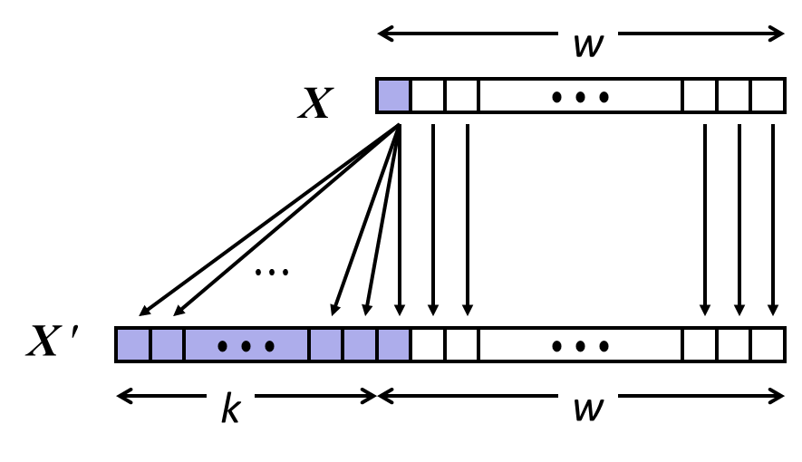
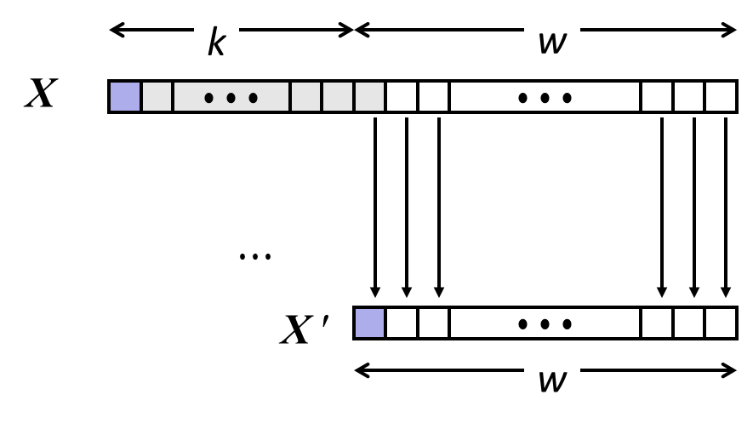
Sign Extension and Truncation
Sign Extension
Truncation

Slide 9
Truncation
Task:
Given k+w-bit signed or unsigned integer X
Convert it to w-bit integer X’ with same value for “small enough” X
Rule:
Drop top k bits:
X ′ = x_{w–1} , x_{w–2} ,…, x₀
k
w
X
• • •
• • •
• • •
X ′
• • •
w

Slide 10
Truncation: Simple Example
No sign change
Sign change
-16 | 8 | 4 | 2 | 1
0 | 0 | 0 | 1 | 0
-16 | 8 | 4 | 2 | 1
0 | 1 | 0 | 1 | 0
2 =
10 =
 | -8 | 4 | 2 | 1
 | 0 | 0 | 1 | 0
 | -8 | 4 | 2 | 1
 | 1 | 0 | 1 | 0
2 =
-6 =
2 mod 16 = 2
10 mod 16 = 10U mod 16 = 10U = -6
-16 | 8 | 4 | 2 | 1
1 | 1 | 0 | 1 | 0
-16 | 8 | 4 | 2 | 1
1 | 0 | 1 | 1 | 0
-6 =
-10 =
 | -8 | 4 | 2 | 1
 | 1 | 0 | 1 | 0
 | -8 | 4 | 2 | 1
 | 0 | 1 | 1 | 0
-6 =
6 =
-6 mod 16 = 26U mod 16 = 10U = -6
-10 mod 16 = 22U mod 16 = 6U = 6

Slide 11
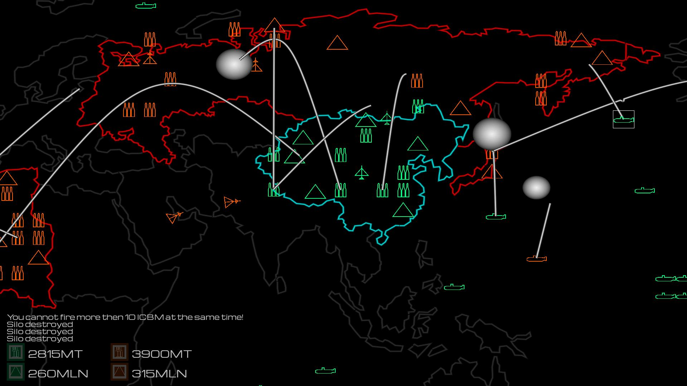
Global Thermonuclear War

Slide 12
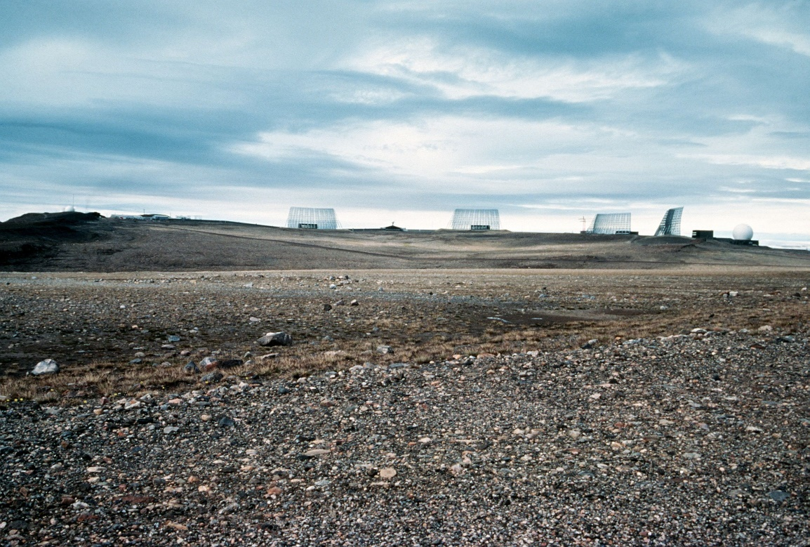
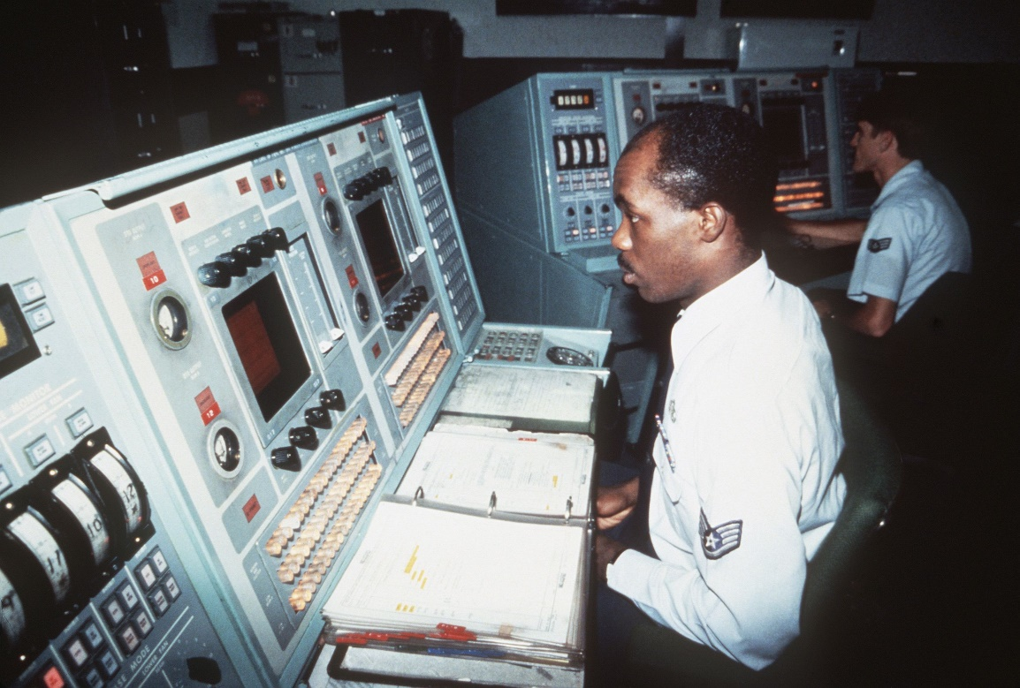
Misunderstanding integers can lead to the end of the world as we know it!
Thule (Qaanaaq), Greenland
US DoD “Site J” Ballistic Missile Early Warning System (BMEWS)
10/5/60: world nearly ends
Missile radar echo: 1/8s
BMEWS reports: 75s echo(!)
1000s of objects reported
NORAD alert level 5:
Immediate incoming nuclear attack!!!!

Slide 13
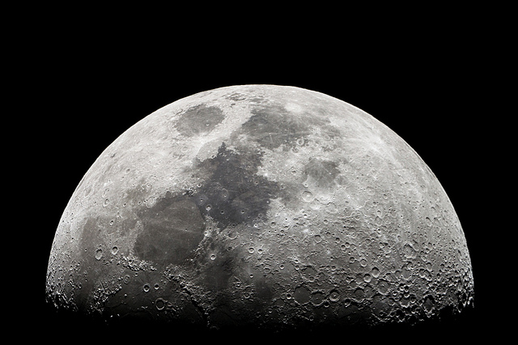

Kruschev was in NYC 10/5/60 (weird time to attack)
someone in Qaanaaq said “why not go check outside?”
“Missiles” were actually THE MOON RISING OVER NORWAY
Expected max distance: 3000 mi; Moon distance: .25M miles!
.25M miles % sizeof(distance) = 2200mi.
Overflow of distance nearly caused nuclear apocalypse!!

Slide 14
Today: Bits, Bytes, and Integers
Representing information as bits
Bit-level manipulations
Integers
Representation: unsigned and signed
Conversion, casting
Expanding, truncating
Addition, negation, multiplication, shifting
Representations in memory, pointers, strings
Summary

Slide 15
Unsigned Addition
u
Operands: w bits
• • •
+
v
• • •
True Sum: w+1 bits
u + v
• • •
Discard Carry: w bits
UAdd_{w}(u , v)
• • •
Decimal
Hex
Binary
Standard Addition Function
Ignores carry output
Implements Modular Arithmetic
s = UAdd_{w}(u , v) = u + v mod 2^{w}
0
0
0000
1
1
0001
2
2
0010
3
3
0011
4
4
0100
5
5
0101
6
6
0110
7
7
0111
unsigned char
1110 1001
+ 1101 0101
E9
+ D5
223
+ 213
8
8
1000
9
9
1001
A
10
1010
1 1011 1110
1BE
446
B
11
1011
C
12
1100
1011 1110
BE
190
D
13
1101
E
14
1110
F
15
1111

Slide 16
Visualizing (Mathematical) Integer Addition
Integer Addition
4-bit integers u, v
Compute true sum Add₄(u , v)
Values increase linearly with u and v
Forms planar surface
Add₄(u , v)
v
u

Slide 17
Visualizing Unsigned Addition
Wraps Around
If true sum ≥ 2^{w}
At most once
Overflow
UAdd₄(u , v)
True Sum
2^{w+1}
Overflow
2^{w}
v
0
Modular Sum
u

Slide 18
Two’s Complement Addition
Operands: w bits
u
• • •
+
v
• • •
True Sum: w+1 bits
u + v
• • •
Discard Carry: w bits
TAdd_{w}(u , v)
• • •
TAdd and UAdd have Identical Bit-Level Behavior
Signed vs. unsigned addition in C:
int s, t, u, v;
s = (int) ((unsigned) u + (unsigned) v);
t = u + v
Will give s == t
1110 1001
+ 1101 0101
E9
+ D5
-23
+ -43
1 1011 1110
1BE
-66
1011 1110
BE
-66

Slide 19
TAdd Overflow
Functionality
True sum requires w+1 bits
Drop off MSB
Treat remaining bits as 2’s comp. integer
True Sum
0 111…1
2^{w}–1
PosOver
TAdd Result
0 100…0
0 011…1
2^{w –1}–1
011…1
0 000…0
0
000…0
1 100…0
–2^{w –1}
100…0
1 011…1
1 000…0
–2^{w}
NegOver

Slide 20
Visualizing 2’s Complement Addition
NegOver
Values
4-bit two’s comp.
Range from -8 to +7
Wraps Around
If sum ≥ 2^{w–1}
Becomes negative
At most once
If sum < –2^{w–1}
Becomes positive
At most once
TAdd₄(u , v)
v
u
PosOver

Slide 21
Characterizing TAdd
Positive Overflow
Functionality
True sum requires w+1 bits
Drop off MSB
Treat remaining bits as 2’s comp. integer
TAdd(u , v)
> 0
v
< 0
< 0
> 0
u
Negative Overflow
2^{w}
(NegOver)
2^{w}
(PosOver)

Slide 22
Multiplication
Goal: Computing Product of w-bit numbers x, y
Either signed or unsigned
But, exact results can be bigger than w bits
Unsigned: up to 2w bits
Result range: 0 ≤ x * y ≤ (2^{w} – 1) ² = 2^{2w} – 2^{w+1} + 1
Two’s complement min (negative): Up to 2w-1 bits
Result range: x * y ≥ (–2^{w–1})*(2^{w–1}–1) = –2^{2w–2} + 2^{w–1}
Two’s complement max (positive): Up to 2w bits, but only for (TMin_{w})²
Result range: x * y ≤ (–2^{w–1}) ² = 2^{2w–2}
So, maintaining exact results…
would need to keep expanding word size with each product computed
is done in software, if needed
e.g., by “arbitrary precision” arithmetic packages

Slide 23
Unsigned Multiplication in C
u
• • •
Operands: w bits
*
v
• • •
True Product: 2*w bits
u · v
• • •
• • •
UMult_{w}(u , v)
Discard w bits: w bits
• • •
Standard Multiplication Function
Ignores high order w bits
Implements Modular Arithmetic
UMult_{w}(u , v) = u · v mod 2^{w}
1110 1001
* 1101 0101
E9
* D5
233
* 213
1100 0001 1101 1101
C1DD
49629
1101 1101
DD
221

Slide 24
Signed Multiplication in C
u
• • •
Operands: w bits
*
v
• • •
True Product: 2*w bits
u · v
• • •
• • •
TMult_{w}(u , v)
Discard w bits: w bits
• • •
Standard Multiplication Function
Ignores high order w bits
Some of which are different for signed vs. unsigned multiplication
Lower bits are the same
1110 1001
* 1101 0101
E9
* D5
-23
* -43
0000 0011 1101 1101
03DD
989
1101 1101
DD
-35

Slide 25
Power-of-2 Multiply with Shift
Operation
u << k gives u * 2^{k}
Both signed and unsigned
Examples
u << 3 == u * 8
(u << 5) – (u << 3) == u * 24
Most machines shift and add faster than multiply
Compiler generates this code automatically
k
u
• • •
Operands: w bits
*
2^{k}
0
•••
0
1
0
•••
0
0
True Product: w+k bits
u · 2^{k}
• • •
0
•••
0
0
Discard k bits: w bits
UMult_{w}(u , 2^{k})
•••
0
•••
0
0
TMult_{w}(u , 2^{k})

Slide 26
Unsigned Power-of-2 Divide with Shift
Quotient of Unsigned by Power of 2
u >> k gives ⎣ u / 2^{k} ⎦
Uses logical shift
k
u
•••
•••
Binary Point
Operands:
/
2^{k}
0
•••
0
1
0
•••
0
0
Division:
u / 2^{k}
0
.
0
•••
0
0
•••
•••
Result:
⎣ u / 2^{k} ⎦
0
0
•••
0
0
•••

Slide 27
Signed Power-of-2 Divide with Shift
Quotient of Signed by Power of 2
x >> k gives ⎣ x / 2^{k} ⎦
Uses arithmetic shift
Rounds wrong direction when x < 0
k
x
•••
•••
Binary Point
Operands:
/
2^{k}
0
•••
0
1
0
•••
0
0
Division:
x / 2^{k}
0
•••
•••
.
•••
Result:
RoundDown(x / 2^{k})
0
•••
•••

Slide 28
Correct Power-of-2 Divide
Quotient of Negative Number by Power of 2
Want ⎡ x / 2^{k} ⎤ (Round Toward 0)
Compute as ⎣ (x+2^{k}-1)/ 2^{k} ⎦
In C: (x + (1<<k)-1) >> k
Biases dividend toward 0
Case 1: No rounding
k
Dividend:
u
1
•••
0
•••
0
0
+2^{k} –1
0
•••
0
0
1
•••
1
1
Binary Point
1
•••
1
•••
1
1
Divisor:
/
2^{k}
0
•••
0
1
0
•••
0
0
⎡ u / 2^{k} ⎤
0
.
1
•••
1
1
1
•••
1
•••
1
1
Biasing has no effect

Slide 29
Correct Power-of-2 Divide (Cont.)
Case 2: Rounding
k
Dividend:
x
1
•••
•••
+2^{k} –1
0
•••
0
0
1
•••
1
1
1
•••
•••
Incremented by 1
Binary Point
Divisor:
/
2^{k}
0
•••
0
1
0
•••
0
0
⎡ x / 2^{k} ⎤
.
0
1
•••
1
1
1
•••
•••
Incremented by 1
Biasing adds 1 to final result

Slide 30
Negation: Complement & Increment
Negate through complement and increase ~x + 1 == -x
Example
Observation: ~x + x == 1111…111 == -1
x
1
0
0
1
1
1
0
1
+
~x
0
1
1
0
0
0
1
0
-1
1
1
1
1
1
1
1
1
x = 15213

Slide 31
Complement & Increment Examples
x = 0
x = TMin
Canonical counter example

Slide 32
Today: Bits, Bytes, and Integers
Representing information as bits
Bit-level manipulations
Integers
Representation: unsigned and signed
Conversion, casting
Expanding, truncating
Addition, negation, multiplication, shifting
Summary
Representations in memory, pointers, strings

Slide 33
Arithmetic: Basic Rules
Addition:
Unsigned/signed: Normal addition followed by truncate, same operation on bit level
Unsigned: addition mod 2^{w}
Mathematical addition + possible subtraction of 2^{w}
Signed: modified addition mod 2^{w} (result in proper range)
Mathematical addition + possible addition or subtraction of 2^{w}
Multiplication:
Unsigned/signed: Normal multiplication followed by truncate, same operation on bit level
Unsigned: multiplication mod 2^{w}
Signed: modified multiplication mod 2^{w} (result in proper range)

Slide 34
Why Should I Use Unsigned?
Don’t use without understanding implications
Easy to make mistakes
unsigned i;
for (i = cnt-2; i >= 0; i--)
a[i] += a[i+1];
Can be very subtle
#define DELTA sizeof(int)
int i;
for (i = CNT; i-DELTA >= 0; i-= DELTA)
. . .

Slide 35
Counting Down with Unsigned
Proper way to use unsigned as loop index
unsigned i;
for (i = cnt-2; i < cnt; i--)
a[i] += a[i+1];
See Robert Seacord, Secure Coding in C and C++
C Standard guarantees that unsigned addition will behave like modular arithmetic
0 – 1 → UMax
Even better
size_t i;
for (i = cnt-2; i < cnt; i--)
a[i] += a[i+1];
Data type size_t defined as unsigned value with length = word size
Code will work even if cnt = UMax
What if cnt is signed and < 0?

Slide 36
Why Should I Use Unsigned? (cont.)
Do Use When Performing Modular Arithmetic
Multiprecision arithmetic
Do Use When Using Bits to Represent Sets
Logical right shift, no sign extension
Do Use In System Programming
Bit masks, device commands,…

Slide 37
Quiz Time!
Check out:
https://canvas.cmu.edu/courses/17808

Slide 38
Today: Bits, Bytes, and Integers
Representing information as bits
Bit-level manipulations
Integers
Representation: unsigned and signed
Conversion, casting
Expanding, truncating
Addition, negation, multiplication, shifting
Summary
Representations in memory, pointers, strings

Slide 39
Byte-Oriented Memory Organization
00•••0
FF•••F
• • •
Programs refer to data by address
Conceptually, envision it as a very large array of bytes
In reality, it’s not, but can think of it that way
An address is like an index into that array
and, a pointer variable stores an address
Note: system provides private address spaces to each “process”
Think of a process as a program being executed
So, a program can clobber its own data, but not that of others

Slide 40
Machine Words
Any given computer has a “Word Size”
Nominal size of integer-valued data
and of addresses
Until recently, most machines used 32 bits (4 bytes) as word size
Limits addresses to 4GB (2³² bytes)
Increasingly, machines have 64-bit word size
Potentially, could have 18 EB (exabytes) of addressable memory
That’s 18.4 X 10¹⁸
Machines still support multiple data formats
Fractions or multiples of word size
Always integral number of bytes

Slide 41
Word-Oriented Memory Organization
32-bit
Words
64-bit
Words
Bytes
Addr.
Addresses Specify Byte Locations
Address of first byte in word
Addresses of successive words differ by 4 (32-bit) or 8 (64-bit)
0000
Addr
=
??
0001
0000
0002
Addr
=
??
0003
0000
0004
Addr
=
??
0005
0004
0006
0007
0008
Addr
=
??
0009
0008
0010
Addr
=
??
0011
0008
0012
Addr
=
??
0013
0012
0014
0015

Slide 42
Example Data Representations
C Data Type | Typical 32-bit | Typical 64-bit | x86-64
char | 1 | 1 | 1
short | 2 | 2 | 2
int | 4 | 4 | 4
long | 4 | 8 | 8
float | 4 | 4 | 4
double | 8 | 8 | 8
pointer | 4 | 8 | 8

Slide 43
Byte Ordering
So, how are the bytes within a multi-byte word ordered in memory?
Conventions
Big Endian: Sun (Oracle SPARC), PPC Mac, Internet
Least significant byte has highest address
Little Endian: x86, ARM processors running Android, iOS, and Linux
Least significant byte has lowest address

Slide 44
Byte Ordering Example
Example
Variable x has 4-byte value of 0x01234567
Address given by &x is 0x100
Big Endian
0x100
0x101
0x102
0x103
01
01
23
23
45
45
67
67
Little Endian
0x100
0x101
0x102
0x103
67
67
45
45
23
23
01
01

Slide 45
Representing Integers
Decimal: 15213
Binary: 0011 1011 0110 1101
Hex: 3 B 6 D
int A = 15213;
long int C = 15213;
Increasing addresses
IA32, x86-64
Sun
IA32
x86-64
Sun
6D
00
3B
00
6D
6D
00
00
3B
3B
3B
00
00
6D
00
00
3B
00
00
6D
00
int B = -15213;
00
IA32, x86-64
Sun
00
00
93
FF
C4
FF
FF
C4
FF
93
Two’s complement representation

Slide 46
Examining Data Representations
Code to Print Byte Representation of Data
Casting pointer to unsigned char * allows treatment as a byte array
typedef unsigned char *pointer;
void show_bytes(pointer start, size_t len){
size_t i;
for (i = 0; i < len; i++)
printf(”%p\t0x%.2x\n",start+i, start[i]);
printf("\n");
}
Printf directives:
%p: Print pointer
%x: Print Hexadecimal

Slide 47
show_bytes Execution Example
int a = 15213;
printf("int a = 15213;\n");
show_bytes((pointer) &a, sizeof(int));
Result (Linux x86-64):
int a = 15213;
0x7fffb7f71dbc 6d
0x7fffb7f71dbd 3b
0x7fffb7f71dbe 00
0x7fffb7f71dbf 00

Slide 48
Representing Pointers
int B = -15213;
int *P = &B;
Sun
IA32
x86-64
EF
FF
FB
2C
AC
28
F5
FF
3C
1B
FE
82
FD
7F
00
00
Different compilers & machines assign different locations to objects
Even get different results each time run program

Slide 49
Representing Strings
char S[6] = "18213";
Strings in C
Represented by array of characters
Each character encoded in ASCII format
Standard 7-bit encoding of character set
Character “0” has code 0x30
Digit i has code 0x30+i
String should be null-terminated
Final character = 0
Compatibility
Byte ordering not an issue
IA32
Sun
31
38
32
31
33
00
31
38
32
31
33
00

Slide 50
Reading Byte-Reversed Listings
Disassembly
Text representation of binary machine code
Generated by program that reads the machine code
Example Fragment
Deciphering Numbers
Value: 0x12ab
Pad to 32 bits: 0x000012ab
Split into bytes: 00 00 12 ab
Reverse: ab 12 00 00
Address Instruction Code Assembly Rendition
8048365: 5b pop %ebx
8048366: 81 c3 ab 12 00 00 add $0x12ab,%ebx
804836c: 83 bb 28 00 00 00 00 cmpl $0x0,0x28(%ebx)

Slide 51


Integer C Puzzles
x < 0 ⇒ ((x*2) < 0)
ux >= 0
x & 7 == 7 ⇒ (x<<30) < 0
ux > -1
x > y ⇒ -x < -y
x * x >= 0
x > 0 && y > 0 ⇒ x + y > 0
x >= 0 ⇒ -x <= 0
x <= 0 ⇒ -x >= 0
(x|-x)>>31 == -1
ux >> 3 == ux/8
x >> 3 == x/8
x & (x-1) != 0
Initialization
int x = foo();
int y = bar();
unsigned ux = x;
unsigned uy = y;

Slide 52
Summary
Representing information as bits
Bit-level manipulations
Integers
Representation: unsigned and signed
Conversion, casting
Expanding, truncating
Addition, negation, multiplication, shifting
Representations in memory, pointers, strings
Summary

