Slide 1

14-513
18-613

Slide 2
Machine-Level Programming IV: Data 15-213/18-213/14-513/15-513/18-613: Introduction to Computer Systems 8th Lecture, September 24, 2020

Slide 3
Announcements
Recitation Monday: C Review / C Bootcamp
Lab 2 (bomblab)
Due Tues, Sept. 29, 11:59pm ET
Written Assignment 2 peer grading
Due Wed, Sept. 30, 11:59pm ET
Written Assignment 3 available on Canvas
Due Wed, Sept. 30, 11:59pm ET

Slide 4
Today
Arrays
One-dimensional
Multi-dimensional (nested)
Multi-level
Structures
Allocation
Access
Alignment
Floating Point

Slide 5
Array Allocation
Basic Principle
T A[L];
Array of data type T and length L
Contiguously allocated region of L * sizeof(T) bytes in memory
char string[12];
x
x + 12
int val[5];
x
x + 4
x + 8
x + 12
x + 16
x + 20
double a[3];
x
x + 8
x + 16
x + 24
char *p[3];
x
x + 8
x + 16
x + 24

Slide 6
Array Access
Basic Principle
T A[L];
Array of data type T and length L
Identifier A can be used as a pointer to array element 0: Type T*
Reference Type Value
val[4] int 3
val int *
val+1 int *
&val[2] int *
val[5] int
*(val+1) int
val + i int *
int val[5];
1
5
2
1
3
x
x + 4
x + 8
x + 12
x + 16
x + 20

Slide 7
Array Access
Basic Principle
T A[L];
Array of data type T and length L
Identifier A can be used as a pointer to array element 0: Type T*
Reference Type Value
val[4] int 3
val int * x
val+1 int * x + 4
&val[2] int * x + 8
val[5] int ??
*(val+1) int 5 //val[1]
val + i int * x + 4 * i //&val[i]
int val[5];
1
5
2
1
3
x
x + 4
x + 8
x + 12
x + 16
x + 20

Slide 8
Array Example
#define ZLEN 5
typedef int zip_dig[ZLEN];
zip_dig cmu = { 1, 5, 2, 1, 3 };
zip_dig mit = { 0, 2, 1, 3, 9 };
zip_dig ucb = { 9, 4, 7, 2, 0 };
zip_dig cmu;
1
5
2
1
3
16
20
24
28
32
36
zip_dig mit;
0
2
1
3
9
36
40
44
48
52
56
zip_dig ucb;
9
4
7
2
0
56
60
64
68
72
76
Declaration “zip_dig cmu” equivalent to “int cmu[5]”
Example arrays were allocated in successive 20 byte blocks
Not guaranteed to happen in general

Slide 9
Array Accessing Example
zip_dig cmu;
1
5
2
1
3
16
20
24
28
32
36
int get_digit
(zip_dig z, int digit)
{
return z[digit];
}
Register %rdi contains starting address of array
Register %rsi contains array index
Desired digit at %rdi + 4*%rsi
Use memory reference (%rdi,%rsi,4)
x86-64
# %rdi = z
# %rsi = digit
movl (%rdi,%rsi,4), %eax # z[digit]

Slide 10
Array Loop Example
#define ZLEN 5
void zincr(zip_dig z) {
size_t i;
for (i = 0; i < ZLEN; i++)
z[i]++;
}
# %rdi = z
movl $0, %eax # i = 0
jmp .L3 # goto middle
.L4: # loop:
addl $1, (%rdi,%rax,4) # z[i]++
addq $1, %rax # i++
.L3: # middle
cmpq $4, %rax # i:4
jbe .L4 # if <=, goto loop
rep; ret

Slide 11
Understanding Pointers & Arrays #1
Decl | A1 , A2 |  |  | *A1 , *A2
 | Comp | Bad | Size | Comp | Bad | Size
int A1[3]
int *A2
A1
Allocated pointer
Unallocated pointer
A2
Allocated int
Unallocated int
Comp: Compiles (Y/N)
Bad: Possible bad pointer reference (Y/N)
Size: Value returned by sizeof

Slide 12
Understanding Pointers & Arrays #1
Decl | A1 , A2 |  |  | *A1 , *A2
 | Comp | Bad | Size | Comp | Bad | Size
int A1[3] | Y | N | 12 | Y | N | 4
int *A2 | Y | N | 8 | Y | Y | 4
A1
Allocated pointer
Unallocated pointer
A2
Allocated int
Unallocated int
Comp: Compiles (Y/N)
Bad: Possible bad pointer reference (Y/N)
Size: Value returned by sizeof

Slide 13
Understanding Pointers & Arrays #2
Decl | An |  |  | *An |  |  | **An
 | Cmp | Bad | Size | Cmp | Bad | Size | Cmp | Bad | Size
int A1[3]
int *A2[3]
int (*A3)[3]
A1
A2
A3
Allocated pointer
Unallocated pointer
Allocated int
Unallocated int

Slide 14
Understanding Pointers & Arrays #2
Decl | An |  |  | *An |  |  | **An
 | Cmp | Bad | Size | Cmp | Bad | Size | Cmp | Bad | Size
int A1[3] | Y | N | 12 | Y | N | 4 | N | - | -
int *A2[3] | Y | N | 24 | Y | N | 8 | Y | Y | 4
int (*A3)[3] | Y | N | 8 | Y | Y | 12 | Y | Y | 4
A1
A2
A3
Allocated pointer
Unallocated pointer
Allocated int
Unallocated int

Slide 15
Multidimensional (Nested) Arrays
Declaration
T A[R][C];
2D array of data type T
R rows, C columns
Array Size
R * C * sizeof(T) bytes
Arrangement
Row-Major Ordering
A[0][0]
• • •
A[0][C-1]
•
•
•
•
•
•
A[R-1][0]
• • •
A[R-1][C-1]
int A[R][C];
• • •
A
[0]
[0]
A
[0]
[C-1]
• • •
A
[1]
[0]
A
[1]
[C-1]
• • •
• • •
A
[R-1]
[0]
A
[R-1]
[C-1]
4*R*C Bytes
Notes:
Board: show 3D example: a[2][3][2] to illustrate the idea of row major as enumerating indices from right to left

Slide 16
Nested Array Example
#define PCOUNT 4
typedef int zip_dig[5];
zip_dig pgh[PCOUNT] =
{{1, 5, 2, 0, 6},
{1, 5, 2, 1, 3 },
{1, 5, 2, 1, 7 },
{1, 5, 2, 2, 1 }};
zip_dig
pgh[4];
1
5
2
0
6
1
5
2
1
3
1
5
2
1
7
1
5
2
2
1
76
96
116
136
156
“zip_dig pgh[4]” equivalent to “int pgh[4][5]”
Variable pgh: array of 4 elements, allocated contiguously
Each element is an array of 5 int’s, allocated contiguously
“Row-Major” ordering of all elements in memory

Slide 17
Nested Array Row Access
Row Vectors
A[i] is array of C elements of type T
Starting address A + i * (C * sizeof(T))
int A[R][C];
A[0]
A[i]
A[R-1]
• • •
A
[0]
[0]
A
[0]
[C-1]
• • •
• • •
A
[i]
[0]
A
[i]
[C-1]
• • •
• • •
A
[R-1]
[0]
A
[R-1]
[C-1]
A
A+(i*C*4)
A+((R-1)*C*4)

Slide 18
Nested Array Row Access Code
1
5
2
0
6
1
5
2
1
3
1
5
2
1
7
1
5
2
2
1
pgh
pgh[2]
int *get_pgh_zip(int index)
{
return pgh[index];
}
# %rdi = index
leaq (%rdi,%rdi,4),%rax # 5 * index
leaq pgh(,%rax,4),%rax # pgh + (20 * index)
Row Vector
pgh[index] is array of 5 int’s
Starting address pgh+20*index
Machine Code
Computes and returns address
Compute as pgh + 4*(index+4*index)

Slide 19
Nested Array Element Access
Array Elements
A[i][j] is element of type T, which requires K bytes
Address A + i * (C * K) + j * K = A + (i * C + j) * K
int A[R][C];
A[0]
A[i]
A[R-1]
• • •
A
[0]
[0]
A
[0]
[C-1]
• • •
• • • • • •
A
[i]
[j]
• • •
• • •
A
[R-1]
[0]
A
[R-1]
[C-1]
A
A+(i*C*4)
A+((R-1)*C*4)
A+(i*C*4)+(j*4)

Slide 20
Nested Array Element Access Code
1
5
2
0
6
1
5
2
1
3
1
5
2
1
7
1
5
2
2
1
pgh
pgh[1][1]
int get_pgh_digit(int index, int dig)
{
return pgh[index][dig];
}
leaq (%rdi,%rdi,4), %rax # 5*index
addl %rax, %rsi # 5*index+dig
movl pgh(,%rsi,4), %eax # M[pgh + 4*(5*index+dig)]
Array Elements
pgh[index][dig] is int
Address: pgh + 20*index + 4*dig
= pgh + 4*(5*index + dig)

Slide 21
Multi-Level Array Example
zip_dig cmu = { 1, 5, 2, 1, 3 };
zip_dig mit = { 0, 2, 1, 3, 9 };
zip_dig ucb = { 9, 4, 7, 2, 0 };
Variable univ denotes array of 3 elements
Each element is a pointer
8 bytes
Each pointer points to array of int’s
#define UCOUNT 3
int *univ[UCOUNT] = {mit, cmu, ucb};
cmu
1
5
2
1
3
univ
16
20
24
28
32
36
160
36
mit
0
2
1
3
9
168
16
ucb
36
40
44
48
52
56
176
56
9
4
7
2
0
56
60
64
68
72
76

Slide 22
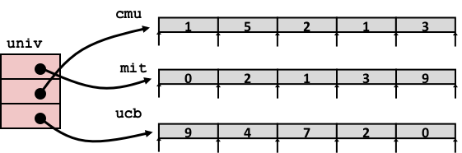
Element Access in Multi-Level Array
int get_univ_digit
(size_t index, size_t digit)
{
return univ[index][digit];
}
salq $2, %rsi # 4*digit
addq univ(,%rdi,8), %rsi # p = univ[index] + 4*digit
movl (%rsi), %eax # return *p
ret
Computation
Element access Mem[Mem[univ+8*index]+4*digit]
Must do two memory reads
First get pointer to row array
Then access element within array

Slide 23
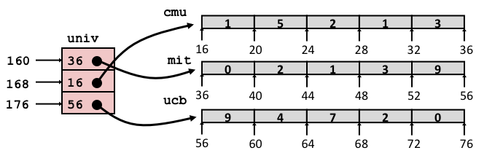
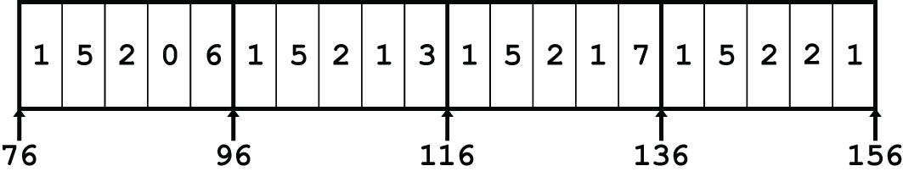
Array Element Accesses
Nested array
Multi-level array
int get_pgh_digit
(size_t index, size_t digit)
{
return pgh[index][digit];
}
int get_univ_digit
(size_t index, size_t digit)
{
return univ[index][digit];
}
Accesses looks similar in C, but address computations very different:
Mem[pgh+20*index+4*digit]
Mem[Mem[univ+8*index]+4*digit]

Slide 24
N X N Matrix Code
#define N 16
typedef int fix_matrix[N][N];
/* Get element A[i][j] */
int fix_ele(fix_matrix A,
size_t i, size_t j)
{
return A[i][j];
}
Fixed dimensions
Know value of N at compile time
Variable dimensions, explicit indexing
Traditional way to implement dynamic arrays
Variable dimensions, implicit indexing
Now supported by gcc
#define IDX(n, i, j) ((i)*(n)+(j))
/* Get element A[i][j] */
int vec_ele(size_t n, int *A,
size_t i, size_t j)
{
return A[IDX(n,i,j)];
}
/* Get element A[i][j] */
int var_ele(size_t n, int A[n][n],
size_t i, size_t j) {
return A[i][j];
}

Slide 25
16 X 16 Matrix Access
Array Elements
int A[16][16];
Address A + i * (C * K) + j * K
C = 16, K = 4
/* Get element A[i][j] */
int fix_ele(fix_matrix A, size_t i, size_t j) {
return A[i][j];
}
# A in %rdi, i in %rsi, j in %rdx
salq $6, %rsi # 64*i
addq %rsi, %rdi # A + 64*i
movl (%rdi,%rdx,4), %eax # Mem[A + 64*i + 4*j]
ret

Slide 26
n X n Matrix Access
Array Elements
size_t n;
int A[n][n];
Address A + i * (C * K) + j * K
C = n, K = 4
Must perform integer multiplication
/* Get element A[i][j] */
int var_ele(size_t n, int A[n][n], size_t i, size_t j) {
return A[i][j];
}
# n in %rdi, A in %rsi, i in %rdx, j in %rcx
imulq %rdx, %rdi # n*i
leaq (%rsi,%rdi,4), %rax # A + 4*n*i
movl (%rax,%rcx,4), %eax # A + 4*n*i + 4*j
ret
Notes:
Why multiply?

Slide 27
Example: Array Access
#include <stdio.h>
#define ZLEN 5
#define PCOUNT 4
typedef int zip_dig[ZLEN];
int main(int argc, char** argv) {
zip_dig pgh[PCOUNT] =
{{1, 5, 2, 0, 6},
{1, 5, 2, 1, 3 },
{1, 5, 2, 1, 7 },
{1, 5, 2, 2, 1 }};
int *linear_zip = (int *) pgh;
int *zip2 = (int *) pgh[2];
int result =
pgh[0][0] +
linear_zip[7] +
*(linear_zip + 8) +
zip2[1];
printf("result: %d\n", result);
return 0;
}
linux> ./array
result: 9
Notes:
Stop and ask students to work out what this might print.

Slide 28
Example: Array Access
#include <stdio.h>
#define ZLEN 5
#define PCOUNT 4
typedef int zip_dig[ZLEN];
int main(int argc, char** argv) {
zip_dig pgh[PCOUNT] =
{{1, 5, 2, 0, 6},
{1, 5, 2, 1, 3 },
{1, 5, 2, 1, 7 },
{1, 5, 2, 2, 1 }};
int *linear_zip = (int *) pgh;
int *zip2 = (int *) pgh[2];
int result =
pgh[0][0] +
linear_zip[7] +
*(linear_zip + 8) +
zip2[1];
printf("result: %d\n", result);
return 0;
}
linux> ./array
result: 9

Slide 29
Quiz Time!
Check out:
https://canvas.cmu.edu/courses/17808

Slide 30
Today
Arrays
One-dimensional
Multi-dimensional (nested)
Multi-level
Structures
Allocation
Access
Alignment
Floating Point

Slide 31
Structure Representation
r
struct rec {
int a[4];
size_t i;
struct rec *next;
};
a
i
next
0
16
24
32
Structure represented as block of memory
Big enough to hold all of the fields
Fields ordered according to declaration
Even if another ordering could yield a more compact representation (due to alignment rules—coming soon)
Compiler determines overall size + positions of fields
Machine-level program has no understanding of the structures in the source code

Slide 32
Generating Pointer to Structure Member
r
r+4*idx
struct rec {
int a[4];
size_t i;
struct rec *next;
};
a
i
next
0
16
24
32
Generating Pointer to Array Element
Offset of each structure member determined at compile time
Compute as r + 4*idx
int *get_ap
(struct rec *r, size_t idx)
{
return &r->a[idx];
}
# r in %rdi, idx in %rsi
leaq (%rdi,%rsi,4), %rax
ret

Slide 33
Following Linked List #1
struct rec {
int a[4];
size_t i;
struct rec *next;
};
C Code
Loop assembly code
r
long length(struct rec*r) {
long len = 0L;
while (r) {
len ++;
r = r->next;
}
return len;
}
a
i
next
0
16
24
32
Register | Value
%rdi | r
%rax | len
.L11: # loop:
addq $1, %rax # len ++
movq 24(%rdi), %rdi # r = Mem[r+24]
testq %rdi, %rdi # Test r
jne .L11 # If != 0, goto loop

Slide 34
Following Linked List #2
struct rec {
int a[4];
size_t i;
struct rec *next;
};
C Code
r
void set_val
(struct rec *r, int val)
{
while (r) {
size_t i = r->i;
// No bounds check
r->a[i] = val;
r = r->next;
}
}
a
i
next
0
16
24
32
Element i
Register | Value
%rdi | r
%rsi | val
.L11: # loop:
movq 16(%rdi), %rax # i = Mem[r+16]
movl %esi, (%rdi,%rax,4) # Mem[r+4*i] = val
movq 24(%rdi), %rdi # r = Mem[r+24]
testq %rdi, %rdi # Test r
jne .L11 # if !=0 goto loop

Slide 35
Structures & Alignment
Unaligned Data
Aligned Data
Primitive data type requires B bytes implies
Address must be multiple of B
struct S1 {
char c;
int i[2];
double v;
} *p;
c
i[0]
i[1]
v
p
p+1
p+5
p+9
p+17
c
3 bytes
i[0]
i[1]
4 bytes
v
p+0
p+4
p+8
p+16
p+24
Multiple of 4
Multiple of 8
Multiple of 8
Multiple of 8

Slide 36
Alignment Principles
Aligned Data
Primitive data type requires B bytes
Address must be multiple of B
Required on some machines; advised on x86-64
Motivation for Aligning Data
Memory accessed by (aligned) chunks of 4 or 8 bytes (system dependent)
Inefficient to load or store datum that spans cache lines (64 bytes). Intel states should avoid crossing 16 byte boundaries.
[Cache lines will be discussed in Lecture 11.]
Virtual memory trickier when datum spans 2 pages (4 KB pages)
[Virtual memory pages will be discussed in Lecture 17.]
Compiler
Inserts gaps in structure to ensure correct alignment of fields

Slide 37
Specific Cases of Alignment (x86-64)
1 byte: char, …
no restrictions on address
2 bytes: short, …
lowest 1 bit of address must be 02
4 bytes: int, float, …
lowest 2 bits of address must be 002
8 bytes: double, long, char *, …
lowest 3 bits of address must be 0002

Slide 38
Satisfying Alignment with Structures
Within structure:
Must satisfy each element’s alignment requirement
Overall structure placement
Each structure has alignment requirement K
K = Largest alignment of any element
Initial address & structure length must be multiples of K
Example:
K = 8, due to double element
struct S1 {
char c;
int i[2];
double v;
} *p;
Internal padding
c
3 bytes
i[0]
i[1]
4 bytes
v
p+0
p+4
p+8
p+16
p+24
Multiple of 4
Multiple of 8
Multiple of 8
Multiple of 8

Slide 39
Meeting Overall Alignment Requirement
For largest alignment requirement K
Overall structure must be multiple of K
struct S2 {
double v;
int i[2];
char c;
} *p;
External padding
 | v |  |  |  |  |  |  | i[0] |  |  |  | i[1] |  |  |  | c | 7 bytes
p+0 |  |  |  |  |  |  | p+8 |  |  |  |  |  |  |  | p+16 |  |  |  |  |  |  |  | p+24
Multiple of K=8

Slide 40
Arrays of Structures
struct S2 {
double v;
int i[2];
char c;
} a[10];
Overall structure length multiple of K
Satisfy alignment requirement for every element
 | a[0] |  |  |  |  | a[1] |  |  |  |  | a[2] |  |  |  |  | • • •
a+0 |  |  |  |  | a+24 |  |  |  |  | a+48 |  |  |  |  | a+72
 | v |  |  |  |  |  |  | i[0] |  |  |  | i[1] |  |  |  | c | 7 bytes
a+24 |  |  |  |  |  |  | a+32 |  |  |  |  |  |  |  | a+40 |  |  |  |  |  |  |  | a+48

Slide 41
Accessing Array Elements
struct S3 {
short i;
float v;
short j;
} a[10];
Compute array offset 12*idx
sizeof(S3), including alignment spacers
Element j is at offset 8 within structure
Assembler gives offset a+8
Resolved during linking
 | a[0] |  |  |  |  | • • • |  |  |  | a[idx] |  |  |  | • • |  |  | •
a+0 |  |  |  |  | a+12 |  |  |  | a+12*idx
 |  |  |  |  | i | 2 bytes |  | v |  |  | j | 2 bytes
 |  |  |  | a+12*idx |  |  |  |  |  | a+12*idx+8
short get_j(int idx)
{
return a[idx].j;
}
# %rdi = idx
leaq (%rdi,%rdi,2),%rax # 3*idx
movzwl a+8(,%rax,4),%eax
Notes:
Give the pseudo-code for the assembly, which field / element is being accessed?

Slide 42
Saving Space
Put large data types first
Effect (largest alignment requirement K=4)
struct S4 {
char c;
int i;
char d;
} *p;
struct S5 {
int i;
char c;
char d;
} *p;
c
3 bytes
i
d
3 bytes
12 bytes
i
c
d
2 bytes
8 bytes

Slide 43
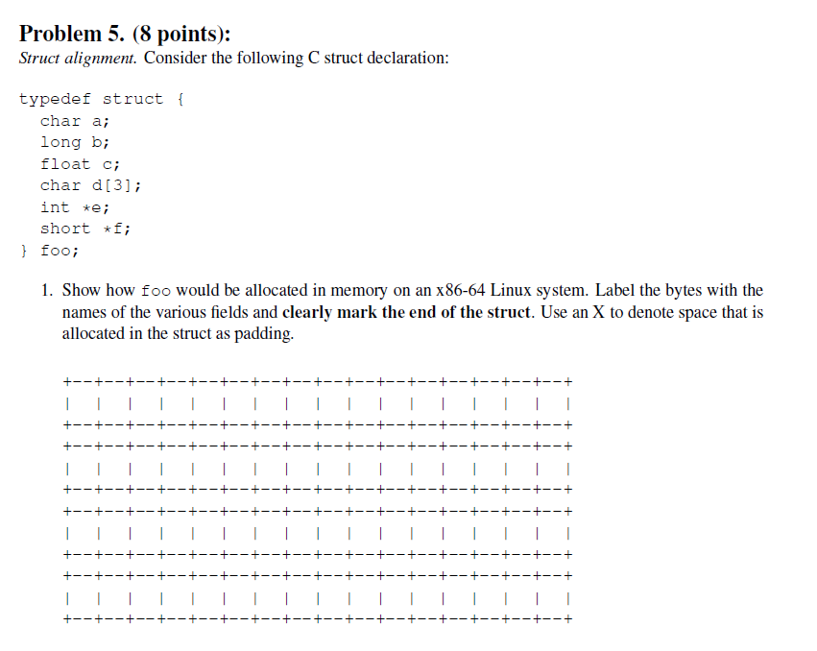
Example Struct Exam Question
http://www.cs.cmu.edu/~213/oldexams/exam1-f12.pdf

Slide 44
Example Struct Exam Question
a
X
X
X
X
X
X
X
b
b
b
b
b
b
b
b
c
c
c
c
d
d
d
X
e
e
e
e
e
e
e
e
f
f
f
f
f
f
f
|
f
http://www.cs.cmu.edu/~213/oldexams/exam1-f12.pdf

Slide 45
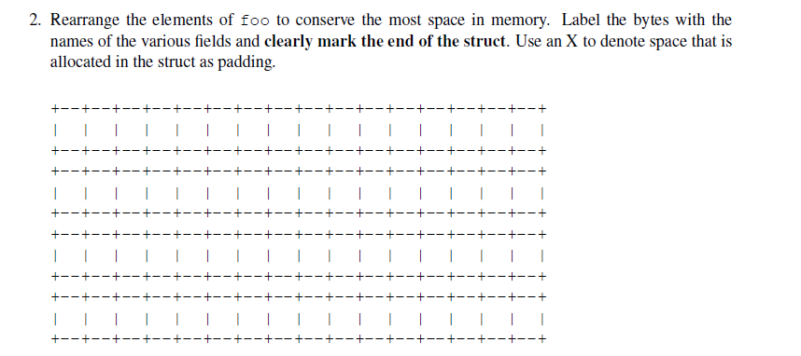
Example Struct Exam Question (Cont’d)
http://www.cs.cmu.edu/~213/oldexams/exam1-f12.pdf

Slide 46
Example Struct Exam Question (Cont’d)
a
d
d
d
c
c
c
c
b
b
b
b
b
b
b
b
e
e
e
e
e
e
e
e
f
f
f
|
f
f
f
f
f
http://www.cs.cmu.edu/~213/oldexams/exam1-f12.pdf

Slide 47
Today
Arrays
One-dimensional
Multi-dimensional (nested)
Multi-level
Structures
Allocation
Access
Alignment
Floating Point

Slide 48
Background
History
x87 FP
Legacy, very ugly
SSE FP
Supported by Shark machines
Special case use of vector instructions
AVX FP
Newest version
Similar to SSE (but registers are 32 bytes instead of 16)
Documented in book

Slide 49
Programming with SSE4
XMM Registers
16 total, each 16 bytes
16 single-byte integers
8 16-bit integers
4 32-bit integers
4 single-precision floats
2 double-precision floats
1 single-precision float
1 double-precision float

Slide 50
Scalar & SIMD Operations
Scalar Operations: Single Precision
SIMD Operations: Single Precision
Scalar Operations: Double Precision
addss %xmm0,%xmm1
%xmm0
+
%xmm1
addps %xmm0,%xmm1
%xmm0
+
+
+
+
%xmm1
addsd %xmm0,%xmm1
%xmm0
+
%xmm1

Slide 51
FP Basics
Arguments passed in %xmm0, %xmm1, ...
Result returned in %xmm0
All XMM registers caller-saved
float fadd(float x, float y)
{
return x + y;
}
double dadd(double x, double y)
{
return x + y;
}
# x in %xmm0, y in %xmm1
addss %xmm1, %xmm0
ret
# x in %xmm0, y in %xmm1
addsd %xmm1, %xmm0
ret

Slide 52
FP Memory Referencing
Integer (and pointer) arguments passed in regular registers
FP values passed in XMM registers
Different mov instructions to move between XMM registers, and between memory and XMM registers
double dincr(double *p, double v)
{
double x = *p;
*p = x + v;
return x;
}
# p in %rdi, v in %xmm0
movapd %xmm0, %xmm1 # Copy v
movsd (%rdi), %xmm0 # x = *p
addsd %xmm0, %xmm1 # t = x + v
movsd %xmm1, (%rdi) # *p = t
ret

Slide 53
Other Aspects of FP Code
Lots of instructions
Different operations, different formats, ...
Floating-point comparisons
Instructions ucomiss and ucomisd
Set condition codes ZF, PF and CF
Zeros OF and SF
Using constant values
Set XMM0 register to 0 with instruction xorpd %xmm0, %xmm0
Others loaded from memory
UNORDERED: ZF,PF,CF←111
GREATER_THAN: ZF,PF,CF←000
LESS_THAN: ZF,PF,CF←001
EQUAL: ZF,PF,CF←100
Parity Flag

Slide 54
Summary
Arrays
Elements packed into contiguous region of memory
Use index arithmetic to locate individual elements
Structures
Elements packed into single region of memory
Access using offsets determined by compiler
Possible require internal and external padding to ensure alignment
Combinations
Can nest structure and array code arbitrarily
Floating Point
Data held and operated on in XMM registers

Slide 55
Understanding Pointers & Arrays #3
Decl | An |  |  | *An |  |  | **An
 | Cmp | Bad | Size | Cmp | Bad | Size | Cmp | Bad | Size
int A1[3][5]
int *A2[3][5]
int (*A3)[3][5]
int *(A4[3][5])
int (*A5[3])[5]
Decl | ***An
 | Cmp | Bad | Size
int A1[3][5]
int *A2[3][5]
int (*A3)[3][5]
int *(A4[3][5])
int (*A5[3])[5]
Cmp: Compiles (Y/N)
Bad: Possible bad pointer reference (Y/N)
Size: Value returned by sizeof

Slide 56
Allocated pointer
Declaration
int A1[3][5]
int *A2[3][5]
int (*A3)[3][5]
int *(A4[3][5])
int (*A5[3])[5]
Allocated pointer to unallocated int
Unallocated pointer
Allocated int
Unallocated int
A1
A2/A4
A3
A5

Slide 57
Understanding Pointers & Arrays #3
Decl | An |  |  | *An |  |  | **An
 | Cmp | Bad | Size | Cmp | Bad | Size | Cmp | Bad | Size
int A1[3][5] | Y | N | 60 | Y | N | 20 | Y | N | 4
int *A2[3][5] | Y | N | 120 | Y | N | 40 | Y | N | 8
int (*A3)[3][5] | Y | N | 8 | Y | Y | 60 | Y | Y | 20
int *(A4[3][5]) | Y | N | 120 | Y | N | 40 | Y | N | 8
int (*A5[3])[5] | Y | N | 24 | Y | N | 8 | Y | Y | 20
Decl | ***An
 | Cmp | Bad | Size
int A1[3][5] | N | - | -
int *A2[3][5] | Y | Y | 4
int (*A3)[3][5] | Y | Y | 4
int *(A4[3][5]) | Y | Y | 4
int (*A5[3])[5] | Y | Y | 4
Cmp: Compiles (Y/N)
Bad: Possible bad pointer reference (Y/N)
Size: Value returned by sizeof

