Slide 1
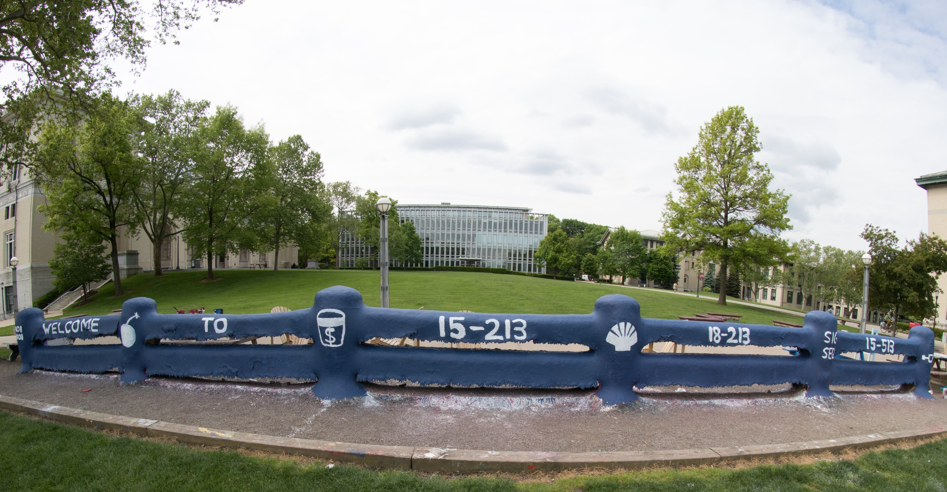
14-513
18-613

Slide 2
Virtual Memory: Systems 15-213/18-213/14-513/15-513/18-613: Introduction to Computer Systems 18th Lecture, October 29, 2020

Slide 3

Announcements
Lab 5 (malloclab)
Checkpoint due Thu, Oct. 29, 11:59pm ET
Written Assignment 7 peer grading
Due Wed, Nov. 4, 11:59pm ET
Written Assignment 8
Due Wed, Nov. 4, 11:59pm ET
Recitation on Malloc Lab (part II)
Mon, Nov. 2. Slides are already posted
U.S. Election Day is Tues, Nov.3
If eligible, go VOTE!
Skip class if need be (NO QUIZ on TUES!)

Slide 4
Review: Virtual Memory & Physical Memory
Physical memory
(DRAM)
Physical page
number or
disk address
Virtual address
Valid
VP 1
PP 0
PTE 0
0
null
VP 2
1
VP 7
VP 4
PP 3
1
0
1
0
null
Virtual memory
(disk)
0
PTE 7
1
VP 1
Memory resident
page table
(DRAM)
VP 2
VP 3
VP 4
VP 6
VP 7
A page table contains page table entries (PTEs) that map virtual pages to physical pages.

Slide 5
Translating with a k-level Page Table
Having multiple levels greatly reduces page table size
Page table base register
(part of the process’ context)
n-1
VIRTUAL ADDRESS
p-1
0
VPN 1
VPN 2
...
VPN k
VPO
the Level 1
page table
a Level 2
page table
a Level k
page table
...
...
PPN
m-1
p-1
0
PPN
PPO
PHYSICAL ADDRESS

Slide 6
Translation Lookaside Buffer (TLB)
A small cache of page table entries with fast access by MMU
TLB
2
PTE
VPN
3
Cache/
Memory
MMU
CPU
VA
PA
1
4
Data
5
Typically, a TLB hit eliminates the k memory accesses required to do a page table lookup.

Slide 7
Recall: Set Associative Cache
Steps for a READ:
Locate set
Check if any line in set has matching tag
Yes + line valid: hit
Locate data starting at offset
E = 2e lines per set
Address of word:
t bits
s bits
b bits
S = 2^{s} sets
CT tag
CI index
CO offset
data begins at this offset
v
tag
0
1
2
B-1
valid bit
B = 2^{b} bytes per cache block (the data)

Slide 8
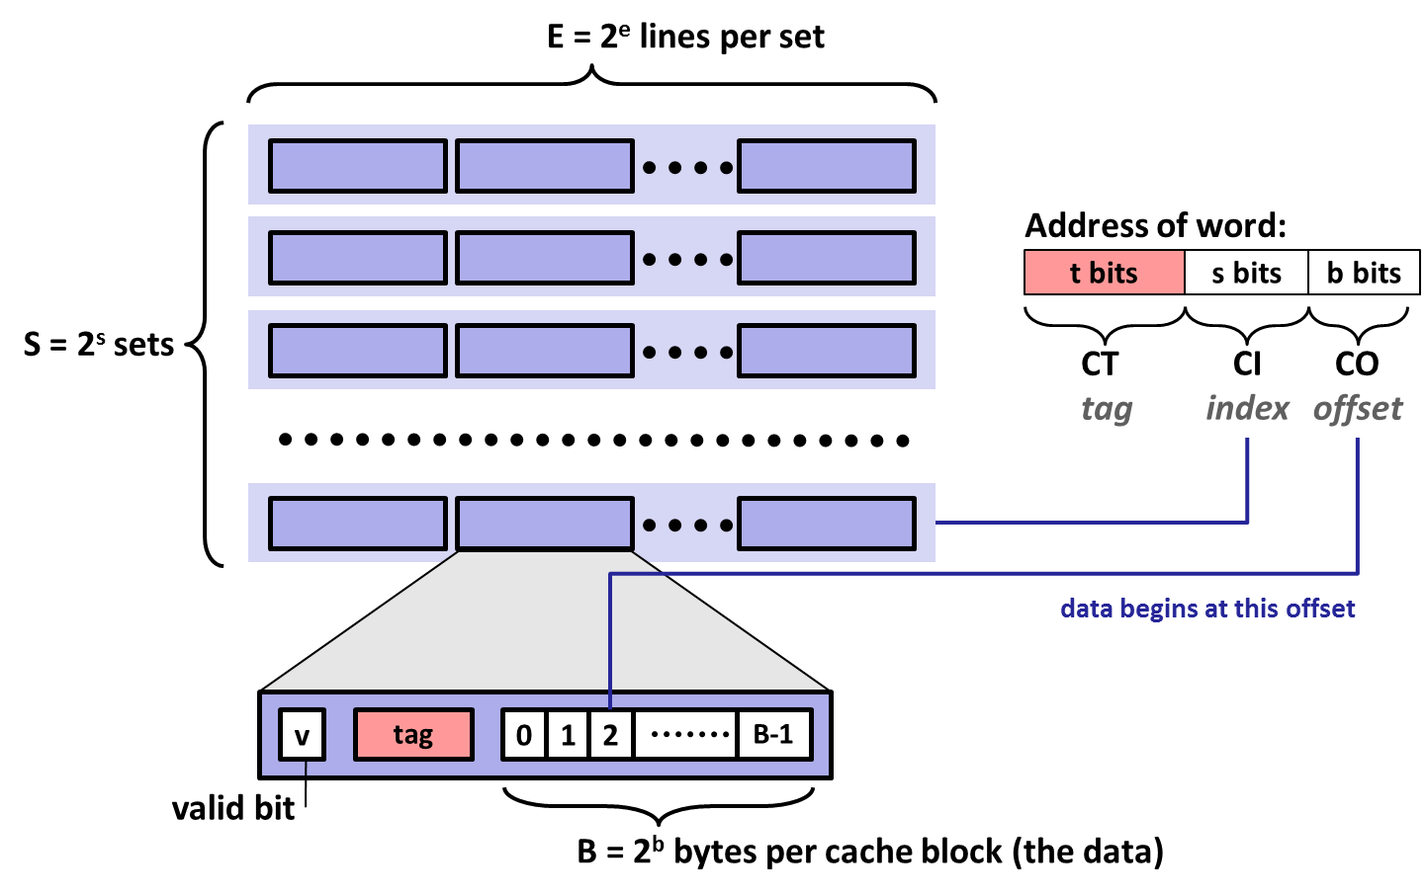
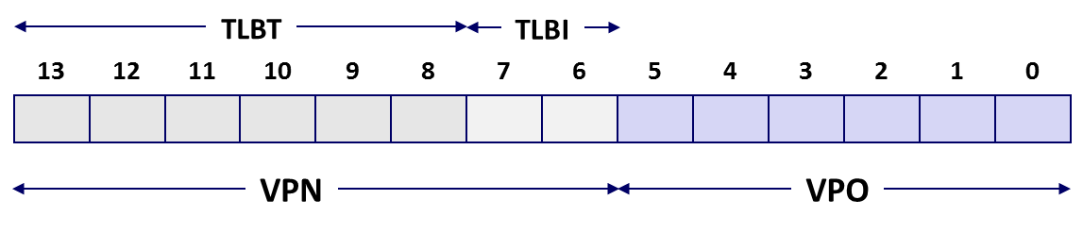
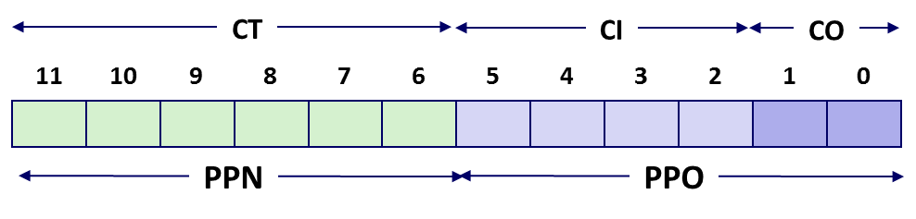

Review of Symbols
Basic Parameters
N = 2^{n} : Number of addresses in virtual address space
M = 2^{m} : Number of addresses in physical address space
P = 2^{p} : Page size (bytes)
Components of the virtual address (VA)
TLBI: TLB index
TLBT: TLB tag
VPO: Virtual page offset
VPN: Virtual page number
Components of the physical address (PA)
PPO: Physical page offset (same as VPO)
PPN: Physical page number
CO: Byte offset within cache line
CI: Cache index
CT: Cache tag
(bits per field for our simple example)

Slide 9
Today
Simple memory system example CSAPP 9.6.4
Case study: Core i7/Linux memory system CSAPP 9.7
Memory mapping CSAPP 9.8

Slide 10
Simple Memory System Example
Addressing
14-bit virtual addresses
12-bit physical address
Page size = 64 bytes
13
12
11
10
9
8
7
6
5
4
3
2
1
0
VPN
VPO
Virtual Page Number
Virtual Page Offset
11
10
9
8
7
6
5
4
3
2
1
0
PPN
PPO
Physical Page Number
Physical Page Offset

Slide 11
Simple Memory System TLB
16 entries
4-way associative
TLBT
TLBI
13
12
11
10
9
8
7
6
5
4
3
2
1
0
0
0
0
0
1
1
0
1
VPN
VPO
VPN = 0b1101 = 0x0D
Translation Lookaside Buffer (TLB)
Set
Tag
PPN
Valid
Tag
PPN
Valid
Tag
PPN
Valid
Tag
PPN
Valid
Set
Tag
PPN
Valid
Tag
PPN
Valid
Tag
PPN
Valid
Tag
PPN
Valid
0
03
–
0
09
0D
1
00
–
0
07
02
1
0
03
–
0
09
0D
1
00
–
0
07
02
1
1
03
2D
1
02
–
0
04
–
0
0A
–
0
1
03
2D
1
02
–
0
04
–
0
0A
–
0
2
02
–
0
08
–
0
06
–
0
03
–
0
2
02
–
0
08
–
0
06
–
0
03
–
0
3
07
–
0
03
0D
1
0A
34
1
02
–
0
3
07
–
0
03
0D
1
0A
34
1
02
–
0

Slide 12
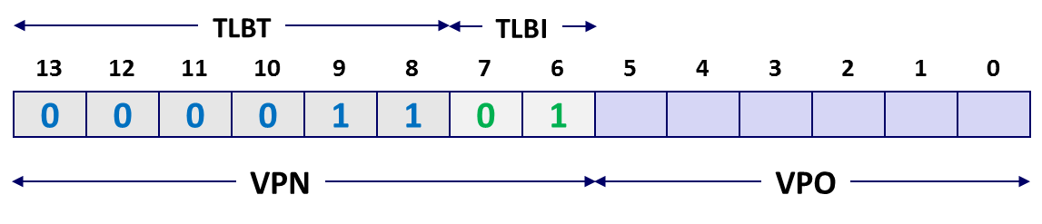
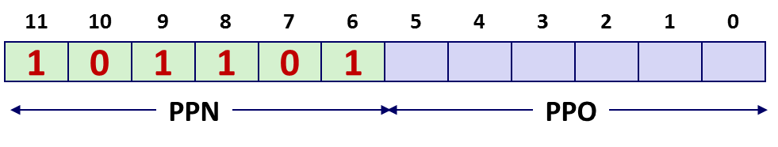
Simple Memory System Page Table
Only showing the first 16 entries (out of 256)
VPN
PPN
Valid
VPN
PPN
Valid
00
28
1
08
13
1
01
–
0
09
17
1
02
33
1
0A
09
1
03
02
1
0B
–
0
04
–
0
0C
–
0
05
16
1
0D
2D
1
0x0D → 0x2D
06
–
0
0E
11
1
07
–
0
0F
0D
1

Slide 13
Simple Memory System Cache
16 lines, 4-byte cache line size
Physically addressed
Direct mapped
V[0b00001101101001] = V[0x369]
P[0b101101101001] = P[0xB69] = 0x15
CT
CI
CO
11
10
9
8
7
6
5
4
3
2
1
0
1
0
1
1
0
1
1
0
1
0
0
1
PPN
PPO
Idx
Tag
Valid
B0
B1
B2
B3
Idx
Tag
Valid
B0
B1
B2
B3
Idx
Tag
Valid
B0
B1
B2
B3
Idx
Tag
Valid
B0
B1
B2
B3
0
19
1
99
11
23
11
8
24
1
3A
00
51
89
0
19
1
99
11
23
11
8
24
1
3A
00
51
89
1
15
0
–
–
–
–
9
2D
0
–
–
–
–
1
15
0
–
–
–
–
9
2D
0
–
–
–
–
2
1B
1
00
02
04
08
A
2D
1
93
15
DA
3B
2
1B
1
00
02
04
08
A
2D
1
93
15
DA
3B
3
36
0
–
–
–
–
B
0B
0
–
–
–
–
3
36
0
–
–
–
–
B
0B
0
–
–
–
–
4
32
1
43
6D
8F
09
C
12
0
–
–
–
–
4
32
1
43
6D
8F
09
C
12
0
–
–
–
–
5
0D
1
36
72
F0
1D
D
16
1
04
96
34
15
5
0D
1
36
72
F0
1D
D
16
1
04
96
34
15
6
31
0
–
–
–
–
E
13
1
83
77
1B
D3
6
31
0
–
–
–
–
E
13
1
83
77
1B
D3
7
16
1
11
C2
DF
03
F
14
0
–
–
–
–
7
16
1
11
C2
DF
03
F
14
0
–
–
–
–

Slide 14
Address Translation Example
Virtual Address: 0x03D4
VPN ___ TLBI ___ TLBT ____ TLB Hit? __ Page Fault? __ PPN: ____
Physical Address
CO ___ CI___ CT ____ Hit? __ Byte: ____
TLBT
TLBI
13
12
11
10
9
8
7
6
5
4
3
2
1
0
0
0
0
0
1
1
1
1
0
1
0
1
0
0
VPN
VPO
0x0F
0x3
0x03
Y
N
0x0D
TLB
Set
Tag
PPN
Valid
Tag
PPN
Valid
Tag
PPN
Valid
Tag
PPN
Valid
0
03
–
0
09
0D
1
00
–
0
07
02
1
1
03
2D
1
02
–
0
04
–
0
0A
–
0
2
02
–
0
08
–
0
06
–
0
03
–
0
3
07
–
0
03
0D
1
0A
34
1
02
–
0
11
10
9
8
7
6
5
4
3
2
1
0
0
0
1
1
0
1
0
1
0
1
0
0
PPN
PPO

Slide 15
Address Translation Example
Physical Address
CO ___ CI___ CT ____ Hit? __ Byte: ____
CT
CI
CO
11
10
9
8
7
6
5
4
3
2
1
0
0
0
1
1
0
1
0
1
0
1
0
0
PPN
PPO
0
0x5
0x0D
Y
0x36
Cache
Idx
Tag
Valid
B0
B1
B2
B3
Idx
Tag
Valid
B0
B1
B2
B3
0
19
1
99
11
23
11
8
24
1
3A
00
51
89
1
15
0
–
–
–
–
9
2D
0
–
–
–
–
2
1B
1
00
02
04
08
A
2D
1
93
15
DA
3B
3
36
0
–
–
–
–
B
0B
0
–
–
–
–
4
32
1
43
6D
8F
09
C
12
0
–
–
–
–
5
0D
1
36
72
F0
1D
D
16
1
04
96
34
15
6
31
0
–
–
–
–
E
13
1
83
77
1B
D3
7
16
1
11
C2
DF
03
F
14
0
–
–
–
–

Slide 16
Address Translation Example: TLB/Cache Miss
Virtual Address: 0x0020
VPN ___ TLBI ___ TLBT ____ TLB Hit? __ Page Fault? __ PPN: ____
Physical Address
CO___ CI___ CT ____ Hit? __ Byte: ____
TLBT
TLBI
13
12
11
10
9
8
7
6
5
4
3
2
1
0
0
0
0
0
0
0
0
0
1
0
0
0
0
0
VPN
VPO
0x00
0
0x00
N
N
0x28
Page table
VPN
PPN
Valid
CT
CI
CO
00
28
1
11
10
9
8
7
6
5
4
3
2
1
0
01
–
0
1
0
1
0
0
0
1
0
0
0
0
0
02
33
1
03
02
1
PPN
PPO
04
–
0
0
0x8
0x28
05
16
1
06
–
0
07
–
0

Slide 17
Address Translation Example: TLB/Cache Miss
Cache
Physical Address
CO___ CI___ CT ____ Hit? __ Byte: ____
Idx
Tag
Valid
B0
B1
B2
B3
Idx
Tag
Valid
B0
B1
B2
B3
0
19
1
99
11
23
11
8
24
1
3A
00
51
89
1
15
0
–
–
–
–
9
2D
0
–
–
–
–
2
1B
1
00
02
04
08
A
2D
1
93
15
DA
3B
3
36
0
–
–
–
–
B
0B
0
–
–
–
–
4
32
1
43
6D
8F
09
C
12
0
–
–
–
–
5
0D
1
36
72
F0
1D
D
16
1
04
96
34
15
6
31
0
–
–
–
–
E
13
1
83
77
1B
D3
7
16
1
11
C2
DF
03
F
14
0
–
–
–
–
CT
CI
CO
11
10
9
8
7
6
5
4
3
2
1
0
1
0
1
0
0
0
1
0
0
0
0
0
PPN
PPO
0
0x8
0x28
N
Mem

Slide 18
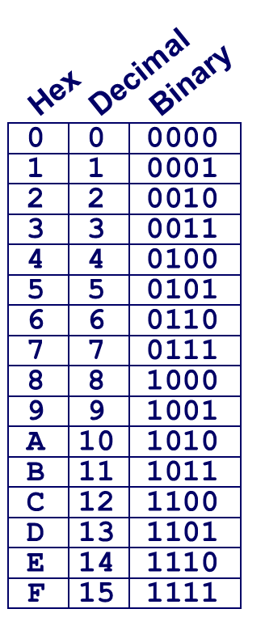
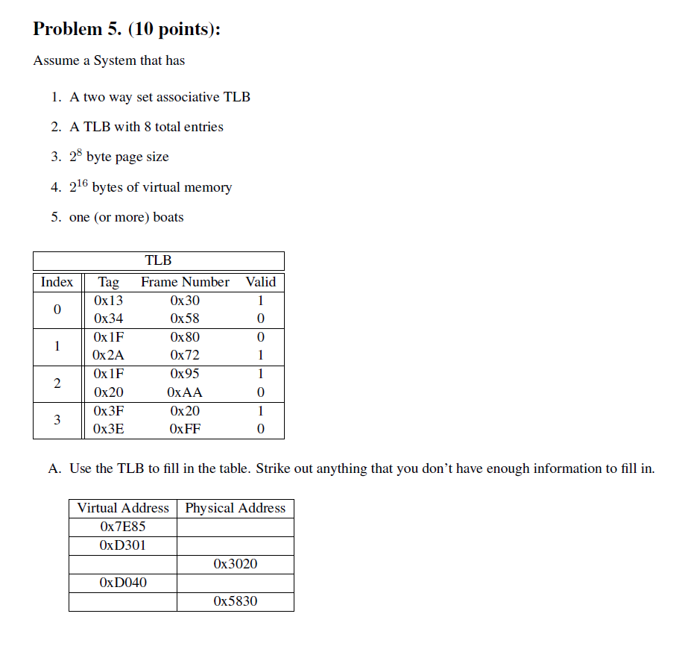
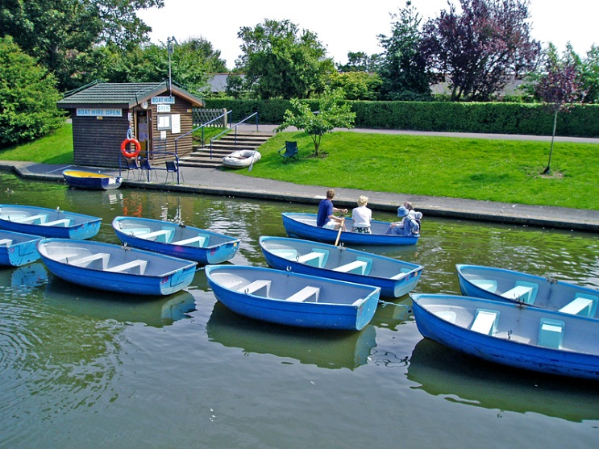
Virtual Memory Exam Question
PPN
TLBT
TLBI
15
14
13
12
11
10
9
8
7
6
5
4
3
2
1
0
0
1
1
1
1
1
1
0
1
0
0
0
0
1
0
1
0x7E85
0x9585
TLBI = 0x2
------
0x7E85
= 0x0111111010000101
0x4C20
TLBT = 0x1F
------
------
Exam: http://www.cs.cmu.edu/~213/oldexams/exam2b-s11.pdf (solution)
0x7E85 → 0x9585
Notes:
Brandon: I find this slide confusing and unintuitive and not good as an exercise, so I am hiding it for now.

Slide 19
Quiz Time!
Check out:
https://canvas.cmu.edu/courses/17808

Slide 20
Today
Simple memory system example
Case study: Core i7/Linux memory system
Memory mapping

Slide 21
Intel Core i7 Memory System
Processor package
Core x4
Registers
Instruction
fetch
MMU
(addr translation)
L1 d-cache
32 KB, 8-way
L1 i-cache
32 KB, 8-way
L1 d-TLB
64 entries, 4-way
L1 i-TLB
128 entries, 4-way
L2 unified cache
256 KB, 8-way
L2 unified TLB
512 entries, 4-way
To other
cores
QuickPath interconnect
4 links @ 25.6 GB/s each
To I/O
bridge
L3 unified cache
8 MB, 16-way
(shared by all cores)
DDR3 Memory controller
3 x 64 bit @ 10.66 GB/s
32 GB/s total (shared by all cores)
Main memory

Slide 22
End-to-end Core i7 Address Translation
CPU
32/64
L2, L3, and
main memory
Result
Virtual address (VA)
36
12
VPN
VPO
L1
hit
L1
miss
32
4
TLBT
TLBI
L1 d-cache
(64 sets, 8 lines/set)
TLB
hit
TLB
miss
...
...
L1 TLB (16 sets, 4 entries/set)
9
9
9
9
40
12
40
6
6
VPN1
VPN2
VPN3
VPN4
PPN
PPO
CT
CI
CO
Physical
address
(PA)
CR3
PTE
PTE
PTE
PTE
Page tables

Slide 23
Core i7 Level 1-3 Page Table Entries
63
62
52
51
12
11
9
8
7
6
5
4
3
2
1
0
XD
Unused
Page table physical base address
Unused
G
PS
A
CD
WT
U/S
R/W
P=1
Available for OS (page table location on disk)
P=0
Each entry references a 4K child page table. Significant fields:
P: Child page table present in physical memory (1) or not (0).
R/W: Read-only or read-write access access permission for all reachable pages.
U/S: user or supervisor (kernel) mode access permission for all reachable pages.
WT: Write-through or write-back cache policy for the child page table.
A: Reference bit (set by MMU on reads and writes, cleared by software).
PS: Page size either 4 KB or 4 MB (defined for Level 1 PTEs only).
Page table physical base address: 40 most significant bits of physical page table address (forces page tables to be 4KB aligned)
XD: Disable or enable instruction fetches from all pages reachable from this PTE.
Notes:
Reference bit – used in LRU

Slide 24
Core i7 Level 4 Page Table Entries
63
62
52
51
12
11
9
8
7
6
5
4
3
2
1
0
XD
Unused
Page physical base address
Unused
G
D
A
CD
WT
U/S
R/W
P=1
Available for OS (page location on disk)
P=0
Each entry references a 4K child page. Significant fields:
P: Child page is present in memory (1) or not (0)
R/W: Read-only or read-write access permission for child page
U/S: User or supervisor mode access
WT: Write-through or write-back cache policy for this page
A: Reference bit (set by MMU on reads and writes, cleared by software)
D: Dirty bit (set by MMU on writes, cleared by software)
G: Global page (don’t evict from TLB on task switch)
Page physical base address: 40 most significant bits of physical page address (forces pages to be 4KB aligned)
XD: Disable or enable instruction fetches from this page.

Slide 25
Core i7 Page Table Translation
9
9
9
9
12
Virtual
address
VPN 1
VPN 2
VPN 3
VPN 4
VPO
L1 PT
Page global
directory
L2 PT
Page upper
directory
L3 PT
Page middle
directory
L4 PT
Page
table
40
40
40
40
CR3
/
/
/
/
Physical
address
of L1 PT
Offset into
physical and
virtual page
/
12
L1 PTE
L2 PTE
L3 PTE
L4 PTE
Physical
address
of page
512 GB
region
per entry
1 GB
region
per entry
2 MB
region
per entry
4 KB
region
per entry
40
/
40
12
Physical
address
PPN
PPO

Slide 26
Cute Trick for Speeding Up L1 Access
CT
Tag Check
40
6
6
Physical
address
(PA)
CT
CI
CO
PPN
PPO
Address
Translation
No
Change
Virtual
address
(VA)
CI
VPN
VPO
L1 Cache
36
12
Observation
Bits that determine CI identical in virtual and physical address
Can index into cache while address translation taking place
Generally we hit in TLB, so PPN bits (CT bits) available quickly
“Virtually indexed, physically tagged”
Cache carefully sized to make this possible

Slide 27
Virtual Address Space of a Linux Process
Process-specific data
structs (ptables,
task and mm structs, kernel stack)
Different for each process
Kernel
virtual
memory
Identical for each process
Physical memory
Kernel code and data
%rsp
User stack
Memory mapped region
for shared libraries
Process
virtual
memory
brk
Runtime heap (malloc)
Uninitialized data (.bss)
Initialized data (.data)
0x00400000
Program text (.text)
0

Slide 28
Linux Organizes VM as Collection of “Areas”
Process virtual memory
vm_area_struct
task_struct
mm_struct
vm_end
mm
pgd
vm_start
vm_prot
mmap
vm_flags
Shared libraries
vm_next
vm_end
pgd:
Page global directory address
Points to L1 page table
vm_prot:
Read/write permissions for this area
vm_flags
Pages shared with other processes or private to this process
vm_start
Data
vm_prot
vm_flags
vm_next
Text
vm_end
vm_start
vm_prot
vm_flags
vm_next
0
Each process has own task_struct, etc

Slide 29
Linux Page Fault Handling
vm_area_struct
Process virtual memory
vm_end
vm_start
vm_prot
vm_flags
shared libraries
vm_next
1
Segmentation fault:
accessing a non-existing page
read
vm_end
vm_start
data
3
vm_prot
read
Normal page fault
vm_flags
vm_next
text
2
Protection exception:
e.g., violating permission by writing to a read-only page (Linux reports as Segmentation fault)
write
vm_end
vm_start
vm_prot
vm_flags
vm_next

Slide 30
Today
Simple memory system example
Case study: Core i7/Linux memory system
Memory mapping

Slide 31
Memory Mapping
VM areas initialized by associating them with disk objects.
Called memory mapping
Area can be backed by (i.e., get its initial values from) :
Regular file on disk (e.g., an executable object file)
Initial page bytes come from a section of a file
Anonymous file (e.g., nothing)
First fault will allocate a physical page full of 0's (demand-zero page)
Once the page is written to (dirtied), it is like any other page
Dirty pages are copied back and forth between memory and a special swap file.

Slide 32
Review: Memory Management & Protection
Code and data can be isolated or shared among processes
0
Address
translation
0
Virtual Address Space for Process 1:
Physical
Address
Space (DRAM)
VP 1
VP 2
PP 2
...
N-1
PP 6
(e.g., read-only
library code)
Virtual Address Space for Process 2:
0
PP 8
VP 1
VP 2
...
...
N-1
M-1

Slide 33
Sharing Revisited: Shared Objects
Process 1
virtual memory
Physical
memory
Process 2
virtual memory
Process 1 maps the shared object (on disk).
Shared
object

Slide 34
Sharing Revisited: Shared Objects
Process 1
virtual memory
Physical
memory
Process 2
virtual memory
Process 2 maps the same shared object.
Notice how the virtual addresses can be different.
But, difference must be multiple of page size.
Shared
object

Slide 35
Sharing Revisited: Private Copy-on-write (COW) Objects
Process 1
virtual memory
Physical
memory
Process 2
virtual memory
Two processes mapping a private copy-on-write (COW) object
Area flagged as private copy-on-write
PTEs in private areas are flagged as read-only
Private
copy-on-write
area
Private
copy-on-write object

Slide 36
Sharing Revisited: Private Copy-on-write (COW) Objects
Process 1
virtual memory
Physical
memory
Process 2
virtual memory
Instruction writing to private page triggers protection fault.
Handler creates new R/W page.
Instruction restarts upon handler return.
Copying deferred as long as possible!
Copy-on-write
Write to private
copy-on-write
page
Private
copy-on-write object

Slide 37
Finding Shareable Pages
Kernel Same-Page Merging
OS scans through all of physical memory, looking for duplicate pages
When found, merge into single copy, marked as copy-on-write
Implemented in Linux kernel in 2009
Limited to pages marked as likely candidates
Especially useful when processor running many virtual machines

Slide 38
User-Level Memory Mapping
void *mmap(void *start, int len,
int prot, int flags, int fd, int offset)
Map len bytes starting at offset offset of the file specified by file description fd, preferably at address start
start: may be 0 for “pick an address”
prot: PROT_READ, PROT_WRITE, PROT_EXEC, ...
flags: MAP_ANON, MAP_PRIVATE, MAP_SHARED, ...
Return a pointer to start of mapped area (may not be start)
Notes:
PROT_READ = ok to read pages
PROT_WRITE = ok to read or write
PROT_EXEC = ok to execute
MAP_ANON = backing store is anonymous object & pages are demand-zeroed
MAP_PRIVATE = copy-on-write object
MAP_SHARED = shared object

Slide 39
User-Level Memory Mapping
void *mmap(void *start, int len,
int prot, int flags, int fd, int offset)
len bytes
start
(or address
chosen by kernel)
len bytes
offset
(bytes)
0
0
Disk file specified by
file descriptor fd
Process virtual memory

Slide 40
Uses of mmap
Reading big files
Uses paging mechanism to bring files into memory
Shared data structures
When call with MAP_SHARED flag
Multiple processes have access to same region of memory
Risky!
File-based data structures
E.g., database
Give prot argument PROT_READ | PROT_WRITE
When unmap region, file will be updated via write-back
Can implement load from file / update / write back to file

Slide 41
Example: Using mmap to Support Attack Lab
Problem
Want students to be able to perform code injection attacks
Shark machine stacks are not executable
Solution
Suggested by Sam King (now at UC Davis)
Use mmap to allocate region of memory marked executable
Divert stack to new region
Execute student attack code
Restore back to original stack
Remove mapped region

Slide 42
Using mmap to Support Attack Lab
Memory
invisible to
user code
Kernel virtual memory
User stack
(created at runtime)
%rsp
(stack
pointer)
Memory-mapped region for
shared libraries
Run-time heap
(created by malloc)
Read/write segment
(.data, .bss)
Read-only segment
(.init, .text, .rodata)
0x40000000
Unused
0

Slide 43
Using mmap to Support Attack Lab
Memory
invisible to
user code
Kernel virtual memory
User stack
(created at runtime)
%rsp
(stack
pointer)
Memory-mapped region for
shared libraries
Region created by mmap
0x55586000
Run-time heap
(created by malloc)
Read/write segment
(.data, .bss)
0x55586000
Read-only segment
(.init, .text, .rodata)
0x40000000
Unused
0

Slide 44
Using mmap to Support Attack Lab
Memory
invisible to
user code
Kernel virtual memory
User stack
(created at runtime)
%rsp
(stack
pointer)
Frame for launch
Memory-mapped region for
shared libraries
Frame for test
Region created by mmap
Frame for getbuf
0x55586000
Run-time heap
(created by malloc)
Read/write segment
(.data, .bss)
0x55586000
Read-only segment
(.init, .text, .rodata)
0x40000000
Unused
0

Slide 45
Using mmap to Support Attack Lab
Memory
invisible to
user code
Kernel virtual memory
User stack
(created at runtime)
%rsp
(stack
pointer)
Memory-mapped region for
shared libraries
Run-time heap
(created by malloc)
Read/write segment
(.data, .bss)
Read-only segment
(.init, .text, .rodata)
0x40000000
Unused
0

Slide 46
Summary
VM requires hardware support
Exception handling mechanism
TLB
Various control registers
VM requires OS support
Managing page tables
Implementing page replacement policies
Managing file system
VM enables many capabilities
Loading programs from memory
Providing memory protection

Slide 47
Using mmap to Support Attack Lab
Allocate new region
void *new_stack = mmap(START_ADDR, STACK_SIZE, PROT_EXEC|PROT_READ|PROT_WRITE,
MAP_PRIVATE | MAP_GROWSDOWN | MAP_ANONYMOUS | MAP_FIXED,
0, 0);
if (new_stack != START_ADDR) {
munmap(new_stack, STACK_SIZE);
exit(1);
}
Divert stack to new region & execute attack code
Restore stack and remove region
stack_top = new_stack + STACK_SIZE - 8;
asm("movq %%rsp,%%rax ; movq %1,%%rsp ; movq %%rax,%0"
: "=r" (global_save_stack) // %0
: "r" (stack_top) // %1
);
launch(global_offset);
asm("movq %0,%%rsp"
:
: "r" (global_save_stack) // %0
);
munmap(new_stack, STACK_SIZE);

