Slide 1
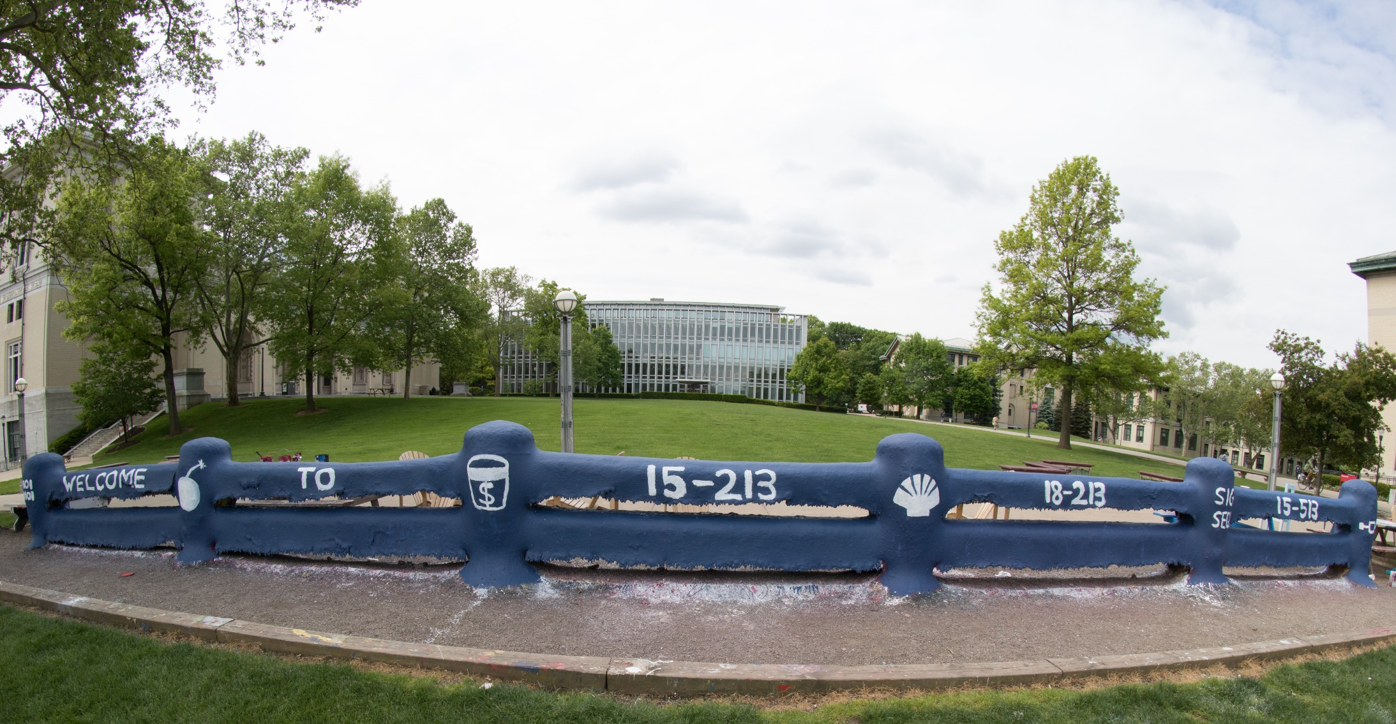
14-513
18-613

Slide 2
Synchronization: Advanced 15-213/18-213/14-513/15-513/18-613: Introduction to Computer Systems 26th Lecture, December 3, 2020

Slide 3
Reminder: Semaphores
Semaphore: non-negative global integer synchronization variable
Manipulated by P and V operations:
P(s): [ while (s == 0); s--; ]
Dutch for "Proberen" (test)
V(s): [ s++; ]
Dutch for "Verhogen" (increment)
OS kernel guarantees that operations between brackets [ ] are executed atomically
Only one P or V operation at a time can modify s.
When while loop in P terminates, only that P can decrement s
Semaphore invariant: (s >= 0)

Slide 4
Review: Using semaphores to protect shared resources via mutual exclusion
Basic idea:
Associate a unique semaphore mutex, initially 1, with each shared variable (or related set of shared variables)
Surround each access to the shared variable(s) with P(mutex) and
V(mutex) operations
mutex = 1
P(mutex)
cnt++
V(mutex)

Slide 5
Review: Using Lock for Mutual Exclusion
Basic idea:
Mutex is special case of semaphore that only has value 0 (locked) or 1 (unlocked)
Lock(m): [ while (m == 0); m=0; ]
Unlock(m): [ m=1]
~2x faster than using semaphore for this purpose
And, more clearly indicates programmer’s intention
mutex = 1
lock(mutex)
cnt++
unlock(mutex)

Slide 6
Note about Examples
Lecture examples will use semaphores for both counting and mutual exclusion
Code is much shorter than using pthread_mutex

Slide 7
Review: Producer-Consumer Problem
producer
thread
consumer
thread
shared
buffer
Common synchronization pattern:
Producer waits for empty slot, inserts item in buffer, and notifies consumer
Consumer waits for item, removes it from buffer, and notifies producer
Examples
Multimedia processing:
Producer creates video frames, consumer renders them
Event-driven graphical user interfaces
Producer detects mouse clicks, mouse movements, and keyboard hits and inserts corresponding events in buffer
Consumer retrieves events from buffer and paints the display
Notes:
Close computers, etc. Ask students to sketch out the code.
Producer thread() { x = buf; … do stuff}
Consumer thread() {do stuff … buf = x; }
P -> Acquire / decrement
V -> Release / Increment

Slide 8
Review: Using Semaphores to Coordinate Access to Shared Resources
Basic idea: Thread uses a semaphore operation to notify another thread that some condition has become true
Use counting semaphores to keep track of resource state.
Use binary semaphores to notify other threads.
The Producer-Consumer Problem
Mediating interactions between processes that generate information and that then make use of that information
Single entry buffer implemented with two binary semaphores
One to control access by producer(s)
One to control access by consumer(s)
N-entry implemented with semaphores + circular buffer

Slide 9
Today
Using semaphores to schedule shared resources CSAPP 12.5.4
Readers-writers problem
Other concurrency issues CSAPP 12.7
Thread safety
Races
Deadlocks
Interactions between threads and signal handling

Slide 10
Readers-Writers Problem
W₁
R₁
Read/
Write
Access
W₂
R₂
Read-only
Access
W₃
R₃
Problem statement:
Reader threads only read the object
Writer threads modify the object (read/write access)
Writers must have exclusive access to the object
Unlimited number of readers can access the object
Occurs frequently in real systems, e.g.,
Online airline reservation system
Multithreaded caching Web proxy

Slide 11
Readers/Writers Examples
W₁
R₁
W₂
R₂
W₃
R₃
W₁
R₁
W₂
R₂
W₃
R₃

Slide 12
Variants of Readers-Writers
First readers-writers problem (favors readers)
No reader should be kept waiting unless a writer has already been granted permission to use the object.
A reader that arrives after a waiting writer gets priority over the writer.
Second readers-writers problem (favors writers)
Once a writer is ready to write, it performs its write as soon as possible
A reader that arrives after a writer must wait, even if the writer is also waiting.
Starvation (where a thread waits indefinitely) is possible in both cases.

Slide 13
Solution to First Readers-Writers Problem
Readers:
Writers:
int readcnt; /* Initially 0 */
sem_t mutex, w; /* Both initially 1 */
void reader(void)
{
while (1) {
P(&mutex);
readcnt++;
if (readcnt == 1) /* First in */
P(&w);
V(&mutex);
/* Reading happens here */
P(&mutex);
readcnt--;
if (readcnt == 0) /* Last out */
V(&w);
V(&mutex);
}
}
void writer(void)
{
while (1) {
P(&w);
/* Writing here */
V(&w);
}
}
rw1.c
A reader that arrives
after a waiting writer
gets priority over the writer

Slide 14
Readers/Writers Examples
W₁
R₁
W₂
R₂
w = 1
readcnt = 0
W₃
R₃
W₁
R₁
W₂
R₂
w = 0
readcnt = 0
W₃
R₃
W₁
R₁
w = 0
readcnt = 2
W₂
R₂
W₃
R₃

Slide 15
Solution to First Readers-Writers Problem
Readers:
Writers:
int readcnt; /* Initially 0 */
sem_t mutex, w; /* Both initially 1 */
void reader(void)
{
while (1) {
P(&mutex);
readcnt++;
if (readcnt == 1) /* First in */
P(&w);
V(&mutex);
/* Reading happens here */
P(&mutex);
readcnt--;
if (readcnt == 0) /* Last out */
V(&w);
V(&mutex);
}
}
void writer(void)
{
while (1) {
P(&w);
/* Writing here */
V(&w);
}
}
rw1.c
Arrivals: R1 R2 W1 R3

Slide 16
Solution to First Readers-Writers Problem
Readers:
Writers:
int readcnt; /* Initially 0 */
sem_t mutex, w; /* Both initially 1 */
void reader(void)
{
while (1) {
P(&mutex);
readcnt++;
if (readcnt == 1) /* First in */
P(&w);
V(&mutex);
/* Reading happens here */
P(&mutex);
readcnt--;
if (readcnt == 0) /* Last out */
V(&w);
V(&mutex);
}
}
void writer(void)
{
while (1) {
P(&w);
/* Writing here */
V(&w);
}
}
rw1.c
R1
Arrivals: R1 R2 W1 R3
readcnt == 1
w == 0

Slide 17
Solution to First Readers-Writers Problem
Readers:
Writers:
int readcnt; /* Initially 0 */
sem_t mutex, w; /* Both initially 1 */
void reader(void)
{
while (1) {
P(&mutex);
readcnt++;
if (readcnt == 1) /* First in */
P(&w);
V(&mutex);
/* Reading happens here */
P(&mutex);
readcnt--;
if (readcnt == 0) /* Last out */
V(&w);
V(&mutex);
}
}
void writer(void)
{
while (1) {
P(&w);
/* Writing here */
V(&w);
}
}
R2
rw1.c
R1
Arrivals: R1 R2 W1 R3
readcnt == 2
w == 0

Slide 18
Solution to First Readers-Writers Problem
Readers:
Writers:
int readcnt; /* Initially 0 */
sem_t mutex, w; /* Both initially 1 */
void reader(void)
{
while (1) {
P(&mutex);
readcnt++;
if (readcnt == 1) /* First in */
P(&w);
V(&mutex);
/* Reading happens here */
P(&mutex);
readcnt--;
if (readcnt == 0) /* Last out */
V(&w);
V(&mutex);
}
}
void writer(void)
{
while (1) {
P(&w);
/* Writing here */
V(&w);
}
}
W1
R2
rw1.c
R1
Arrivals: R1 R2 W1 R3
readcnt == 2
w == 0

Slide 19
Solution to First Readers-Writers Problem
Readers:
Writers:
int readcnt; /* Initially 0 */
sem_t mutex, w; /* Both initially 1 */
void reader(void)
{
while (1) {
P(&mutex);
readcnt++;
if (readcnt == 1) /* First in */
P(&w);
V(&mutex);
/* Reading happens here */
P(&mutex);
readcnt--;
if (readcnt == 0) /* Last out */
V(&w);
V(&mutex);
}
}
void writer(void)
{
while (1) {
P(&w);
/* Writing here */
V(&w);
}
}
W1
rw1.c
R2
Arrivals: R1 R2 W1 R3
readcnt == 1
w == 0
R1

Slide 20
Solution to First Readers-Writers Problem
Readers:
Writers:
int readcnt; /* Initially 0 */
sem_t mutex, w; /* Both initially 1 */
void reader(void)
{
while (1) {
P(&mutex);
readcnt++;
if (readcnt == 1) /* First in */
P(&w);
V(&mutex);
/* Reading happens here */
P(&mutex);
readcnt--;
if (readcnt == 0) /* Last out */
V(&w);
V(&mutex);
}
}
void writer(void)
{
while (1) {
P(&w);
/* Writing here */
V(&w);
}
}
W1
R3
rw1.c
R2
Arrivals: R1 R2 W1 R3
readcnt == 2
w == 0
R1

Slide 21
Solution to First Readers-Writers Problem
Readers:
Writers:
int readcnt; /* Initially 0 */
sem_t mutex, w; /* Both initially 1 */
void reader(void)
{
while (1) {
P(&mutex);
readcnt++;
if (readcnt == 1) /* First in */
P(&w);
V(&mutex);
/* Reading happens here */
P(&mutex);
readcnt--;
if (readcnt == 0) /* Last out */
V(&w);
V(&mutex);
}
}
void writer(void)
{
while (1) {
P(&w);
/* Writing here */
V(&w);
}
}
W1
R3
rw1.c
Arrivals: R1 R2 W1 R3
readcnt == 1
w == 0
R2

Slide 22
Solution to First Readers-Writers Problem
Readers:
Writers:
int readcnt; /* Initially 0 */
sem_t mutex, w; /* Both initially 1 */
void reader(void)
{
while (1) {
P(&mutex);
readcnt++;
if (readcnt == 1) /* First in */
P(&w);
V(&mutex);
/* Reading happens here */
P(&mutex);
readcnt--;
if (readcnt == 0) /* Last out */
V(&w);
V(&mutex);
}
}
void writer(void)
{
while (1) {
P(&w);
/* Writing here */
V(&w);
}
}
W1
rw1.c
Arrivals: R1 R2 W1 R3
readcnt == 0
w == 1
R3

Slide 23
Other Versions of Readers-Writers
Shortcoming of first solution
Continuous stream of readers will block writers indefinitely
Second version
Once writer comes along, blocks access to later readers
Series of writes could block all reads
FIFO implementation
See rwqueue code in code directory
Service requests in order received
Threads kept in FIFO
Each has semaphore that enables its access to critical section

Slide 24
Solution to Second Readers-Writers Problem
int readcnt, writecnt; // Initially 0
sem_t rmutex, wmutex, r, w; // Initially 1
void reader(void)
{
while (1) {
P(&r);
P(&rmutex);
readcnt++;
if (readcnt == 1) /* First in */
P(&w);
V(&rmutex);
V(&r)
/* Reading happens here */
P(&rmutex);
readcnt--;
if (readcnt == 0) /* Last out */
V(&w);
V(&rmutex);
}
}
A reader that arrives after a writer must wait, even if the writer is also waiting

Slide 25
Solution to Second Readers-Writers Problem
void writer(void)
{
while (1) {
P(&wmutex);
writecnt++;
if (writecnt == 1)
P(&r);
V(&wmutex);
P(&w);
/* Writing here */
V(&w);
P(&wmutex);
writecnt--;
if (writecnt == 0);
V(&r);
V(&wmutex);
}
}
A reader that arrives after a writer must wait, even if the writer is also waiting

Slide 26
Managing Readers/Writers with FIFO
Time
Requests
R
R
W
R
R
R
W
W
R
W
Allowed
Concurrency
Idea
Read & Write requests are inserted into FIFO
Requests handled as remove from FIFO
Read allowed to proceed if currently idle or processing read
Write allowed to proceed only when idle
Requests inform controller when they have completed
Fairness
Guarantee every request is eventually handled

Slide 27
Readers Writers FIFO Implementation
Full code in rwqueue.{h,c}
/* Queue data structure */
typedef struct {
sem_t mutex; // Mutual exclusion
int reading_count; // Number of active readers
int writing_count; // Number of active writers
// FIFO queue implemented as linked list with tail
rw_token_t *head;
rw_token_t *tail;
} rw_queue_t;
/* Represents individual thread's position in queue */
typedef struct TOK {
bool is_reader;
sem_t enable; // Enables access
struct TOK *next; // Allows chaining as linked list
} rw_token_t;

Slide 28
Readers Writers FIFO Use
In rwqueue-test.c
/* Get write access to data and write */
void iwriter(int *buf, int v)
{
rw_token_t tok;
rw_queue_request_write(&q, &tok);
/* Critical section */
*buf = v;
/* End of Critical Section */
rw_queue_release(&q);
}
/* Get read access to data and read */
int ireader(int *buf)
{
rw_token_t tok;
rw_queue_request_read(&q, &tok);
/* Critical section */
int v = *buf;
/* End of Critical section */
rw_queue_release(&q);
return v;
}

Slide 29
Library Reader/Writer Lock
Data type pthread_rwlock_t
Operations
Acquire read lock
Pthread_rwlock_rdlock(pthread_rw_lock_t *rwlock)
Acquire write lock
Pthread_rwlock_wrlock(pthread_rw_lock_t *rwlock)
Release (either) lock
Pthread_rwlock_unlock(pthread_rw_lock_t *rwlock)
Observation
Library must be used correctly!
Up to programmer to decide what requires read access and what requires write access

Slide 30
Today
Using semaphores to schedule shared resources
Readers-writers problem
Other concurrency issues
Races
Deadlocks
Thread safety
Interactions between threads and signal handling

Slide 31
One Worry: Races
A race occurs when correctness of the program depends on one thread reaching point x before another thread reaches point y
/* a threaded program with a race */
int main(int argc, char** argv) {
pthread_t tid[N];
int i;
for (i = 0; i < N; i++)
Pthread_create(&tid[i], NULL, thread, &i);
for (i = 0; i < N; i++)
Pthread_join(tid[i], NULL);
return 0;
}
/* thread routine */
void *thread(void *vargp) {
int myid = *((int *)vargp);
printf("Hello from thread %d\n", myid);
return NULL;
}
race.c
Notes:
Resume here 7/28, re-export slides afterward

Slide 32

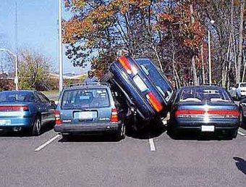
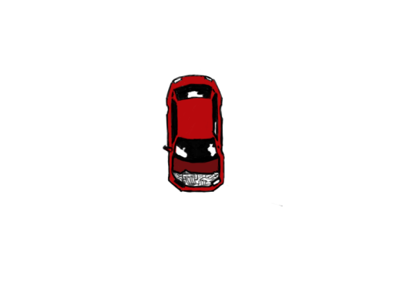

Data Race

Slide 33
Race Elimination
Don’t share state
E.g., use malloc to generate separate copy of argument for each thread
Use synchronization primitives to control access to shared state
Different shared state can use different primitives

Slide 34
Today
Using semaphores to schedule shared resources
Producer-consumer problem
Other concurrency issues
Races
Deadlocks
Thread safety
Interactions between threads and signal handling

Slide 35
A Worry: Deadlock
Def: A process is deadlocked iff it is waiting for a condition that will never be true.
Typical Scenario
Processes 1 and 2 needs two resources (A and B) to proceed
Process 1 acquires A, waits for B
Process 2 acquires B, waits for A
Both will wait forever!

Slide 36
A Worry: Deadlock
Def: A process is deadlocked iff it is waiting for a condition that will never be true.
More fully (and beyond the scope of this course), a deadlock has four requirements
Mutual exclusion
Circular waiting
Hold and wait
No pre-emption

Slide 37
Deadlocking With Semaphores
int main(int argc, char** argv)
{
pthread_t tid[2];
Sem_init(&mutex[0], 0, 1); /* mutex[0] = 1 */
Sem_init(&mutex[1], 0, 1); /* mutex[1] = 1 */
Pthread_create(&tid[0], NULL, count, (void*) 0);
Pthread_create(&tid[1], NULL, count, (void*) 1);
Pthread_join(tid[0], NULL);
Pthread_join(tid[1], NULL);
printf("cnt=%d\n", cnt);
return 0;
}
void *count(void *vargp)
{
int i;
int id = (int) vargp;
for (i = 0; i < NITERS; i++) {
P(&mutex[id]); P(&mutex[1-id]);
cnt++;
V(&mutex[id]); V(&mutex[1-id]);
}
return NULL;
}
Tid[0]:
P(s₀);
P(s₁);
cnt++;
V(s₀);
V(s₁);
Tid[1]:
P(s₁);
P(s₀);
cnt++;
V(s₁);
V(s₀);

Slide 38
Deadlock Visualized in Progress Graph
Thread 1
Locking introduces the
potential for deadlock:
waiting for a condition that will never be true
Any trajectory that enters
the deadlock region will
eventually reach the
deadlock state, waiting for either s₀ or s₁ to become nonzero
Other trajectories luck out and skirt the deadlock region
Unfortunate fact: deadlock is often nondeterministic (race)
Deadlock
state
V(s₀)
Forbidden region
for s₀
V(s₁)
P(s₀)
Forbidden region
for s₁
Deadlock
region
P(s₁)
Thread 0
P(s₀)
P(s₁)
V(s₀)
V(s₁)
s₀=s₁=1

Slide 39
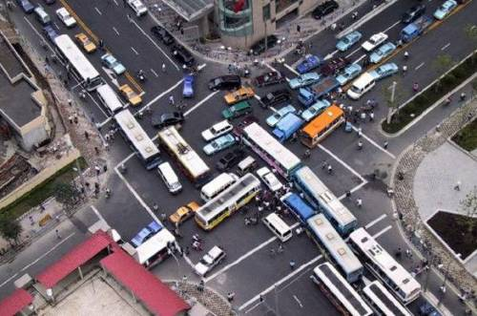
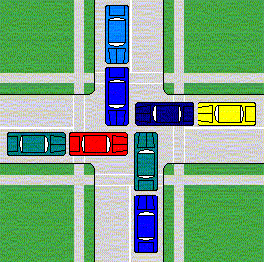
Deadlock

Slide 40
Avoiding Deadlock
Acquire shared resources in same order
int main(int argc, char** argv)
{
pthread_t tid[2];
Sem_init(&mutex[0], 0, 1); /* mutex[0] = 1 */
Sem_init(&mutex[1], 0, 1); /* mutex[1] = 1 */
Pthread_create(&tid[0], NULL, count, (void*) 0);
Pthread_create(&tid[1], NULL, count, (void*) 1);
Pthread_join(tid[0], NULL);
Pthread_join(tid[1], NULL);
printf("cnt=%d\n", cnt);
return 0;
}
void *count(void *vargp)
{
int i;
int id = (int) vargp;
for (i = 0; i < NITERS; i++) {
P(&mutex[0]); P(&mutex[1]);
cnt++;
V(&mutex[id]); V(&mutex[1-id]);
}
return NULL;
}
Tid[0]:
P(s₀);
P(s₁);
cnt++;
V(s₀);
V(s₁);
Tid[1]:
P(s₀);
P(s₁);
cnt++;
V(s₁);
V(s₀);

Slide 41
Avoided Deadlock in Progress Graph
Thread 1
No way for trajectory to get stuck
Processes acquire locks in same order
Order in which locks released immaterial
V(s₀)
Forbidden region
for s₀
V(s₁)
P(s₁)
Forbidden region
for s₁
P(s₀)
Thread 0
P(s₀)
P(s₁)
V(s₀)
V(s₁)
s₀=s₁=1

Slide 42
Demonstration
See program deadlock.c
100 threads, each acquiring same two locks
Risky mode
Even numbered threads request locks in opposite order of odd-numbered ones
Safe mode
All threads acquire locks in same order

Slide 43
Livelock Visualized in Progress Graph
Thread 1
Livelock is similar to a deadlock, except the threads change state, but remain in a deadlock trajectory.
Livelock
state
Forbidden region
for s₀
Forbidden region
for s₁
Livelock
region
Thread 0

Slide 44
Deadlock, Livelock, Starvation
Deadlock
One or more threads is waiting on a condition that will never be true
Livelock
One or more threads is changing state, but will never leave a deadlock / livelock trajectory
Starvation
One or more threads is temporarily unable to make progress

Slide 45
Quiz Time!
Check out:
https://canvas.cmu.edu/courses/17808

Slide 46
Today
Using semaphores to schedule shared resources
Readers-writers problem
Other concurrency issues
Races
Deadlocks
Thread safety
Interactions between threads and signal handling

Slide 47
Crucial concept: Thread Safety
Functions called from a thread must be thread-safe
Def: A function is thread-safe iff it will always produce correct results when called repeatedly from multiple concurrent threads.
Classes of thread-unsafe functions:
Class 1: Functions that do not protect shared variables
Class 2: Functions that keep state across multiple invocations
Class 3: Functions that return a pointer to a static variable
Class 4: Functions that call thread-unsafe functions

Slide 48
Thread-Unsafe Functions (Class 1)
Failing to protect shared variables
Fix: Use P and V semaphore operations (or mutex)
Example: goodcnt.c
Issue: Synchronization operations will slow down code

Slide 49
Thread-Unsafe Functions (Class 2)
Relying on persistent state across multiple function invocations
Example: Random number generator that relies on static state
static unsigned int next = 1;
/* rand: return pseudo-random integer on 0..32767 */
int rand(void)
{
next = next*1103515245 + 12345;
return (unsigned int)(next/65536) % 32768;
}
/* srand: set seed for rand() */
void srand(unsigned int seed)
{
next = seed;
}

Slide 50
Thread-Safe Random Number Generator
Pass state as part of argument
and, thereby, eliminate static state
Consequence: programmer using rand_r must maintain seed
/* rand_r - return pseudo-random integer on 0..32767 */
int rand_r(int *nextp)
{
*nextp = *nextp*1103515245 + 12345;
return (unsigned int)(*nextp/65536) % 32768;
}

Slide 51
Thread-Unsafe Functions (Class 3)
/* Convert integer to string */
char *itoa(int x)
{
static char buf[11];
sprintf(buf, "%d", x);
return buf;
}
Returning a pointer to a static variable
Fix 1. Rewrite function so caller passes address of variable to store result
Requires changes in caller and callee
Fix 2. Lock-and-copy
Requires simple changes in caller (and none in callee)
However, caller must free memory.
char *lc_itoa(int x, char *dest)
{
P(&mutex);
strcpy(dest, itoa(x));
V(&mutex);
return dest;
}

Slide 52
Thread-Unsafe Functions (Class 4)
Calling thread-unsafe functions
Calling one thread-unsafe function makes the entire function that calls it thread-unsafe
Fix: Modify the function so it calls only thread-safe functions ☺

Slide 53
Reentrant Functions
Def: A function is reentrant iff it accesses no shared variables when called by multiple threads.
Important subset of thread-safe functions
Require no synchronization operations
Only way to make a Class 2 function thread-safe is to make it reentrant (e.g., rand_r )
All functions
Thread-safe
functions
Reentrant
functions
Thread-unsafe
functions

Slide 54
Thread-Safe Library Functions
All functions in the Standard C Library (at the back of your K&R text) are thread-safe
Examples: malloc, free, printf, scanf
Most Unix system calls are thread-safe, with a few exceptions:
Thread-unsafe function Class Reentrant version
asctime 3 asctime_r
ctime 3 ctime_r
gethostbyaddr 3 gethostbyaddr_r
gethostbyname 3 gethostbyname_r
inet_ntoa 3 (none)
localtime 3 localtime_r
rand 2 rand_r

Slide 55
Today
Using semaphores to schedule shared resources
Readers-writers problem
Other concurrency issues
Races
Deadlocks
Thread safety
Interactions between threads and signal handling

Slide 56
Signal Handling Review
Receive
signal
I_{curr}
Handler
I_{next}
Action
Signal can occur at any point in program execution
Unless signal is blocked
Signal handler runs within same thread
Must run to completion and then return to regular program execution

Slide 57
Threads / Signals Interactions
fprintf.lock()
Receive
signal
I_{curr}
Handler
I_{next}
fprintf.unlock()
Many library functions use lock-and-copy for thread safety
Because they have hidden state
malloc
Free lists
fprintf, printf, puts
So that outputs from multiple threads don’t interleave
sprintf
Not officially asynch-signal-safe, but seems to be OK
OK for handler that doesn’t use these library functions

Slide 58
Bad Thread / Signal Interactions
fprintf.lock()
Receive
signal
I_{curr}
Handler
I_{next}
fprintf.lock()
fprintf.unlock()
fprintf.unlock()
What if:
Signal received while library function holds lock
Handler calls same (or related) library function
Deadlock!
Signal handler cannot proceed until it gets lock
Main program cannot proceed until handler completes
Key Point
Threads employ symmetric concurrency
Signal handling is asymmetric

Slide 59
Threads Summary
Threads provide another mechanism for writing concurrent programs
Threads are growing in popularity
Somewhat cheaper than processes
Easy to share data between threads
However, the ease of sharing has a cost:
Easy to introduce subtle synchronization errors
Tread carefully with threads!
For more info:
D. Butenhof, “Programming with Posix Threads”, Addison-Wesley, 1997

