Slide 1
System Challenges of Intermittent Computing
Kiwan Maeng
Notes:
talk about our paper,

Slide 2
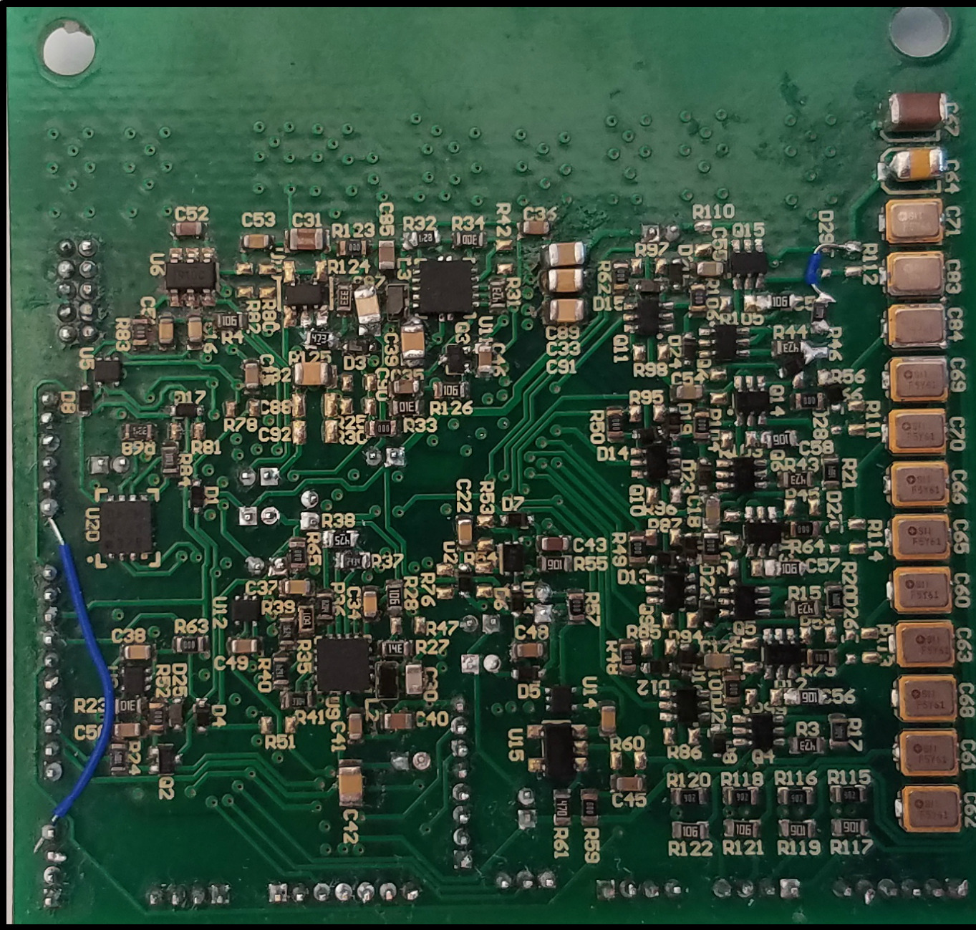
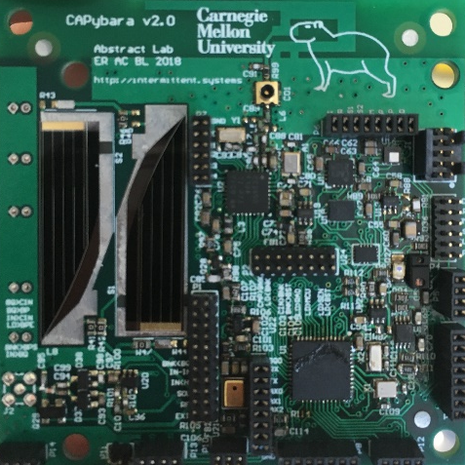
Recap: Just-In-Time (JIT) Checkpointing Enables Intermittent Execution
Workload
prep
encrypt string
out
Voltage
Checkpointing threshold
Time
Notes:
~4:00
This can be solved by a technique called the JIT C.
Just to make things clear, the solution of a JIT C that I’ll introduce is an alternative solution from the task-based approach that my colleague, Emily, presented earlier.

Slide 3
Recap: JIT Checkpointing Enables Intermittent Execution
…
prep
encrypt
1
2
Voltage
!
Energy is low!!
Time
Notes:
hits

Slide 4
Recap: JIT Checkpointing Enables Intermittent Execution
Checkpoint!!
prep
encrypt
1
2
Voltage
!
Energy is low!!
Time

Slide 5
Recap: JIT Checkpointing Enables Intermittent Execution
prep
encrypt
…
1
2
encrypt
Restore
Voltage
Time

Slide 6
Recap: JIT Checkpointing Enables Intermittent Execution
prep
encrypt
1
2
encrypt string
Voltage
!
Time

Slide 7
Recap: JIT Checkpointing Enables Intermittent Execution
prep
encrypt
1
2
encrypt string
encrypt string
out
Voltage
Time

Slide 8



Real-world Applications Need More Than Computation
Atomic Execution
Periodic Execution
I need to stay alive while I’m communicating!
Sense the temperature every 10 seconds!
Wildlife tracking
[Zhang 2004]
Smart agriculture
[Vasisht 2017]
Notes:
Because these systems do not require a battery to operate, they have a lot of potentials in the field where periodic battery replacement is infeasible,
such as ..

Slide 9

Intermittence Complicates Additional Execution Models
Atomic Execution
Periodic Execution
I need to stay alive while I’m communicating!
Sense the temperature every 10 seconds!
Notes:
Because these systems do not require a battery to operate, they have a lot of potentials in the field where periodic battery replacement is infeasible,
such as ..

Slide 10
Outline
Challenge 1. Periodic Execution
Solution 1. CatNap
Challenge 2. Atomic Execution
Solution 2. Samoyed
Future Work
Notes:
This is going to be..

Slide 11

Power Failures Complicate Periodic Execution
Sense the temperature every 10 seconds!
Notes:
So why is it hard to run program periodically on intermittent systems? First, varying incoming power makes periodic execution complicated. Let’s again, say that the programmer wants the system to collect a temperature data every 10 seconds.

Slide 12

Power Failures Complicate Periodic Execution
Voltage
Time

Slide 13
Power Failures Complicate Periodic Execution
Voltage
Time

Slide 14
Power Failures Complicate Periodic Execution
Voltage
Time

Slide 15
Power Failures Complicate Periodic Execution
Voltage
Time

Slide 16
Power Failures Complicate Periodic Execution
10s
Voltage
Time

Slide 17

Power Failures Complicate Periodic Execution
Voltage
Time

Slide 18
Power Failures Complicate Periodic Execution
Voltage
Time

Slide 19
Power Failures Complicate Periodic Execution
> 10s
Voltage
Time

Slide 20

Concurrent Execution Complicate Periodic Execution
Sense the temperature every 10 seconds and do compression!
Notes:
Another problem can occur when multiple code are being executed concurrently. For example, one might write a program that collects data every 10 seconds, and concurrently compresses the data.

Slide 21
Concurrent Execution Complicate Periodic Execution
Voltage
Time

Slide 22
Concurrent Execution Complicate Periodic Execution
Voltage
Time

Slide 23
Concurrent Execution Complicate Periodic Execution
Voltage
Time

Slide 24
Concurrent Execution Complicate Periodic Execution
Not enough energy!
…
Voltage
Time

Slide 25
Concurrent Execution Complicate Periodic Execution
Not enough energy!
…
Voltage
Time
> 10s

Slide 26
Concurrent Execution Complicate Periodic Execution
Not enough energy!
…
Voltage
Can we run periodic code in intermittent devices?
Time
> 10s

Slide 27
Outline
Challenge 1. Periodic Execution
Solution 1. CatNap
Challenge 2. Atomic Execution
Solution 2. Samoyed
Future Work
* Kiwan Maeng and Brandon Lucia, Adaptive Low-Overhead Scheduling for Periodic and Reactive Intermittent Execution. PLDI 2020
Notes:
This is going to be..

Slide 28
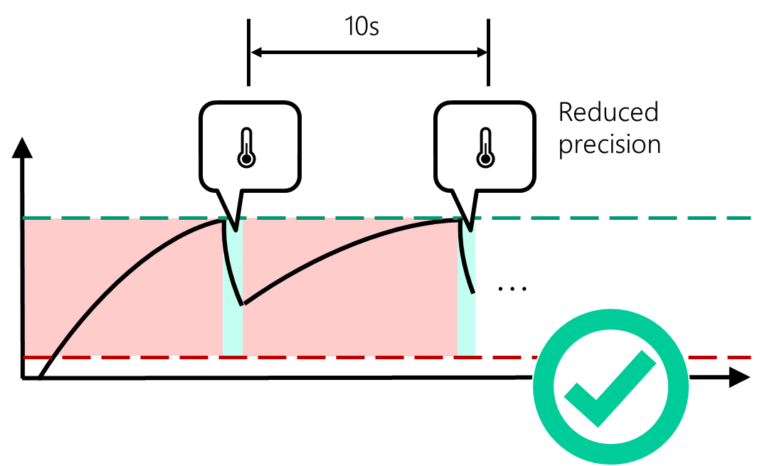
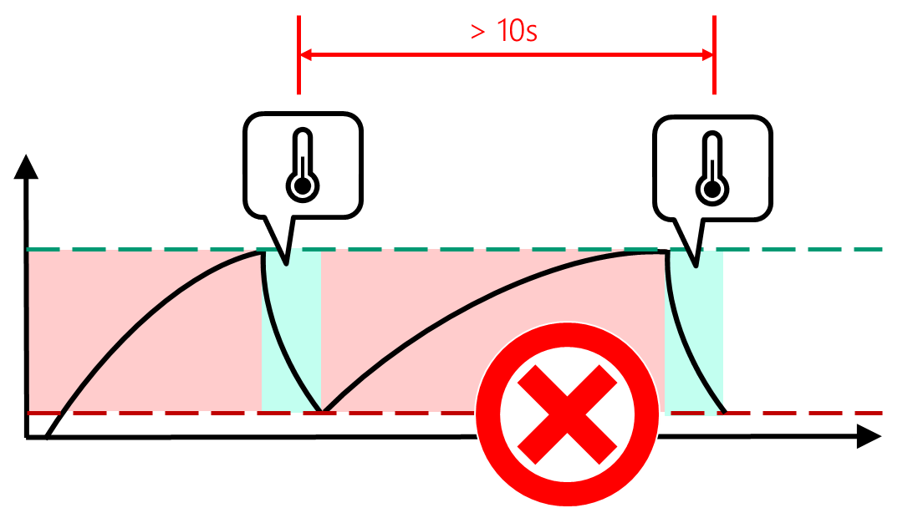
Idea 1: Quality degradation
32bit
8bit
Notes:
One possible solution to this is reducing the quality of the program. For example, the program might choose to collect a less accurate sample, while using less energy and thus keeping up with the programmer-specified periodic requirement. This is possible because many sensors can be configured to use less energy, while being less accurate.

Slide 29
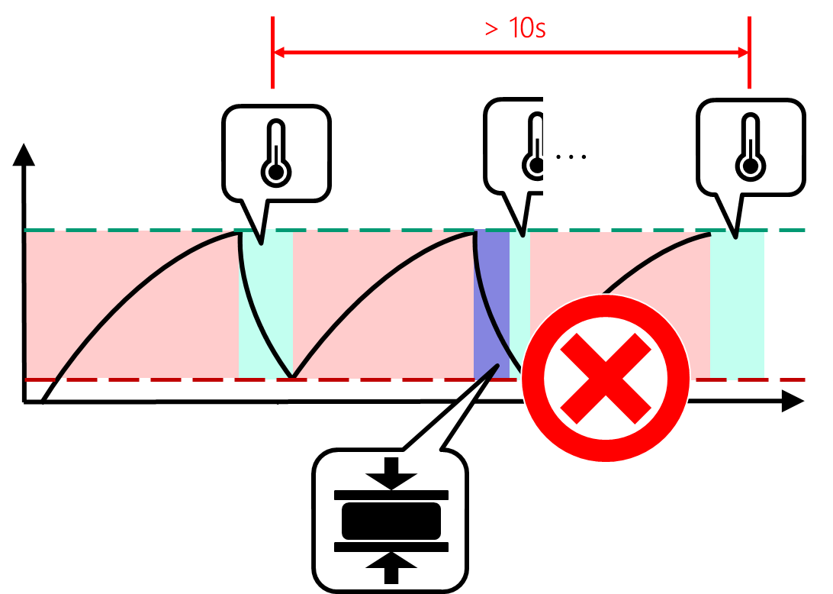
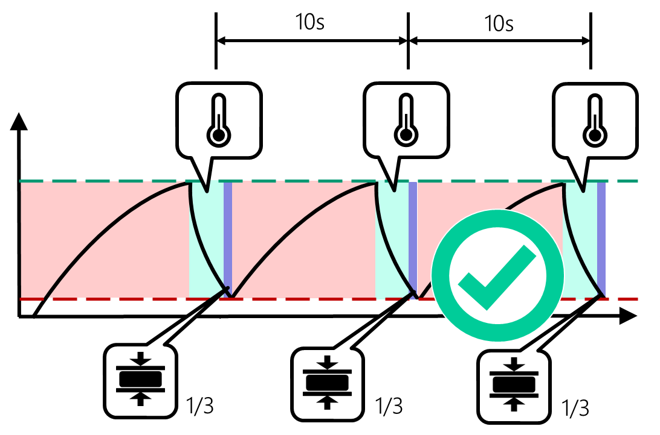
Idea 2: Schedule Code Execution and Recharging
Notes:
This problem can be solved with smart scheduling. Instead of using too much energy right before the data collection, if the system had spreaded the compression at the “right moments”, the system would have run correctly, as you can see from the right figure.

Slide 30


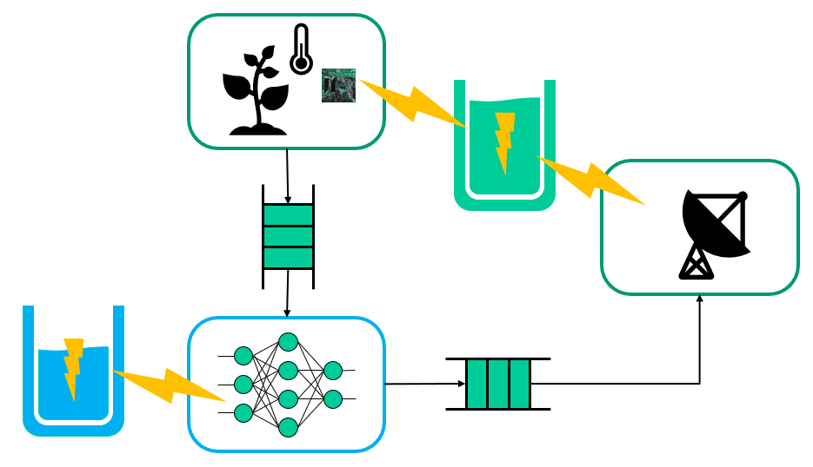
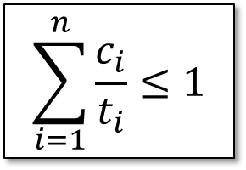
CatNap: Computation and Recharge Scheduler
$$\sum_{i=1}^{n}{\frac{c_{i}}{t_{i}}}≤1$$
32bit
8bit
Programming Model
Scheduler
Feasibility Test
Degradation Logic
Notes:
Don’t go into detail

Slide 31
Programmer Specifies Time-critical Events and Time-insensitive Tasks
Event
Event
Code with a time requirement (periodic/reactive requirement)
Short, atomic
e.g., sensor read, communication, …
Task
Task
Code without a time requirement
Long, interruptible
e.g., compute
Notes:
CatNap requires the programmer to write a program as a collection of events and tasks. Events are code that has a time requirement. Code that must run periodically or reactively should be declared as an event. Events run atomically, and must be kept short. Usually, things like a sensor read or a communication must become an event. Tasks, on the other hand, are code without a time requirement. They can be long, and can be interrupted by an event or a recharge. Tasks usually hold computations.

Slide 32
CatNap Schedules According to Priorities
Task
Event
Recharge (event)
Tasks
Low priority
Recharge (task)
Events
High priority
Event buffer recharge
Middle priority
Task buffer recharge
Low priority
Notes:
Then, CatNap scheduler shedules events, tasks, an recharges with different priorities. CatNap runs events with the highest priority, as soon as they arrive. When the energy reserve for events is not full, CatNap prioritizes recharging the buffer over running the tasks or recharging for the tasks.

Slide 33
CatNap Schedules According to Priorities
Task
Event
Recharge (event)
Tasks
Low priority
Recharge (task)
Events
High priority
Event buffer recharge
Middle priority
Task buffer recharge
Low priority
If a set of events and recharges are schedulable, CatNap can always schedule them! (proof: paper)
Notes:
Then, CatNap scheduler shedules events, tasks, an recharges with different priorities. CatNap runs events with the highest priority, as soon as they arrive. When the energy reserve for events is not full, CatNap prioritizes recharging the buffer over running the tasks or recharging for the tasks.

Slide 34
CatNap Schedules According to Priorities
Task
Event
Recharge (event)
Tasks
Low priority
Recharge (task)
Events
High priority
Event buffer recharge
Middle priority
How do you know?
Task buffer recharge
Low priority
If a set of events and recharges are schedulable, CatNap can always schedule them! (proof: paper)
Notes:
Then, CatNap scheduler shedules events, tasks, an recharges with different priorities. CatNap runs events with the highest priority, as soon as they arrive. When the energy reserve for events is not full, CatNap prioritizes recharging the buffer over running the tasks or recharging for the tasks.

Slide 35



A Feasibility Test Checks If Events are Schedulable
DETAIL
Theorem
Assume an event $ε_{i}∈ \left\{ε_{1},ε_{2},{…, ε}_{n}\right\}$ uses energy $e_{i}$ and has a period of $t_{i}$. If an incoming power is $R$ and $c_{i}=\frac{e_{i}}{R}$ , the events and charges can be scheduled if:
$$\sum_{i=1}^{n}{\frac{c_{i}}{t_{i}}}≤1$$
32bit
8bit
Event 1
Event 2
Not schedulable
Schedulable
Event 3
Main idea: Does a set of events use more energy than what can be recharged?
Full proof is provided as an Appendix of the paper.
Notes:
We developed a mathematical formula to test the schedulability with a given input power. Of course, you do not need to digest the formula right now. If you are interested, a full proof of the feasibility test is provided as an Appendix.

Slide 36
CatNap Schedules According to Priorities
Task
Event
Recharge (event)
Tasks
Low priority
Recharge (task)
Events
High priority
Event buffer recharge
Middle priority
What if it’s not?
Task buffer recharge
Low priority
If a set of events and recharges are schedulable, CatNap can always schedule them! (proof: paper)
Notes:
Then, CatNap scheduler shedules events, tasks, an recharges with different priorities. CatNap runs events with the highest priority, as soon as they arrive. When the energy reserve for events is not full, CatNap prioritizes recharging the buffer over running the tasks or recharging for the tasks.

Slide 37
Quality Degradation Makes Infeasible Schedule Feasible
32bit
8bit
Programmer provides set of degradation rules
Notes:
One possible solution to this is reducing the quality of the program. For example, the program might choose to collect a less accurate sample, while using less energy and thus keeping up with the programmer-specified periodic requirement. This is possible because many sensors can be configured to use less energy, while being less accurate.

Slide 38


Evaluation: CatNap Enables Periodic Execution
Ran periodic and compute-intensive workloads concurrently
Ran by harvesting RF energy
Compared with InK [Yıldırım 2018]
Periodic temperature sensing every 0.57s (event)
Downsampling with a square filter (task)
38
Notes:
Next, we concurrently ran a periodic workload of measuring the temperature every 0.57 second, and a compute-intensive workload of downsampling the data with a square filter. Again, we ran the evaluation on a real energy-harvesting setup and compared with InK. For CatNap, the … was programmed as an event , while … as a task

Slide 39
Evaluation: CatNap Enables Periodic Execution
Target period
(closer is better)
Notes:
This graph shows the resulting period of the actually sampled data. On the X-axis, different incoming power configuration is shown. For each configuration, the period of the actually sampled data is plotted for CatNap and InK. The target period specified by the programmer is shown as a red line. It is a good system if the bar is close to the red line. As you can see, CatNap meets the period requirement in all the incoming power, while InK violates the requirement heavily when the incoming power gets smaller. CatNap meets with the period nicely mainly because the downsampling task did not touch the energy reserve for the temperature measuring event, and the temperature sensing event can always run whenever needed.

Slide 40
Outline
Challenge 1. Periodic Execution
Solution 1. CatNap
Challenge 2. Atomic Execution
Solution 2. Samoyed
Future Work
Notes:
This is going to be..

Slide 41
Power Failure Breaks Atomicity
Workload
prep
encrypt string
out
AES
Voltage
Time
Notes:
To demonstrate the problem with peripherals, let’s look at the system with a hardware encryption accelerator.

Slide 42
Power Failure Breaks Atomicity
Workload
prep
wait
out
AES
encrypt string
Voltage
Time
Notes:
offloads
In this work, we only target blocking peripheral, where the cpu starts the execution and waits while it finishes.

Slide 43
Power Failure Breaks Atomicity
prep
wait
…
…
AES
encrypt string
Voltage
!
Energy is low!!
Time

Slide 44
Power Failure Breaks Atomicity
prep
wait
Checkpoint!!
…
AES
encrypt string
Voltage
!
Time

Slide 45
Power Failure Breaks Atomicity
prep
wait
…
Cannot checkpoint…
(peripheral state not always visible)
AES
encrypt string
Voltage
!
Time
Notes:
However, the state of the peripheral may not always be able to be checkpointed.

Slide 46
Power Failure Breaks Atomicity
prep
wait
…
Cannot checkpoint…
(peripheral state not always visible)
AES
encrypt string
input buffer
output buffer
!
internal circuitry
Time
Notes:
However, the state of the peripheral may not always be able to be checkpointed.

Slide 47
Power Failure Breaks Atomicity
prep
wait
AES
encrypt string
Voltage
Time

Slide 48
Power Failure Breaks Atomicity
prep
wait
wait
…
AES
encrypt string
Undefined state!
Voltage
Time
Notes:
maybe it is not even running, or maybe it is running with some garbage data.
This can ultimately cause a critical failure such as program hanging indefinitely, or producing a wrong result.

Slide 49
Power Failure Breaks Atomicity
Workload
prep
wait
out
AES
encrypt string
This region must be atomic! (not interrupted by checkpoints/failures)
Voltage
Time
Notes:
offloads
In this work, we only target blocking peripheral, where the cpu starts the execution and waits while it finishes.

Slide 50
Initial Attempt: Selectively Disabling Checkpoints
Workload
prep
wait
out
AES
encrypt string
What if we never collect a checkpoint here?
Notes:
In the previous example, the problem happened when we tried to checkpoint in the middle of the accelerator operation.
So one might think, it can be easily solved by never collecting a checkpoint while the accelerator is running. Let’s say we never collect a checkpoint in the yellow region, and always go back and
restart the entire region when power fails in the middle.
This approach can avoid the accelerator getting into an undefined state. However, different problems still remain.

Slide 51
Initial Attempt: Selectively Disabling Checkpoints
prep
wait
wait
wait
…
AES
encrypt string
encrypt string
encrypt string
The program never ends!
51
Notes:
If the accelerator operation is too long, the system will keep reexecuting the accelerator from the beginning, without every finishing.

Slide 52

Outline
Challenge 1. Periodic Execution
Solution 1. CatNap
Challenge 2. Atomic Execution
Solution 2. Samoyed
Future Work
* Kiwan Maeng and Brandon Lucia, Supporting Peripherals in Intermittent Systems with Just-In-Time Checkpoints. PLDI 2019
Notes:
This is going to be..

Slide 53
Idea: Peripheral Operations Usually Can Be Decomposed into Smaller Operations
str[0:N]
str[0:N/2]
str[N/2:N]
AES
AES
AES
53
Notes:
For example, an AES encryption of a string of length N can be broken down into two smaller instances of an AES encryption, with each taking half of the original string as its input

Slide 54
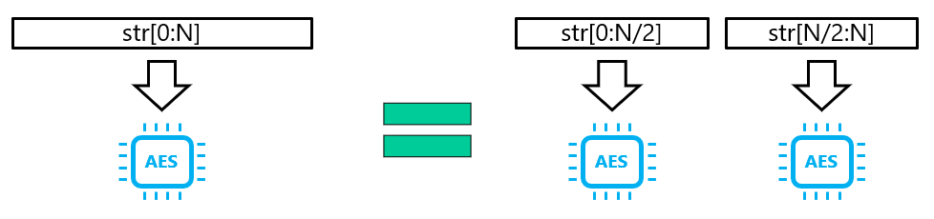
Solution: Peripheral Access Decomposition
prep
wait
out
AES
encrypt string
Specifies the decomposition rule

Slide 55

Solution: Peripheral Access Decomposition
prep
wait
out
AES
encrypt string
Adds necessary instrumentation
Notes:
Now, to sum up,

Slide 56

Solution: Peripheral Access Decomposition
prep
wait
out
AES
encrypt string
Hello, world!
MEM
Dynamically runs decomposition
Notes:
On runtime, the system will dynamically decompose the peripheral operation if necessary.
For example, if the peripheral operation is too large to finish in one energy cycle,

Slide 57
Solution: Peripheral Access Decomposition
prep
wait
wait
out
AES
enc
enc
Hello, world!
MEM
Dynamically runs decomposition
Notes:
The runtime system dynamically decompose it into a smaller operation using the user-provided rule.

Slide 58
Solution: Peripheral Access Decomposition
prep
wait
wait
wait
wait
out
AES
Hello, world!
MEM
Dynamically runs decomposition
Notes:
And this can happen recursively, until each operation becomes small enough.

Slide 59
Solution: Peripheral Access Decomposition
prep
wait
wait
wait
wait
wait
wait
wait
out
AES
Memoizes the appropriate size
Hello, world!
MEM
Notes:
After decomposing sufficiently, the system can run each peripheral operations with checkpointing in between.
After finding the appropriate size, the system memorizes the size and use it in the future instead of doing the dynamic search every time.

Slide 60

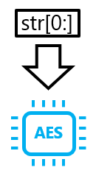
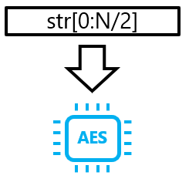
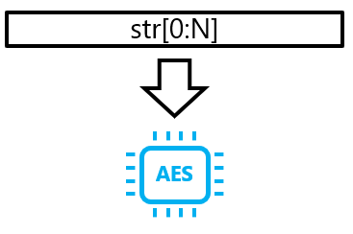
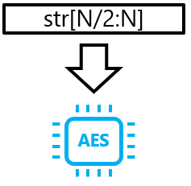
Solution: Peripheral Access Decomposition
…
Check the energy use of the decomposed code
…
Too large
Sufficiently small
60
Notes:
You may have noted that this approach does not work if even the maximally decomposed operation is too large to run.
We have a energy profiler that synthesizes the smallest possible peripheral operation and measures the energy use on compile time to make sure the decomposition always work.

Slide 61
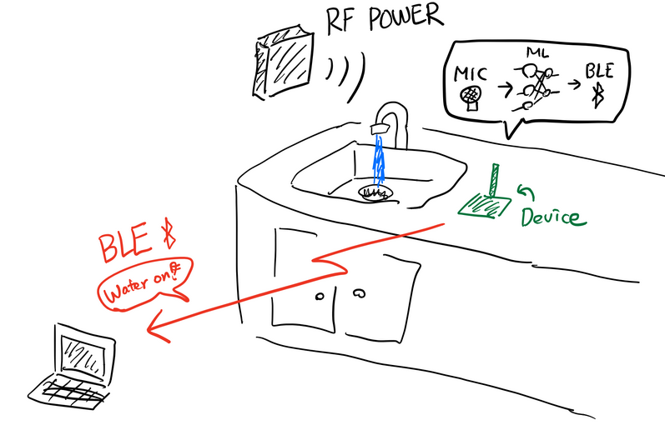
Evaluation: Kitchen Monitoring ML application
Send Bluetooth low-energy (BLE) alert if faucet or food dispenser is on.
Using microphone, ML accelerator, and BLE module.
61
Notes:
You may have noted that this approach does not work if even the maximally decomposed operation is too large to run.
We have a energy profiler that synthesizes the smallest possible peripheral operation and measures the energy use on compile time to make sure the decomposition always work.

Slide 62
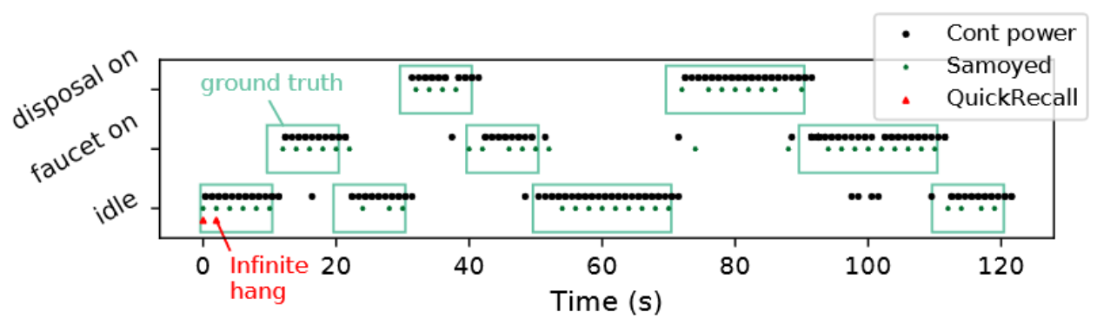
Evaluation: Kitchen Monitoring ML application
Our work
Prior work
62
Notes:
You may have noted that this approach does not work if even the maximally decomposed operation is too large to run.
We have a energy profiler that synthesizes the smallest possible peripheral operation and measures the energy use on compile time to make sure the decomposition always work.

Slide 63
Outline
Challenge 1. Periodic Execution
Solution 1. CatNap
Challenge 2. Atomic Execution
Solution 2. Samoyed
Future Work
Notes:
This is going to be..

Slide 64
Summary and Future Work
CatNap enables periodic execution with recharge scheduling, feasibility test, and degradation.
Samoyed enables atomic execution with dynamic region decomposition.
What is next?
What if there is not enough power at all (e.g., night)?
How fast/slow is the app going to be?
Can we do node-to-node communication?
Notes:
This is going to be..

Slide 65
System Challenges of Intermittent Computing
Kiwan Maeng
Notes:
talk about our paper,

