Slide 1

Careers & Employability
Cardiff University Enterprise

Slide 2

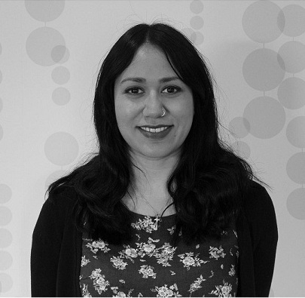



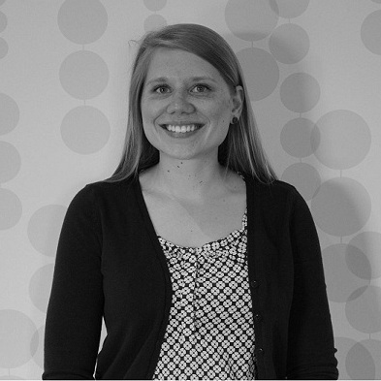
Our bit is about…
Neil Coles & Jay Begum
Your Business
Cardiff University Enterprise

Slide 3



Cardiff University Enterprise
Thursday evening guest speaker events
1-2-1 drop-in idea surgeries
Spark idea competition (up to £3000 prize)
Ignite 19-21 Feb 2015

Slide 4
SME

Slide 5
The CBI said in September 2009, that there is….
“A set of attributes, skills and knowledge that all labour market participants should possess to ensure they have the capability of being effective in the workplace
- to the benefit of themselves, their employer and the wider economy.”
CBI (September 09)

Slide 6
Small & Medium Sized Enterprise Source: http://www.cardiff.gov.uk/ (Economy & Culture Scrutiny Committee: 15 January 2009)
Cardiff:
19,700 SMEs
Employing 66,100 people.
Wales:
188,900 SMEs
Employing 581,300 people
Generating £35.8 bn in turnover
European Union:
23 million SMEs
Employing around 75 million people
Representing 99% of all business

Slide 7
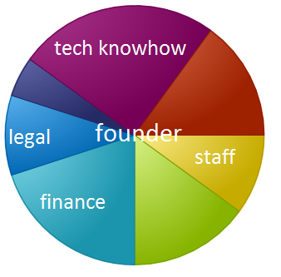
Establishing your SME
Are small firms scaled up large firms?
Basic legal structures
Sole traders
Limited companies
Notes:
Small firm scaled up
Fundamental difference in they way they operate
How and why a particulate small firm goes about it’s work in a particular way is to understand the owner manager
Finance is a different being – they can not raise it in a similar way, strategically that operate in a different way, they do not have departments to the extent of larger companies (the department is someone), they make business via personal contacts
Small firms often have a small selection of customers, therefore they are more prone to risk
Life style
Businesses that are primarily set up to undertake an activity of an owner manager
Often they will fund or not quite fund a salary
Jewellery, craft, photography – driven by a lifestyle choice
Growth Firms
Set up with the intention of high growth rates
Often the entrepreneur - but an entrepreneur does not have to be a business person (they could be a chemist)
Visit Fast Growth 50.com
Sole trader
Statistics.gov.uk 73.9% of all UK firms have no employees
Traditionally one person start-up (but can employ)
Setting up a sole trader is simple. All you need is the first customer.
Accounting and auditing regulations are lower
Personal payment of tax based upon the profits of the business
Limitations – finance is harder to acquire & personally liable for all debts of the company
Partnerships
Individual sole traders who pool resources
There is a need for a partnership agreement
Each partner is liable for the collective debt
Limited companies
A legal entity in its own right
There is a separation between owners (shareholders), managers and the company.
The company itself can sue and can sue
The company can enter contracts
Due to separation - liability is limited to the amount of capital placed in by the shareholder (personally they are not liable)
Tax is dealt with via corporation tax
Increased regulation – completion of yearly accounts and registration via Company's House
To set one up Google, ‘Company Registration Agent’ or visit the Companies House Website

Slide 8
Meetings
Collaboration
A gathering of people at agreed time/date with an intention of discussing issues & agreeing actions
Specific purpose to every meeting
Important part of business life
At best; allow all to contributor effectively
At worst; they can be boring
Most effective meetings are well planned, well chaired & members are cooperative

Slide 9
Basic Rules of Meetings
Members must attend on time, pay attention and take an active part in proceedings
An agenda should be agreed and followed with clear objectives
Members should prepare for meetings in advance and should deliver upon actions set
Members must accept the authority of the chair to organise proceedings
Everyone must have the opportunity to make themselves heard
A record should be taken (minutes) of decisions reached and it should be ratified by the group before circulation.

Slide 10
Careers & Employability
Cardiff University Enterprise

