Slide 1


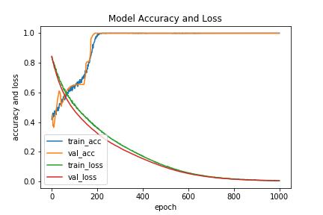
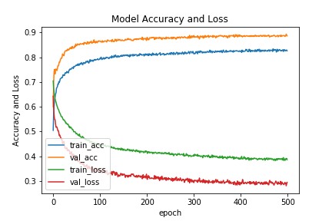
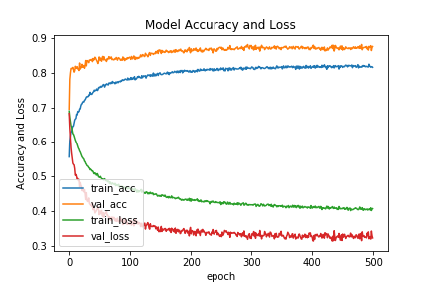
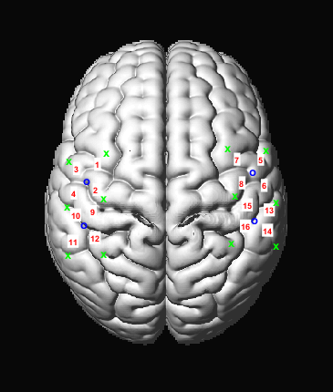
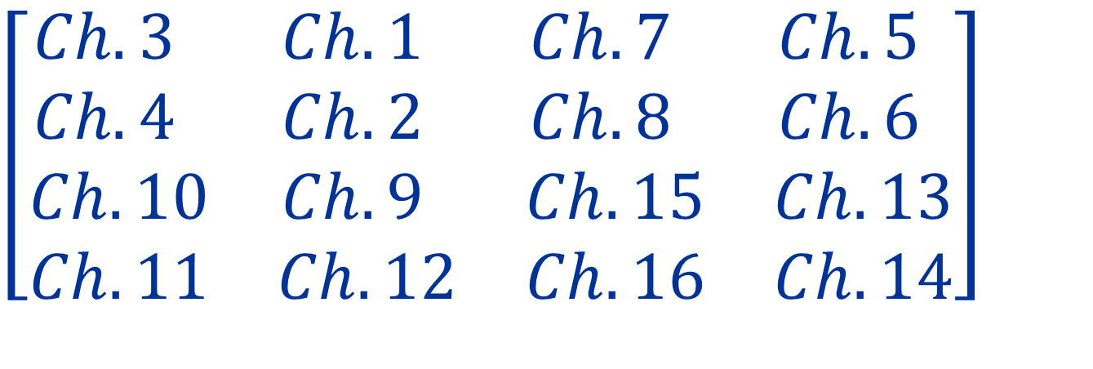

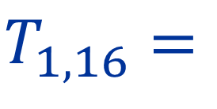
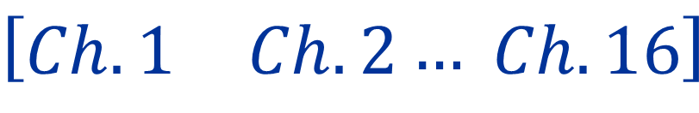
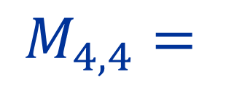
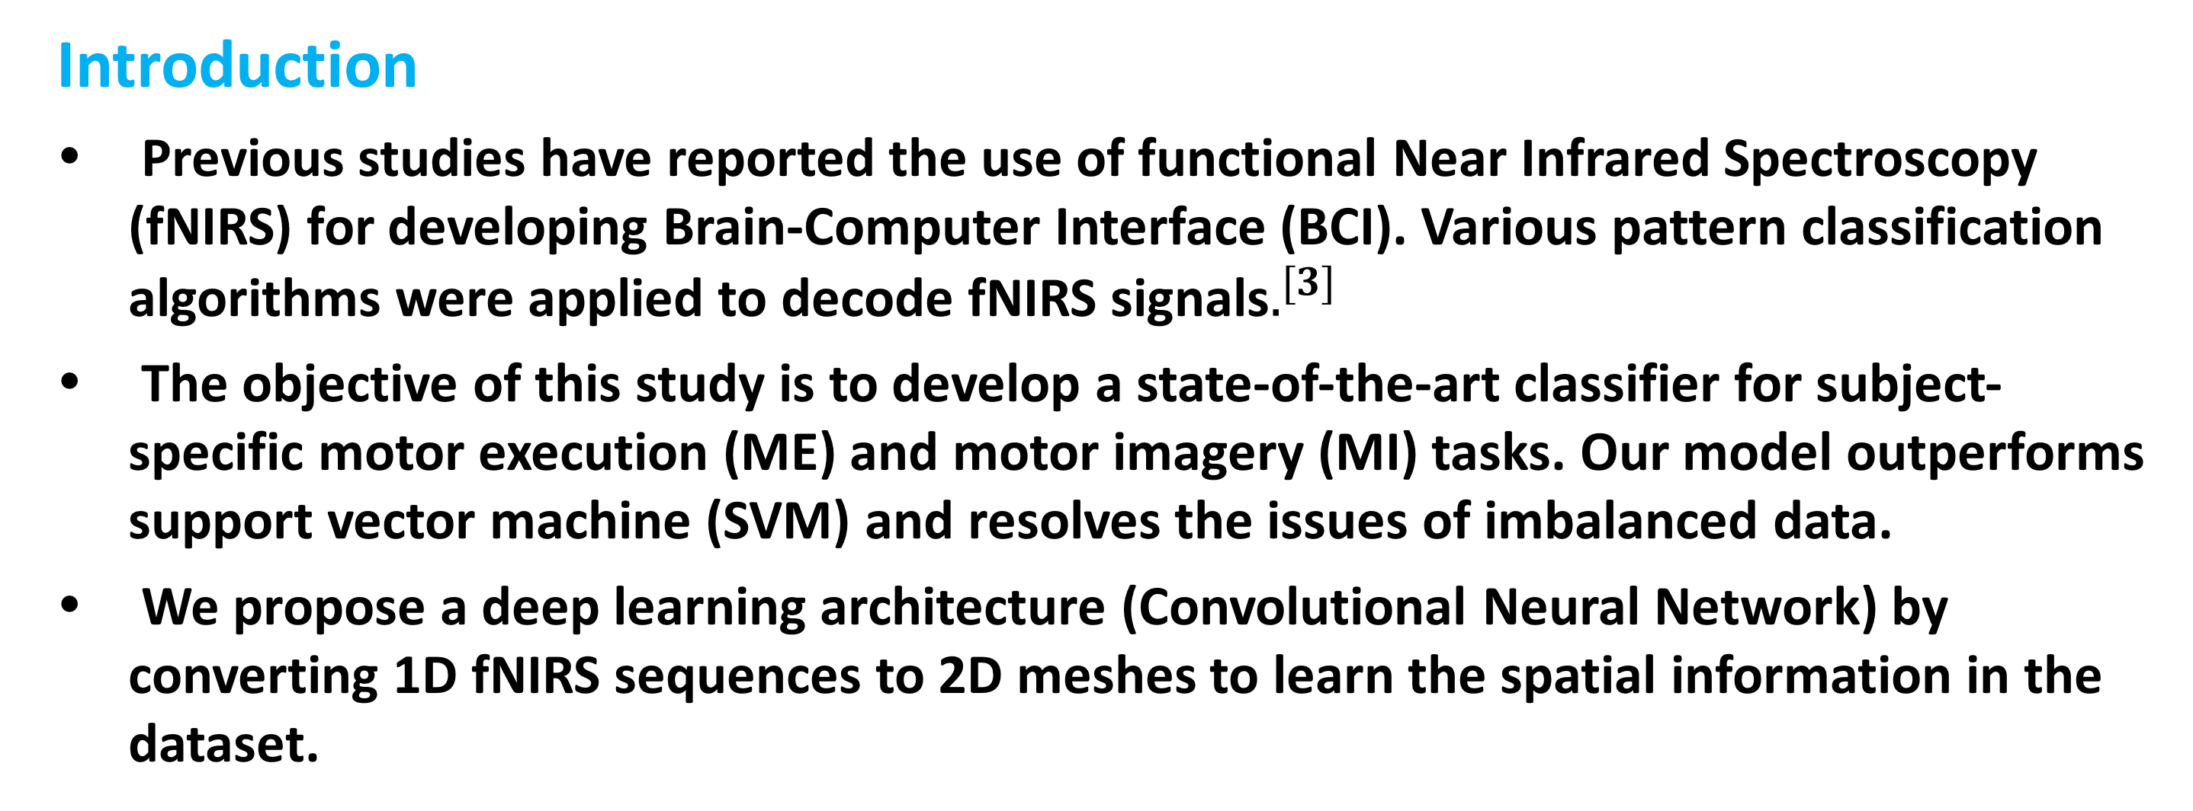
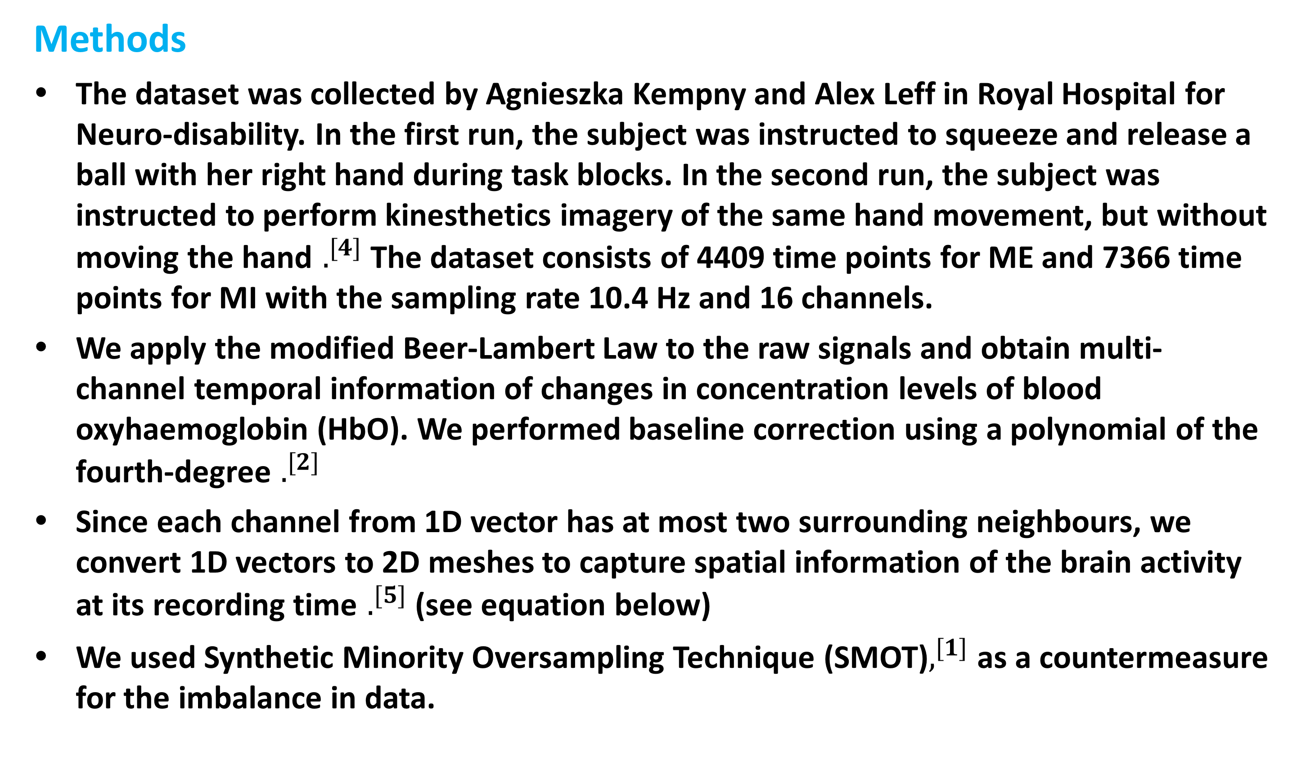
Brain State Classification on Functional Near Infrared Spectroscopy
using Convolutional Neural Networks
Andrew (Young Cho) Lee, Jim (Eui Young) Chung, Xiaofu He
Department of Psychiatry
Columbia University Medical Center & The New York State Psychiatric Institute
Introduction
Previous studies have reported the use of functional Near Infrared Spectroscopy (fNIRS) for developing Brain-Computer Interface (BCI). Various pattern classification algorithms were applied to decode fNIRS signals$.^{[3]}$
The objective of this study is to develop a state-of-the-art classifier for subject-specific motor execution (ME) and motor imagery (MI) tasks. Our model outperforms support vector machine (SVM) and resolves the issues of imbalanced data.
We propose a deep learning architecture (Convolutional Neural Network) by converting 1D fNIRS sequences to 2D meshes to learn the spatial information in the dataset.
Results
Without resampling (SMOT), MI and ME prediction accuracies are close to 0% while Rest condition accuracy being close to 100%.
For the combined ME and MI dataset (MI vs. ME), CNN achieves accuracy, recall and precision scores being very close to 1 (Fig. 2 shows the trained model).
For the MI dataset (MI vs. Rest condition), CNN exhibits the accuracy of 70% for MI and 60% for Rest, while SVM showed the accuracy of 62.3% for MI and 67.7% for Rest (Fig. 3).
When trained on MI dataset only and classified ME data set, CNN showed the accuracy of 64.2% on ME (task-related) dataset, while SVM showed the accuracy of 54% for ME (Fig. 4).
Feature Map
Feature Map
Feature Map
…
Conv #1
Conv #2
Conv #3
Conv #4
Figure 2. Accuracy and Loss ME vs. MI
Figure 3. Train on MI and Predict on MI
Figure 3. Train on MI and Predict on ME
Figure 1. Convolutional Neural Network Layout
Conclusion
fNIRS data are extremely noisy in nature. Also, the imbalance in classes (rest 85% vs. task 15%) makes it more difficult to train the model. Resampling through SMOT allows the model to classify task-related conditions (ME & MI) from Rest condition.
For task-related conditions, CNN outperforms SVM.
The current study demonstrates the potential usage of fNIRS in brain state classification applying deep learning. We plan to further improve the performance by expanding our dataset.
Methods
The dataset was collected by Agnieszka Kempny and Alex Leff in Royal Hospital for Neuro-disability. In the first run, the subject was instructed to squeeze and release a ball with her right hand during task blocks. In the second run, the subject was instructed to perform kinesthetics imagery of the same hand movement, but without moving the hand $.^{[4]}$ The dataset consists of 4409 time points for ME and 7366 time points for MI with the sampling rate 10.4 Hz and 16 channels.
We apply the modified Beer-Lambert Law to the raw signals and obtain multi-channel temporal information of changes in concentration levels of blood oxyhaemoglobin (HbO). We performed baseline correction using a polynomial of the fourth-degree $.^{[2]}$
Since each channel from 1D vector has at most two surrounding neighbours, we convert 1D vectors to 2D meshes to capture spatial information of the brain activity at its recording time $.^{[5]}$ (see equation below)
We used Synthetic Minority Oversampling Technique (SMOT)$,^{[1]}$ as a countermeasure for the imbalance in data.
Acknowledgments
This work was supervised by Dr. Xiaofu He from Department of Psychiatry, Columbia University Medical Center & The New York State Psychiatric Institute and supported in part by Data Science Institute.
Please contact Dr. He at xh2170@cumc.columbia.edu.
References
Niteshi C, Kevin B, Lawrence H, Philip K, et al. 2002
Lapborisuth P, Zhang X, Noah A, Hirsch J, et al. 2017
Robinson N, Zaidi AD, Rana M, Prasad VA, Guan C, Birbaumer N, et al. 2016
Tak S, Uga M, Flandin G, Dan I, Penny WD 2016 J. Neurosci. Meth.
Zhang, Yao, X.Zhang, Wang, Chen, Boots, et al. 2018

