Slide 1

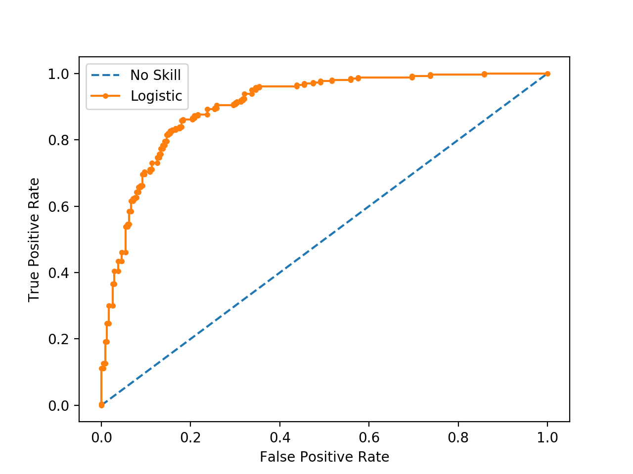
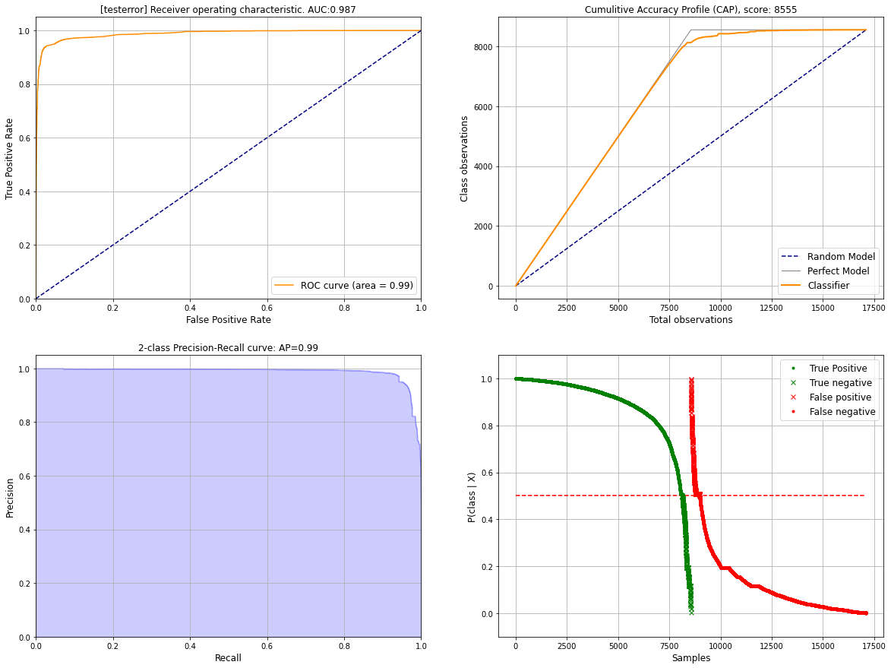
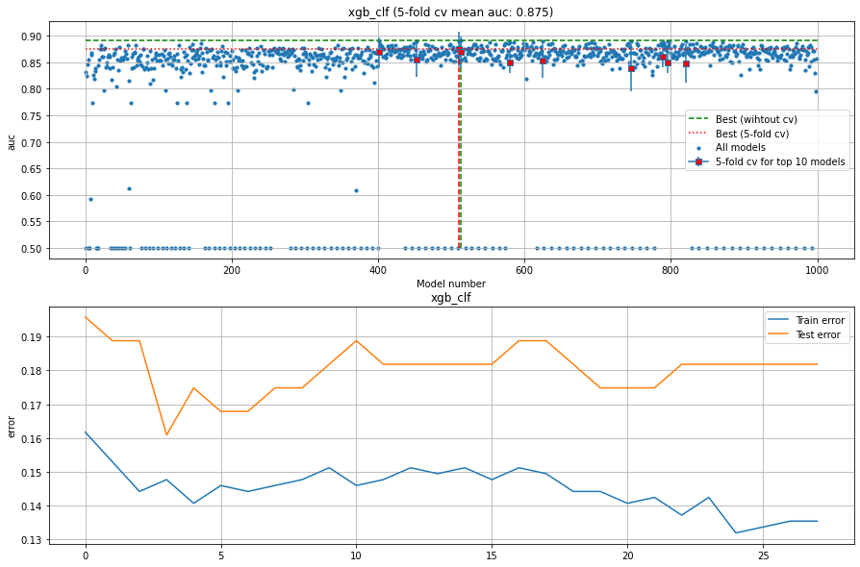
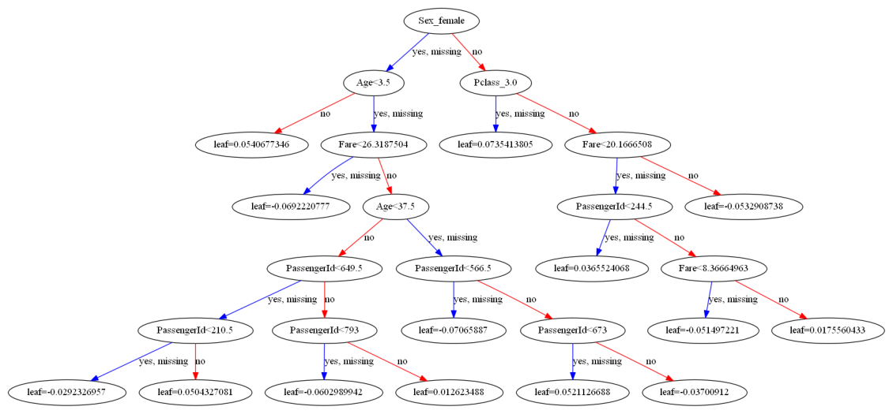
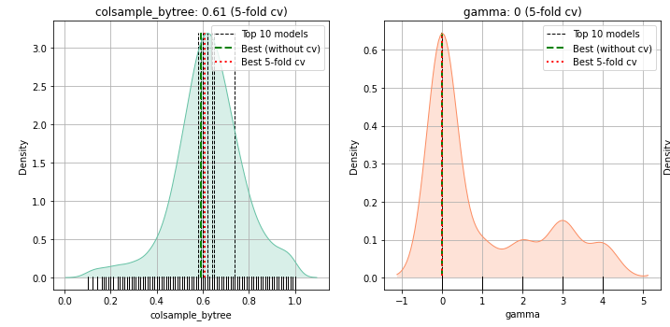
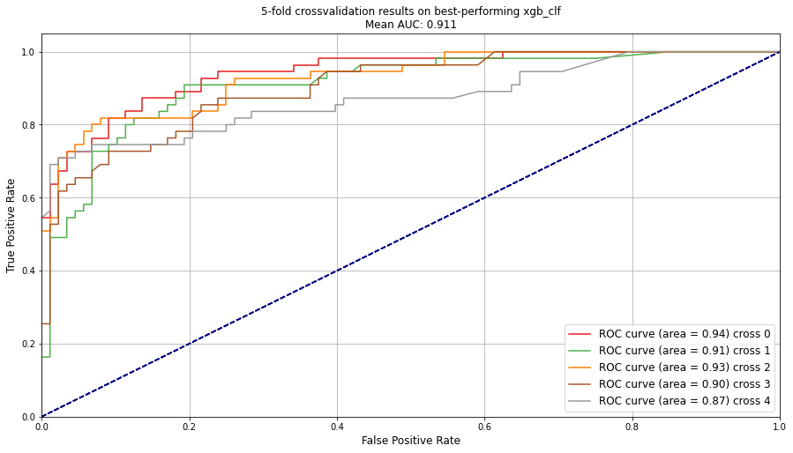
hgboost
Hyperparameter optimization using HyperOpt
and k-fold cross validation
Finding parameters
Trainset (80%)
Total dataset
Model i
Model i
Model parameter i
Performance on validation set
Validation
(20%)
Best model
parameters
Fitted model
Fit model on entire dataset using optimized parameters
Analyse results

