Slide 1

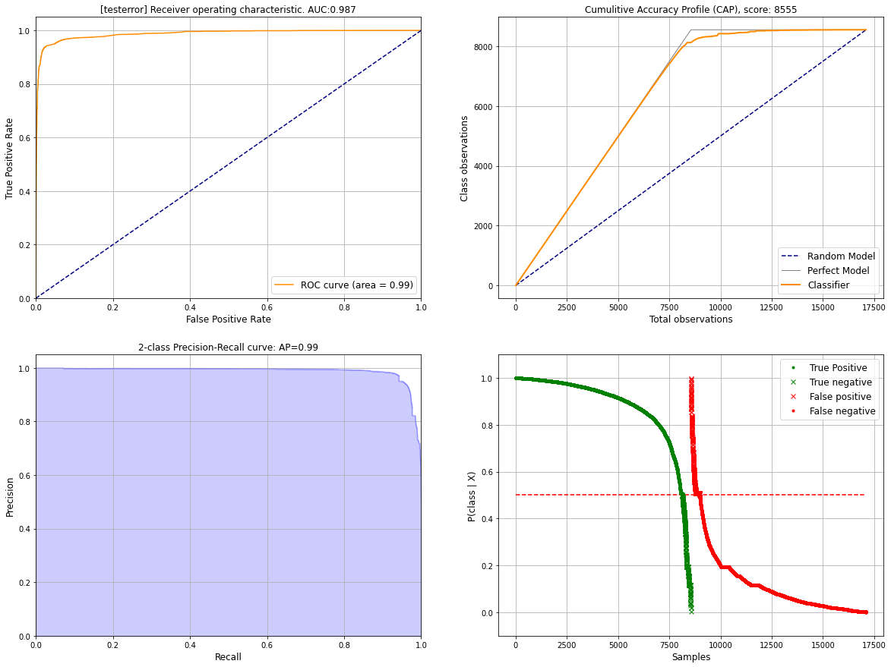
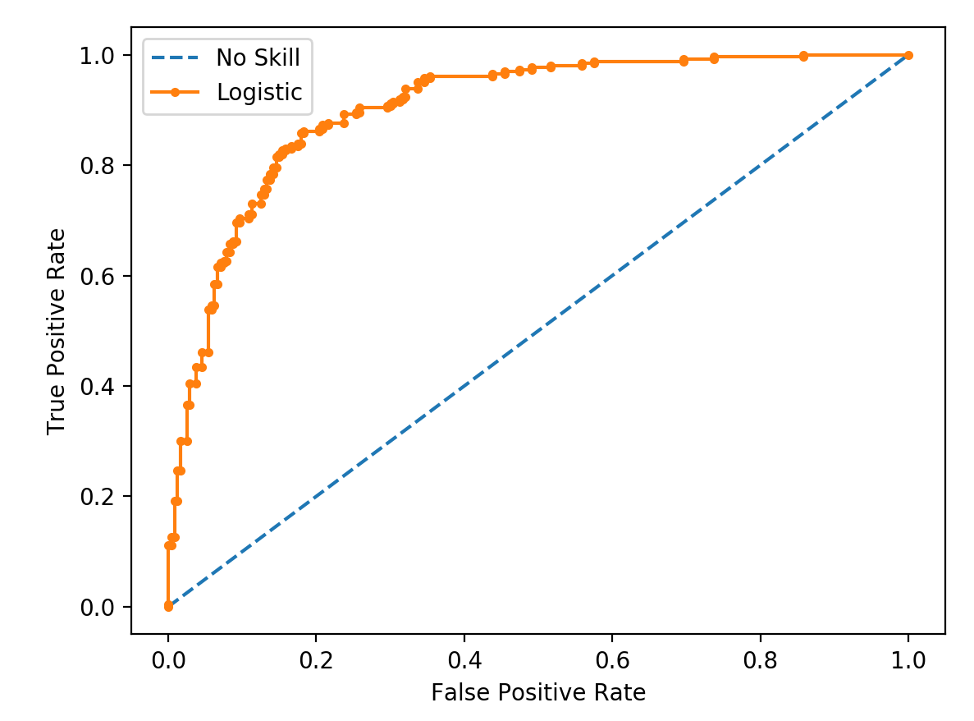
Hyperparameter optimization by k-fold cross validation
hgboost
Trainset (80%)
Total dataset
Model i
Model i
Performance on validation set
Model i
Validation
(20%)
Best Model

