Slide 1
COMP6441 PROJECT
4
CHALLENGES
Beginner Web Security
CTF Lab
Four attack paths. Four secure comparisons.
[CONFIRM STUDENT NAME] • z5671001
Notes:
This project is a local beginner-friendly web security CTF lab. I built four intentionally vulnerable challenges and matched every one with a secure comparison. I will show the project goal, the challenge sequence, two attack examples, the matching defences, and how testing improved the final version.

Slide 2
A safe lab for learning trust boundaries
GOAL
LEARNING FLOW
SCOPE
Build four beginner-friendly web security challenges.
Pair every exploit with a secure comparison.
Outcome: a complete local teaching lab.
Attempt the vulnerability.
Reveal an artificial flag.
Compare the same input with a safer design.
Runs only on 127.0.0.1.
Uses artificial flags and demo data.
No external target is scanned or attacked.
02
Notes:
The goal was to turn common web weaknesses into a safe learning sequence. Learners first attempt a vulnerability, reveal an artificial flag, and then compare the same input with a safer implementation. Everything runs locally on 127.0.0.1 with demonstration data. This keeps the work educational and lets the project explain both attacker behaviour and defensive design without targeting an external system.

Slide 3
Four challenges expose one trust problem
01 TRUST
02–03 CONTEXT
04 QUERY LOGIC
Cookie Role Bypass
The server trusts a client-side role cookie.
Lesson: authorisation decisions must come from server-controlled identity.
Reflected XSS
Unsafe HTML rendering.
Path Traversal
Unsafe filename joining.
Lesson: validate and encode input for the exact output or file context.
Simple SQL Injection
The login query is built by concatenating strings.
Lesson: parameterised queries keep user input as data instead of SQL code.
03
Notes:
The lab contains four challenges with one common theme: user-controlled input is trusted in the wrong context. The cookie task trusts client-side role state. Reflected XSS lets a search value become executable output. Path traversal lets a filename escape the intended directory. SQL injection lets login data alter query logic. Each challenge includes progressive hints, completion tracking, a flag, and an unlocked secure comparison.

Slide 4
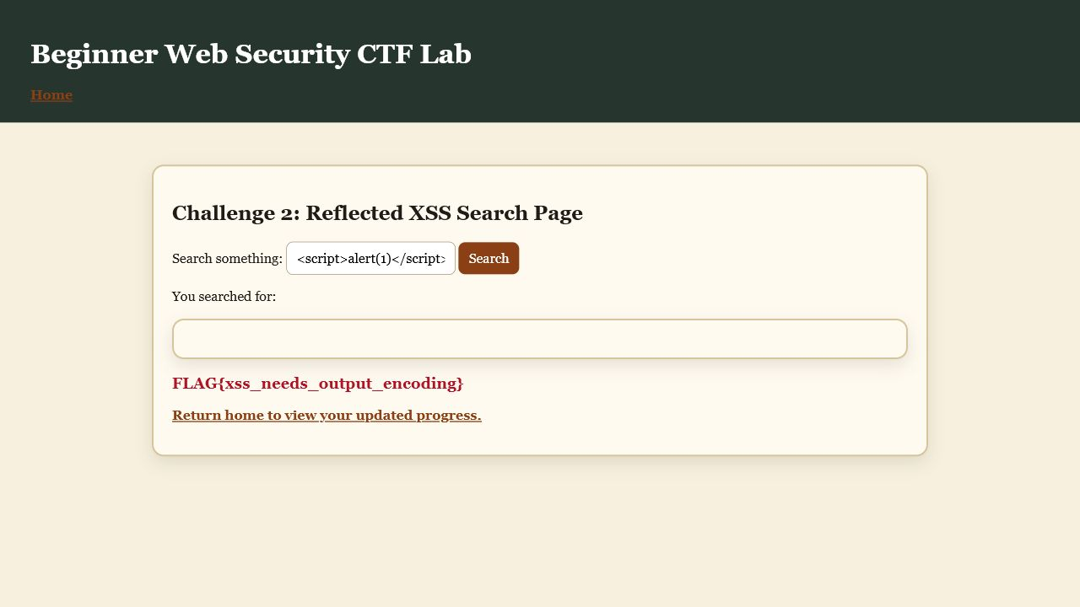
Attack story: reflected XSS
Trust boundary
A search query is read from the URL and rendered with |safe.
<script>alert(1)</script>
The payload becomes executable content and reveals the challenge flag. In a real application, the same flaw could run script in another user's browser.
04
Notes:
This screenshot shows the intended reflected XSS path. The application reads a search query and deliberately marks it as safe, so the browser interprets the payload as HTML and JavaScript instead of plain text. The artificial flag confirms that the exploit path was reached. The security lesson is the trust boundary: attacker-controlled text crossed directly into an executable browser context.

Slide 5
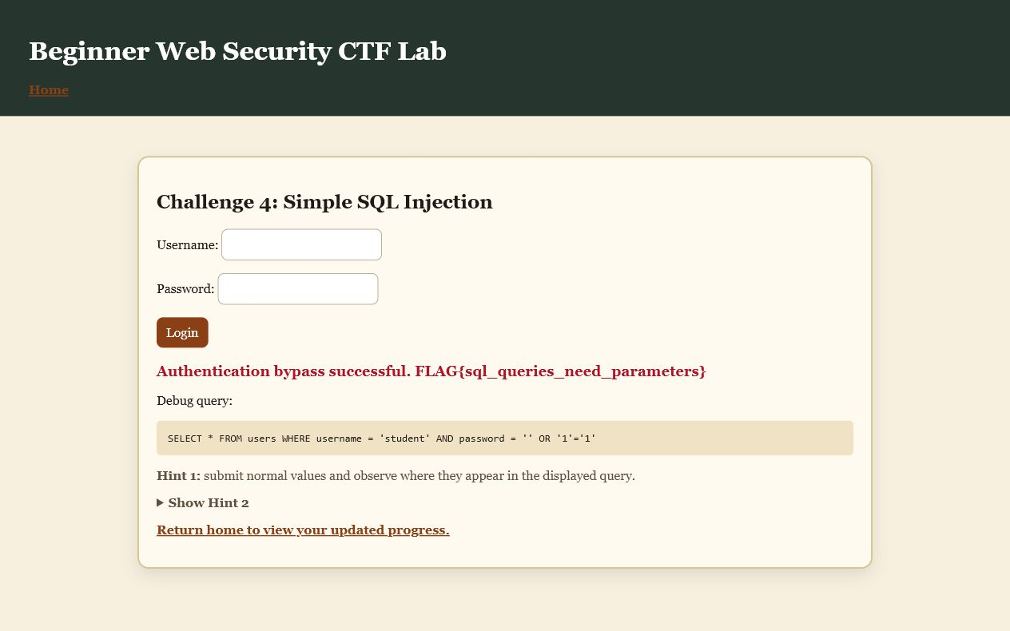
Attack story: SQL injection
Data became query logic
A login string is concatenated into SQL, so input can change the WHERE clause.
admin' OR '1'='1' --
The payload bypasses authentication and reveals the flag. The same trust error appears in the cookie and file challenges: user input crosses a boundary without the correct contextual control.
05
Notes:
The SQL injection task demonstrates the same trust problem in a different context. The vulnerable login builds a query by concatenating strings, so this payload changes the WHERE clause and bypasses authentication. The lab then reveals an artificial flag. Cookie manipulation and path traversal use different inputs, but all three failures come from allowing user-controlled data to cross a sensitive boundary without the correct control.

Slide 6
From vulnerable behaviour to secure design
The defence is context-specific: move authority to the server, encode output, constrain file access, and bind SQL parameters.
VULNERABLE DESIGN
SECURE COMPARISON
• Trust the role cookie
• Render input with |safe
• Join an arbitrary filename
• Concatenate login SQL
• Server-side session and role lookup
• HTML escaping plus restrictive CSP
• Allowlisted filenames and safe base path
• Parameterised SQL query
06
Notes:
The secure pages use a control matched to each context. Cookie authorisation moves to a signed session identity and a backend role lookup. XSS uses output encoding and a restrictive Content Security Policy. File access uses an allowlist and a fixed base directory. SQL injection uses placeholders and parameter binding. Direct secure URLs also return HTTP 403 until the matching challenge is completed, so the learning sequence is enforced on the server.

Slide 7
Iteration produced measurable improvements
BUILD
USER TEST
FINAL QA
Four working challenges
Flags and intended paths
Two-level progressive hints
Two participant sessions
Cookie instructions clarified
Progress tracker and defence unlocks added
11 automated tests passed
Direct secure-route locking
CSP-compatible shared stylesheet
WEEK 2 PROPOSAL
15 JULY
18 JULY
07
Notes:
The project changed through evidence. The first build established four working exploit paths, flags, and two-level hints. Two beginner testing sessions showed that the cookie task needed clearer save-and-refresh instructions and that learners wanted visible progress and defence feedback. Final validation then found that the secure XSS policy blocked the original inline CSS. I moved the stylesheet to a same-origin file, updated the policy, added automated assertions, and reran all eleven tests successfully. This improved both usability and security.

Slide 8
PROJECT OUTCOME
Questions
From exploit to
secure design
Working educational CTF
Attacker + defender analysis
Evidence-driven improvement
Scope boundary
Local demonstration • intentionally vulnerable routes • not production-ready
Notes:
The final result is a complete local learning lab rather than a production web application. Its main outcome is the controlled comparison between exploit behaviour and secure design. The project strengthened my understanding of trust boundaries, context-specific controls, user testing, and validation. Its limitations are deliberate local-demo choices, including intentionally vulnerable routes and simple demonstration credentials. I am ready to answer questions about the implementation or evidence.

