Slide 1
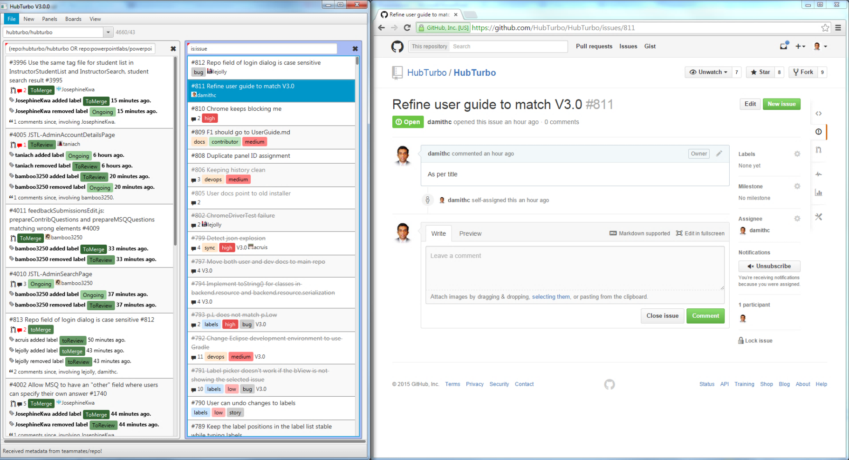
Panel View
Browser View

Slide 3
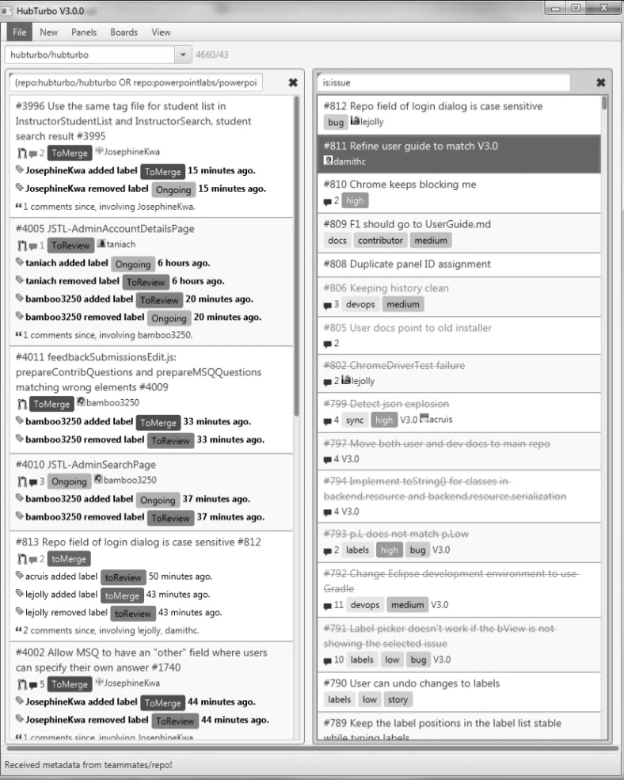
Default repo
Board
Panels

Slide 4
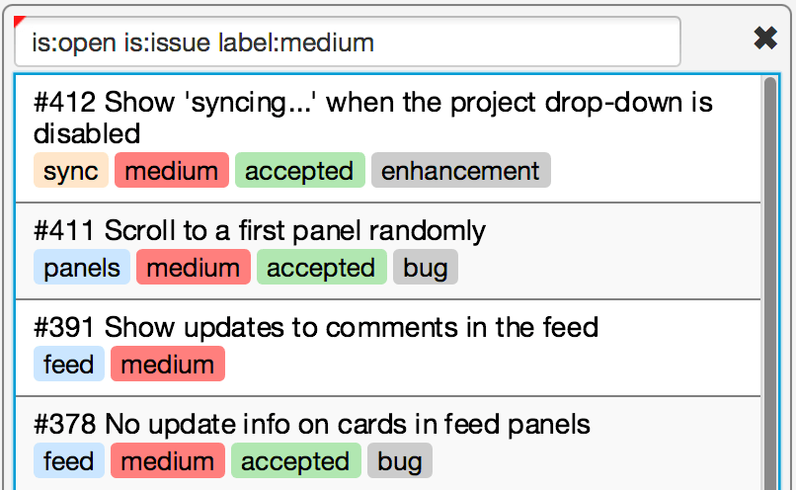
A panel
filter
Issues cards matching the filter

