Slide 1
Project Title: Eyeonic
Supervisor: Sir Muhammad Hamza
Co-Ordinator: Miss Hafsa Qadir

Slide 2
E-PROJECT
Batch Code:
2309F3
Team Members:
MUHAMMAD HUBAB KHAN
MUHAMMAD ARSALAN KHAN
FATIMA SARFRAZ

Slide 3
Problem Statement
The Eyeonic project endeavors to bridge this gap by reimagining eyewear as a harmonious fusion of advanced optical technology, personalized style, and ergonomic design. By addressing the inherent challenges of the current eyewear landscape, Eyeonic aims to deliver a transformative experience that empowers users with eyewear that not only meets but anticipates their evolving needs, setting new standards for innovation and style in the eyewear industry.

Slide 4
Introduction
Welcome to Eyeonic! We're here to change how you see eyewear, combining innovation, style, and comfort. Join us in exploring a fresh, personalized way to experience eyecare. Your journey to redefined vision starts with Eyeonic..

Slide 5
Scope
Eyeonic website is all about changing how you experience eyewear. We offer a carefully curated selection of stylish and comfortable eyewear. Our goal is to provide a user-friendly platform for exploring and customizing eyecare solutions.

Slide 6
Our Site Map
Frames
Contact Us
Home
Contact lenses
Comparison
Sunglasses

Slide 7
CONCLUSION
The Eyeonic is all about reimagining eyewear. It blends innovation, style, and comfort to create a unique eyecare experience. Breaking away from the ordinary, Eyeonic aims to redefine how users interact with eyewear by combining cutting-edge technology with trendy designs. The website is a doorway to a world where eyewear is not just a necessity but a personalized and enjoyable journey.

Slide 8
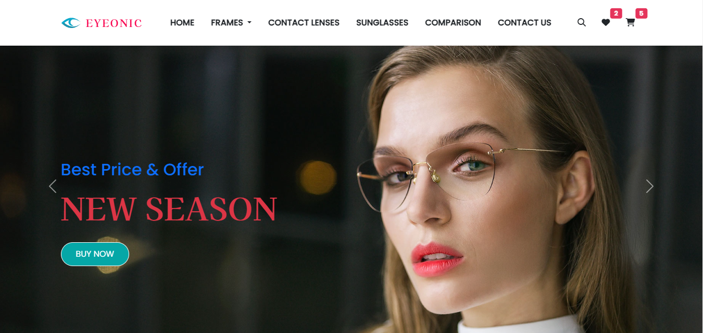

Slide 9
Thank You

