Slide 1
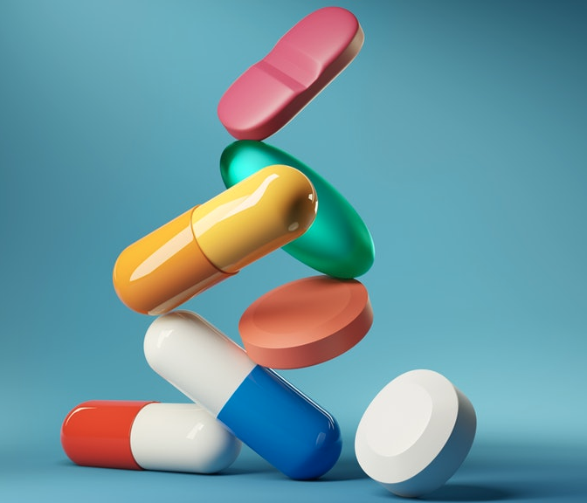
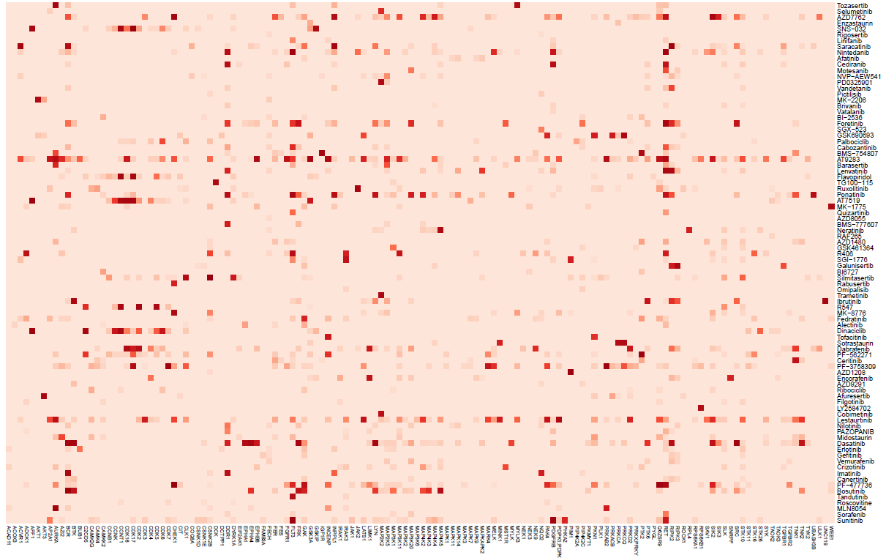
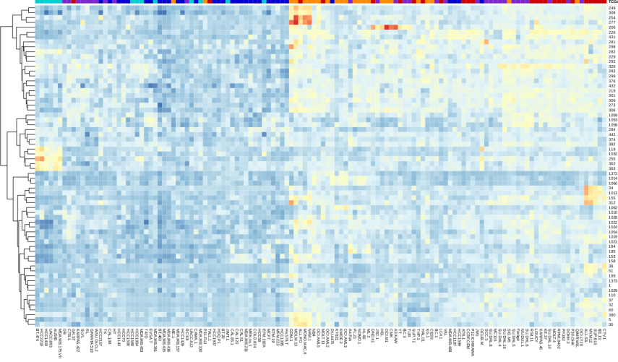
Kinase inhibitor screen
Drug response assay
Kinobeads
pulldown
Linear regression model
Proteins
Tumors / cell lines
Tumors / cell lines
x
ß₁₁ ß₁₂ ß₁₃ ß₁₄
ß₂₁ ß₂₂ ß₂₃ ß₂₄
ß₃₁ ß₃₂ ß₃₃ ß₃₄
≈
Drugs
affinity
Drugs
viability
Proteins
Protein Dependence Matrix

