Slide 1
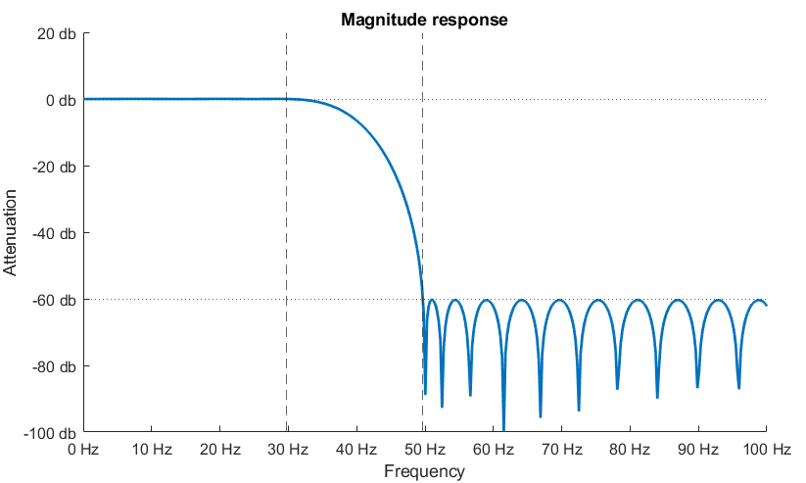
transition- band
pass-band
stop-band
-6 dB (half-amplitude) cut-off frequency: 39.79 Hz (common for FIR filters)
-3 dB (half-energy) cut-off frequency: 37.35 Hz (common for IIR filters)
also called roll-off
stop-band frequency (-60 dB): 49.7 Hz
pass-band frequency (0 dB): 29.75 Hz
stop-band
ripples

