Slide 1
Event Driven Architecture
Best Practices and Guidelines
Last Updated December 2020
Copyright © 2020 Accenture. All rights reserved, Proprietary and Confidential

Slide 2
Event Basics

Slide 3
What is an Event
EVENT BASICS
Simply stated, an event is something that happened, and cannot “unhappen”. Architecturally, we typically break these into technical events and business events.
Business Events
Examples include: bill paid, order placed, customer updated, email received
Are typically what we really care about from a functional perspective, we can derive these from Event Storming exercises and Domain Driven Design
Not always initiated externally– we may create a business event from another business event – order placed may generate an order shipped event
Ideally, we should keep these business events around in perpetuity
Technical events
Examples include: database updated, file uploaded, button clicked, notification sent
These are derived from business events, typically many technical events may be generated from a single business event
Can be used to communicate between systems
Must be well understood by teams to build composable systems
Generally less important to retain for long periods of time
If something happened, it is an event, and is not deleted from the record. ”Additive events” need ”subtractive” events, e.g. if you cancel an order, it doesn’t change that an order happened, it just means you need a refund.

Slide 4
Processing Events
EVENT BASICS
Events are recorded to an event log, and then processed by one or more services. Events do not “fall off” of the log, instead they are persisted
MICROSERVICE
ANALYTIC SYSTEMS
Publishes
Receives
EVENT
EVENT
EVENT LOG
{
EVENT
EVENT
EVENT
EVENT
EVENT
EVENT
EVENT
EVENT
EVENT
EVENT
EVENT
EVENT
EVENT
MICROSERVICE
FUNCTION
ERP SYSTEMS
EVENT
EVENT
EVENT
Receives
Receives
Receives
Events are persisted on an event log, in a uniform schema
Events are typically organized by topics. Events of a different type should not exist on the same topic. As an example, customer paid and customer cart data are on different topics, even if they relate to customer behavior. If you are interested in the order of events by customer across use cases, consider creating a third topic of “customer actions” that only relate to the actions performed on a customer, discarding the rest
Services then listen to these events, and do something (e.g., send an order, email someone, or create another event to the same log)
You do not define the listeners ahead of time, an event can have multiple listeners, and they may not all exist at the time of the event creation
This is technically different from an ESB or Queue
Copyright © 2020 Accenture. All rights reserved, Proprietary and Confidential

Slide 5
Event Handling in Domain Context
EVENT BASICS
Events can be used for inter or intra domain communication. Between domains, restrict to Business Events
Online Store Domain
Back Office Domain
MICROSERVICES
Publish
ANALYTIC SYSTEMS
Consume
EVENT
BIZ EVENT
BIZ EVENT
EVENT LOG
BIZ EVENT
BIZ EVENT
BIZ EVENT
BIZ EVENT
BIZ EVENT
EVENT
EVENT
EVENT
EVENT
Lambda
ERP SYSTEMS
EVENT
BIZ EVENT
Consume
Consume
Within domains, events can be technical or business events. Across domains, only the business events should be relevant. If a separate domain is looking at technical events (e.g., DB updated, request received) then that could be a sign of ill-defined domains or a distributed monolithic system.

Slide 6
Enterprise Transformation

Slide 7
Empowering Decoupled Teams
ENTERPRISE TRANSFORMATION
Technology behind event driven systems unlocks the capability to have truly decoupled, product-focused teams
Mature / Traditional Business
New Growth Business
Product
Product
Product
Product
App
Srvcs
App
Srvcs
App
Srvcs
App
Srvcs
Everything that happens is an event
Maintain single source of record with a distributed source of truth via materialized views
Complexity of Data Model now lives within the Product Teams. No longer coupled to ERP or cross-domain data integrity
Event Hub is the “pulse of the enterprise” with events flowing to whomever is interested
New data that comes in also propagates to the event hub, new systems become systems of record, propagating their changes to the event hub
Eventually, any legacy systems become smaller, and replacing them less challenging
Materialized View
Materialized View
Materialized View
Materialized View
Materialized View
System of Record
System of Record
Event Hub
(Feeds Materialized Views of Data)
Change Data Capture
Change Data Capture
ERP Systems
Legacy Systems

Slide 8
Event Governance
ENTERPRISE TRANSFORMATION
Event management best practices for large organizations
Organizations should strive to make events discoverable to others
This is easier said than done – must consider PII/GDPR, security, blast radius, etc
Frequently easier for organizations to make “business events” more social/democratized than individual technical events
Events should have a standard ”envelope” that enclose the event – what system created it, tracer IDs, etc – so that the events can stand alone as systems evolve. We suggest using the CloudEvents specification, detailed later in this deck
Events should be as small as possible, encompassing the data needed for that event. Topics should only contain one type of event. Smaller events and more topics are better suited to a distributed system and are easier to reason about.
Within domains/product teams, the team should decide how to introduce new events, but as organization moves to more event model, namespacing and approvals may be required to prevent “topic sprawl”
Topic sprawl includes things like ’domain-event-topic-v1-aug2020-v2-names-A-c’ -- hard to parse name, versioned topics that likely don’t need versions, and partitioning by topic instead of underlying event hub partition semantics
Do not enable topic auto-creation. Every topic on a log should be documented and named. This can get complex (KSQL is one example) and in those instances, use wildcard naming (BizDomain-SubDomain-EventType-*) and enforce governance on the wildcards
Once an event is used outside of the application team, that event should be given the same “weight” given to a public API. Events are the new interfaces, and should be governed likewise.

Slide 9
Event Driven Foundations

Slide 10


Digital Decoupling
EVENT DRIVEN FOUNDATIONS
Gradually Transform Legacy Systems to Unlock Value
ONLINE
(LEGACY CHANNELS)
ONLINE (LC)
ONLINE (NEW)
REALTIME
INTERACTIONS
ONLINE
REALTIME
INTERACTIONS
ECOSYSTEM
MIDDLEWARE / SOA
MIDDLEWARE
/ SOA
SERVICES PLATFORM
SERVICES PLATFORM
DIFFERENTIATING DOMAINS
LEGACY / CORE
SPECIFIC LEGACY (optional)
CORE DOMAINS
LEGACY / CORE
NEW DOMAIN SERVICES
AUTOMATION
BI / ANALYTICS
INTELLIGENCE
INTELLIGENCE
AUTOMATION
BI / ANALYTICS
DATA EVENTS
DATA EVENTS
INTEGRATION / BATCH
INTEGRATION / BATCH
INTEGRATION
Functional Element
Strangled Functional Element
New architecture / transformed functionality
Analyze
Identify data needed to support transformed functional capabilities for target state increment
Decouple & Modernize
Free needed data from legacy and unlock ability to build new capabilities using modern architectures, tools, and agile. Strangle functionality in legacy over time as appropriate to shrink or eliminate.
Evolve to Target
Evolve gradually towards new architecture gaining enterprise agility while being able to leverage the legacy for specific purpose. This optimizes value of all elements of architecture.
Iterate use cases
10
Copyright © 2020 Accenture. All rights reserved, Proprietary and Confidential

Slide 11
Stateful Functions
EVENT DRIVEN FOUNDATIONS
Services and Functions retain their own state even when the data is distributed on the log
MICROSERVICE
Microservices and functions sometimes need to have an awareness of state across aggregated events. Use cases include: Fraud Detection, Anomaly Detection, Windowed Analytics. For these use cases, an in-memory database can be used within the service. Functions can connect to in-memory persistent store
Consider the CQRS pattern--- build the database from events directly, and if the function needs to reference the data, it can. Using this pattern means we can deprioritize availability and durability of these (potentially many) small databases as they can simply be recreated from the event store
If event hub supports it (KSQL for Kafka, as an example) consider native tooling for aggregation to keep as much state as events on the hub
Publishes
EVENT
EVENT LOG
EVENT
EVENT
EVENT
EVENT
EVENT
FUNCTION
EVENT
DB
Consumes

Slide 12
Idempotent Service Operations
EVENT DRIVEN FOUNDATIONS
Distributed systems, by design, have participants that may not be available. Services must remain idempotent, or resilient to multiple repeated operations without negative side effects
Idempotent requests can be processed multiple times without side-effects
GET /books/1 <– Read Request
PUT /orders/2 <- Update existing order, with {payload}
DELETE /message/3 <- Delete specific record
If something goes wrong (server internal error, lost of connectivity), the request can be simply repeated until the server is back up again.
All requests that modify the state of something (like a PUT) should be carefully considered to insure idempotence does not have unintended affects (eg, “PUT” a new bank balance multiple times is not inherently safe)
In contrast, unsafe requests modify the state of the service and cannot be repeated without additional (unwanted) effects.
Unsafe requests require special handling in case of exceptional situations (e.g., state reconciliation).
POST /account/1/debit {amount: $200} <- Debit Account $200 – what happens if this message is processed twice??
A stateless service cannot know if this was the first request for this debit, or if the message was delivered twice due to some failure. Remediation depends on the use case, but consider the following:
Make it stateful. Use an “idempotency key” or a GUID. Send the GUID to the service, and the service can check if it has processed this transaction. For transactional services (e.g., banking, loyalty transactions), consider a relational database separate from the service to contain this information, even if you are proxying to the legacy system.
Use transactions, or “commit after processing” semantics – do not mark events as processed unless the downstream transaction is successful
Use reconciling events --- charge credit card should have a matching credit card charged event, nothing more, and nothing less. This is important for edge cases, if 1 out of a million points transactions happen twice, have a service watching the stream of reconciled events, and then automatically correct it.
Treat the log as the ledger – partition by account to ensure ordering, and “balance” is just a computed view of that log. Produce using transactions, so that it is technically impossible to have duplication of produced messages note: this is much easier to guarantee on the producer side since one only need to verify it was produced, not that some arbitrary system processed a consumed event correctly.

Slide 13
DevOps for Events
EVENT DRIVEN FOUNDATIONS
Continuous integration for event-based systems
Event based systems could be comprised of many different enabling technologies (e.g., Kafka, NATS, Solace, Microservices, CDC, etc) with varying levels of technical DevOps requirements that are specific to the implementation. Generic guidance includes:
Treat events, once published to a shared log, like API contracts. Other systems may be reliant upon those messages
Use Schemas to encode events, with shared schema registries for access
Utilize “fake” producers that are constantly pumping events into the log. Consider taking snapshots of upper environments (including production) and populating events within the lower environments (e.g., Development, Test) for testing
Treat topics/event configuration as code. Topics should be created with scripts and event schemas should be checked into the repository. Updating topic metadata should be thoughtful, and automated.

Slide 14
Real-Time Data Throughout

Slide 15
Event Driven Architecture (High Level)
REAL-TIME DATA THROUGHOUT
DOMAIN SPECIFIC MATERIALIZED VIEWS
Reactive Event Driven (RED) Reference Architecture
NoSQL
MICROSERVICE
ANALYTIC SYSTEMS
RDBMS
Publishes
Receives
EVENT
EVENT
SPLUNK
EVENT LOG
EVENT
EVENT
EVENT
EVENT
EVENT
EVENT
EVENT
EVENT
EVENT
EVENT
EVENT
EVENT
EVENT
EVENT
MICROSERVICE
FUNCTION
CHANGE DATA CAPTURE
EVENT
EVENT
EVENT
ERP SYSTEMS
Changes as Events
Receives
Receives
Event Driven, Cloud Native
Data has a single source of record but a distributed view of the truth allowing for complex logic to live closer to the product
Cloud Native by default, with enabling services deployed as containers or functions
Legacy Systems enabled with Change Data Capture tooling
Removal from batch processing everywhere
A modern event hub (e.g. Kafka, Kinesis, Solace, others) is the “Pulse of the Enterprise” allowing services to communicate more easily between business domains
Services do not call services. They either publish or react to events.
Events can be technical (database update, request) or business (product purchased, customer contacted)
Copyright © 2020 Accenture. All rights reserved, Proprietary and Confidential

Slide 16
Example Data Flow
REAL-TIME DATA THROUGHOUT
Publish New Events
As items change status within ServiceNow, emit events to allow consuming microservices to react.
ServiceNow Integration
ServiceNow
ServiceNow
Consumes
Publishes
ENRICHED EVENT
NOTIFICATION
EVENT LOG
NOTIFICATION
NOTIFICATION
NOTIFICATION
NOTIFICATION
NOTIFICATION
NOTIFICATION
NOTIFICATION
Notification Topic
ENRICHED EVENT
ENRICHED EVENT
ENRICHED EVENT
ENRICHED EVENT
ENRICHED EVENT
ENRICHED EVENT
Business Event Topic
RAW EVENT
RAW EVENT
RAW EVENT
RAW EVENT
RAW EVENT
RAW EVENT
RAW EVENT
RAW EVENT
Raw Change Topic
RAW EVENT
RAW EVENT
RAW EVENT
RAW EVENT
RAW EVENT
RAW EVENT
RAW EVENT
RAW EVENT
Raw Change Topic
RAW EVENT
RAW EVENT
ENRICHED EVENT
CHANGE DATA CAPTURE
CHANGE DATA CAPTURE
RAW EVENT
SOURCE OF RECORD #1
Changes as Events
SOURCE OF RECORD #2
Changes as Events
RAW EVENT
MICROSERVICE
Publishes
Consumes
RDBMS
React to Events
The microservice can take raw events from legacy systems, and transform them. Likewise, it can hydrate a view of data into a database as needed, and use that database to further perform transforms.

Slide 17
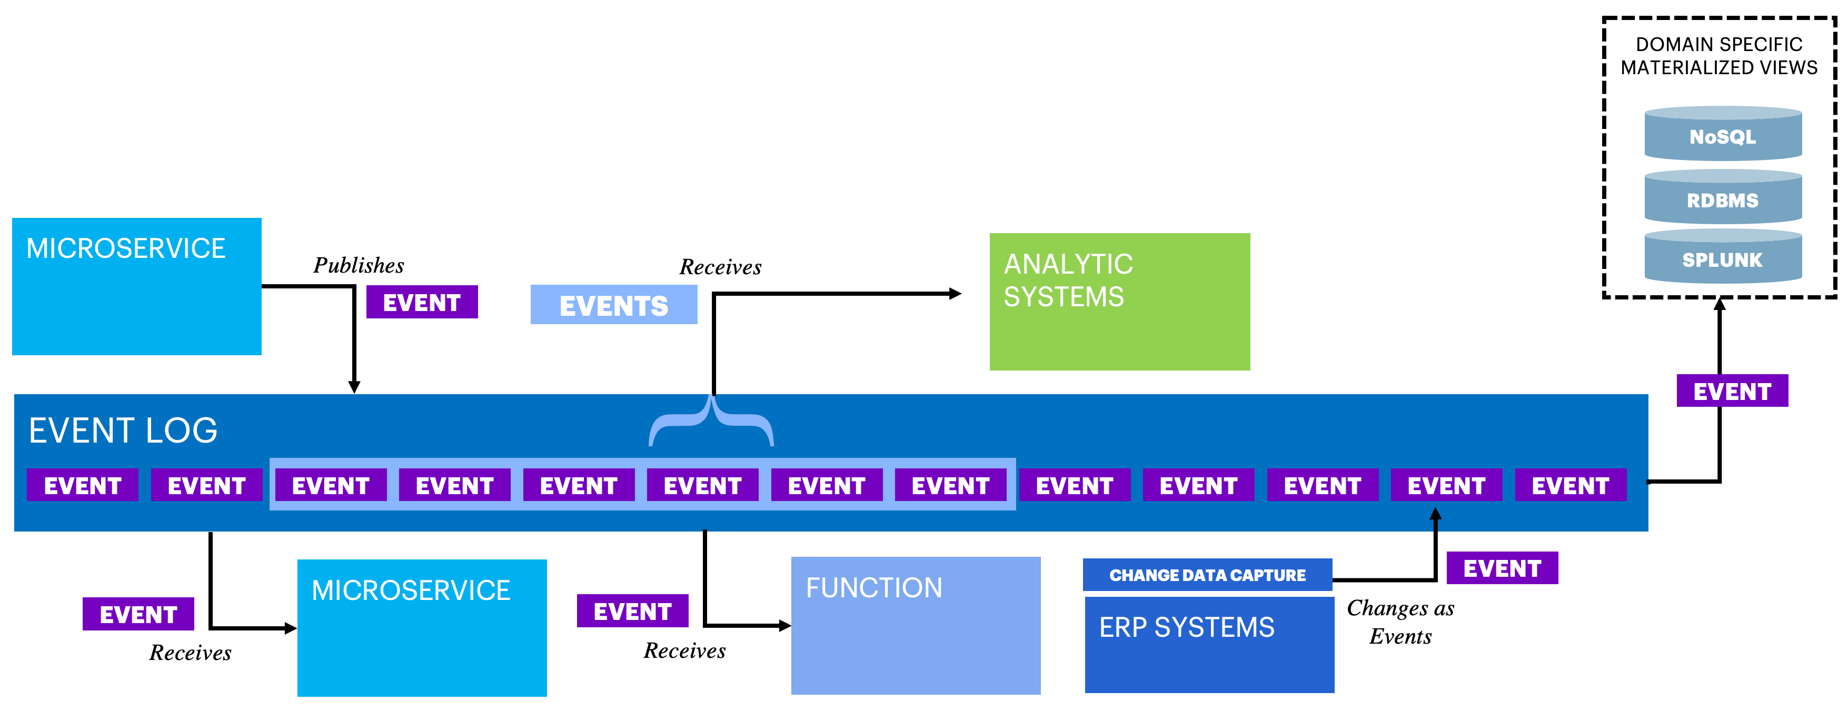
No Stale Data
D
G
E
F
C
H
REAL-TIME DATA THROUGHOUT
All data stores and materialized views are connected to the event hub directly and updated in real time. Avoid all batch processing.
Distributed caches can be great to improve application performance, but they are commonly misused to share data across the enterprise, leading to “Stale Data”, or data that once was true, but cannot be trusted as the truth.
This methodology assumes all events are streamed in real time. If batch processes inform downstream systems, then you have a de-facto cache that must be removed in order to rely on the materialized views.
By replicating the data with CDC tooling, data is hydrated across the entire enterprise in real-time. Other tools, like Kafka Connect, listen to events to hydrate materialized views of data.
One event might exist in many materialized views. The complexity of this data model exists in the product or business domain, this is not centralized. This way, the product teams can fetch data from the event log how and when they need it. Producers of events have no control over how consumers use the events-- a consumer may only be interested in a very small subset of the event payload and ignore the rest.
Domain Aligned Data
These Databases should be defined, controlled, and used exclusively by the relevant product team. Complexity
B
A
Notes:
Owner: Luis

Slide 18
Immutable Event Store
D
G
Domain Aligned Data
These Databases should be defined, controlled, and used exclusively by the relevant product team. Complexity
E
F
C
H
REAL-TIME DATA THROUGHOUT
The event log should be immutable. Events happened, then cannot “unhappen”
As a business operates day-to-day, events are constantly occurring. Sales made, customers contacted, phones answered, no matter the event, the underlying concept is that these events cannot change*. Just like you can’t go back in time, you cannot make an event ‘unhappen’. If you needed to correct some mistake, you issue an offsetting event (e.g., refund, return, credit memo, etc).
This has powerful implications. The visibility gained by seeing these events happen across the enterprise enables many possibilities. Further, you can deprioritize the resilience of the materialized views as they can simply be re-hydrated from the stored events.
If you are familiar with Blockchain, this is a very similar concept, just without the cryptography/consensus aspects.
An event that is written to the log should have some guarantee of durability, and order (if only by partition). Seek to retain as many events as possible, but the only events that can/should be deleted are the oldest events.
Once received, events do not “fall off” the log (this is not a queue). The log may mark it as read/consumed, but the event still exists. This allows new consumers to process the event, even if that new consumer did not exist at the time of the events creation.
*Even if you technically could, the underlying premise of a reactive architecture is that the downstream systems react to these events, so removing an event technically would likely result in undesirable effects. This shared understanding is important.
A
B
Notes:
Owner: Luis

Slide 19
Consider CQRS
REAL-TIME DATA THROUGHOUT
Command Query Responsibility Segregation sounds complex, but the theory is simple: separate your reads from your writes
An update command is received from the Presentation Layer.
Validation and update logic is executed resulting in an event produced to the log.
The same event will hydrate a fit-for-purpose materialized view
Query Logic reads from this materialized view
Finally, the Query services update the Presentation Layer
Materialized view is recreated from persistent log of events If a database that hosts this materialized view fails, then it can simply be recreated, or “re-hydrated” from the underlying event store. Events are backed up to ensure the ability of fast recovery.
In many systems, the number of reads typically exceeds the number of writes. Separating the read side and the write side into separate models within a bounded context provides ability to scale each one of them independently, but performance alone is not the primary driver:
You only need to backup one thing (the event log) instead of many different databases for DR (you should, however, not rely on the log to rehydrate millions of rows instantly – define your RTO and RPO to determine which databases can be hydrated like this)
Creates ultimate flexibility of architecture to adapt, microservices don’t need to know about databases, their performance characteristics, or anything else about how they work
Ensures that events are “First class citizens” as they are the source of truth for everything.
Bounded Context
A
Presentation / User
E
Command
Query
Write Model
D
Read Model
B
Materialized View
C
Event
Event
Event Log
Event Backup Archive
H
Notes:
Owner: Luis

Slide 20
Event Security

Slide 21
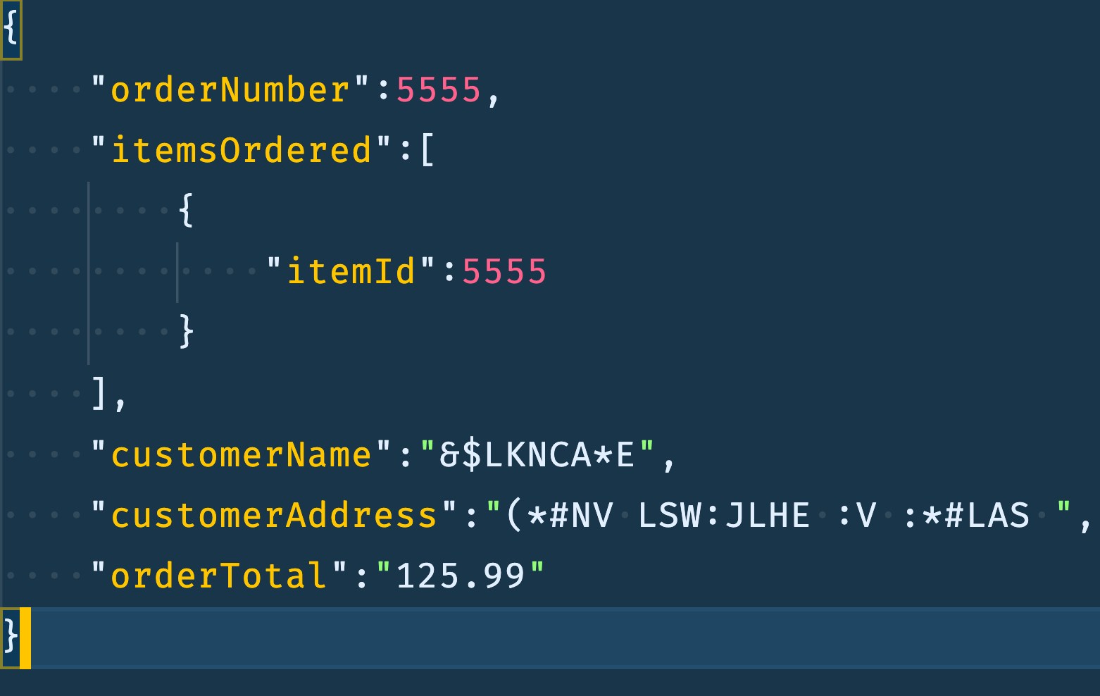
Event Encryption
D
G
E
F
EVENT SECURITY
We should maximize enterprise data sharing (aka, “Data Democratization”) but limit blast radius of sensitive data
In a distributed event system we must balance data democratization (or, the free use of data across an organization) with the protection of sensitive data. We think of encrypting events in 3 ways:
Events in transit should always be encrypted using industry standard encryption methodologies (SSL/TLS),
Disks/storage holding past events should always be encrypted at the filesystem level.
Field level encryption should be considered only for the most sensitive data. Field level encryption is the most secure way to store data, but also computationally more expensive, and lowers the amount of data that can be shared.
Object Notes:
Non-sensitive data should not be subject to field level encryption. As an example, if you wanted to report on all orders in real time, being able to read from this event stream is easily done.
PII or PHI, or other sensitive data, should be encrypted at the field level. This enables a broad reusability across the enterprise without leaking sensitive data.
A
A
B
B
A
Notes:
Owner: Luis

Slide 22
Field Level Encryption Considerations
EVENT SECURITY
All Data should be encrypted in transit and at rest (on disk). The level of field encryption depends on risk tolerance. If the topic contains no sensitive data, then do not use field encryption.
None
Shared Key
Key-per-entity
Tokenization
Key-per-message
Short lived topics
Domain Specific topics (not shared out of domain)
All topics use same encryption key
GDPR is not a concern
Encrypt fields based on the person/business entity of the message
Useful for GDPR and other compliance purposes where deleting messages is required.
Use a third party to “tokenize” fields
Can create bottleneck/single point of failure, if the tokenizer is down, messages cannot flow
Every message has a specific encryption key to that message
Only useful for the most sophisticated systems
Flexible, Fast
More Secure
This assumes topics with PII. For regulated environments (PHI) consider more secure methodologies.

Slide 23
GDPR Considerations
D
G
Domain Aligned Data
These Databases should be defined, controlled, and used exclusively by the relevant product team. Complexity
E
F
H
EVENT SECURITY
”Right to be Forgotten” is challenging for immutable event stores. Consider crypto-shredding PII
Cyrpto-Shredding is the practice of encrypting data related to a specific person with their own key. If that person requests for their data to be removed, you can simply delete the key, while retaining the event.
PII should be stored encrypted on the log, especially if it is long lived. Here, we show “John’s” and “Steve’s” data in plaintext because we have his encryption key. To any other user, they would not be able to decrypt this data.
Once we have a GDPR request, we can revoke or delete the encryption key assigned to a specific person. Deleting this key means that no one, inside or outside of the organization, can attribute Steve’s events to him.
Using the encryption key as an identifier, downstream systems that store data (e.g., materializedd views) can also remove Steve’s data. This can be automated if you employ a crytpo-shredding notification topic. In the event of a rehydration, Steve’s data is now encrypted, and the materialized view can choose to ignore the data, or not, but either way, its gone forever.
EVENT LOG
John’s Encryption Key
JOHN
JOHN
JOHN
JOHN
JOHN
JOHN
A
Steve’s Encryption Key
Steve’s Encryption Key Deleted
STEVE
STEVE
STEVE
&UZ8h
JK7Y
Ui^&
B
A
GDPR Notification Topic
C
Notes:
Owner: Luis

Slide 24
Event Standardization

Slide 25
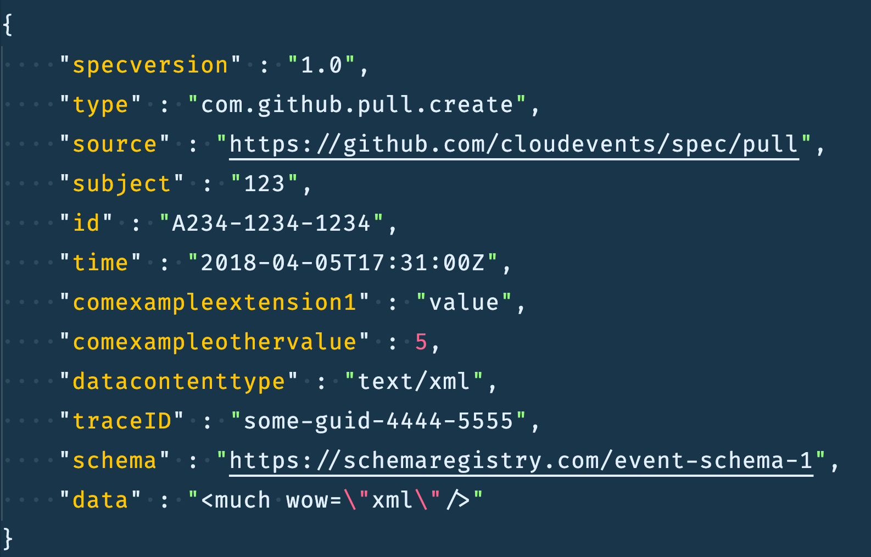
Use CloudEvents Specification
D
EVENT STANDARDIZATION
CloudEvents ensure a consistent, portable event structure ready for federated access
Consider Message Headers
For event hubs that support headers (like kafka) it is a common pattern to put the “envelope” of the CloudEvent into the headers, and the AVRO encoded message as the message field.
CloudEvents are a standardization effort to create common “envelopes” for events. This ensures a consistent approach to traceability, schema versions, origin, and more. It is just a standard, and should be extended to meet the needs of your organization.
The spec version is the version of the specification that the message is encoded to. This should match the CloudEvents specification. Between this marker and “B” include some of the CloudEvents spec fields you might find.
This field is considered to be an “extension” of the CloudEvents specification. Here, the traceID is used to track the event from place to place, usually tied to the origin. Example: A web request might be the originator of this traceID, and all subsequent messages that are created throughout the system have this same trace ID. To define this tracer, consider the OpenTracing initiative
This schema is another CloudEvents extension, that declares how the data field is laid out. This allows the message to be decoded by services against a schema registry
The data field contains the actual important content, or business information, about an event. This data can be any format you like, but should conform to a schema. The way data is structured within the data element is completely independent of the CloudEvents specification.
A
B
C
D
More information can be found CloudEvents.io
Notes:
Owner: Luis

Slide 26
Encode messages with a Schema, Use a Schema Registry
EVENT STANDARDIZATION
Messages that are encoded with AVRO, Protobuf, or JSON schemas are easier to curry across applications within the enterprise
Schema Registry
A schema registry is one source of truth for the shapes of the event data within the organization.
Schema Registry allows for systems across the enterprise to gain access to the shape of data, reducing the overhead to share data.
Extending the schema registry can enable an enterprise wide “event catalog” to view events.
When evolving schemas, ensure compatibility wherever possible.
Benefits of Utilizing a Schema
Encoded messages are smaller than unencoded, saving space (up to 20% lower storage requirement than unencoded messages)
Encoded messages can be used by other systems to understand what’s inside. Example: using a service to read events into a materialized view – with the schema you are able to map fields to columns in the database
Forces type safety across services… listening services expect a message shape and when both conform to schema, guaranteed to get it.

Slide 27
Testing

Slide 28
Testing Event Driven Systems
TESTING
Event driven systems, architected correctly, are easier to test than other types of systems
Individual services should be idempotent, which allows for rigorous testing without fear of unwanted side effects
Microservices should act as function operators: consume a message, do something, and produce a result. This lends itself well to automated testing methodologies
Consider functional programing paradigms within each custom service to allow for similar input/output style unit testing
Construct end-to-end functional tests, with known good outcomes stored as a reference. Example: if you are using 10 microservices that all act on a flow, then run that flows changes
If you are consuming events from other domains, it is critical to have proper governance in place. As a producer you should inform of changes to event payloads or structures

Slide 29
Contacts

Slide 30
Event Driven Architecture Contacts
Executive Sponsors
Architecture
Simon Kissler
North America
Simon.Kissler@Accenture.com
NORTH AMERICA
EUROPE
Chad Mott
Chad.Mott@Accenture.com
Olivier Fortin
Olivier.Fortin@Accenture.com
Matt Lancaster
North America
Matthew.D.Lancaster@Accenture.com
Yevgeny Osherov
Yevgeny.Osherov@Accenture.com
Roman Schiefer
Roman.Schiefer@Accenture.com
Jason Rosso
Jason.Rosso@Accenture.com
Jan Willies
Jan.Willies@Accenture.com
Dominik Wagenknecht
Europe
Dominik.Wagenknecht@Accenture.com
ASIA
Global Sponsor - Max Furmanov
Max.Furmanov@Accenture.com
John Kriter
John.R.Kriter@Accenture.com

