Slide 1
Architecture Layers
Strategy and Business Architecture Elements
System and Technology Architecture Elements

Slide 2
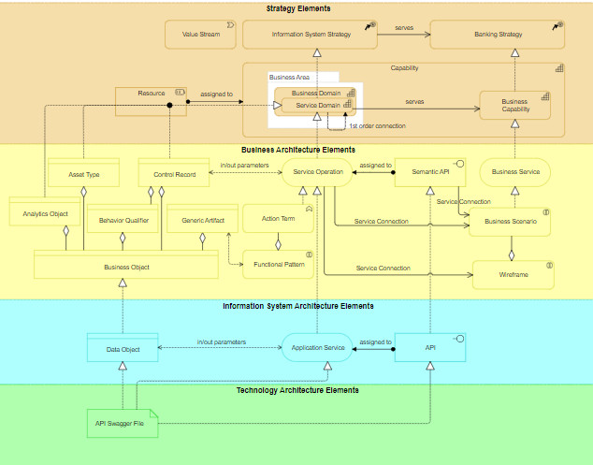

Slide 3
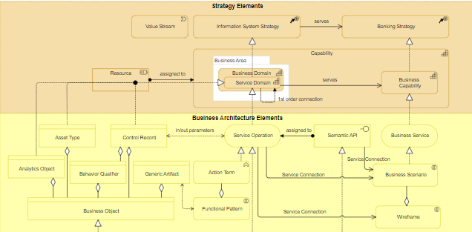

Slide 4
