Slide 1



GET RICH OR DIE TRYIN! (Do not take the title literally)
STOCK EXCHANGE shareS – KEY FIGURES AND THE ATTEMPT TO PREDICT THE SHARE PRICE

Slide 2
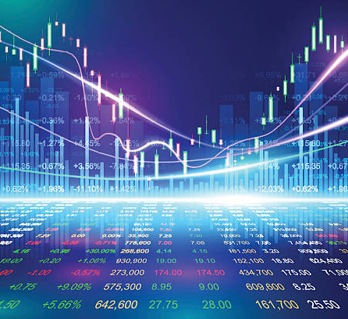
What influences the price of stock shares?
Demand and supply
Dividends
Economy
Management
Political Climate
Short term or long term investors
Inflation?
not really there is a much bigger influence factor:
INTEREST RATES!!!!

Slide 3

The selection of the stocks:
Only shares with the highest esg rating:
Environmental
Conservation of the natural world. - Climate change and carbon emissions. - Air and water pollution
Social
Consideration of people & relationships. - Customer satisfaction. - Data protection and privacy.
Governance
covers a broad range of corporate activities including board and management structures as well as a company's policies, standards, information disclosure, auditing and compliance.

Slide 4

Who makes the ESG rating?
While dozens of companies evaluate ESG factors, four major rating agencies dominate this market:
MSCI, Sustainalytics, RepRisk, and new entrant ISS.
A few examples of companies with high ESG ratings:
Nvidia, Salesforce, Adobe, Microsoft, Black Rock, Texas Instruments etc.
What? Makes one think….

Slide 5
Year 2020 Income before Tax in mill USD

Slide 6
Year 2020 Net Revenue in mill USD

Slide 7
Year 2020: Income before Tax divided by net revenue

Slide 8

Attempt to predict the future stock price!

Slide 9
Prediction with Deep Learning Microsoft, Vertex, Nvidia
 | MSFT
Index | Date | Close | Predictions | Mean_Square_Error
1627 | 21.06.20 | 262,63 | 251,45 | 1,03
1628 | 22.06.20 | 265,51 | 252,22 | 1,46
1629 | 23.06.20 | 265,26 | 253,15 | 1,21
1630 | 24.06.20 | 266,69 | 254,08 | 1,31
1631 | 25.06.20 | 265,01 | 255,04 | 0,82
 | VRTX
Index | Date | Close | Predictions | Mean_Square_Error
1627 | 21.06.20 | 187,69 | 187,66 | 0,00
1628 | 22.06.20 | 188,86 | 185,90 | 0,07
1629 | 23.06.20 | 187,52 | 184,75 | 0,06
1630 | 24.06.20 | 191,94 | 183,86 | 0,54
1631 | 25.06.20 | 194,33 | 183,73 | 0,93
 | NVDA
Index | Date | Close | Predictions | Mean_Square_Error
1627 | 21.06.20 | 737,09 | 728,96 | 0,55
1628 | 22.06.20 | 755,46 | 733,91 | 3,84
1629 | 23.06.20 | 762,28 | 739,75 | 4,20
1630 | 24.06.20 | 768,21 | 745,97 | 4,09
1631 | 25.06.20 | 761,23 | 752,31 | 0,66

Slide 10
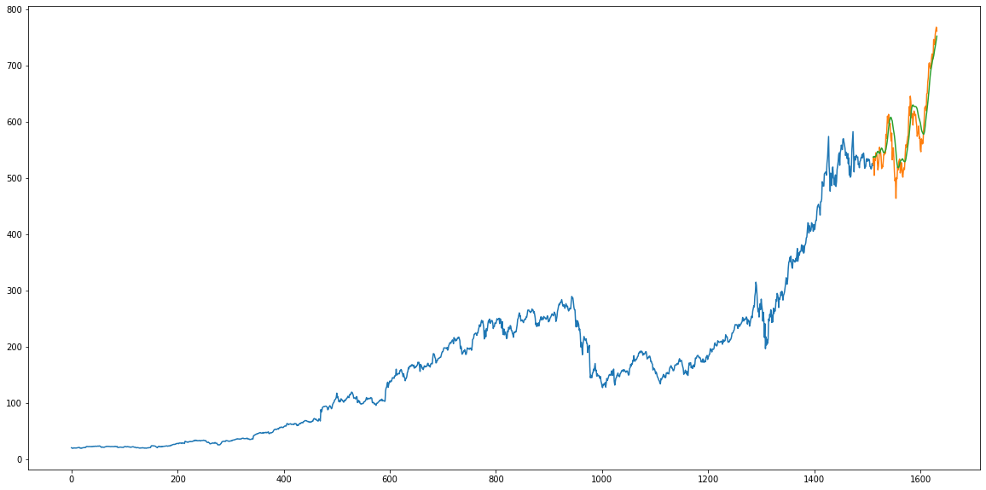
Plotting NVDA: orange line = predictions

Slide 11
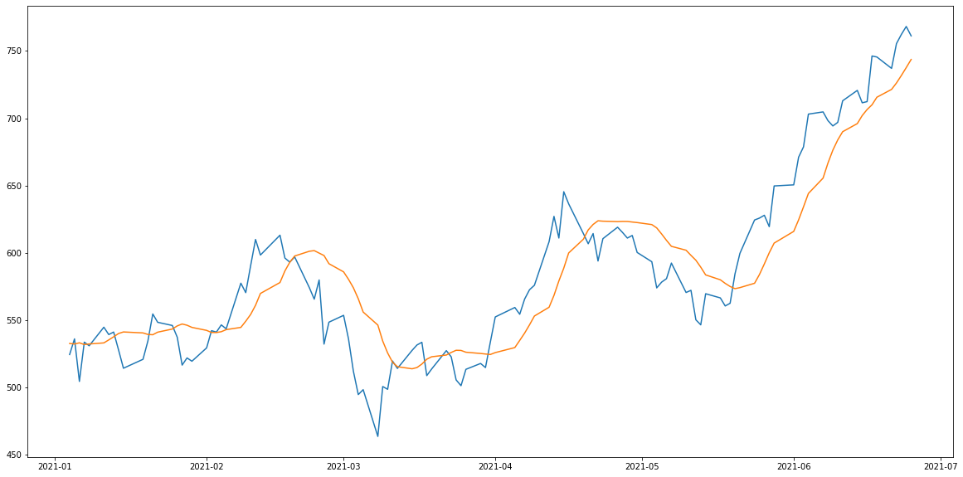
Plotting NVDA 2021: orange line = predictions

Slide 12
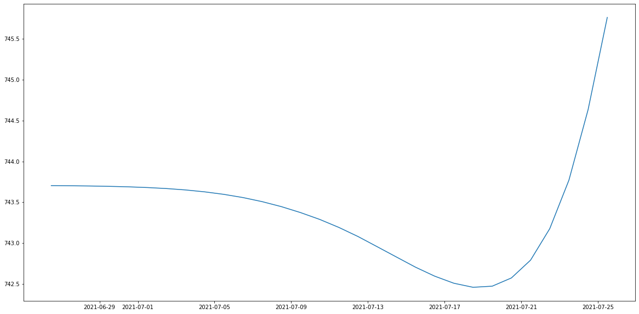
FINALLY: NVDA PREDICTION FOR THE NEXT 50 DAYS

