Slide 1

Open Data Visualization
Open Data Student Hackathon
04.03.2019
Hubert Baginski

Slide 2
What is Open Data?
available
accessible
re-useable and redistributable
for everyone

Slide 3


Where can I find Open Data?
data.gv.at
opendataportal.at

Slide 4
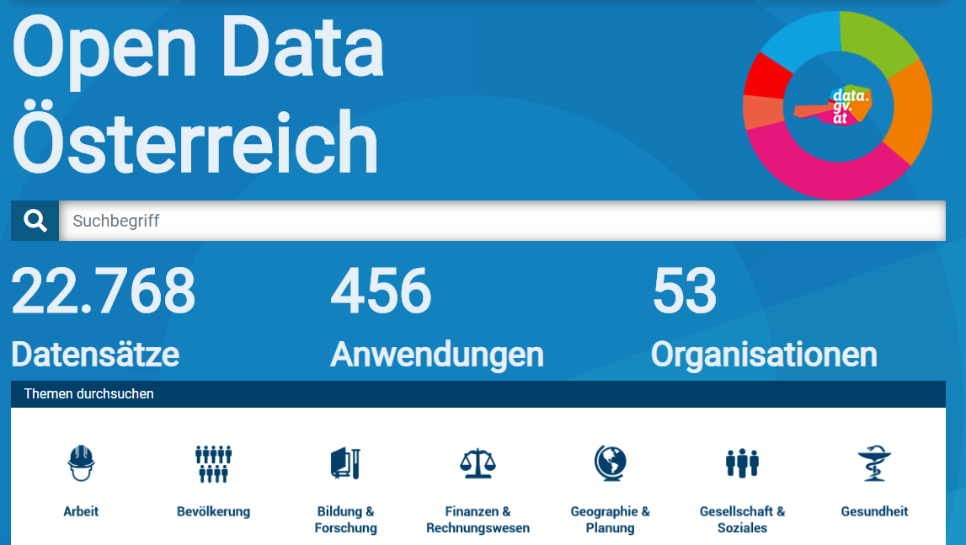
data.gv.at

Slide 5
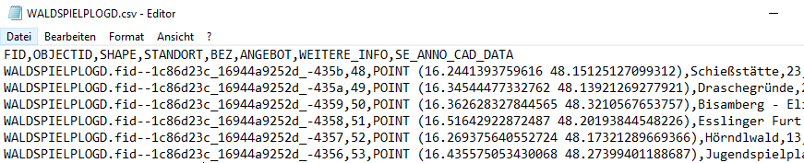
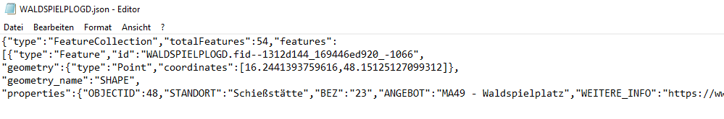
What does it look like?

Slide 6
https://hubertbaginski.github.io/open_data_vis/
https://github.com/HubertBaginski/open_data_vis/

