Slide 1

Variation Theory and the Utility of Linguistics
William Labov,
University of Pennsylvania
Faire Signe: Colloque en hommage à Pierre Encrevé 18 octobre, 2006
Notes:
This paper concerns the question as to whether linguistics is in fact a useful science for the solution of important social problems. Here, in France, no one can fail to be impressed by the remarkable contributions of Pierre Encreve in this domain, particularly in the extraordinary shift of policy towards linguistic diversity and the positive evaluation of regional dialects.
In the U.S., however, several generations of linguists have been instructed that their field is without any serious social applications, and only charlatans would presume otherwise. Several decades ago, Chomsky made this position explicit in an interview with Mitsou Ronat.
She then said, “What about Labov?” Chomsky said, “What has he done?” Ronat replied, “He showed that Black English is a language. Chomsky said, “Well everyone knows that.”
To tell the truth, I was a bit irritated. Yet after a while, I figured, “Maybe that’s not so bad an epitaph.” It’s true enough that about 1/3 of my work has revolved around the language of African Americans, and my most frequently reproduced paper is a polemic denouncing the claim of educational psychologists that the language of black children has no logical structure at all. Yet in fact it is only in the last ten years that I have begun to work within the schools directly on the problem of raising reading levels, and applied our sociolinguistic research to that problem. In this presentation, I would like to report a few indications that this effort has positive results.

Slide 2
The minority differential in reading achievement:
Average national NAEP reading score by race
Notes:
This demonstrates that problem we jointly face is long-standing and despite many programs and efforts the minority differential in reading achievement continues.

Slide 3
The local minority differential in reading achievement
Proportion below PROFICIENT on STAR reading test, L.A. county, 2005
Notes:
The seriousness of the problem can be seen more clearly in this contrast of black and white readers in Los Angeles, California. This is from a recent slide I prepared for a meeting of superintendants and educators of the Los Angeles School system, who have become aware that their newly adopted methods of direct instruction, phonics-driven, has improved the reading levels of white students but not black.

Slide 4
Some causes of reading failure
Lead poisoning
Malnutrition
Cognitive problems
Attentional disorders
Inadequate family support
Reading failure
Discouragement
Inadequate school resources
Inadequate instruction
Loss of confidence in the alphabet
Behavioral problems
Inadequate knowledge of children’s language and culture
Alienation
Suspension
Notes:
I do not mean to suggest that the linguistic component of reading instruction is the central problem. Here is a view of some causes of reading failure.
Thus the red areas indicate the domains of behavior that can be affected by sociolinnguistic research.

Slide 5
The decision on whether or not to intervene in oral reading
• should be informed by the best estimate of whether the reader has identified the word intended in the text
• will be helped by knowledge of how the reader normally articulates that word in every-day speech
• It is therefore important to distinguish between mistakes in reading and dialect differences in production
• How can this be done?
Notes:
Here is one particular aspect of instruction where the linguist can inform the reading teacher. The primary way in which the teacher finds out about the child’s language is by monitoring oral reading.
Here I define reading as a way of deriving meaning from the printed page. Recent reading research has demonstrated that the productive route to this end is the alphabetic decoding of the word to correctly identify the word intended by the writer. It is therefore essential for the teacher to know whether a given deviation from the text represents the idenetification of the wrong. Here are a set of proposals for leaving the decision in the hands of the informed reading instructor.

Slide 6
Clear errors and potential errors
Clear errors: selection of wrong words:
Reader: Tyreke J., 8 years old, 3rd grade, African American, Philadelphia.
Text: My blood began to boil.
Reading: My boat began to bill.
Potential errors: failure to articulate a monomorphemic cluster
Reader: Keyana P.., 8 years old, 3rd grade, African American, Philadelphia.
Text: then poured the coke on the ground
Reading: then [?] the cola on the groun.
Potential errors: failure to articulate a monomorphemic cluster
Reader: Jaleel P.., 9 years old, 3rd grade, African American, Philadelphia.
Text: Your cat stays here at the risk of his life
Reading: Your cat says here at the ris’ of his life.
Potential error: failure to articulate a past tense morpheme:
Reader: Filores J., 8 years old, 3rd grade, African American, Philadelphia.
Text: I played it cool and took a sip of my coke.
Reading: I play it cool and took a sip of my coke

Slide 7
Does the grammar of the spoken language interfere with reading?: the past tense -ed
Potential errors:
Simplification of final homovoiced clusters in single morphemes
find → /fayn/ = fine
told → /towl/ = toll
mist → /mis/ = miss
rift → /rif/ = riff
Potential errors:
Simplification of final homovoiced clusters formed by the grammatical suffix {-ed}
dined → /dayn/ = dine
rolled → /rowl/ = roll, role
missed → /mis/ = miss
laughed → /læf/ = laugh

Slide 8
Potential errors with the past tense
Reader: Jaleel P., 8 years old, 3rd grade, African American, Philadelphia.
Text: Next Ray turned around and was looking at me.
Reading: Next Ray turn around and was looking at me
Text: Ray screamed, “Wait!”.
Reading: Ray scream, “Wait!”
Text: Ray came by and opened his coat
Reading: Ray came by and open his coat
Text: I gave a whistle and opened the door
Reading: I give a [wIstIz] and opened the door
neutralized

Slide 9

Ray and his Cat Come Back
Pre-test diagnosticreading for decoding skills
(from the Individualized Reading Manual)
Notes:
Our diagnostic reading

Slide 10
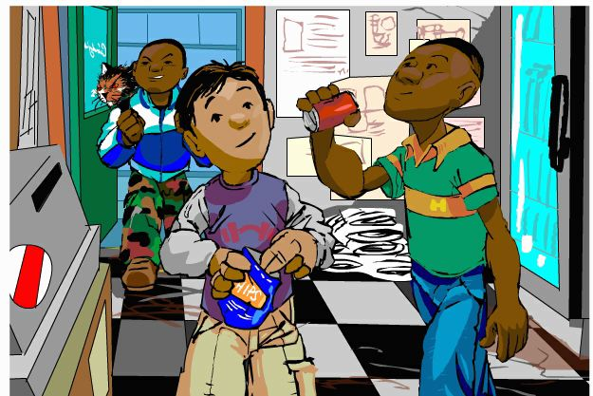
    Ray and his cat were a pain in the rear.
    Ray sneaked up on Matt and put the cat in his ear.
snuck
Notes:
Focusing on the most difficult word in the reading: sneaked, which has an initial and final cluster, the irregular vowel pair <ea> and a past tense morpheme.

Slide 11
The reading of sneaked
111 African American students in California
read sneaked wrong 73
read sn- OK 45
read -k OK 42
read sn- & -k OK 37
-ea- as short a 15 snack, etc.
-ea- as long a 6 snake, etc (<great, break, steak).
-ea- as long e 7 sneak, etc.
snucked 2
snuck 3
sneakted 2
sneak 3
Total incorrect: 38 (34%)
correct reading
correct reading?
48 (43%)
Notes:
A breakdown of reading errors for sneaked

Slide 12
Four morphosyntactic variables of AAVE in spontaneous speech of second graders by language/ethnic group. N=287.
consonant possessive verbal copula
clusters -s -s -s

Slide 13
Does the grammar of the spoken language interfere with reading?: the possessive -s
In African-American Vernacular English, the possessive <‘s> is not used between two nouns:
Standard English AAVE
my brother’s house my brother house
my mother’s cousin’s boy friend my mother cousin boy friend

Slide 14
The Semantic Shadow Hypothesis
    An error in the identification of a word in a given sentence will raise the probability of an error in the remainder of that sentence.

Slide 15
The RX program

Slide 16
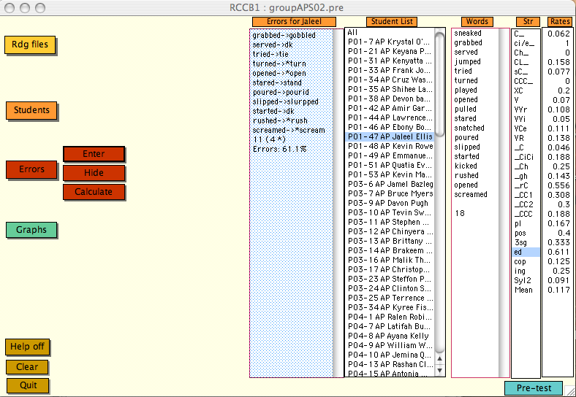
RX page 2

Slide 17
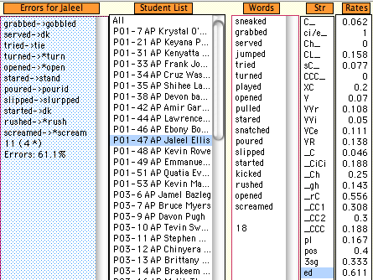
RX ed

Slide 18
Frequency of following errors for clear errors and correct reading by dialect type

Slide 19
Frequency of following errors for clear errors and correct reading

Slide 20
Frequency of following errors for clear errors, potential errors and correct reading by dialect type [N=567]

Slide 21
Proportion of clear errors, potential errors and correct reading for Latino elementary school children [N=198]
significant difference (p < .01)
significant difference (p < .01)

Slide 22
Proportion of clear errors, potential errors and correct reading for African-American elementary school children [N=238]
significant difference (p < .01)
identical

Slide 23
Absence of possessive {s} between two nouns in spontaneous speech of struggling readers, California schools, 2002-2003
Notes:
The absence of ‘s between two nouns among black strugglng readers in the California population

Slide 24
Possessive constructions in the diagnostic reading, Ray and His Cat Come Back
in Aunt Cindy’s store
grabbed Matt’s chips
jumped in Ray’s coat
didn’t reach up to Ray’s chin

Slide 25
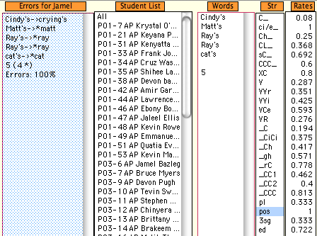
RX possessive

Slide 26
The possessive of the relative pronoun who in AAVE
[from Memory tests in Harlem, 1967]
Repeat back as carefully as you can:
I don’t know whose book it was
Typical response from members of the pre-adolescent Thunderbirds
I don’t know who book it was
Notes:
AAVE has no ‘se in WHOSE

Slide 27
Ray’s Cat Gets Stuck

Slide 28
Ray and His cat Gets Stuck
The cat landed on Ray's head and dug its claws in Ray's nose
Ray was screaming, "Get off my head!"
The cat wouldn't listen but just kept digging instead
He took off wearing that cat for a hat
It wasn't very pretty but whose fault was that
Not mine I thought as Ray ran down the street
That would be the last time that all of us would meet
Notes:
Our post-test reading with an example of “whose”

Slide 29
Reading errors for “I don’t know whose fault it was”
Percent was, wasn’t for whose in California schools, 2001-2004

Slide 30
Ray and His cat Gets Stuck
African-American students from a southern California school, 2002-3
Text: It wasn't very pretty but whose fault was that?
C-03 (2nd grade): was float was that
C-04 (2nd grade): was fell was that
C-07 (3rd grade): was frote was that
C-27 (4th grade): was full was that
C-23 (3d grade): wasn’t fight was that
C-32 (2nd grade): who fell->fault was that?
C-37 (4th grade): who->whose felt->fault was that?
Notes:
California records on “whose” showing that the absence of the -se leads to the error in word identification whose -> was,
and then in inability to decode the following word.

Slide 31
A primary goal of variation theory:
The interpretation of zeroes
Given the absence of {d} in the surface forms of past tense AAVE, is the {d} present in the underlying form?
Answer: most probably YES
Given the absence of {s} in the surface forms of AAVE possessives, is the {s} present in the underlying form?
Answer: most probably NO

Slide 32
Summary Statement on African American English
This statement is designed as a brief summary of current knowledge of African American English, concentrating on those features that have the most relevance to the acquisition of Standard English reading, writing and speaking in the classroom. It is in response to the new criterion in the California Curriculum Commission 2008 K-8 Reading/Language Arts/English Language Development Adoption Criteria, which requires:
    additional support for students who use African American language who may have difficulty with phonological awareness and standard academic English structures of oral and written language, including spelling and grammar.

Slide 33
Summary statement on African American English by
    William Labov, Professor and Director of the Linguistics
    Laboratory, University of Pennsylvania
    Guy Bailey, Chancellor, University of Missouri-Kansas City
    John Baugh, Professor, Director of African and African
    American Studies, Washington University in St. Louis
    Lisa J. Green, Associate Professor of Linguistics, University
    of Massachusetts, Amherst
    John Rickford, Professor of Linguistics, Stanford University
    Geneva Smitherman, University Distinguished Professor and
    Director of the African American Language and Literacy
    Program, Michigan State University
    Tracey Weldon, Associate Professor, English language and
    Literature, University of South Carolina
    Walt Wolfram, William C. Friday Distinguished Professor, Department of
    English, North Carolina State University
    Hesh S. Alim, Associate Professor, University of California Los Angeles

Slide 34
Statement on the possessive
In Standard English, ‘s is added to a noun to indicate possession, as in John’s cat and This is John’s. In AAVE, the ‘s suffix is not added when another noun follows (John cat) but it does appear when there is no noun (This is John’s.) The possessive ‘s is also added to mine (This is mines).
The possessive pronoun whose is not found in AAVE, but is realized as who (I don’t know who book it was).
To acquire standard English, speakers of AAVE must learn to recognize and reproduce the ‘s marker of possession between two nouns.

Slide 35
The past tense
Standard English forms the past tense of regular verbs with the suffix –ed, which usually forms a consonant combination or cluster in verbs like worked or rolled (but not in started).
Like other consonant clusters (see page 1), this combination can be simplified, but less often than with clusters that form part of the stem (fist, hand). In AAVE, the second consonant is deleted more often than in other dialects, so that the past can sound the same as the present.
In speech, the past is sometimes realized with two consonants (pickted), and this happens very often in reading, when struggling readers are trying hard to pronounce past tense verbs.

Slide 36
Direct instruction on the possessive
--from Chapter 12, Individualized Reading Manual
Sometimes the s tells us who something belongs to.
When it does that, it has an apostrophe before it.
This is John's boat.
This is my brother's coat.

Slide 37
More instruction on the possessive from the IRM
People don't always say the s in John's bat,
but they always say it at the end of a sentence:
This is John's. And it's always there in writing.
Notice that we don't bother with the apostrophe
after some little words:
This is hers. This is yours. This is ours.

Slide 38
A narrative designed to reinforce the teaching of the standard English suffixes, especially the possessive
Notes:
A text that focuses on grammatical endings, especially WHOSE.

Slide 39
page 2
Dub-L came up to me before class started.
I sit in the second row in Mr. Benson's class.
He said, "Hey, Michael, take this dollar."
He opened my desk and stuck it inside my
English book's cover. "And don't tell anybody I gave it to you, right?"

Slide 40
page 3

Slide 41
page 4
Mr. Benson said, "Is that your dollar?"
I said, "No, it isn't."
He said, "Whose dollar is it?"
I said, "I don't know whose dollar it is."
He said, "Janine told me that she lost a dollar this morning. Is that Janine's dollar?"
I said, "No, it isn't."
Notes:
A page with practice on WHOSE.

