Slide 1
Return to the Obvious: the Ubiquity of Categorical Rules
W. Labov, U. of Pennsylvania
Panel on Usage-based and rule based approaches to phonological variation
SS17 Amsterdam March 4, 2008

Slide 2
www.ling.upenn.edu/~labov

Slide 3
The Neogrammarian viewpoint
Every sound change, inasmuch as it occurs mechanically, takes place according to laws that admit no exception. --Ostoff and Brugmann 1878
Sound-change is merely a change in the speakers’ manner of producing phonemes and accordingly, affects a phoneme at every occurrence, regardless of the nature of any particular linguistic form in which the phoneme happens to occur. . . The whole assumption can be briefly put into the words: phonemes change. --Bloomfield 1933:353-4

Slide 4
The lexical diffusion viewpoint
The phonetic law does not affect all items at the same time: some are designed to develop quickly, others remain behind, some offer strong resistance and succeed in turning back any effort at transformation. --Gauchat (cited in Dauzat 1922)
We hold that words change their pronunciations by discrete, perceptual increments (i.e., phonetically abrupt) but severally at a time (i.e., lexically gradual) --Wang and Chen 1977:150.
The lexically gradual view of sound change is incompatible, in principle, with the structuralist way of looking at sound change. --Chen and Wang 1957:257.

Slide 5
A proposed resolution
Regular sound change is the result of a gradual transformation of a single phonetic feature of a phoneme in a continuous phonetic space.
Lexical diffusion is the result of the abrupt substitution of one phoneme for another in words that contain that phoneme.

Slide 6
A proposed role of word frequency
Change that is both phonetically and lexically
gradual presents a serious challenge to theories with phonemic underlying forms. An alternate exemplar model that can account for lexical variation in phonetic detail is outlined here. This model predicts that the frequency with which words are used in the contexts for change will affect how readily the word undergoes a change in progress
-Bybee 2002 Abstract :261

Slide 7
How frequency affects the rate of change
Words are represented as clusters of exemplars, and the
relative weight of exemplars with different patterns may change over time as reduction proceeds. If the distribution of words in actual discourse contexts differs,
the rate at which their exemplar clusters change, and thus the rate at which they undergo a change, may differ.
--Bybee 2002:282

Slide 8
Factor weights for grammatical status group in -t,d deletion in Philadelphia [N=6097]

Slide 9
Factor weights for frequency group in -t,d deletion in Philadelphia [N=6097]

Slide 10
Range for -t,d deletion factor groups in Philadelphia [N=6097]
 | Range
Preceding segment | 0.232
Following segment | 0.411
Grammatical status | 0.553
Stress | 0.126
Homovoiced vsl. heterovoiced | 0.071
Word internal vs. word final | 0.076
Word frequency | 0.051

Slide 11
Lexical regularity. . .
Sound changes that are complete can be identified as regular or not, depending upon whether they affected all lexical items existing at the time of the change. Ongoing changes cannot be designated as regular or not, since they are not complete.
--Bybee 2002:263

Slide 12
The English Great Vowel shift
/i:/ [iy] [uw] /u:/
/e:/ /o:/
/æ:/ [ay] [aw] /ç:/

Slide 13
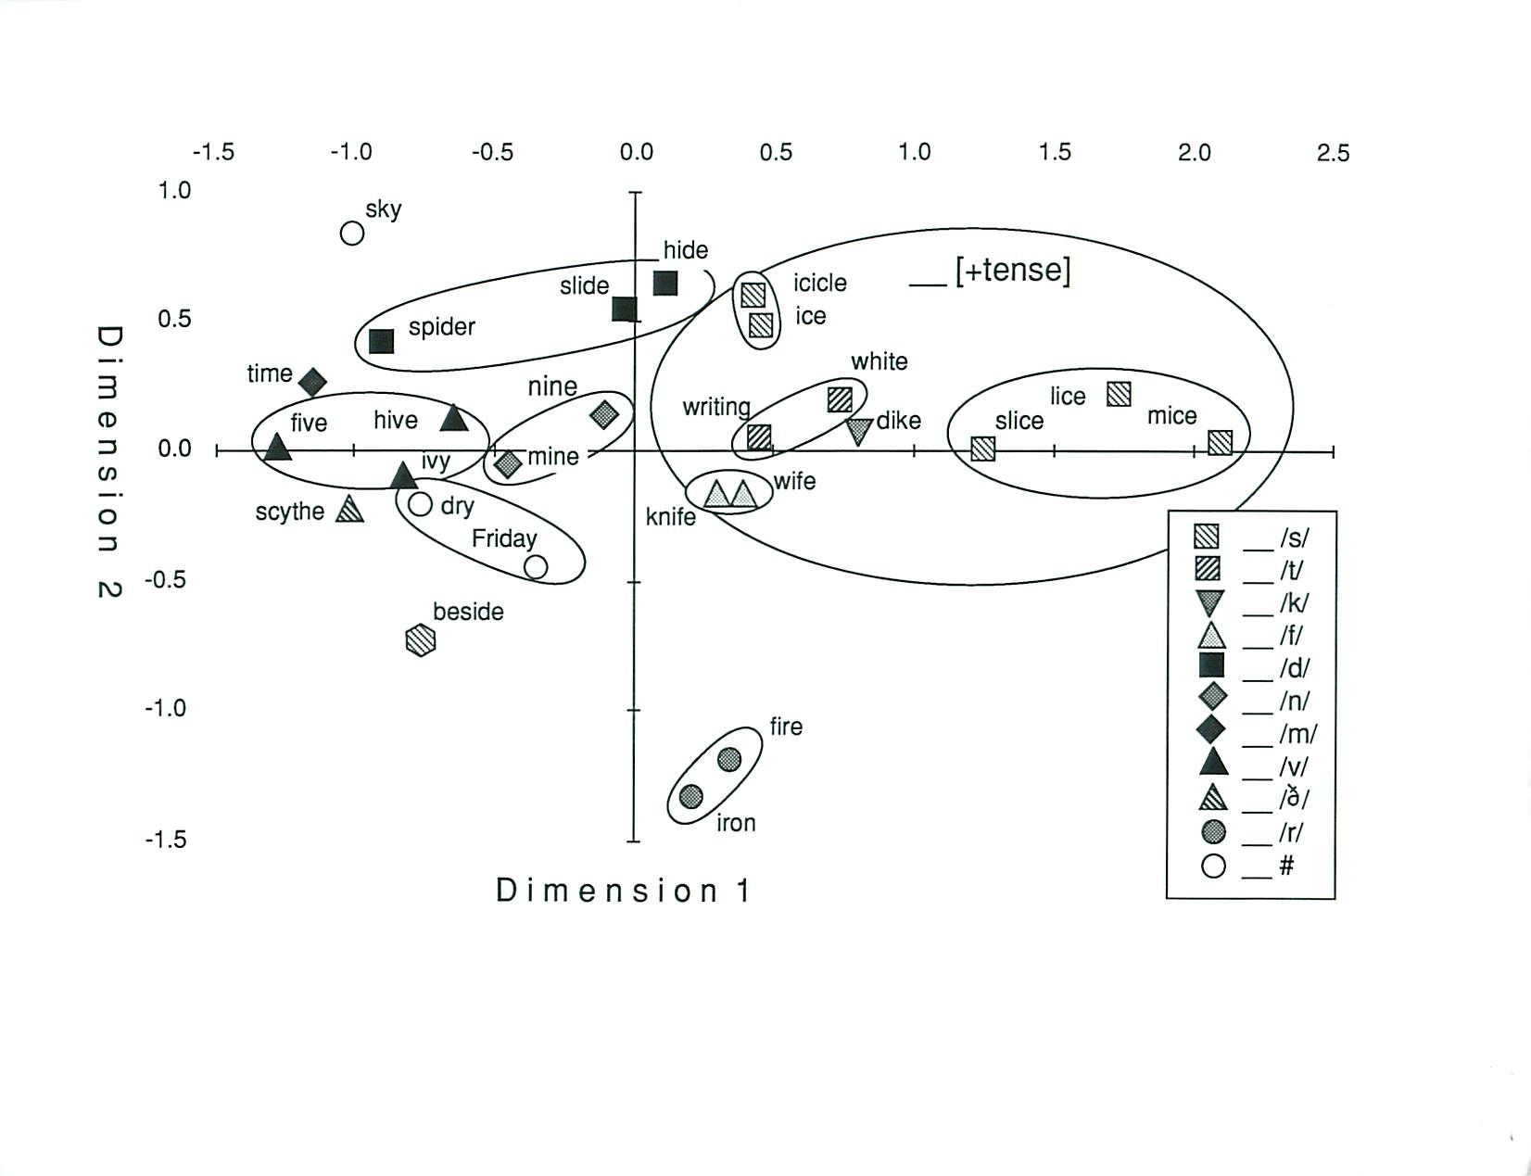
RSCEDD /I/ close
Principal components analysis of the development of OE i: words in the phonetic transcripts of 311 English communities in the S.E.D.
--from Fig. 17.7 , Labov 1994

Slide 14
The fronting of /ow/ in North America
Constant 1387 N = 6736
Age * 25 years -24 p < .0001
Female 46 p < .0002

Slide 15
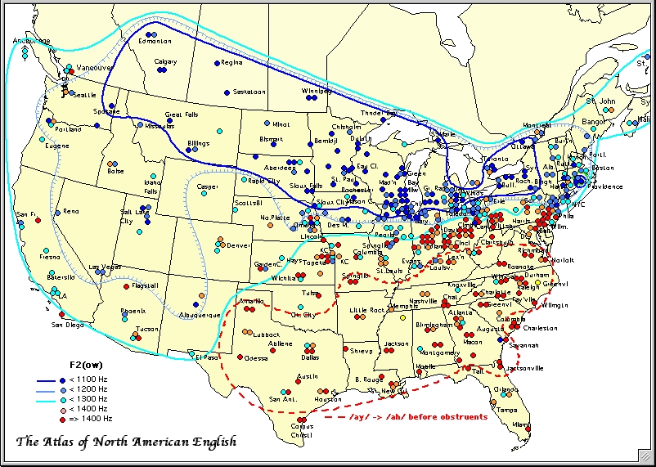
Fronting of /ow/ in North America

Slide 16
Distribution of /ow/ vowels for all of North America. [N=8313].Vowels before /l/ are shown in black [N=1577].

Slide 17
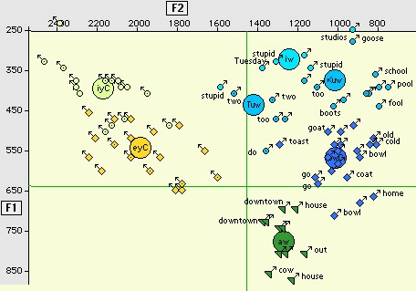
Absence of fronting of Vw in vowel system of Alex S., 42, Providence, RI TS 474.

Slide 18
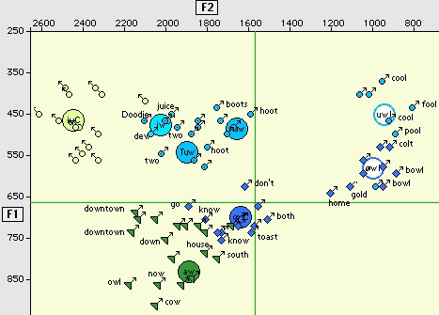
Fronting of Vw in the vowel system of Danica L., 37, Columbus, OH, TS 737.

Slide 19
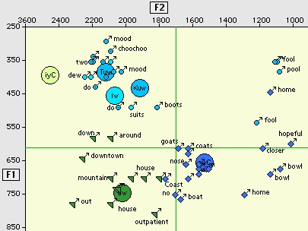
Fronting of /ow/ of Fay M., 41 [1995], Lexington KY TS 283

Slide 20
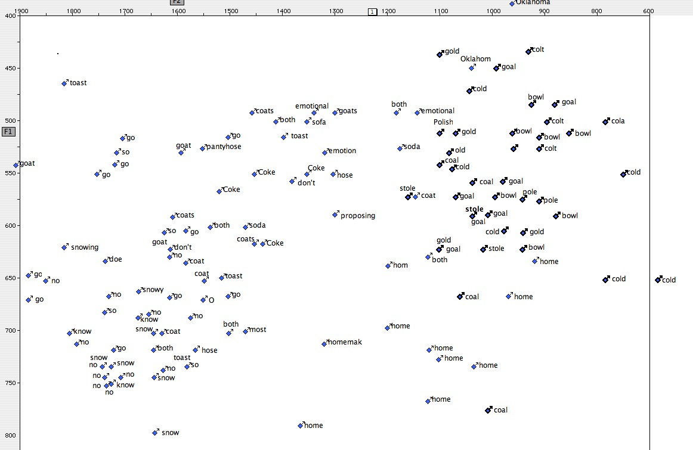
/ow/ for six Telsur speakers from Columbus OH

Slide 21
34 most frequent /ow/ words in the Brown and Telsur corpora

Slide 22
Surviving regression coefficients in both halves of a random split in the /ow/ tokens [even = 3927, odd = 3869]
no
home
p <.00001 <.001 <.05

Slide 23
Distribution of no [N=348, yellow] and know [N=630, blue] in F1/F2 space

Slide 24
Fronting of /ow/ for words before /l/ and others for all of North America and for the Southeast (South and Midland). Words selected by regression analysis at p <.001 level as ahead of phonological prediction, light blue; behind, yellow.

Slide 25
Is home a lexical exception to the fronting of /ow/?

Slide 26
/ow/ for six Telsur speakers from Columbus OH

Slide 27
Is home a lexical exception to the fronting of /ow/?
 | N | F1 | F2
/ow/ | 5950 | 616 | 1304
/owl/ | 2576 | 575 | 1010
home | 775 | 669 | 1068
Oklahoma | 14 | 589 | 1045
homebody, etc. | 28 | 641 | 1037
Omaha | 10 | 655 | 1119
hoe | 26 | 621 | 1233

Slide 28
The /h_m/ effect on the fronting of /ow/

Slide 29
Provisional conclusions on the role of frequency and lexical membership
Word frequency has an effect on stable lenition processes such as -t,d deletion. It appears to be considerably smaller than the effect of the major phonetic and grammatical factors.
Many phonological systems show categorical phonological splits determined by phonetic features without regard to lexical membership or word frequency.
Close examination of sound changes in progress which do not involve lenition have shown a high degree of phonetic regularity and no effect of word frequency. Some lexical items show slight fluctuations within the major phonetic subclasses, though no cases have been found so far of words not selected by the sound change as defined phonetically.
Further studies of duration may illuminate the extent to which lexical effects are the result of differential stress and affect.
Further studies are required to define the conditions under which sound change proceeds by lexical diffusion, as in the case of Mid-Atlantic short-a.

