Slide 1
The Life History of Linguistic Change
Northern Cities Shift
Canadian Shift
Inland North: front /o/
Back vowel shift
Low back merger
Increase phonetic distance
Eastern seaboard: raise /oh/
Pittsburgh chain shift
South: add upglide
Back upglide chain shift
William Labov, University of Pennsylvania
/o/ ~ /oh/
Skewed opposition depending on length
ICHL Montreal August 2007
Notes:
Il y a deux ans, au dernier congrès de Linguistique Historique à Madison, Wisconsin, j’ai donné une conférence sous le titre, “Evènements déclenchants” (Triggering Events), qui traitait du premier changement dans une chaine de changements linguistiques, liés par un rapport de causalité. A ce moment là, l’Atlas Linguistique d’Amérique du Nord n’était pas encore paru. Actuellement, après la publication de l’Atlas, il est possible de présenter ces résultats dans un optique plus large. Aujourd’hui, je voudrais développer le concept d’une SUITE de changements, en commençant par les évènements déclenchants, suivi d’une considération des principes qui gouvernent les groupes des changements. Donc, j’introduis le concept de BIFURCATIONS de la route, le locus fondamentale de la diversité des dialectes. Ensuite, je discute des forces sociales qui poussent les changements en chaine à s’avancer. Enfin, je spécifie où les forces sociales peuvent ou ne peuvent pas jouer un role important dans la configuration de telles suites de changements linguistiques.

Slide 2
www.ling.upenn.edu/~labov
Notes:
Apology for not having a handout. This PowerPoint presentation can be downloaded from my home page, at the address shown here.

Slide 3
A sequence of linguistic changes
A’
B’
Unidirectional
Causally linked
A
B
Bidirectional
Contingent alternatives
Triggering event
Unstable condition
Notes:
In all thaet follows, we will be following a eneral schema of this type. The triggering event is the creation of an unstable condition, which is followed by a branching network of bidirectional changes, alternatives contingent on a variety of hisorical accidents. Such bidirectional changes are followed by unidirectional changes, responsible for the permanent divergnce of neighboing dialects. Unidirectional changes are exemplified by two types: chain shifts and mergers, chain shifts which preserve the number of contrasts in the system and mergers which reduce them.

Slide 4
Components of a sequence of linguistic changes
Triggering events: the first in the chain of causally connected events
Governing principles: constraints that determine the unidirectional character of changes
Forks in the road: alternate pathways of change that differentiate sister dialects
Driving forces: factors that lead to the continued incrementation of the changes
Re-analysis: the process that leads to the uniform distribution of the changes across the speech community.
Notes:
The presentation today will not deal with the life history of a particular linguistic change or a combination of linguistic changes like a chain shift or a merger. The object of study will be a sequence of linguistic changes, linked by a nexus of two types of relations: causal consequences and contingent alternatives. The causal relations will be characterized as ‘unidirectional’ and the contingent alternatives as ‘bidirectional’. In following the history of these sequences, we can consider five components: [read]
I’ll be dealing with the first four here.

Slide 5
Two ways of looking at the problems of language change
Weinreich, Labov & Herzog 1968
Accounting for changes
This presentation
Accounting for sequences of changes
The actuation problem
Constraints problem
The transition problem
The embedding problem
The evaluation problem
Triggering events
Governing principles
Forks in the road
Driving forces
Re-analysis
Notes:
The 1968 paper on empirical foundations of a theory of language change by Weinreich, Herzog and myself dealt with particular changes, and identified the five problems seen on the right. They correspond roughly to the components of the current analysis of historical sequences. The actuation problem--why a change occurred at a particular time and place--corresponds to the search for the triggering event of a sequence of changes. The constraints problem for individual dialects corresponds to the study of governing principles for systems as a whole. The transition problem--how the system moved from state A to state B--is in the same area as the identification of forks in the road, alternative routes that a system may or may not follow. The embedding problem had two aspects--embedding in the linguistic system, which here will be dealt with under ‘governing principles’, and embedding in the social system, which here corresponds to the investigation of forces that drive the system forward. I will not be dealing here with the evaluation problem or the process of re-analysis which is responsible for the ultimate uniformity that is a normal outcome of the sequence.

Slide 6
ANAE notation for the word classes of North American English
Notes:
These are the subsystems of vowels within which the sructural movements take place The binary notation recognized by most linguists for North American English is here developed as four sub-systems: the short vowels, the front upgliding vowels, the back upgliding vowels, and the much smaller set (in r-pronouncing dialects) of long and ingliding vowels. Principles of maximal dispersion, maintenance of margins of security operate only within these subsystems. Studies of misunderstandings in spontaneous speech show that they occur primarily within these sub-systems.
This represents the initial position for the description of sound changes in North American English in the Atlas of North American English. The labels in these cells refer to historical word classes useful for the analysis of North American English,bu not necessarily for other varieties found in Britain, the Caribbean or elsewhere.

Slide 7
ANAE notation aligned with JC Wells’ word classes for American English
Notes:
For those who are more familiar with the notation developed by JC Wells, this diagram may be useful. Wells’ notations are also grouped into subsets that correspond to these. The labels that he applies to American English, shown here, have no such analytical intent, but they correspond to the classes that we use to describe chain shifting.

Slide 8
Triggering events
Notes:
Can there be a triggering event? Is not every linguistic state the outcome of a previous linguistic state? Concept of the history of mammals, which leads back to the extinction of dinosaurs. What caused the extinction of the dinosaurs? A favored hypothesis is the climatic changes brought about by a meteoric impact. It is of course conceivable that we can trace the causes of that event back to a particular intersection of a set of orbits. But I think we can agree that the prediction of this meteor impact would not in any way enlarge our understanding of the evolution of mammals. It is the accidental concatenation of a series of events that are quite orthogonal to the biological evolution.
The general strategy that I will follow is to

Slide 9
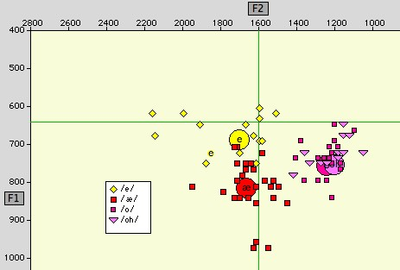
The Canadian Shift in the vowel system of Marsha M., 24 [1997], Montreal, TS659
lowering of /e/
merger of /o/ and /oh
backing of /æ/
Notes:
Let us first consider one simple sequence of linguistic changes, beginning with the Canadian Shift. It was first described by Clarke et al. in 1995 as a lowering and retraction of the front short vowels. We see it exemplified here in the speech of a 24-year old woman

Slide 10
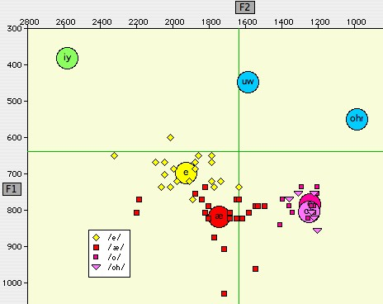
The Canadian Shift in the vowel system of Hubert B., 17, Toronto, TS798
lowering of /e/
merger of /o/ and /oh
backing of /æ/

Slide 11
The Canadian Shift: mean values of Canadian Telsur subjects [N=25] compared to all others [N=414].
Source: The Atlas of North American English
Notes:
Clarke’s small study in Toronto is confirmed by the Canadian subjects of our Atlas. This diagram shows the mean values for the 25 Canadian Telsur speakers compared to the means for the 414 others. There is no difference fo shortr /i/. But Canadian short /e/ is lower than the general mean, and an even greater difference appears for short-a, which is lowerw and backer than the general mean. We also observe that short-o is located well to the back of the general average.

Slide 12
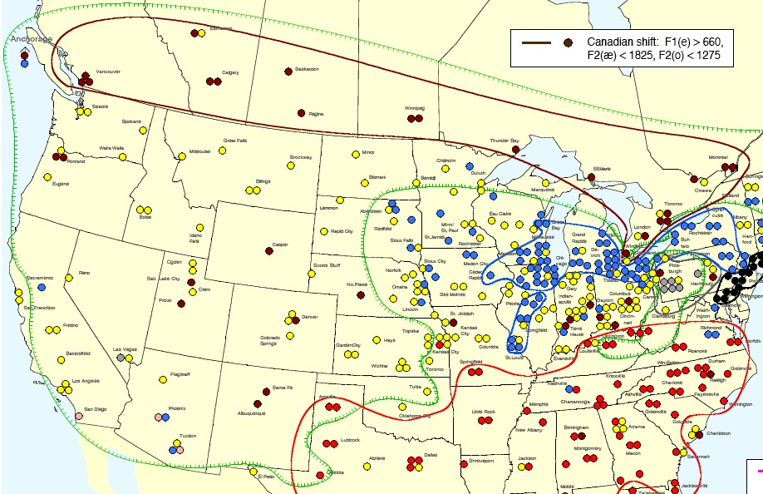
The Canadian Shift nested in the Low Back Merger area (ANAE Map 11.7)
Low back merger isogloss
Notes:
Here is the geographic distribution of the Canadian Shift. The dark red symbols are speakers for whom short-e is below mid position,F1 > 600 Hz, short-a is shifting back towards central position, F2 < 1825 Hz, and short-o is well to the back, F2 < 1275 Hz. It turns out that this chain shift defines the Canadian dialect area better than the most well known feature, Canadian raising.

Slide 13
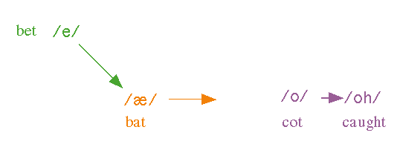
The Canadian Shift
3
2
1
Notes:
Let us then take as a linguistic example a the search for the triggering events that led to the Canadian Shift.

Slide 14
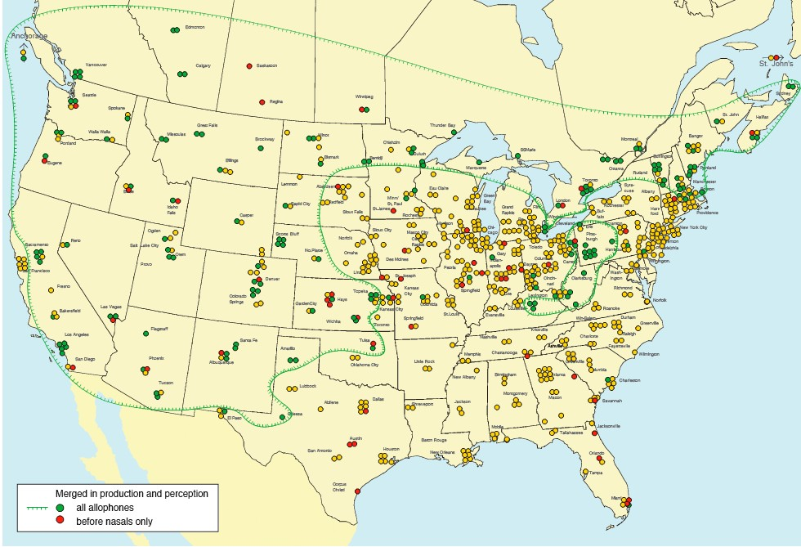
The low back merger of /o/ and /oh/ in cot and caught, etc. (ANAE Map 9.1)
Canada
E.N.E.
The West
W. Pa.

Slide 15
The development of /oh/
OE
ME
EME
thought, bought
off, cost, cloth, strong
water, wash
vocaliza-tion of /x/
ah
oht
o __f,s,T,N
wa
av
breaking
fought, taught
hawk, laundry
length-ening
eah
round-ing
vocaliza-tion of /v/
rounding
thaw, straw, claw
aw
_x0003_[au]
_x0003_[ç:]
/oh/
vocaliza-tion of /g/
σσ−> σ
denasal-ization
vocaliza-tion of /l/
mono-phthong-ization
ag
alC
au
a+u
aN
maw, saw, draw
talk, call, all
applaud, because
brawn, pawn
lawn, spawn
OF

Slide 16
Minimal pairs contrasting /o/ and /oh/
/o/ /oh/
cot caught
Don dawn
hock hawk
stock stalk
odd awed
cod cawed
Sol Saul
odd ability audibility
. . . . . .

Slide 17
Contrast of /o/ and /oh/ after tensing of /o/
/o/ /o/ -> /oh/ /oh/
t cot, tot, hot, got, dot caught. bought, taut, fought
d odd, hod, god, sod awed, hawed, gaud, sawed
s toss, moss, floss, cost sauce, exhaust, caustic
z Oz, positive cause, clause, hawser, paws
n don, don, pond on dawn, awn, yawn, lawn
l doll, moll, collar all, tall, maul, caller
p hop, pop, top, sop ----------
b rob, hob daub, bauble
c& Scotch, botch, watch ----------
j lodge, dodge, Roger ----------
g log. hog, cog, dog auger, augment, augur, August
k stock, hock, clock stalk, hawk, talk
f {boff} off, doff, scoff, cough,
T {Goth} cloth, moth, ----------
S gosh, bosh, tosh ----------
D bother ----------
z& ---------- ----------
m bomb, Tom, prom ----------
N {ping pong} strong. song, wrong ----------
# ---------- law, saw, flaw, thaw, claw
apicals

Slide 18
A linguistic sequence
e
Canadian Shift
oh
æ
o
Low back merger
/oh/
~ /o/
Unstable condition
EME ç:
Mod E. off, lost, song
ME ç(:}u
OF an
ME av
ME a(:}u
OF au
OF a+u
OE oht
OE eah
OE aw
OE au
OE ah

Slide 19
A linguistic sequence 1
e
Canadian Shift
oh
æ
o
Merge /o/ --> /oh/
Triggering event
/oh/ ~ /o/
Unstable condition

Slide 20
Governing principles

Slide 21
General principles of merger
Garde’s Principle:
Mergers cannot be reversed by linguistic means
Herzog’s Corollary:
Mergers expand at the expense of distinctions

Slide 22
A linguistic sequence 1
e
Canadian Shift
oh
æ
o
Merge /o/ --> /oh/
Unidirectional
/oh/ ~ /o/ ~ /ah/

Slide 23
General principles of chain shifting
In chain shifts,
I. Long vowels rise.
II. Short nuclei fall.
II. Back nuclei shift to the front.
--Labov, Yaeger & Steiner 1972

Slide 24
General principles of chain shifting
In chain shifts,
I. Tense nuclei rise along a peripheral track
II. Lax nuclei fall along a non-peripheral track

Slide 25
Martinet on maximal dispersion
Phonemes co-existing in a language tend naturally to optimize the possibilities that are available from the speech organs; they tend to be as distant from their neighbors as possible while remaining easy to articulate and easy to perceive. . .
Martinet 1955:62 (tr. WL),
attributed to de Groot TCLP 1931:121

Slide 26
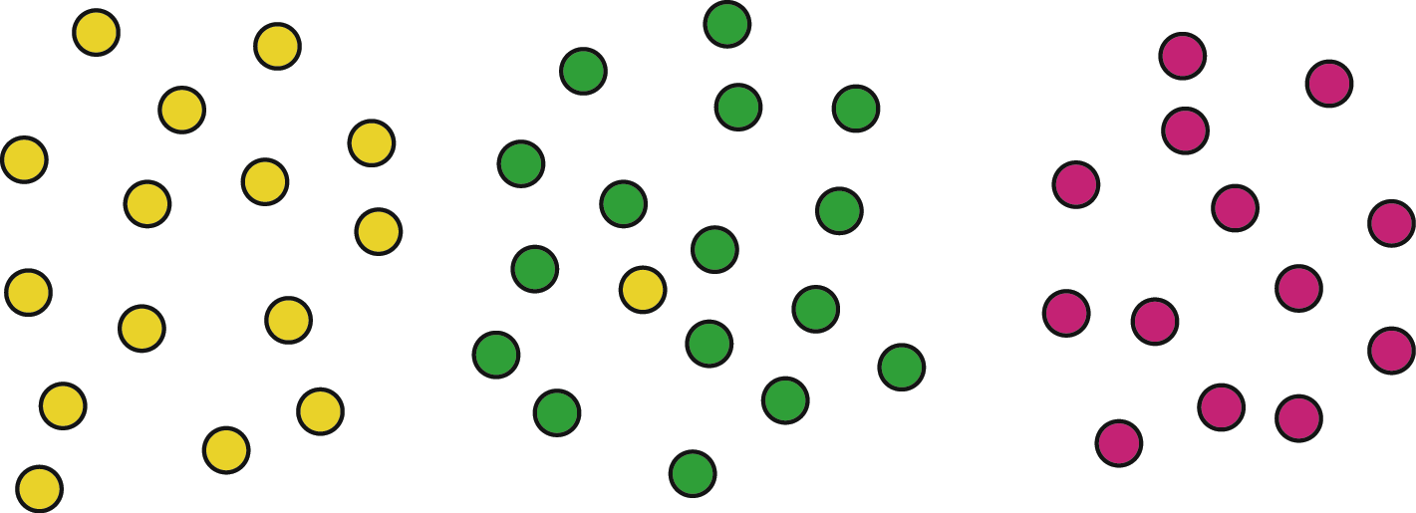
A stable distribution of English low vowels: an outlier not recognized as a member of the /æ/ distribution
mean F2 1700 Hz
/æ/ /o/ /oh/

Slide 27
A stable distribution of English low vowels: an outlier not recognized as a member of the /æ/ distribution
mean F2 1700 Hz
/æ/ /o/ /oh/

Slide 28
An unstable distribution of English low vowels: /o/ merged with /oh/ so that the /æ/ outlier affects the central tendency of /æ/,
mean F2 1650 Hz
/æ/ /o=oh/

Slide 29
The Canadian Shift across subsystems
Long and ingliding vowels
Short vowels
/oh/
/e/
/æ/
/o/
Notes:
The logic of the chain shifting is illustrated in this diagram. The merger is a collapse of a short vowel /o/ in COT with the long and ingliding vowel /oh/ in CAUGHT. To which subsystem do we assign the collapsed vowel? The decision is dictated by the phonological facts. While the original short-o was a checked vowel, which cannot occur in stressed word-final position, the merged vowel occurs in free as well as checked position: that is, the vowel of COT is now an allophone of the vowel of CAW. The short vowels then re-adjust automatically to achieve maximal dispersion.

Slide 30
A linguistic sequence 1
e
Canadian Shift
oh
æ
o
Unidirectional
Merge /o/ --> /oh/
Unidirectional
/oh/ ~ /o/

Slide 31
Forks in the road

Slide 32
Forks in the road of the Canadian Shift
/i/
/u/
/e/
/ /
/oh/
/æ/
/o/

Slide 33
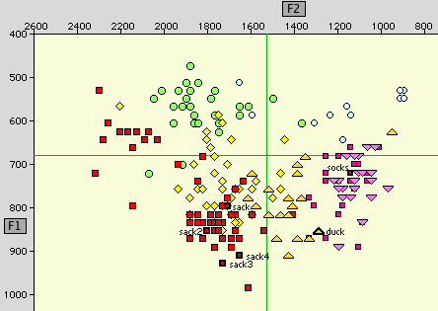

The Pittsburgh Shift in the vowel system of Ken K., 35, TS 258
Notes:
This is a map of the vowel system of Ken K., 35, of Pittsburgh, who spoke the word you just heard. We observe first that his merged /o/ ~ /oh/ is very far back [CLICK] but short-a has not responded by shifting back towards center. It is low front [CLICK]. Instead, wedge has fallen into the empty place so that the word you heard as DOCK [CLICK] was intended as DUCK.

Slide 34
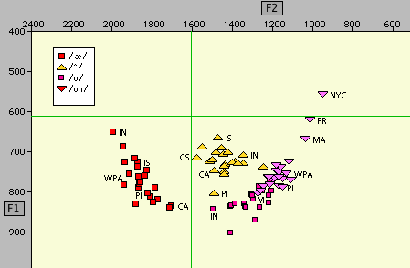
The Pittsburgh Shift in a Plotnik display of means of 21 dialects
_x0010_PI = Pittsburgh; WPA = Western Pennsylvania; CA = Canada; IN = Inland North; M = Midland; MA = Mid-Atlantic; PR = Providence; IS = Inland South
no lowering of /^/
,CA
low back merger
no backing of /æ/
backing of /æ/
lowering of /^/
Notes:
In this superposition of 21 dialects, we can see that [CLICK] Pittsburgh as a whole has a far back merger position, [CLICK] no pronounced backing of short-a, and [CLICK] a much lower mean value for wedge than any other dialect.

Slide 35
A linguistic sequence 2
e
Canadian Shift
oh
æ
o
Unidirectional
Unidirectional
Bidirectional
Merge /o/ --> /oh/
oh
Unidirectional
o
Pittsburgh Shift
/oh/ ~ /o/

Slide 36
A linguistic sequence 3
e
Canadian Shift
oh
æ
o
Unidirectional
Unidirectional
Bidirectional
Merge /o/ --> /oh/
Bidirectional
unround-ing /o/
oh
Unidirectional
o
Pittsburgh Shift
/oh/ ~ /o/

Slide 37
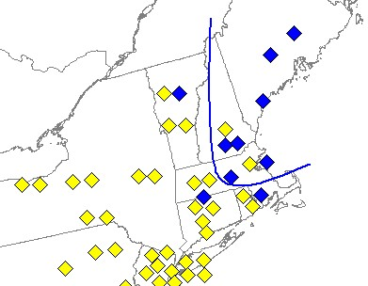
Unrounding of /o/ in Western New England
Burlington
F2(o) < 1300 Hz
F2(o) >= 1300 Hz
Rutland
Manchester
Boston

Slide 38
The merger of /o/ and /ah/
llama pasta taco Scarlatti Rama pajama Obama Bach Iraq …..
off cloth loss lost strong song ….
/oh/
/o/
[A]
/ah/
half bath past aunt dance …..
EME ç:
EME A:
ME çXt
ME ç:u
OE oht
ME av
ME a:u
salve halve
OF an
pa ma spa bra hah
OE eah
OF au a+u
calm palm
OE aw
OE au
OE ah
father

Slide 39
A linguistic sequence 3
e
Canadian Shift
oh
æ
o
Unidirectional
Unidirectional
Unidirectional
Bidirectional
Merge /o/ --> /oh/
Merge /o/ --> /ah/
balm = bomb father = bother
Bidirectional
unround-ing /o/
oh
Unidirectional
o
Pittsburgh Shift
/oh/ ~ /o/ ~ /ah/

Slide 40
A linguistic sequence 3
e
Canadian Shift
Inland North: fronting of /o, ah/
oh
æ
o
Unidirectional
Unidirectional
Unidirectional
Bidirectional
Merge /o/ --> /oh/
Merge /o/ --> /ah/
Bidirectional
unround-ing /o/
oh
Unidirectional
o
Pittsburgh Shift
/oh/ ~ /o/ ~ /ah/

Slide 41
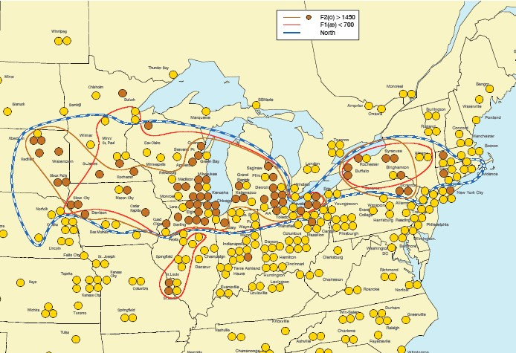
Fronting of /o,ah/ in the Inland North (ANAE Map 14.5).

Slide 42
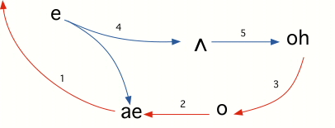
The Northern Cities Shift
Ked
cud
cawed
ah
cad
cod

Slide 43

The Northern Cities Shift
desk
busses
bosses
mat
head
block
socks

Slide 44
A linguistic sequence
Northern Cities Shift
e
oh
e
Canadian Shift
Inland North: fronting of /o, ah/
æh
ah
oh
æ
o
Unidirectional
Unidirectional
Unidirectional
Unidirectional
Bidirectional
Merge /o/ --> /oh/
Merge /o/ --> /ah/
Bidirectional
unround-ing /o/
oh
Unidirectional
o
Pittsburgh Shift
/oh/ ~ /o/ ~ /ah/

Slide 45
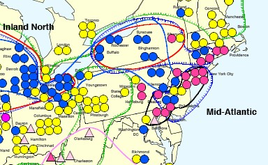
Raising of /oh/ in the Mid-Atlantic States: Providence to Baltimore
Magenta symbols: F1(oh) < 700 Hz

Slide 46
A linguistic sequence 4
Northern Cities Shift
e
oh
e
Canadian Shift
Inland North: front /ah/
æ
ah
oh
æ
o
Unidirectional
Unidirectional
Bidirectional
oh(r)
Unidirectional
Unidirectional
Eastern seaboard: raise /oh/
ah(r)
Back vowel shift
Bidirectional
Merge /o/ --> /oh/
Merge /o/ --> /ah/
Bidirectional
Unidirectional
unround-ing /o/
oh
Unidirectional
o
Pittsburgh Shift
/oh/ ~ /o/ ~ /ah/

Slide 47
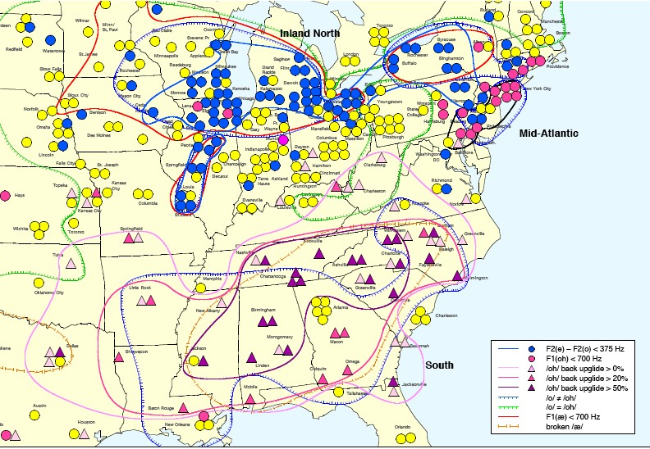
Three areas of resistance to the low back merger (ANAE Map 11.2)

Slide 48
A linguistic sequence 5
Northern Cities Shift
e
oh
e
Canadian Shift
Inland North: front /ah/
æ
ah
oh
æ
o
Unidirectional
Unidirectional
Bidirectional
oh(r)
Unidirectional
Unidirectional
Eastern seaboard: raise /oh/
ah(r)
Back vowel shift
Bidirectional
Merge /o/ --> /oh/
Merge /o/ --> /ah/
Bidirectional
Unidirectional
round-ing /o/
unround-ing /o/
oh [ç:]
Unidirectional
Bidirectional
oh
[ço]
o
South: add upglide to /oh/
Pittsburgh Shift
æw
aw
[Ao]
Unidirectional
Back upglide chain shift
/oh/ ~ /o/ ~ /ah/

Slide 49
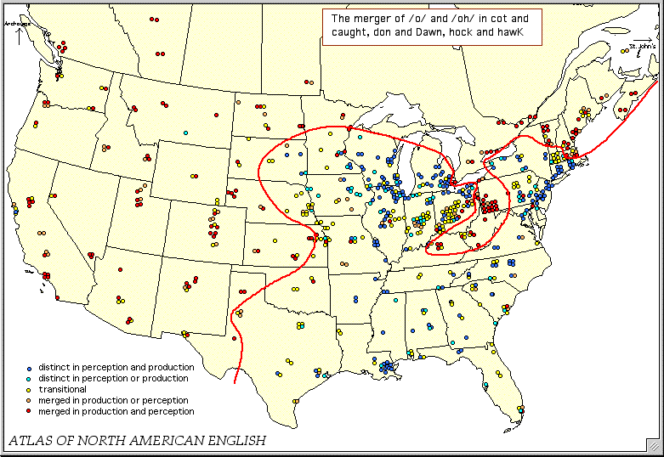
Merger of /o/ and /oh/ in cot and caught, Don and dawn, hock and hawk

Slide 50
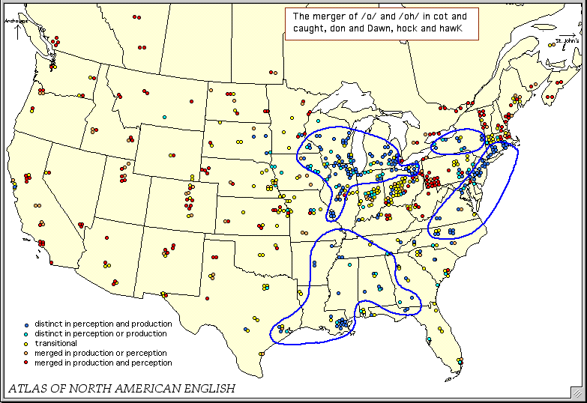
Alternatives to the low back merger
NCS
NCS
Back Vowel Shift
Back Upglide Shift

Slide 51
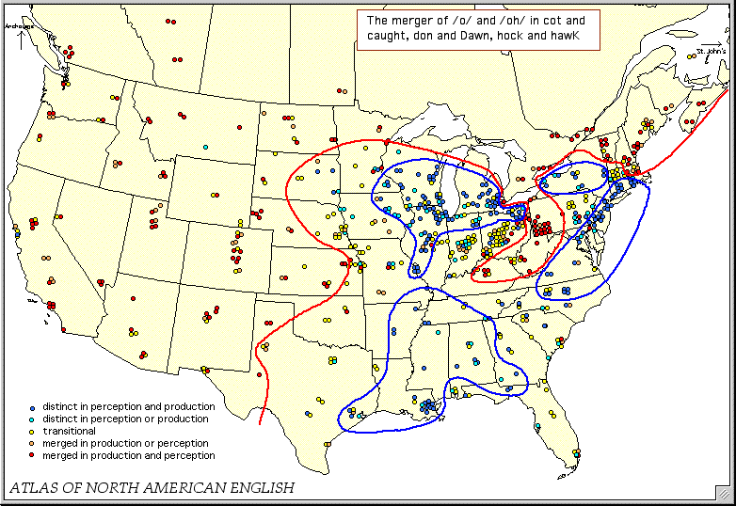
Low back merger and alternatives to the low back merger
_x0003_Canadidn Shift
NCS
NCS
Pitts-burgh Shift
Back Vowel Shift
Back Upglide Shift

Slide 52
Driving forces

Slide 53
Gender and social category determination of five elements of the Northern City Shift in a Detroit suburban high school
æ
Source: Eckert 2000

Slide 54
Social correlates of four measures of the Northern Cities Shift [N=71]
Age * Female Years of
25 yrs Gender Education
Raising /æ/ 34* 8.6*
/e/-/æ/ reversal 34* 26*
/e/-/o/ alignment 112***
/^/-/o/ reversal 37 -16*

Slide 55
Three areas of resistance to the low back merger
St. Louis corridor

Slide 56
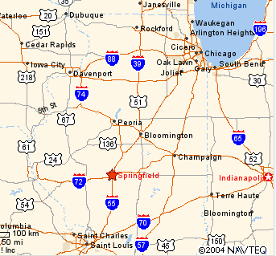
The St. Louis corridor along Interstate I-55
Fairbury

Slide 57
Fronting of /o,ah/ in the Inland North (ANAE Map 14.5).
9 Telsur speakers from No. Illinois
*
*
*
*
*
*
*
*
*
9 Telsur speakers from the St. Louis corridor
*
*
*
*
*
*
*
*
*

Slide 58
Distribution of NCS measures in No. Illinois and the St. Louis corridor

Slide 59
A linguistic sequence 5
Northern Cities Shift
e
oh
e
Canadian Shift
Inland North: front /ah/
æ
ah
oh
æ
o
Unidirectional
Unidirectional
Bidirectional
oh(r)
Unidirectional
Unidirectional
Eastern seaboard: raise /oh/
ah(r)
Back vowel shift
Bidirectional
Merge /o/ --> /oh/
Merge /o/ --> /ah/
Bidirectional
Unidirectional
round-ing /o/
unround-ing /o/
Unidirectional
Bidirectional
oh
oh
o
South: add upglide to /oh/
æw
aw
Pittsburgh Shift
Unidirectional
Back upglide chain shift
/oh/ ~ /o/ ~ /ah/
Notes:
The linguistic sequence in this overview links five major dialect regions over a large part of North America in a network of contingent, bidirectional relations and unidirectional causal relations. Where in this network can we expect social forces to play a significant role? The results of sociolinguistic research so far indicate that social evaluation is largely confined to the output allophones of a sound system and to lexical stems, while abstract structural relations involved in chain shifts and mergers are rarely the objects of social perception. Though the social evaluation of single elements within a chain shift may contribute to the forward impulse that advances or retards the shift, the shift as a whole is a mechanical consequence of the reaction of other phonemes in the same subsystem. Elements in the shift are locked into a structural configuration that is specific to a region with a given settlement history, and unlike mergers, such shifts do not diffuse readily across dialect boundaries.Thus the unidirectional changes are structural configurations that proceed largely under their own momentum.
It is the bidirectional changes that are the most likely locus of social differentiation. They are not locked into a structural configuration and are therefore more susceptible to social evaluation and exploitation.
CLICK. We do not know what is the delicate balance that tipped the scales towards the backing of /æ/ in Canada and the West, and towards the lowering of wedge in Pittsburgh. The selection of one or the other chain shifts triggered by the low back merger is an option that might easily be influenced by differential social evaluation, but Pittsburgh and Canada, separated by Lake Erie, are not in direct contact,.
CLICK. The rounding or unrounding of short-o is a bidirectional change that has been treated as a sociolinguistic variable by Trudgill in Norfolk. It is possible that the unrounding of short-o here in Western New England and New York State was influenced by social evaluation in the early 19th century when it occurred, but we have no record of this.
CLICK. Given this unrounding we observe two distinct options in the phonetic differentiation of /oh/ and the merged /ah/. While the fronting of /o/ has not been found to be socially marked in the Inland North, the raising of /oh/ is a major sociolinguistic variable along the Eastern seaboard, especially in New York City. with lower middle class Jewish speakers in the lead, From the perspective of the west coast, this raising of /oh/ is what marks New York City speech.
CLICK. The Southern development of a back upglide in law, water, walk, etc. appears to have received social evaluation, in that it is receding more than other Southern features among younger speakers. In fact, the loss of the back upglide is responsible for the spread of the low back merger in the South, given the bidirectional character of the alternation.
This overview gives us insight into the development of diversity in neighboring dialects which are not separated by any barriers to communication. The development of divergence requires a two-step model of linguistic change. If all changes were unidirectional, dialects and languages in contact would never diverge. If all changes were bidirectional, no general direction of development would follow. The dramatic divergence in North American English dialects appears to be the result of the alternation of unidirectional and bidirectional changes in the sequences we have modeled here.

Slide 60
The Pittsburgh Shift across subsystems
Long and ingliding vowels
Short vowels
/o,oh/
/oh/
/e/
/æ/
/o/
Notes:
The logic of the chain shifting is again clear: the merger of /o/ and /oh/ represents a migration of short /o/ into the long and ingliding vowels. The short vowel system reacts to this loss not by a backing of /æ/, as in Canada, but instead it is wedge that moves into the vacant position.

