Slide 1
Implications of sociolinguistic findings for phonological theory
William Labov, University of Pennsylvania
18th Manchester Phonology Meeting

Slide 2
• The implications of phonological conditioning for the identification of underlying forms and the feed-forward model
• The implications of the regularity of sound change for phonological models of perception and production

Slide 3
The first study of internal factors governing linguistic variation Proportion of –t,d clusters deleted for 11 members of the Jets in single interviews
Labov, Cohen, Robins and Lewis 1968

Slide 4
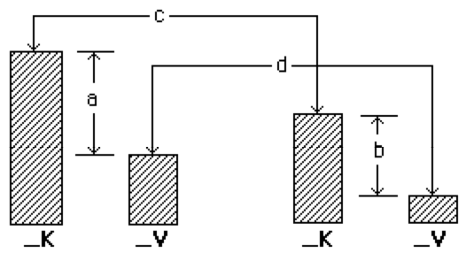
Lexically regular variation: coronal stop deletion in English. Two basic constraints on the simplification of /t,d/ clusters in English: the effect of a following consonant vs. a following vowel (a vs. b) and the effect of grammatical boundary (c vs. d)
Monomorphemic Past tense

Slide 5
Proportion deleted of monomorphemic –t,d clusters before consonants and vowels for eleven members of the Jets.

Slide 6
Effect of following consonant on realization of past tense –ed in spontaneous speech of 112 African American struggling readers [N=722]
Following segment

Slide 7
Where is variation located?
Variable morphological insertion of the past tense morpheme {d}
vs.
Invariant morphological insertion of the past tense morpheme {d}
Regressive assimilation to /t,d/
Variable deletion of /t,d/
Proposal:
Postlexical phonetic conditioning implies morphological invariance.
Conversely, variable morphological insertion implies the absence of postlexical conditioning
Question:
If linguistic variation can look up a derivation, why not look down?
“do not insert segment X if by so doing we create an impermissible cluster at the post-lexical level?”

Slide 8
AAVE copula: Variable insertion vs. variable contraction and deletion
0
əz
0
əz
z
Contraction
Insertion₁
əz
z
Insertion₂
z
0
Deletion

Slide 9
Phonetic conditioning of contraction and deletion for two adolescent groups in South Harlem [from Labov, Cohen Robins and Lewis 1968]
Jo’s talking
Jo’s talking
Jen talking
Jen talking
Cobras
Jets
K__ V__ K__ V__

Slide 10
Phonotactic effects on contraction and deletion
CV subject CVC subject
Jo is talking Jen is talking
CVVC CVC
Jo’s talking Jen’s talking
CVC CVCC
Jo talking Jen talking
CVC CVC
Contraction
Deletion

Slide 11
Variable AAVE copula and auxiliary is the result of successive contraction and deletion of an underlying form /iz/
Lexical entry V => /iz/
Stress assignment [+str] => [-str]
Vowel reduction /iz/ => /əz/
Contraction: /əz/ => (z)
Deletion: /z/ => (0)
əz
Əz
z
Contraction
z
0
Deletion

Slide 12
Absence of phonological conditioning of word-final /s/ for AA groups in South Harlem [from Labov, Cohen, Robins & Lewis 1968]
Monomorphemic
Verbal {s}
nice dog
(ni’ dog)
he’s cold
Adults
So. WC
he’s out
nice apple
Type of Recording:
Group Session vs Single Interviews
Group Single Group Single

Slide 13
Logistic regression analysis of verbal {s} in the spontaneous speech of 58 African-American struggling readers, Philadelphia, 2001 (Note that all blue represent non-significant differences; only red are significant)
Verb
Region
Preceding segment
Gender
Grade
Following segment
Subject Pronoun/ Noun phrase

Slide 14
Hypercorrection as evidence of morphological variation
Third singular {s}
He can goes out (13, T-birds)
I don’t know how to gets no girls. (13, Jets)
He’d knows that (15, NYC)
Past tense {d}
* He can tried to do it.
* He will passed me.

Slide 15
Establishing the locus of variation
Systematic phonological conditioning of a variable implies invariance at the morphosyntactic level and absence of phonological conditioning implies variability at the morphosyntactic level
Effect of
following Morphological
segment variation
English -t,d deletion + -
AAVE copula + -
Spanish (s) + -
English (REL) - +
AAVE verbal {s} - +
AAVE possessive - +

Slide 16

Convergent evidence from the study of reading errors

Slide 17
A study of reading errors in an Individualized Reading Program, 2001-2

Slide 18
When to intervene in oral reading?
To decide when to correct an oral reading, the tutor should distinguish between deviations from standard pronunciation, and failure to identify the meaningful elements in the text.
How can this be done?

Slide 19
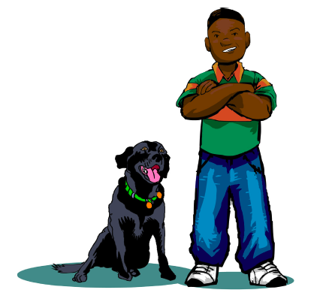
Absence of verbal /s/ in oral reading: Jason P., age 7
Hey Black doesn’t eat cats, not even one
He just likes to growl and watch them run.
grow
which
Correct
Reading
True
error
True
error

Slide 20
Absence of verbal /s/ in oral reading: Jason P., age 7
Hey Black doesn’t eat cats, not even one
He just likes to growl and watch them run.
lose
Clear
error

Slide 21
Absence of verbal /s/ in oral reading: Jason P., age 7
Hey Black doesn’t eat cats, not even one
He just likes to growl and watch them run.
licked
Clear
error

Slide 22
Absence of verbal /s/ in oral reading: Jason P., age 7
Hey Black doesn’t eat cats, not even one
He just likes to growl and watch them run.
like
grow
which
Potential error
True
error
True
error

Slide 23
The Semantic Shadow Hypothesis: An error in the identification of a given morpheme increases the probability of errors in the decoding of the following text.

Slide 24
Frequency of following errors for clear errors and correct reading by dialect feature
Dialect feature

Slide 25
Interpreting potential errors
A potential error type (e.g., omission of verbal {s}) may be treated as a true reading error if the rate of following errors is significantly greater than the rate for correct readings.

Slide 26
Frequency of following errors for clear errors, potential errors and correct reading by dialect type [N=567]
Potential errors

Slide 27
Frequency of following errors for clear errors, potential errors and correct readings by dialect type for African American readers [N=238]

Slide 28
W. Labov and B. Baker. What is a reading error? In press. Applied Psycholinguistics.

Slide 29
• The implications of phonological conditioning for the identification of underlying forms and the feed-forward model
• The implications of the regularity of sound change for phonological models of perception and production

Slide 30
• The implications of phonological conditioning for the identification of underlying forms and the feed-forward model
• The implications of the regularity of sound change for phonological models of perception and production

Slide 31
The Neogrammarian viewpoint
Every sound change, inasmuch as it occurs mechanically, takes place according to laws that admit no exception. --Ostoff and Brugmann 1878
Sound-change is merely a change in the speakers’ manner of producing phonemes and accordingly, affects a phoneme at every occurrence, regardless of the nature of any particular linguistic form in which the phoneme happens to occur. . . The whole assumption can be briefly put into the words: phonemes change. --Bloomfield 1933:353-4

Slide 32
The lexical diffusion viewpoint
The phonetic law does not affect all items at the same time: some are designed to develop quickly, others remain behind, some offer strong resistance and succeed in turning back any effort at transformation. --Gauchat (cited in Dauzat 1922)
We hold that words change their pronunciations by discrete, perceptual increments (i.e., phonetically abrupt) but severally at a time (i.e., lexically gradual) --Wang and Chen 1977:150.

Slide 33
A proposed resolution
Regular sound change is the result of a gradual transformation of a single phonetic feature of a phoneme in a continuous phonetic space.
Lexical diffusion is the result of the abrupt substitution of one phoneme for another in words that contain that phoneme.
But--
The lexically gradual view of sound change is incompatible, in principle, with the structuralist way of looking at sound change.
--Chen and Wang 1957:257.

Slide 34
The feed-forward model
In fluent, mature speakers, the phonetic implementation system is a modular, feed-forward system, reflecting its nature as an extremely practiced and automatic behavior. . . The model is feed-forward because no arrows go backwards, from articulatory to phonological encoding, or from the phonological encoding to the lexical level. It is modular because no lexeme information can influence the phonetic implementation directly, bypassing the level of phonological buffering.
--Pierrehumbert 2002, “Word-specific phonetics”

Slide 35
The intersection of the exemplar model and the lexical diffusion view of sound change
Obviously, this treatment is not confined to lenition; any systematic bias on the allophonic outcome would incrementally impact high frequency words at a greater rate than low frequency words. In short the model is applicable to any Neogrammarian sound change, by which I mean sound changes which get started in the phonetic implementation and eventually sweep through the vocabulary.
--Pierrehumbert 2002

Slide 36
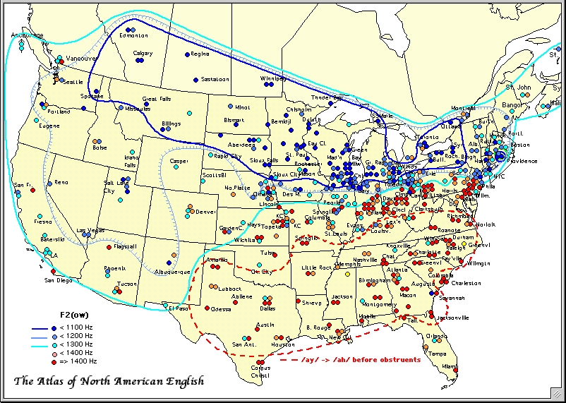
The fronting of /ow/ in North America (from ANAE Ch. 12)

Slide 37
Distribution of /ow/ vowels for all of North America. [N=8313].Vowels before /l/ are shown in black [N=1577].

Slide 38
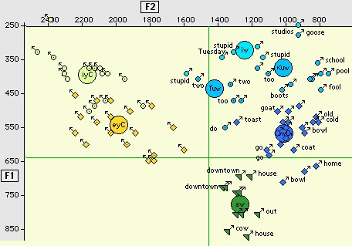
Absence of fronting of Vw in vowel system of Alex S., 42, Providence, RI TS 474.

Slide 39
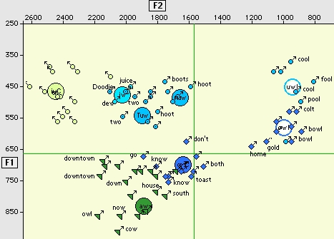
Fronting of all Vw in the vowel system of Danica L., 37, Columbus, OH, TS 737.

Slide 40
34 most frequent /ow/ words in the Brown corpus with Telsur frequencies

Slide 41
Fronting of /ow/ for words before /l/ and others for all of North America and for the Southeast (South and Midland). Words selected by stepwise regression analysis at p <.001 level as ahead of phonological prediction, light blue; behind, yellow.

Slide 42
Is home a lexical exception to the fronting of /ow/?
 | N | F1 | F2
/ow/ | 5950 | 616 | 1304
/owl/ | 2576 | 575 | 1010
home | 775 | 669 | 1068
Oklahoma | 14 | 589 | 1045
homebody, etc. | 28 | 641 | 1037
Omaha | 10 | 655 | 1119
hoe | 26 | 621 | 1233

Slide 43
Phonetic effects of onset /h/ and coda /m/ on fronting of /ow/

Slide 44
Significant regression coefficients (p < .01) of F2 of /ow/ in the Southeastern region.

Slide 45
Significant regression coefficients (p < .01) of F2 of /ow/ in the Southeastern region.

Slide 46
Significant regression coefficients (p < .01) of F2 of /ow/ in the Southeastern region.

Slide 47
Significant regression coefficients (p < .01) of F2 of /ow/ in the Southeastern region.

Slide 48
Significant regression coefficients (p < .01) of F2 of /ow/ in the Southeastern region.

Slide 49
Conclusion
Regular sound change is governed by persistent, stable and predictable phonetic effects on all members of a phonemic category, but may be accompanied by minor, unstable and unpredictable lexical effects on individual lexical items

Slide 50
What kind of phonological theory is consistent with studies of linguistic change and variation?
A theory that describes speech production as the selection and linearization of abstract categories.
A theory that can incorporate probabilities into the rules and constraints governing production and perception.
A hierarchical system in which decisions made at a given level are independent of decisions made at a lower level.
A theory which predicts when the unit of sound change is the phoneme and when it is the word stem.
An architecture that accesses and uses lexical information at the final stages of speech production.

Slide 51
Absence of morphosyntactic segments in the spontaneous speech of 399 struggling readers, grades 2-4, by ethnicity/language, 2001

Slide 52
www.ling.upenn.edu//~labov

Slide 53
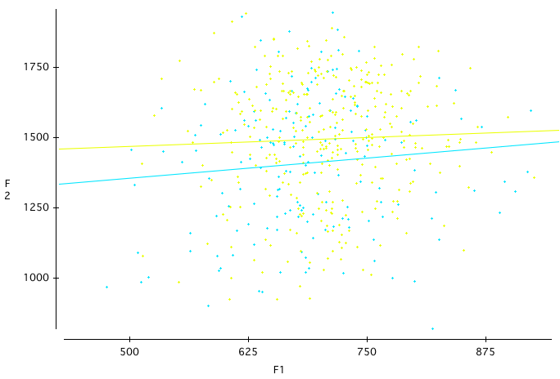
Distribution of no [N=348, yellow] and know [N=630, blue] in F1/F2 space

Slide 54
Absence of morphosyntactic segments in the spontaneous speech of 399 struggling readers, grades 2-4, by ethnicity/language, 2001

