Slide 1
Cognitive Consequences of Sound Change:
Misunderstandings in Everyday Life
William Labov, University of Pennsylvania
NWAV37 Rice University Houston Nov 8, 2008
Notes:
The study of language in every-day life doesn’t proceed very far without encountering many inefficiencies, miscommunications and misunderstandings. This experience has led me for one to the conclusion that language does not work as well as we would like it to. Back in 1968, WLH said that no one had observed inefficiencies in communication in the course of language change. Since then we have, and some of that evidence wiill be presented here.
Some recent research shows that members of the speech community store remembered tokens with associated information on the age, gender, social class and personal identity of the speakers who uttered them, and regional dialect as well. Thus Hay, Warren and Drager 2006 showed that listeners were influenced by such information in responding to the ongoing merger of New Zealand English fear vs. fair, etc. Their judgments of whether a front mid token of /fehr/ was a member of the /ihr/ or /ehr/ category were influenced by the age and social class of the person who was supposed to have uttered it. Other work shows a sensitivity to the influence of the regional dialect of the experimenter. These findings were interpreted as support for an exemplar theory that episodic memories are preserved as the basis of speech perception and production (Pierre-Humbert 2002, 2006). Such work might indeed support C.-J. Bailey’s idea of a pan-dialectal grammar that allows us to understand other dialects.
The range of events that might produce misunderstanding, observed in recent sociolinguistic studies, is quite extensive.. Chain shifts and mergers lead to phonological mismatches on a grand scale. This report will bear on the question: are members of other regions confused when they come into contact with the results of these linguistic changes.

Slide 2
This PowerPoint can be downloaded from www.ling.upenn.edu/~labov

Slide 3
Principles of Linguistic Change
Vol III: Cognitive and cultural factors
Ch. 1. Introduction
Part A. Cross dialectal comprehension
Ch. 2. Natural misunderstandings
Ch, 3. Replication of the Peterson-Barney Experiment
Ch. 4. The Gating Experiments
Part B. The life history of linguistic change
Ch. 5. Triggering events
Ch. 6. Governing principles
Ch. 7. Forks in the road
Ch, 8. Divergence
Ch. 9. Driving forces
Ch. 10. Yankee cultural imperialism and the Northern Cities Shift
Ch. 11. Experimental evidence on evaluation of the NCS
Ch. 12. Endpoints
Part C. The unit of linguistic change
Ch. 13. The binding force in linguistic change.
Ch. 14. Words floating on the surface of sound change
Part D. Transmission and diffusion
Ch. 15. The diffusion of language from place to place
Ch. 16. The diffusion of language from group to group¯

Slide 4
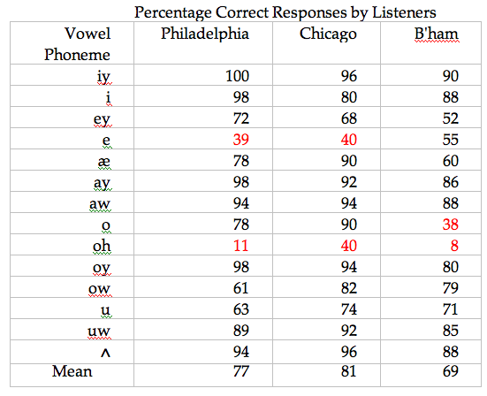
Over-all success in identifying Chicago /k_d/ utterances
keyed kid cade Ked cad kide cowed cod cawed coid code cud cooed cud

Slide 5

Percent correct in Gating Experiments by city and educational level in Cross Dialectal Comprehension study: block
block living on Senior citizens
one block living on one block

Slide 6
Standard form for collecting misunderstandings
MISUNDERSTANDINGS Date__________________
Speaker______________________ Hearer ________________
Dialect area ___________________ ______________________
Speaker said [continue on back for full setting]:
Hearer head:
Hearer corrected misheafing after ____sec ____ min
____before utterance was over
____ by speaker’s response to look or query
____ by inference from further utterances
____ by accidental events that followed

Slide 7
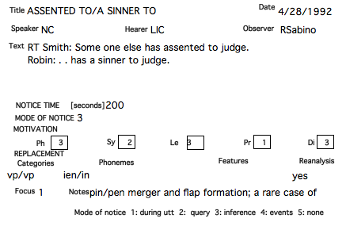
Natural misunderstanding token
vp/np

Slide 8
Main contributors to the study of natural misunderstanding
    Home dialect Total dialect % dialect
    motivated motivated
    Robin Sabino Long Island City 137 43 31
    Gillian Sankoff Montreal 137 26 19
    Wm Labov [WL] NNJ 123 27 22
    Ruth Herold Connecticut 88 30 34
    Mark Karan NNJ 67 14 21
    Sherry Ash Chicago 63 22 35
    Tom Veatch California 31 2 6
    Charles Boberg Edmonton 12 10 83
    Corey Miller NYC 6 3 50
    Other 204 58 28
    Total 868 235

Slide 9
Numbers of natural misunderstandings observed, 1984-2008
Dialect motivated
27%
25%

Slide 10
Factors promoting and inhibiting misunderstanding

Slide 11
Percent distribution of locus of misunderstanding for dialect-motivated errors and others
Homo- Segment One seg- Two seg- >2 seg- Reanal-
nym lost ment ments ments ysis

Slide 12
Syntactic reanalysis of homonymous sequences
    Philadelphia newscaster: leaving a third passenger too dazed to escape.
    Ruth Herold [CT]: . . . leaving a third passenger two days to escape.
    Tom Veatch [CAL]: [writing down items to buy] Two c’s in broccoli?
    Ruth Herold[CT]: What’s two-season broccoli?
    Judy S. [Phila]: We'll go down to Knights St.
Mark Karan [NNJ] => We'll go down tonight's street.

Slide 13
Re-analysis with single segmental misunderstanding
Susan Mann [CA]: Can I pour us both juice?
Ruth Herold [CT]: What's a spoke juice?
Susan: [pɔ˔rəsb̥oθdʒu<s]
Ruth => [pɔ˔rəsb̥okdʒu<s]

Slide 14
Misunderstanding of a single segment
Albert B [MI]: That batch of paper was terrible
Rob B.[TE] => tearable

Slide 15
How the misunderstandings were detected
During the utterance 107
By an immediate query 370
By inference after 199
From observation of later events 72
Never 15

Slide 16
Correction of misunderstanding by immediate query
Pat D. [Philadelphia]: I hated dissecting (frogs and worms) in science so the second time my class dissected I dissected an apple instead, and the time after that I dissected a carrot.
Lois K. [=> I dissected a parrot]: You dissected a what?

Slide 17
A delayed correction
Charlotte M. [VA]: Every time Robin takes a picture of me she gets a "telephone pole" in the picture.
Maureen S. [PI] => telephone call
Charlotte: Yes, she gets a telephone pole in the pictures, even in the living room.
Maureen: Well, maybe she has call forwarding, you know.
Charlotte: Call forwarding?
Maureen: Yes, you know that service.
Charlotte: No, no, telephone pole.
Maureen: Pole? What pole?

Slide 18
A misunderstanding never corrected
Rosemarie D. [carrying in dinner]: OK! Come to the table!
WL [to Rosemarie D.]: You run a tight ship.
Tom D.: She makes us slave.
Rosemarie _x0004_D.: Why would I want you to leave?
Tom D.: One day, we'll explain it all to Rosemarie.
Tom: [ʃime˔ɪksəsle˔ɪv]
Rosemarie =>[ʃime˔ɪksəsli˕ɪv]

Slide 19
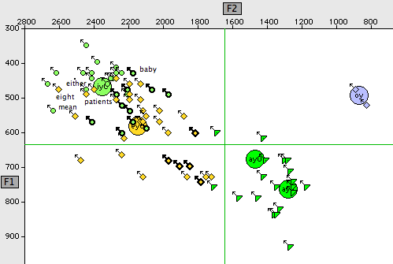

Front upgliding vowels of Rosanne V., 30 [1996], Phila, TS 567
say

Slide 20
An unusual pragmatic motivation of misunderstanding
Resident, examining Gillian: Are you tenured?
Gillian S. [CA]: Yes [ => tender]
Resident: For how long?
Gillian: What?
Resident: How long have you had it?
Gillian : What do you mean?
Resident: How long have you had tenure?
Gillian: [laughs, and nurse too, who understood 'tender']

Slide 21
Another rare pragmatic motivation
Answering machine: "You've reached Sam and Ann's. Please leave a message after the tone and we'll call you back.
Atissa Banuazizi => Ann will call you back.

Slide 22
Sound changes

Slide 23
Raising of /æ/ to [i:ə]
Male in Computer Resource Center: It's located in Ann Arbor.
Robin Sabino: => Ian. [She made him repeat it. He said it the same. She asked him to spell it, and he spelled ARBOR.]
Robin Sabino: Ian Hancock is at Texas
Corky Feagin => Ann Hancock
    Charlotte A. [VA]: Is Ann coming?
    Marybeth L. [Phila suburbs]: Incoming? Incoming from where?

Slide 24
Raising of /i/ to [i:ə]
Corky Feagin reports from John Baugh that a woman from outside of Texas told a Texan that her son was named "Ian". The Texan couldn't understand why anybody would name a child something so strange as the preposition IN.

Slide 25
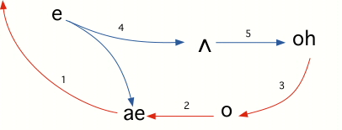
The Northern Cities Shift
desk
busses
bosses
mat
head
block
socks

Slide 26
Cross-dialectal effect of /o/ fronting in the Northern Cities Shift
Neither my boyfriend Dave nor I are natives to Michigan, and we are not NCS speakers. Dave had the following misunderstanding happen three times in the Lansing area, at two different grocery stores, with two different workers: he asked for 'catfish' and the man behind the counter gave him cod, thinking he said 'codfish.’
--Jane Goodheart

Slide 27
The Northern Cities Shift
desk
busses
bosses
mat
head
block
socks

Slide 28
Cross-dialectal effect of /e/ lowering in the Northern Cities Shift
Telephone surveyor [Chicago]: Do you have any pets in the house?
Brian T. [Eastern US] => pots. [thought that 'pot' was not likely since everyone has pots and pot = marijuana was too personal; asked for repetition several times until understood.]

Slide 29
The fronting of (aw) in Philadelphia from [æʊ] to [e:ɔ]

Slide 30
The homonymy of “crown” and “crayon” in Philadelphia
Crown [kre:ɔn]
Crayon [kre:ɔn]

Slide 31
Cross-dialectal perception of Philadelphia of /aw/ as [e:ɔ]
Brian K. [Phila suburbs]: You know what else is there [in Easton, PA]? The Crayola Crayon factory.
Sherry Ash [Chicago] => The Crayola crown factory.
Christine K. [So. TN]: Laurel leaves were used to make crowns
Robin Sabino [NYC] => to make crayons

Slide 32
Intervocalic /l/ in Philadelphia as [ɤ]:
Gating experiment: “I fell down the CELLAR steps”

Slide 33
Cross-dialectal perception of Philadelphia intervocalic /l/
Bank teller [Phila, reads “William”]
WL [ NNJ] => WHAM.
Harvey S [Phila]: “Tell him it’s Harvey”
MBH [NE] => Thomas Harvey.
Tess [Phila]: Can Alice go on the volleyball courts?
Gillian Sankoff, WL => Bible courts.
Man [Phila]: Have you got a cooler?
Mark Karan [NNJ]: Have you got a Coor?

Slide 34
Homonymy of balance and bounce in Philadelphia:
Jeffrey W. [Phila]: . . . to see if the payroll sheets balance
Corey Miller [NY] => to see if the payroll sheets bounce.
Larry B. [Phila, speaking to his 4-year-old son Jonathan]
". . . balance."
Jonathan, 4: bounce. [repeat, and began to bounce up and down.]
--observed by Ruth Herold

Slide 35
A Philadelphian’s hyperperception of intervocalic /l/
Instructor [Phila]: Tell me what this sentence implies to you: "Mr. Williams strode into the office.”
Student [Phila]: It means he was real casual.
Instructor: For strode? as in stride? Do you know what "stride" means?
Student: I'm sorry, I thought you said, "strolled". "Strode" means 'forcefully.'

Slide 36
Mergers

Slide 37
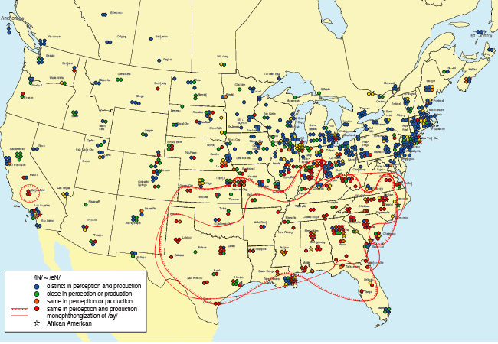
The merger of /i/ and /e/ before nasal consonants, Atlas of North American English Map 9.5
South
Notes:
Returning to the case of /in/ and /en/, which are commonly the same in both hearing and production of AA speakers at all educational levels,
a pattern that originates in the South.

Slide 38
The pin/pen merger
Bank teller [African-American]: You have your Penn ID?
Sherry Ash [Chicago]: PIN ID?
Teller: Your Penn ID?
Sherry: PIN ID?
Melissa H. [TN]: Every time I say “Insurance”. . .
Ruth Herold [CT] => every time I say “entrance”

Slide 39
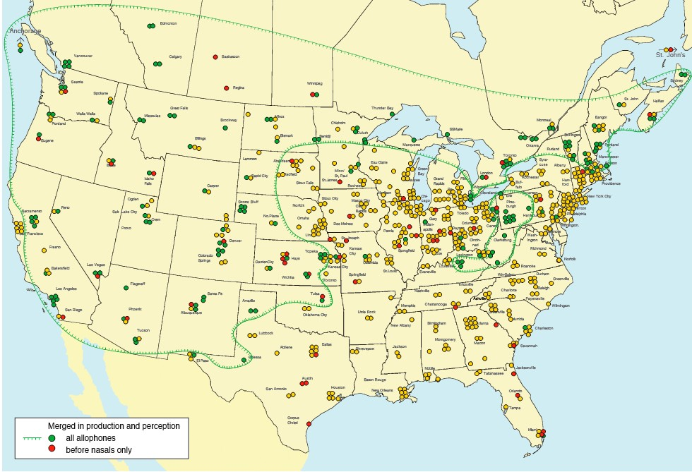
The low back merger of /o/ and /oh/ (ANAE Map 9.1)
Canada
E.N.E.
The West
W. Pa.

Slide 40
Montreal allophones of merged /o ~ oh/
copy [kɔpi]
coffee [kɔfi]
caught [kɒt]

Slide 41
The low back merger: perception of copy as coffee
Gillian S. [Montreal]: We won't save any time to come here for a copy shop.
WL [NNJ]: Coffee shop?
Gillian S., [Montreal]: Oh! Copy shop! Here it is!
WL [NNJ] =>looks for coffee shop
Gillian S. [Montreal]: I wonder if there's a copy place near the airport?
WL [NNJ] => Why would she need coffee?
David S. [Montreal]: It's time to make the copies.
WL [NNJ]: But I've already had my coffee
David Sankoff [Montreal]: I'll get your copy right away.
WL [NNJ] => Why is he getting us coffee?
Ann T. [Vancouver]: Do you have the copy key?
Don Ringe [KY]: Is there a key to the coffee?

Slide 42
The low back merger: perception of coffee as copy
Carl R. [Boston]: How did the coffee machine work out?
Sherry Ash [Chicago]: [began a story about her copying machine]
David B. [OK]: There is a nice coffee stain on this one.
Mark Karan [NNJ] => There is a nice copy stain on this one

Slide 43
The low back merger: confusion between Don [Ringe] and Dawn [Suvino]
Gillian S. [Montreal]: It would be even better if Don could take her to the airport.
WL [NNJ] => wondered for some time about how Dawn, who is blind,
could take her.
Ann T. [CA]: [at students meeting] Elise spent quite a long time talking to Dawn.
Ruth Herold [CT]: What do you mean? [=> since Don is not a new student]
Sherry Ash [Chicago]: I’ve been talking to Dawn here. .
Carl R. [Boston]: . . Hindle? [=> Don Hindle]
Mary A. [RI]: I started sneezing . . . and after a while I figured Dawn’s dog must’ve been in there.
Ann T. [CA]: Don doesn’t have a dog.
Mary: No, DAWN!

Slide 44
Misunderstanding of mergers by status of speaker and hearer
Speaker Hearer Cases
Merged Unmerged 20
Unmerged Merged 5
Merged Merged 0
Unmerged Unmerged 0
Notes:
The set of 868 natural misunderstandings yields some insight into the nature and extent of cross-dialectal comprehension, but it plainly has limitations. We have only occasional records of the phonetic form of the input which we largely project from the dialect background of the speakers. We have no information on the absolute frequency of misunderstanding as compared to understanding.The data do give us an idea of the relative number of misunderstandings due to dialect motivation, though we cannot be sure of the extent to which the observer’s attention was biased towards cases of this type. Most of the misunderstandings noted here were across dialect boundaries; there are relatively few among speakers of the same dialect, but the comparison is not a controlled one,
These limitations will be corrected in the chapter which reports the controlled experiments on cross-dialectal comprehension. Conversely, the results on natural misunderstanding will serve to correct the limitations of these controlled experiments. The high percentage of errors in the identification of isolated words in the Gating experiment is partly an artifact of cutting out words from the stream of speech and partly confusion introduced by the competing superposed norms in the formal context of the experimental situation. The data on natural misunderstandings is free from such ambiguity. We can project other methods of studying misunderstanding--we can examine errors in the transcriptions of recorded text or we can search through tape recordings of sociolinguistic interviews. The first will provide too many errors, the second too few. With all its limitations, the method we used here emerges as one valid way of capturing the cognitive consequences of linguistic change.
These results run counter to the common illusion that we have no trouble understanding other North American dialects of English. If the stored memories of our previous experience were available for search and comparison, along with our memories of who said what, as exemplar theory argues, we would not go on repeatedly confusing the Canadian allophones of coffee and copy Instead we hear these utterances through the filter of our own categories: the allophone [ɔ] in copy is heard as the phoneme /oh/ in coffee.. This result gives llittle support to the notion that over the years, we construct a pan-dialectal phonology that translates one system into another. The study of natural misunderstandings displays a persistent, mechanical and comical incompetence on the part of the most highly trained and knowledgeable observers. Why are these errors so comical? I submit it is because they show us to be victims of our own habitual behavior, unable to make use of the rich store of knowledge that we access through conscious reflection. I return to the observation that a very large part of these natural misunderstandings are from linguists whose professional competence rests on their knowledge of dialect differences. I speak in the third person about these mishearers, though I was myself a prominent member of the group. If anyone should be able to draw upon a pan-dialectal grammar, built by years of study and experience, to interpret the productions of speakers of other dialects, they should have been able to do so. But they did not.
This view of the cognitive consequences of linguistic change makes it even more urgent that we pursue the search for the driving forces responsible for these large scale rotations, mergers and confusions. I’ve made an effort in later chapters of the work in progress that this report is extracted from.It would be comforting to think that linguistic change is the work of active agency in which we all maximize our status through the manipulation of social variants. But I put it to you that these 868 observations of natural misunderstandings show considerable distance between intention and achievement in linguistic interaction. We observe no desire to be misunderstood or to misunderstand, but to the extent that we recognize it, a sense of strong dismay that something has upset the linguistic applecart.

Slide 46
Distribution of misunderstandings within and across sub-systems
Within subsystems Across sub-systems

Slide 47
Confusion across subsystems in natural misunderstandings
Loss of glide in perception Addition of glide in perception
unmkd _N _L KKL_ unmkd _N _L KKL_
iy↔i 1 1
uw↔u 2 2
ey↔e 5 3 2 1
ow↔ʌ 10 1 1
ay↔a 5 3 2 2
aw↔a 3 1 4 1 2 4
Total 13 4 17 1 4 4 9 2

Slide 48
Misunderstanding maintained over several turns
Dana M. [NYC]: What are you giving up for Lent?
Caroline H. [UK] => What are you giving out for Lent?
Caroline [annoyed] : "Pancakes."
Dana: You're giving up PANCAKES?

Slide 49
Confusion of short vowels in natural misunderstandings
unmarked/_nasal/__liquid/liquid cluster__
/i/ /u/
/e/ /ʌ/
/æ/ /o/
1-0-0-0
8-0-1-0
1-0-0-0
0-2-0-1
1-1-0-0
9-2-3-0
4-2-1-0
5-0-0-3

Slide 50
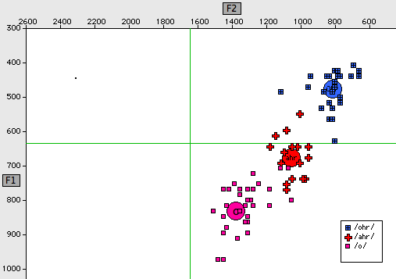
Back Chain Shift before /r/ in Philadelphia: Rosanne V., 30, TS 567

Slide 51
The Back Chain Shift before /r/ in Philadelphia: card => court
    Steve N. [Phila]: We better get hold of him soon, because his [de:ns kɔrd] is going to be filled up.
    Gillian Sankoff [Canada] => dance court [couldn't figure out what he meant; but after she hung up, realized that he had meant dance card].

